Slide 1
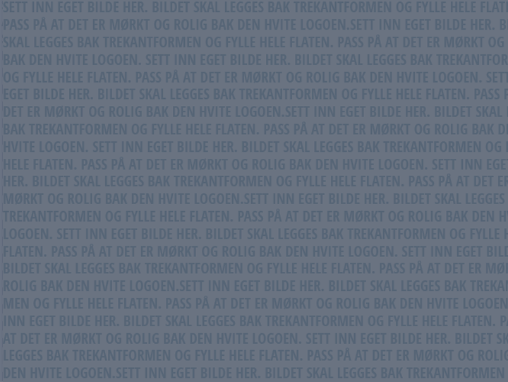
Virtual Reality
Lars Ailo Bongo
Dept. of Computer Science & Center for Bioinformatics,
University of Tromsø, Norway
http://bdps.cs.uit.no
http://sfb.cs.uit.no
Photo: Jo Jorem Aarseth

Slide 2
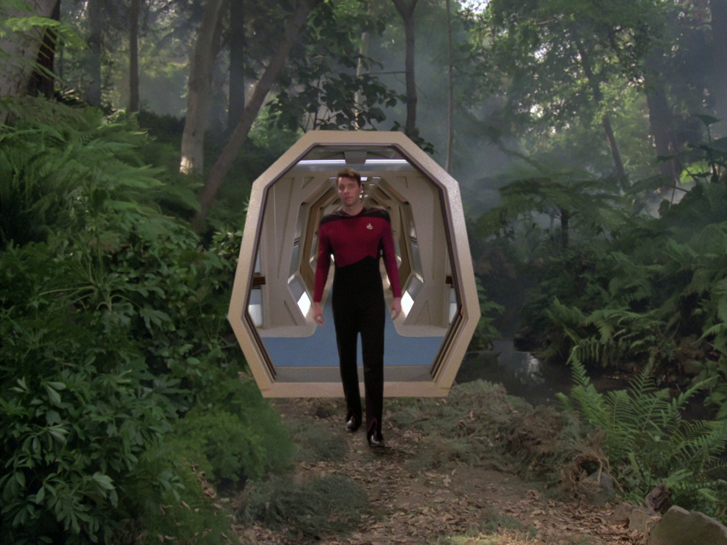
Realities

Slide 3
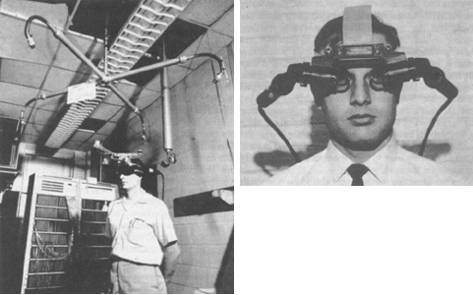
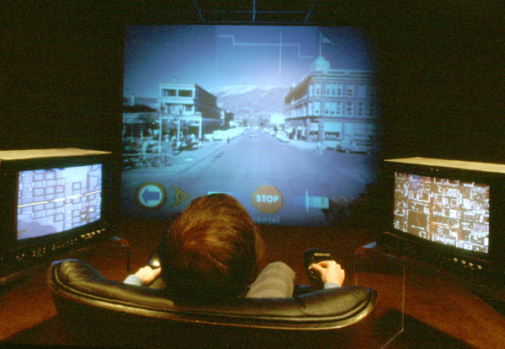
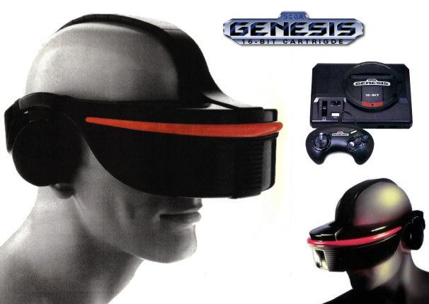
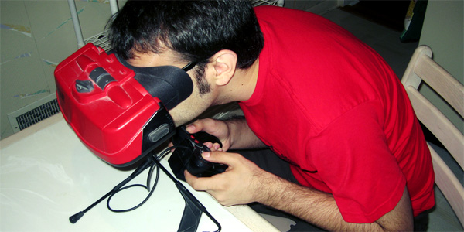
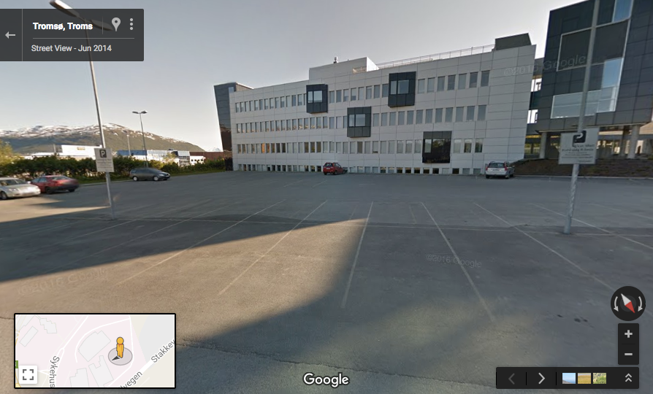
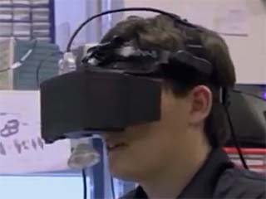
History
The Sword of Damocles (Uo Utah)
Aspen Movie Map (MIT)
Sega VR
Nintendo Virtual Boy
Second Life
Google Street View
Oculus Rift

Slide 4
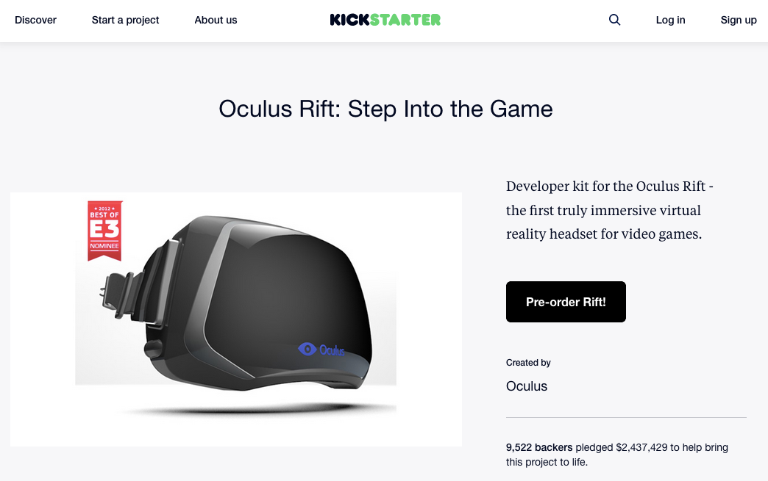
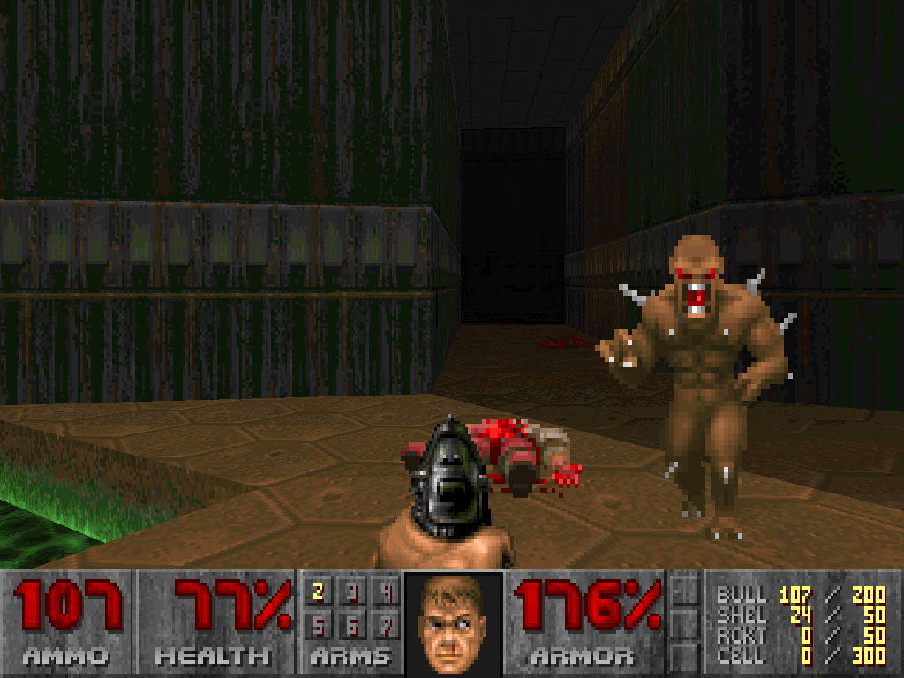
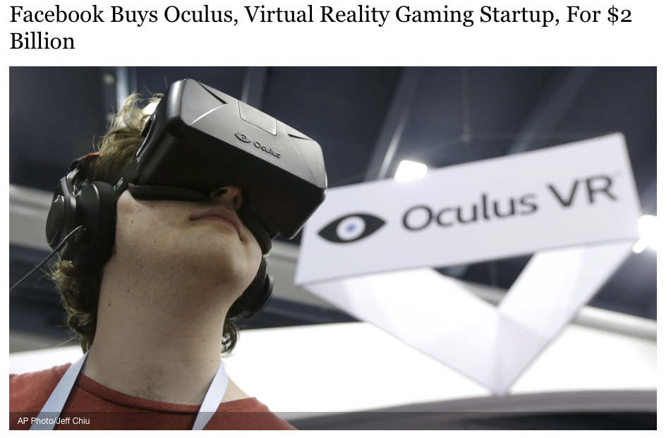
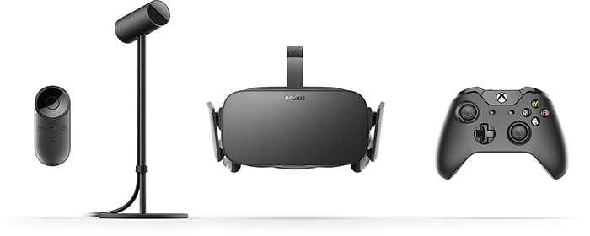
Oculus Rift

Slide 5
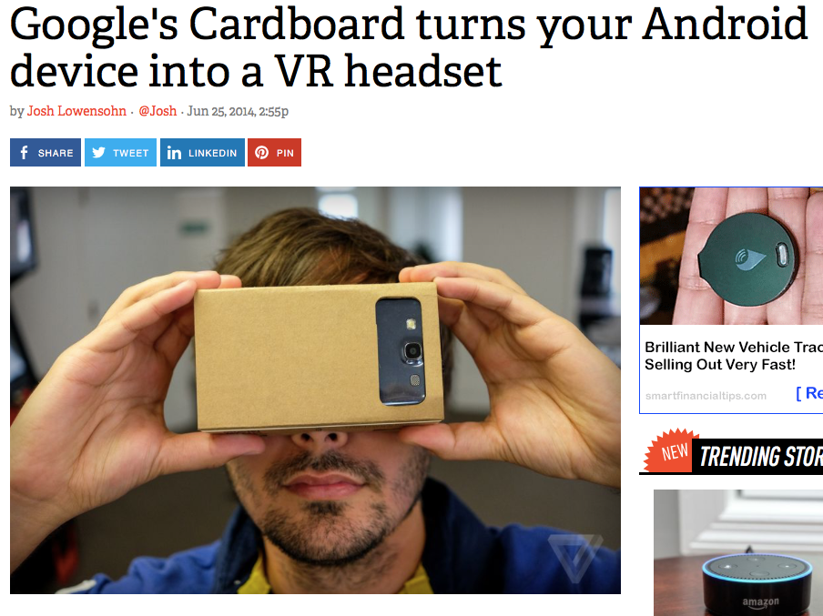
Google Cardboard

Slide 6
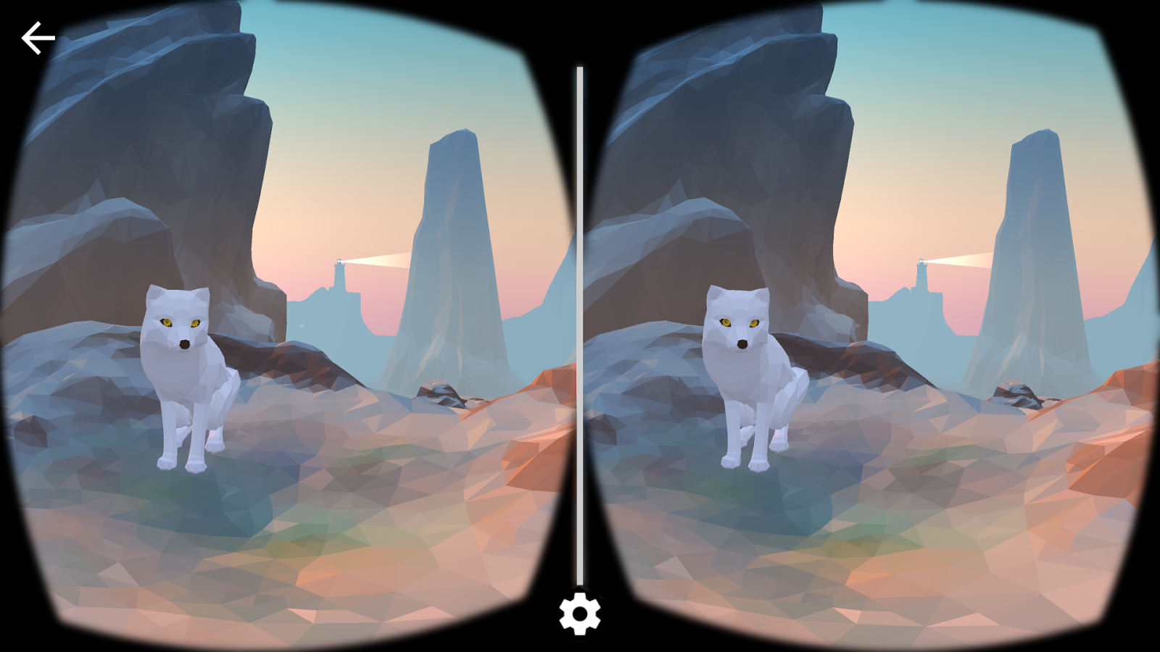
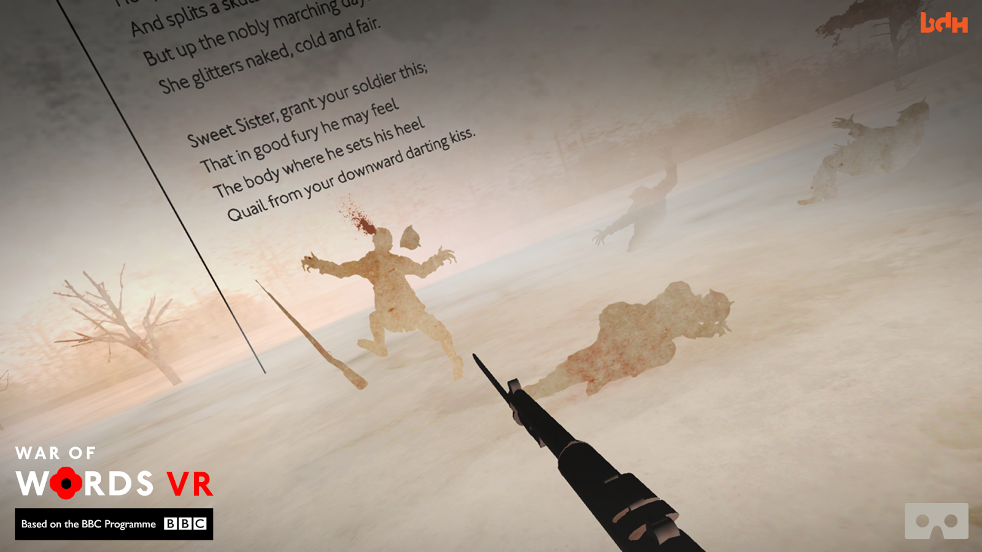
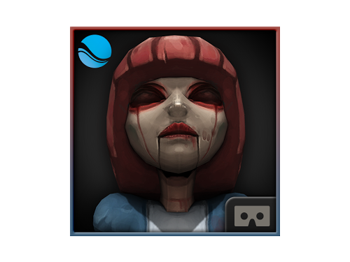
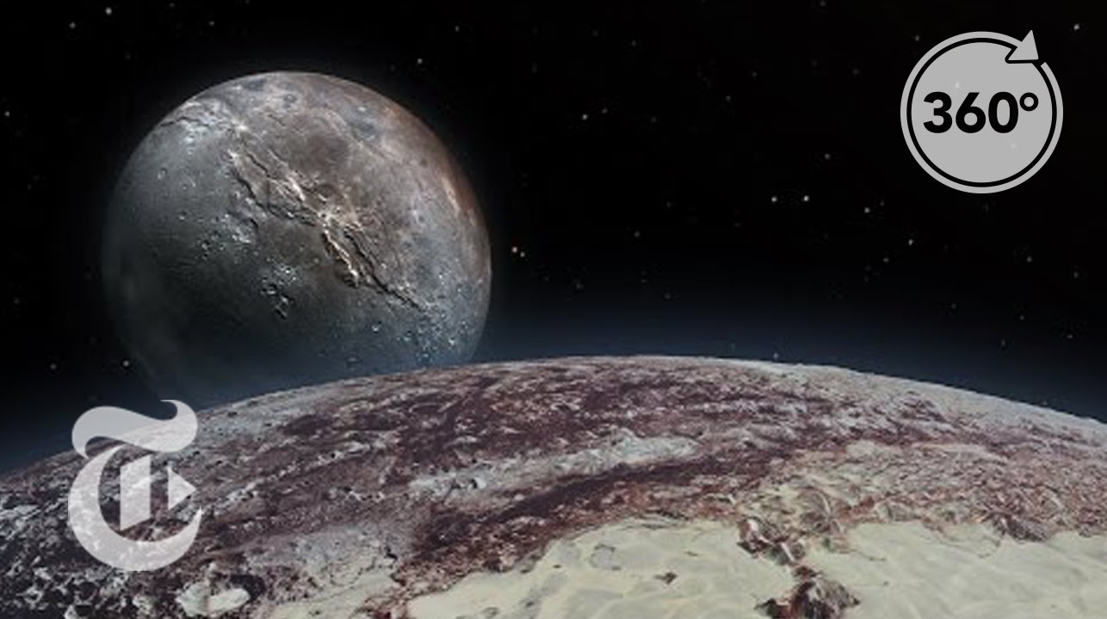
State-of-the-art Software
Google Cardboard
Cardboard Demos
War of Words
Sisters
NYT VR

Slide 7
Current VR Kits
Google Cardboard
Samsung VR
PlayStation VR (mid October)
Oculus Rift
HTC Vive ( )

Slide 8
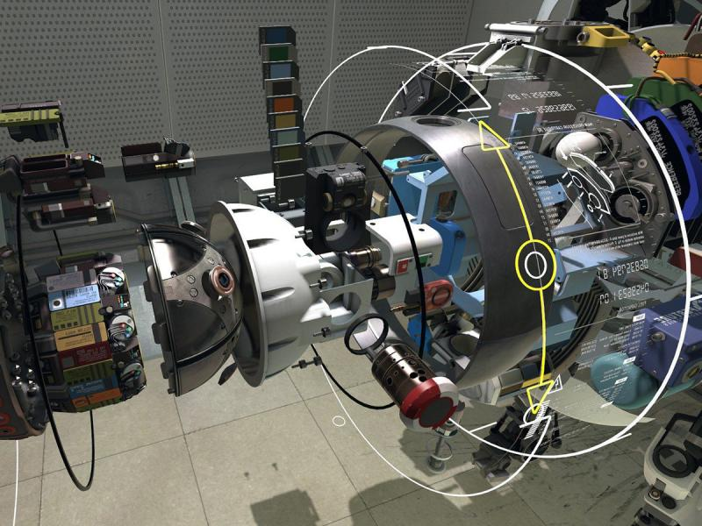
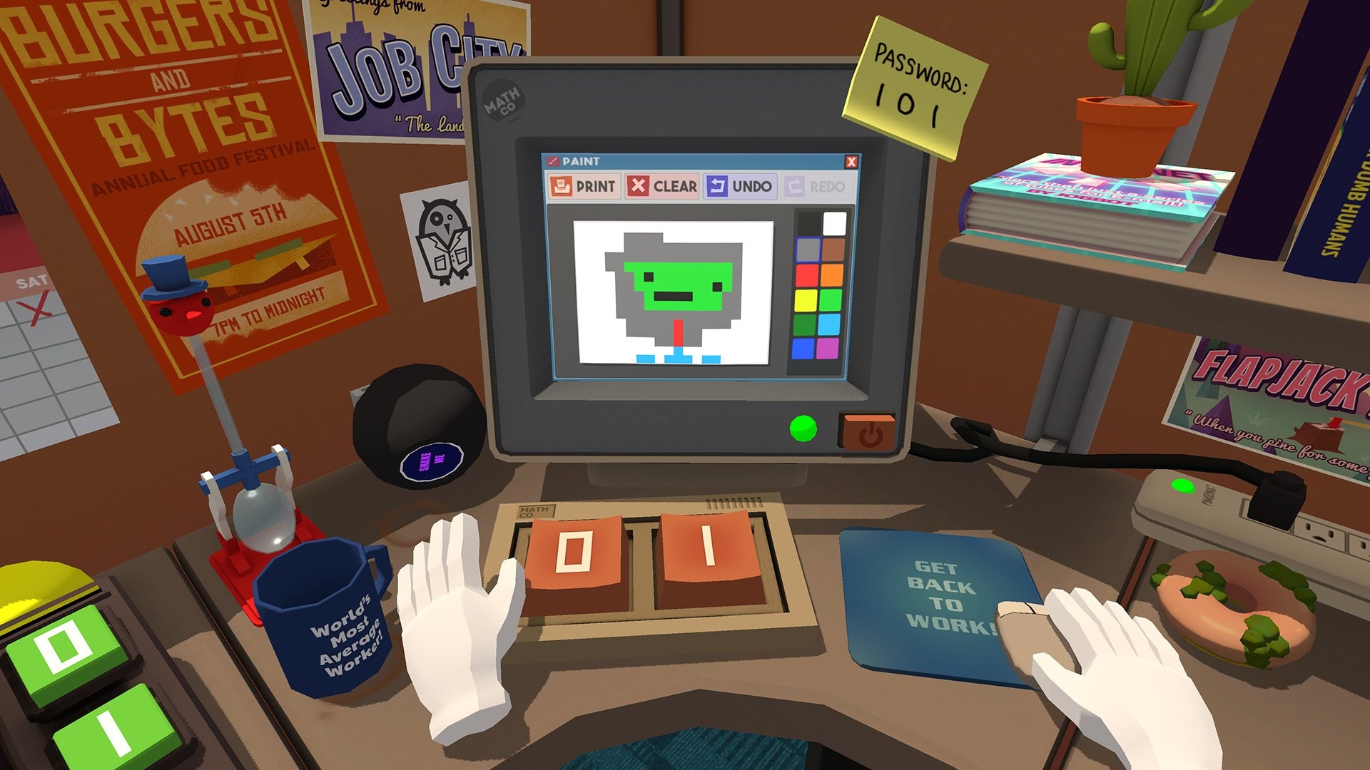
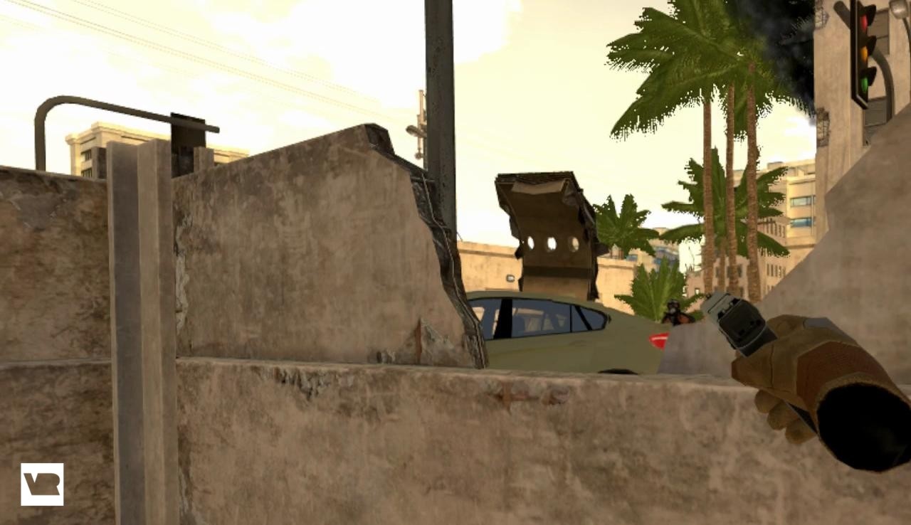
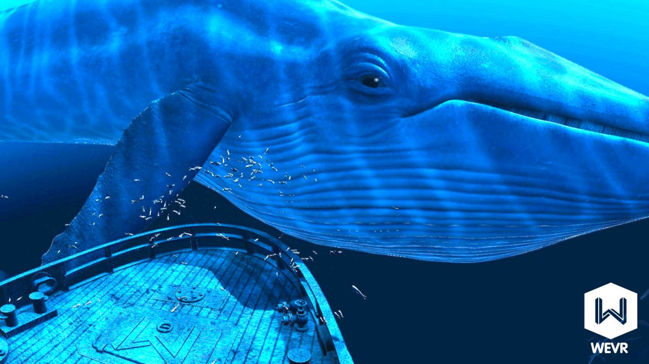
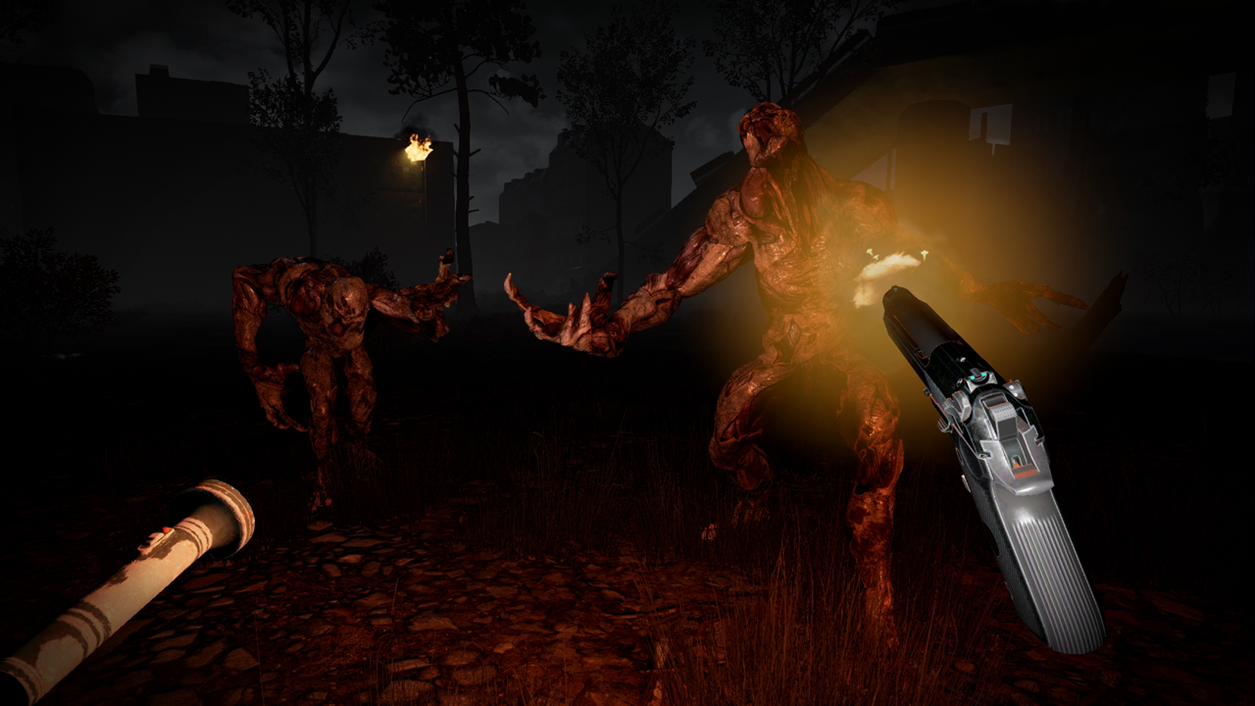
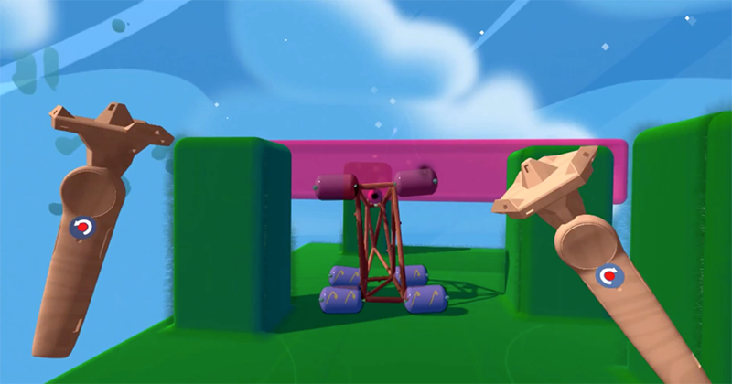
State-of-the-art Software
HTC Vive
The Lab
Job Simulator
theBlu
Fantastic Contraptions
Tilt Brush
Onward
The Brookhaven Experiment

Slide 9
Building VR applications
Notes:
Screenshot: Unity

Slide 10
Building VR applications (2)
Notes:
Screenshot: Unity code editor

Slide 11
Building VR applications (3)
Notes:
Screenshot: Unity code libraries

Slide 12
Building VR applications (4)
Notes:
Screenshot: Unity with 3D models

Slide 13
Building VR applications (5)
Notes:
Screenshot: Unity with VR toolkit

Slide 14
Lessons learned
Frode Opdahl (master student @ IFI)
Special curriculum: explore VR technology
Unity makes VR programming too easy!
If you know Unity
Game (app) design important
Almost no research articles about HTC Vive (yet)
Many opportunities for novel applications

Slide 15
Making a visualization
Make 3D visualization
Make it alive
Make it interactive
Achieve >90HZ FPS
Avoid motion sickness

Slide 16
VR @ UiT
IFI has 2 HTC Vive kits
IIS has 1 Oculus Rift
Norut has 1 Oculus Rift & 1 HTC Vive

Slide 17
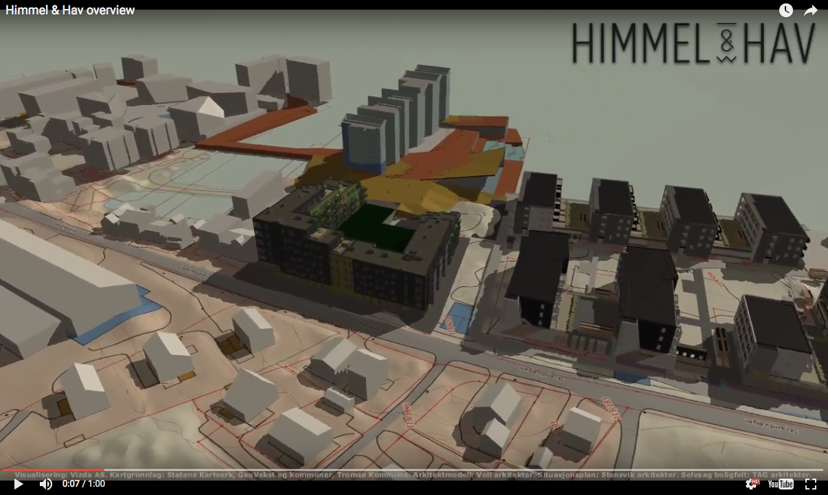
Tromsø startup (Vizda)

Slide 18
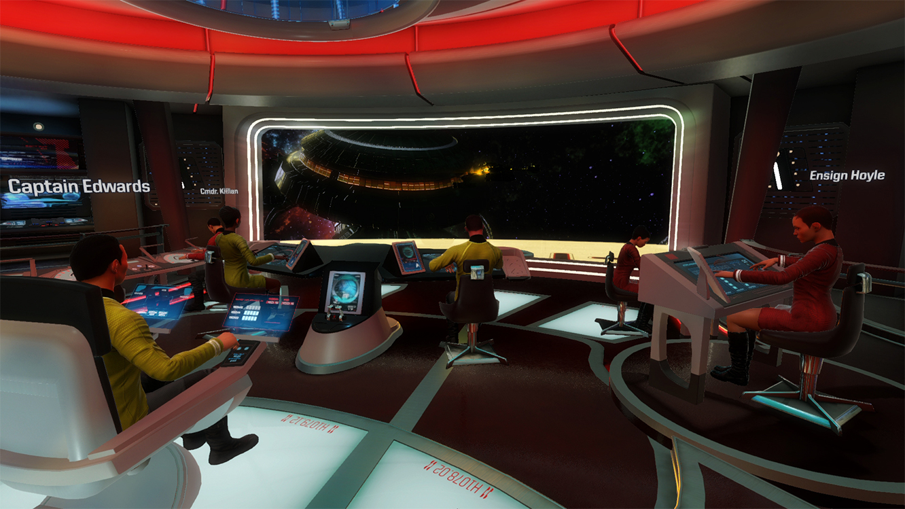
Conclusion
VR hardware is here
VR applications games very rude
Easy to program
Very open field
Try it!

