Slide 1


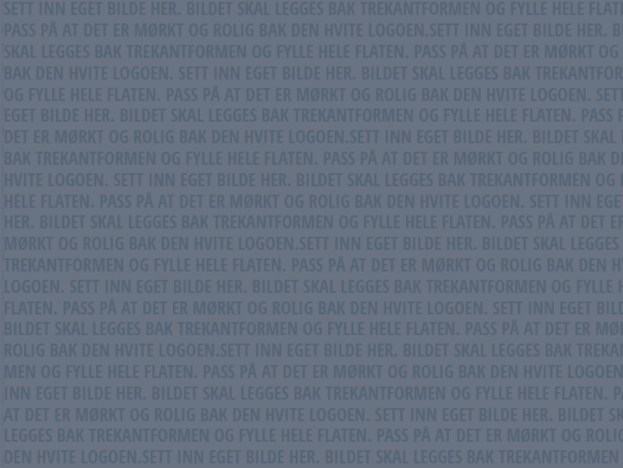
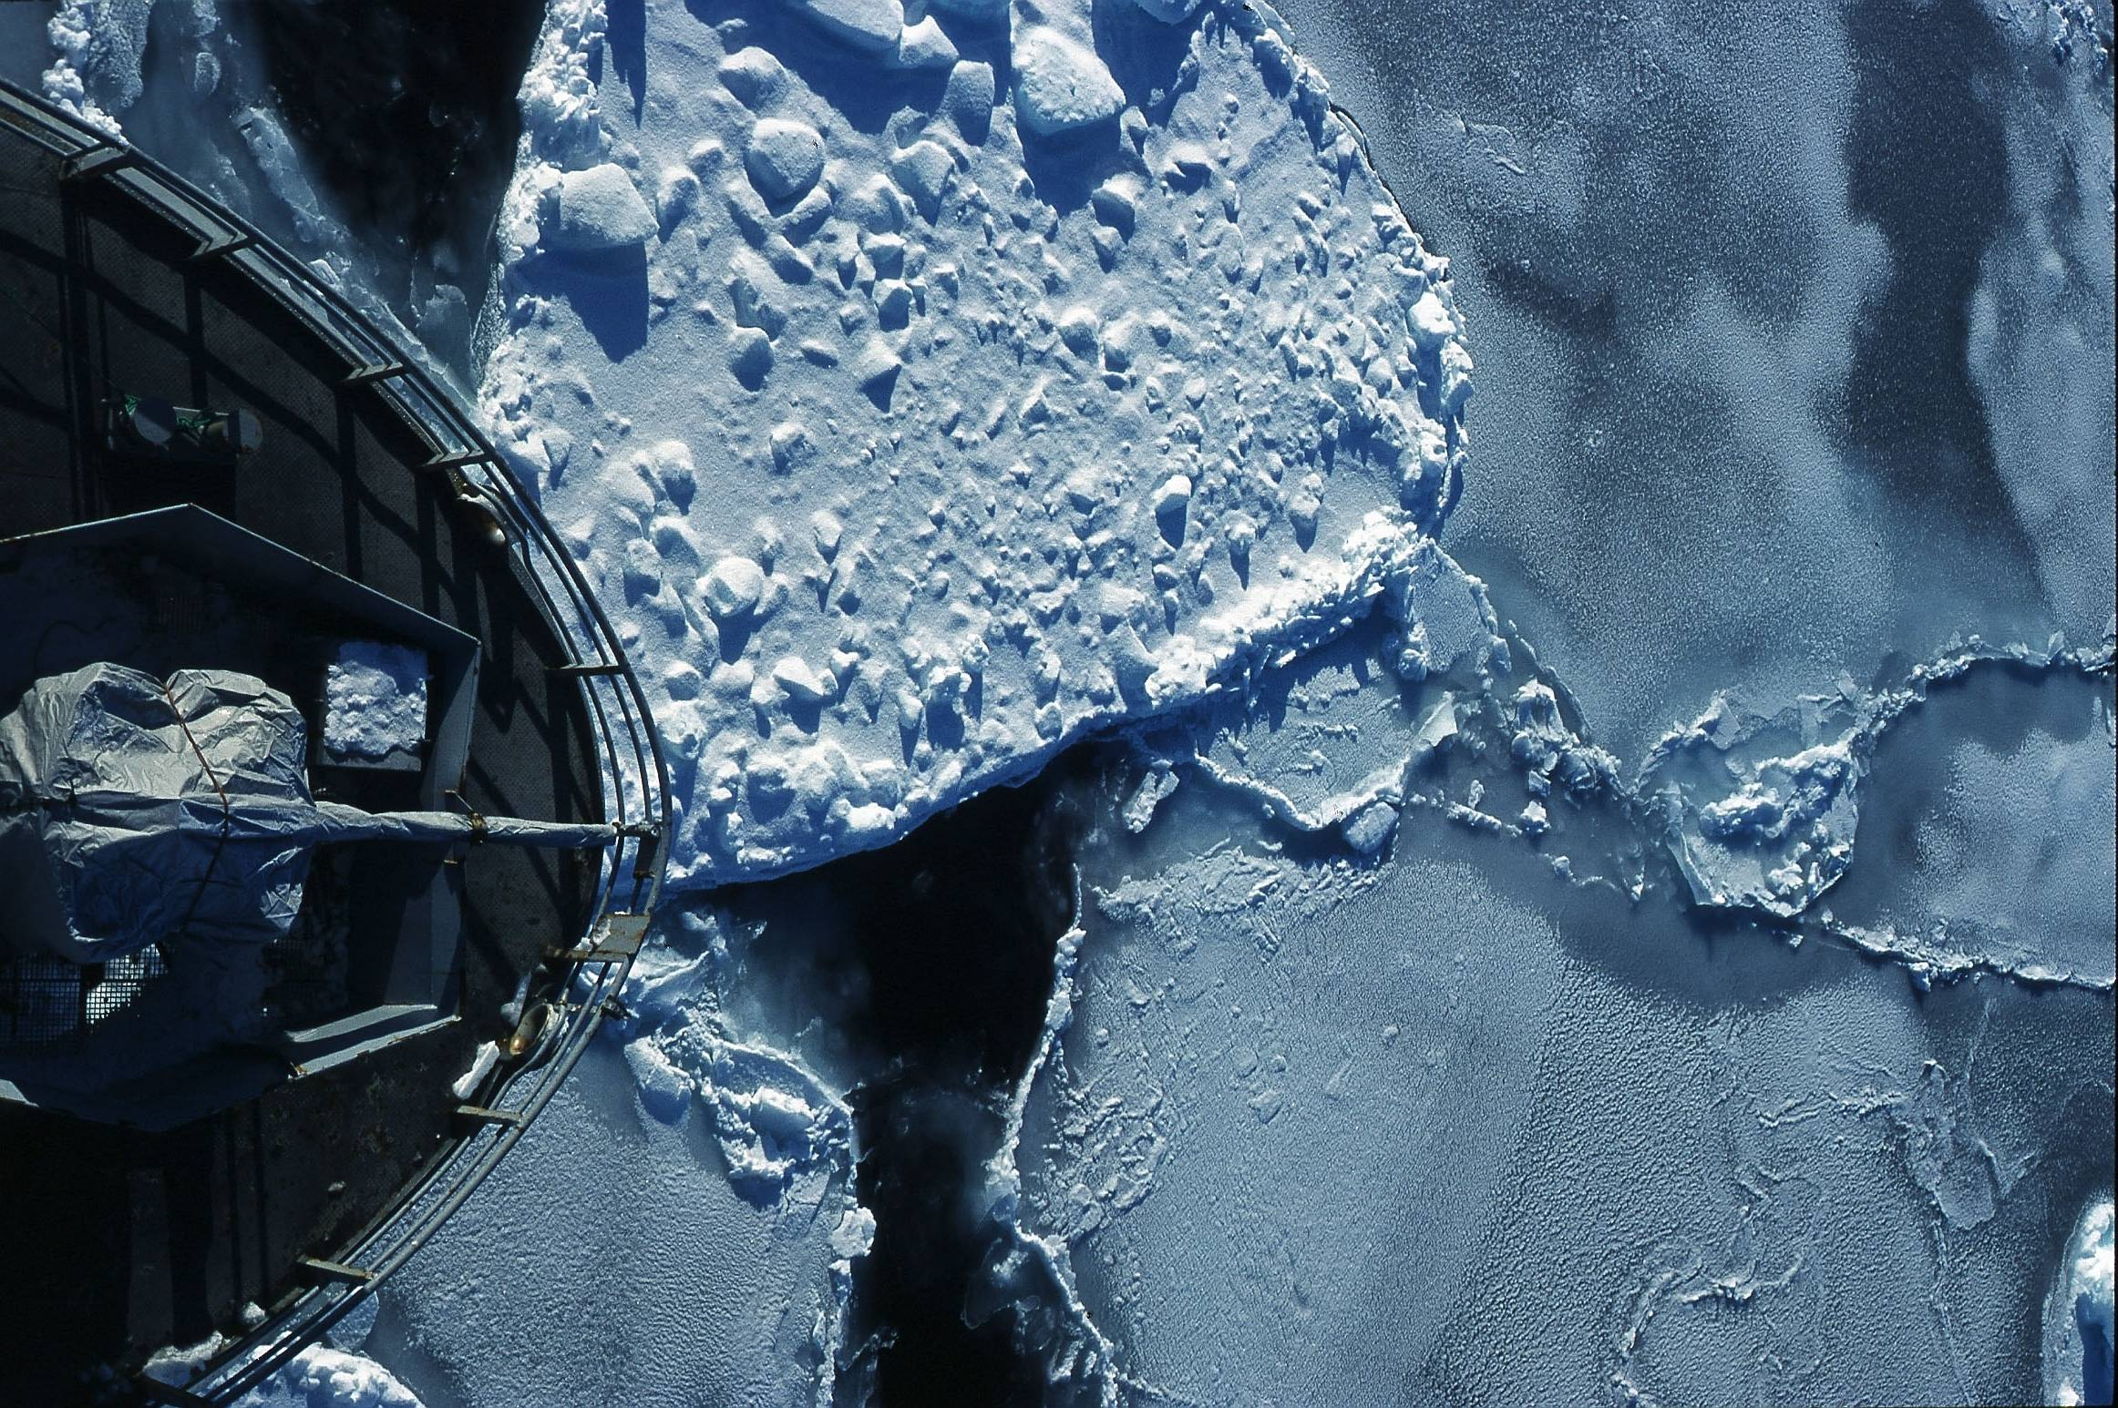


Lars Ailo Bongo
Dept. of Computer Science & Center for Bioinformatics,
University of Tromsø, Norway
http://bdps.cs.uit.no
http://sfb.cs.uit.no
Photo: Jo Jorem Aarseth

Slide 2







EBI, ITA, CSC, Sigma2, UiB, NTNU, ++
SfB
NOWAC
NorInnova, Aveiro, ++
BDPS lab
++
System Epidemiology
NOTCH
MAP5, McGill, NR, UiO, ++

Slide 3
Outline
BDPS: team and projects
Bioinformatics: data management challenge
Our research: interactive data analytics
  Too many slides!
BDPS: resources
New possibilities and some challenges

Slide 4
The Team
NOWAC
  Einar Holsbø
  (PhD student)
  Bjørn Fjukstad
  (PhD student)
  (New PhD student,
  Q3 2016)
Lung sounds
  Morten Grønnesby (master student)
Center for Bioinformatics
  Edvard Pedersen
  (PhD student)
  Espen Robertsen
  (PhD student)
  Inge Alexander Raknes (engineer)
  Giacomo Tartari (engineer)
  Aleksandr Agafonov (engineer from 15/2)
  (1 new position?)
  Jarl Fagerli
  (master student)
  Jon Ivar Kristiansen (system administrator)

Slide 5
Collaborators
NOWAC
Prof. Eiliv Lund (PI)
Prof. Etienne Birmelé
(Paris Descartes)
Prof. Mike Hallett (McGill)
Dr. Karina Standahl Olsen
Dr. Vanessa Dumeaux
(McGill/ Tromsø)
Dr. Hege Bøvelstad
(Oslo/ Tromsø)
Mie Jareid (PhD student)
Knut Hansen (engineer)
Morten Aarflot (stastician)
Center for Bioinformatics
Prof. Nils Peder Willassen
(Center leader)
Prof. Peik Haugen
Prof. Olga Troyanskaya
(Princeton & Simons Foundation)
Dr. Rob Finn (EBI)
Roy Drageseth (ITA)
Dr. Erik Hjerde
NeLS team
Elixir teams
CSC Cloud team
Lung sounds: Prof. Hasse Melbye, Juan Carlos Aviles Solis, Robert Jenssen

Slide 6
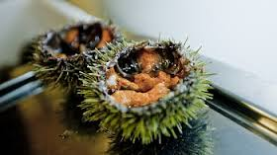
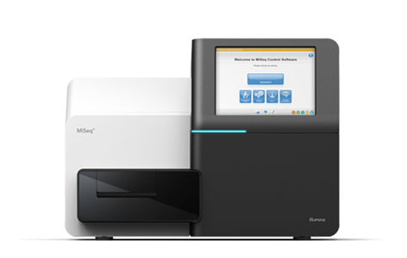
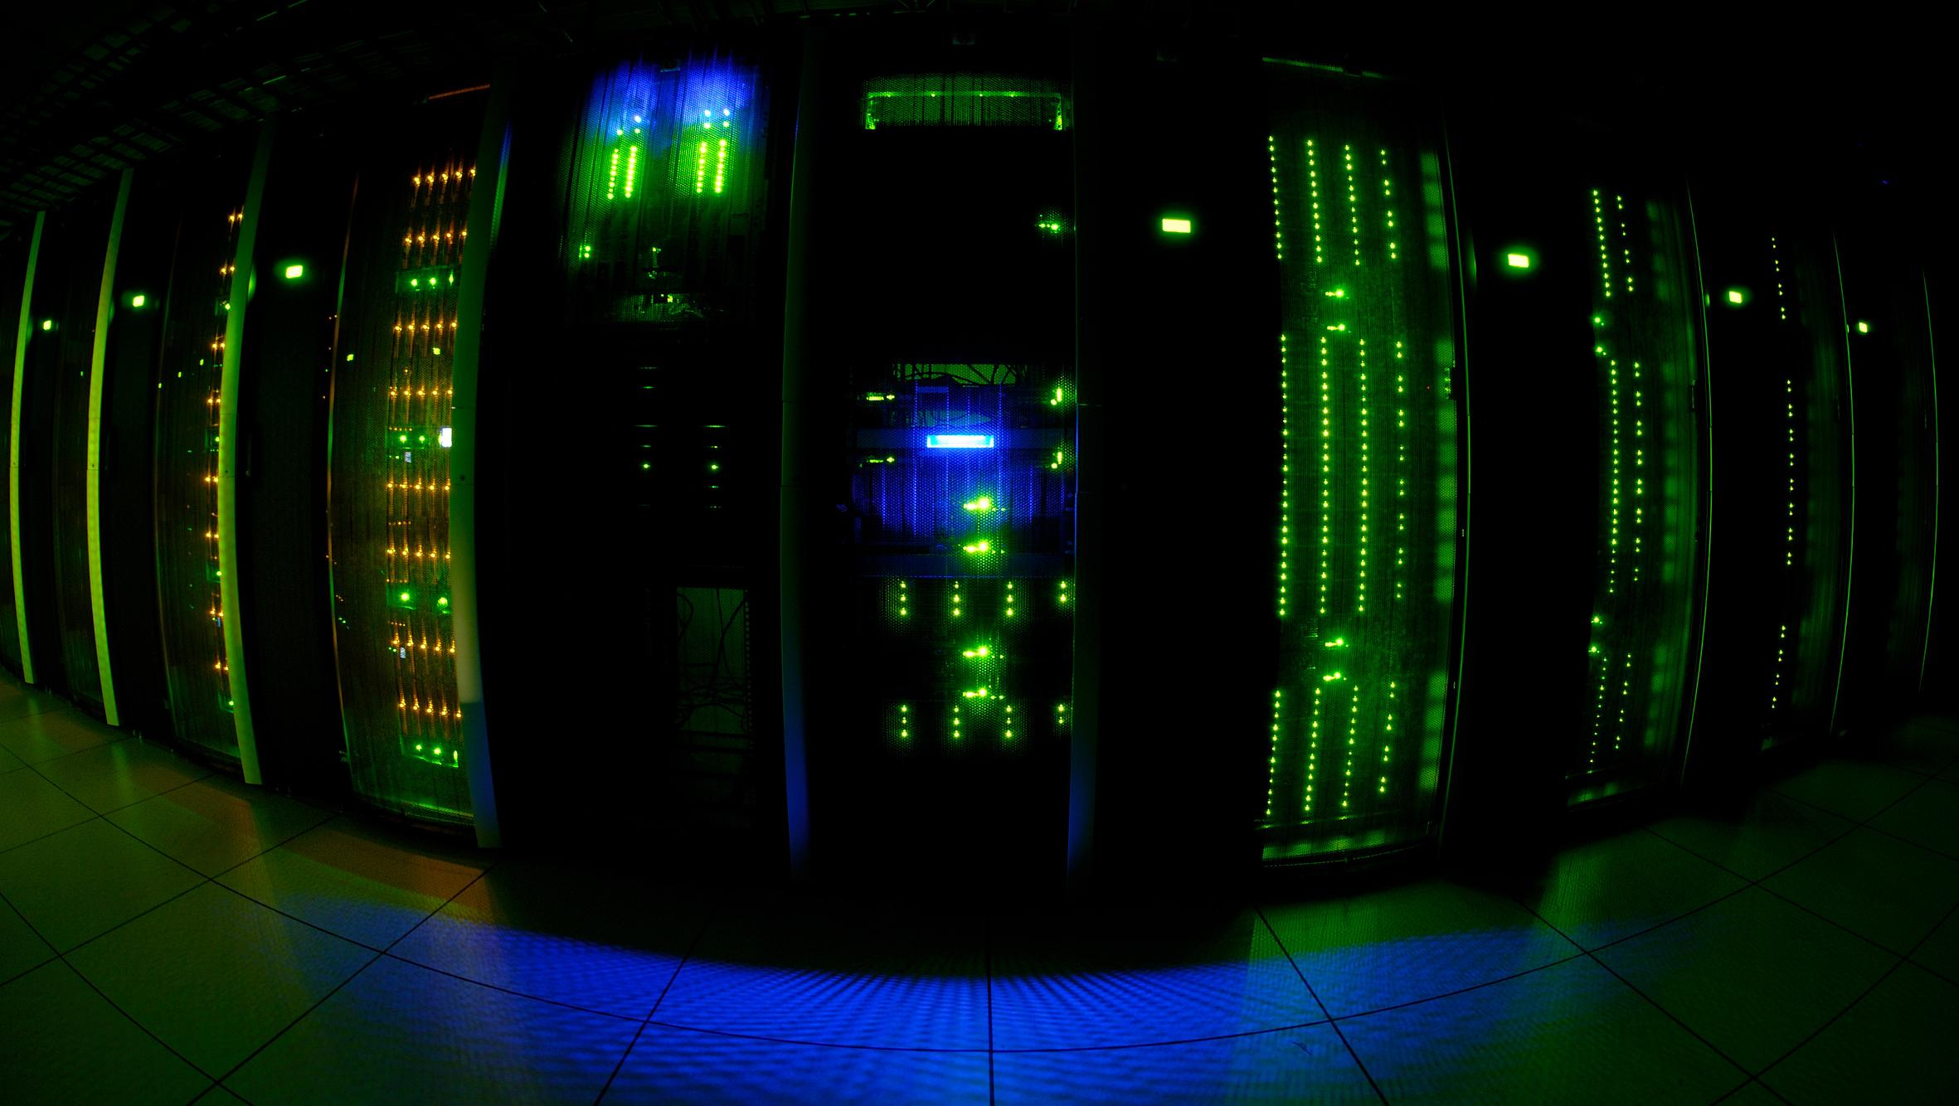
Center for Bioinformatics (SfB)
Interdisciplinary research
  Computer science
  Biotechnology
  Bioinformatics
Bioinformatics e-infrastructure services
Special focus on marine metagenomics
Commercial exploitation of marine resources
http://sfb.cs.uit.no

Slide 7
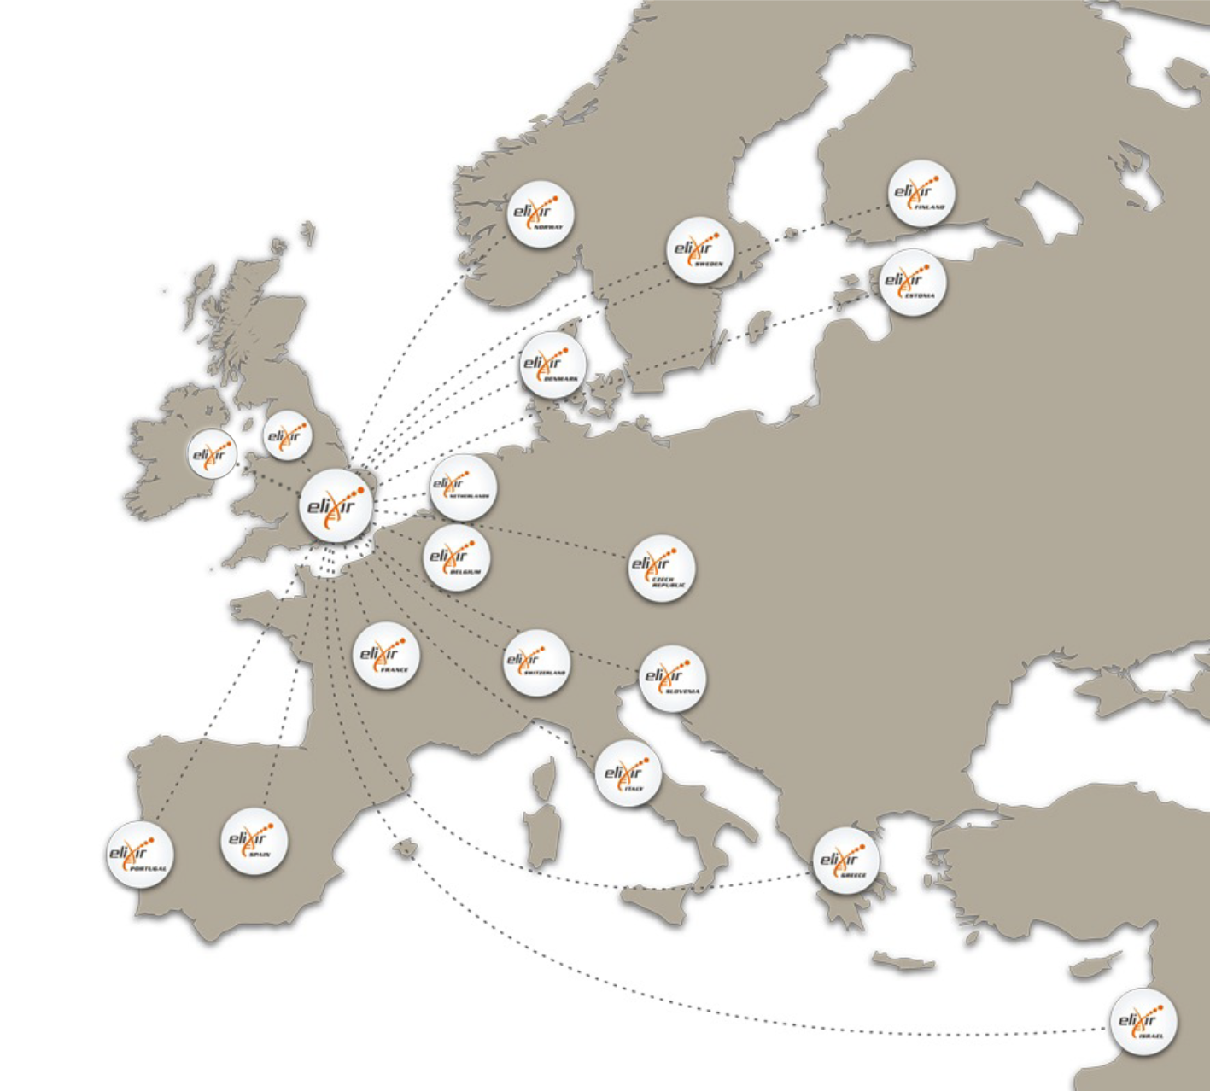








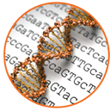

ELIXIR: An international distributed infrastructure for biological data
Technical platforms
Data
Standards
Tools
Compute
Training
User communities
Marine metagenomics
Crop and forest plants
Human data
Rare diseases

Slide 8
Infrastructure for Life Sciences
Integration and interoperability of data and services
Tools
Services & connectors to drive access and exploitation
Standards
Data
Access, Exchange & Compute on sensitive data
Compute
Sustain core data resources
Training
Professional skills for managing and exploiting data
8

Slide 9
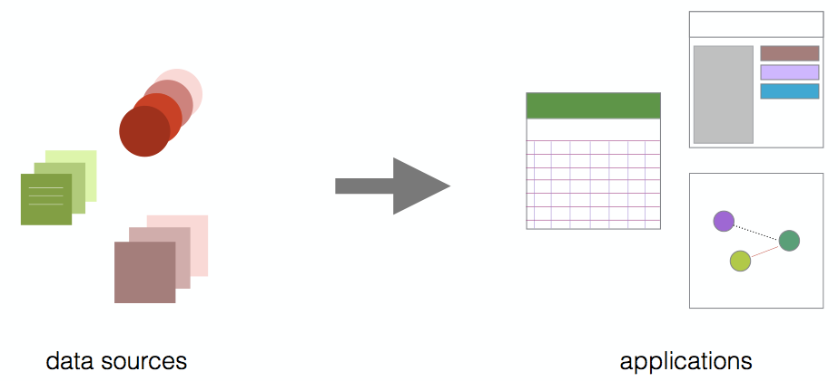
Norwegian Woman and Cancer (NOWAC)
Large and unique biobank of blood samples
Understand development of cancer (and how to avoid it)
Develop diagnosis approaches
Develop or improve treatment
http://site.uit.no/nowac/

Slide 10
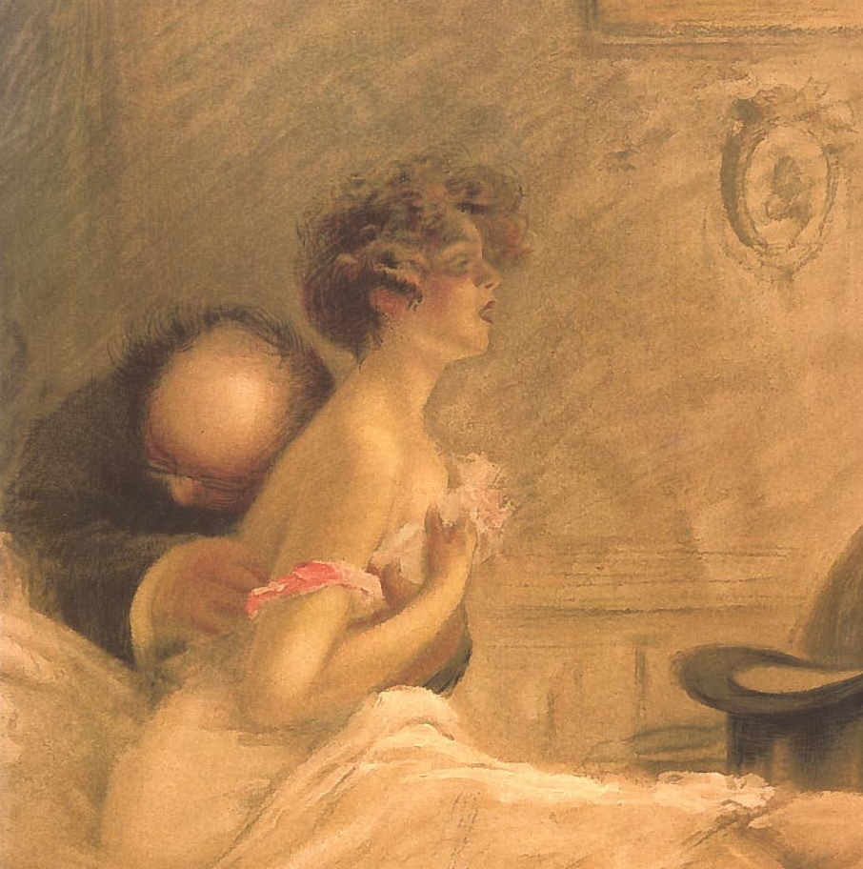
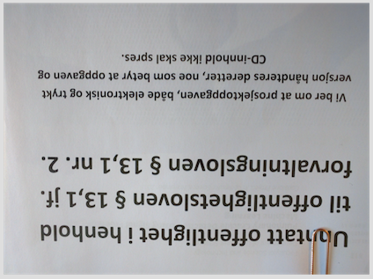
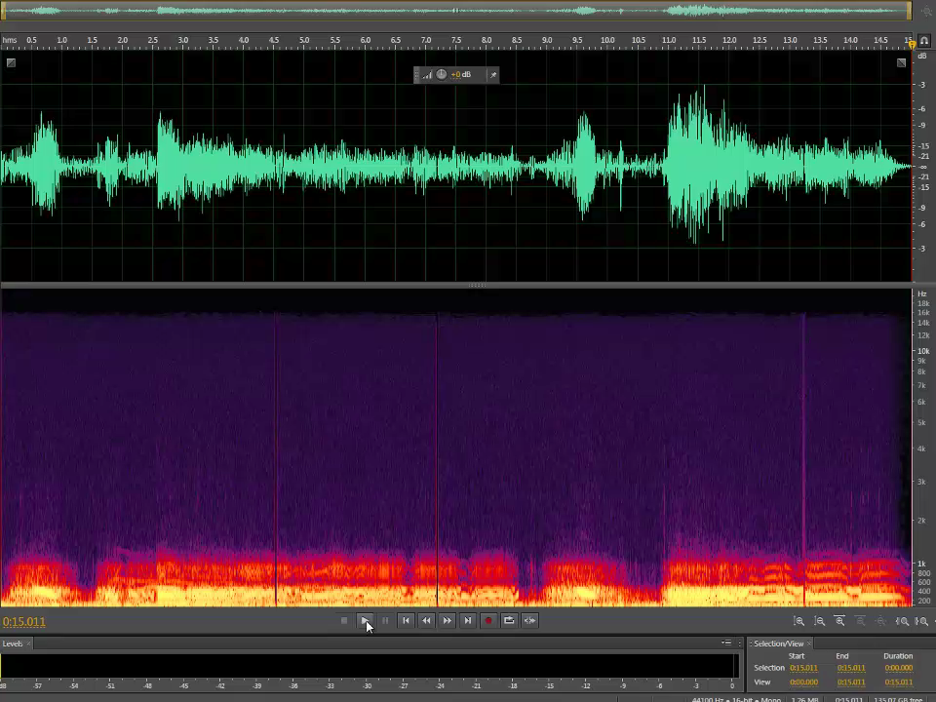
Lung sounds
1000s of recordings (Tromsøundersøkelsen)
Machine learning based classification

Slide 11
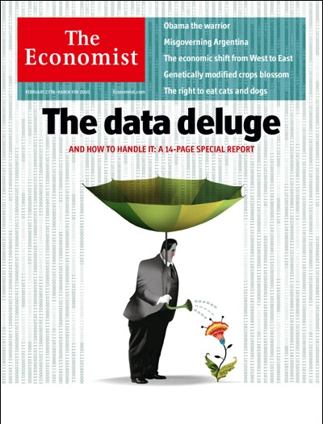
Notes:
2010

Slide 12
Notes:
Published in 2009
Jim Gray’s talk 2007
Empirical
Theoretical
Computational
Data exploration

Slide 13
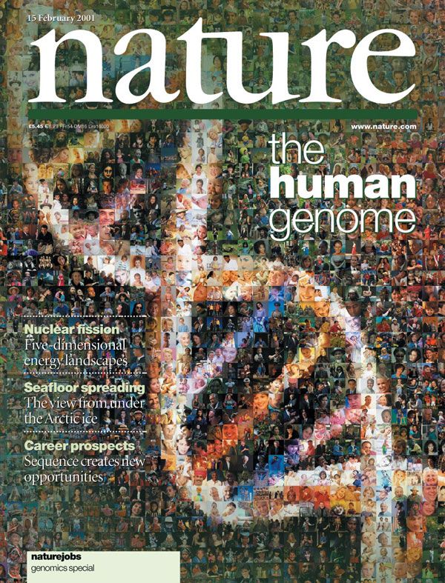
Notes:
2001

Slide 14

Notes:
2013: Special issue on cancer genomics

Slide 15
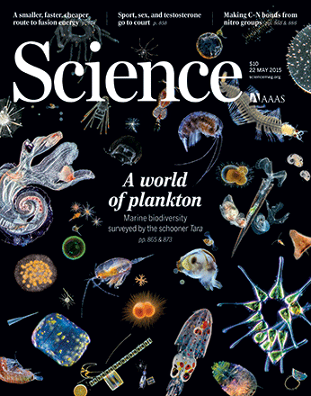
Notes:
2015: marine metagenomics

Slide 16
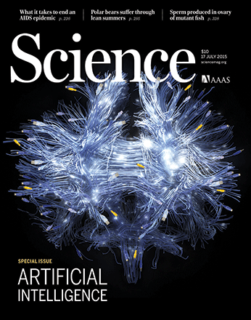
Notes:
2015: AI

Slide 17
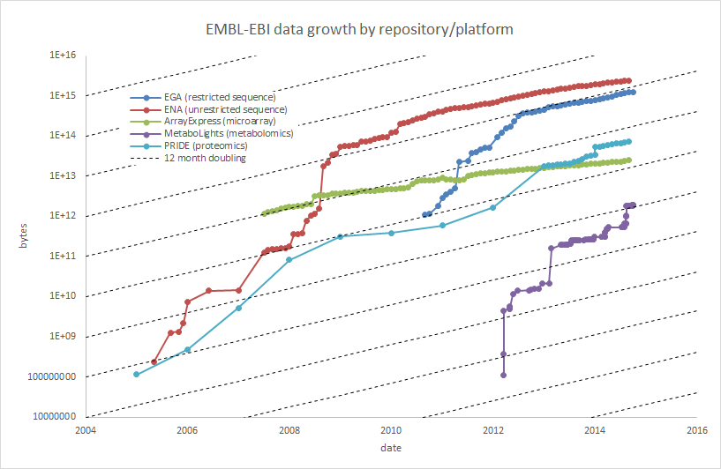
Data growth in the life sciences
Notes:
Phenomenal data growth – dotted lines represents doubling every twelve months

Slide 18
The data deluge
Computer speed and storage capacity is doubling every 18 months and this rate is steady
DNA sequence data is doubling every 6-8 months over the last 3 years and looks to continue for this decade
Source: Nature News & Comment, June 2013

Slide 19
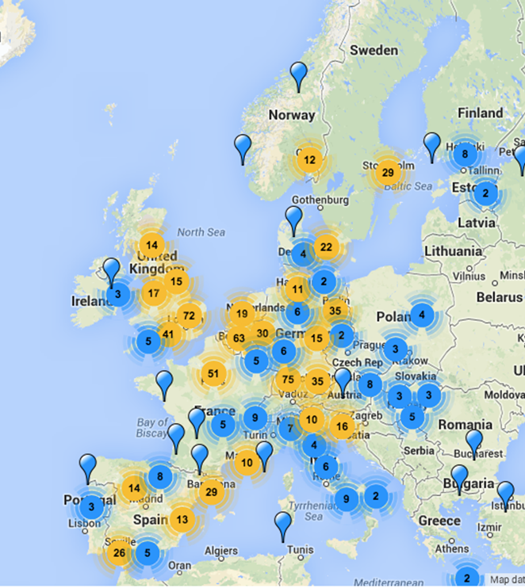
The data challenge: Geographic spread
Data production sites increasing across Europe
European Illumina seq sales up 20% 2014
Source: http://omicsmaps.com

Slide 20
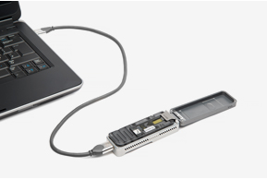
Notes:
Oxford nanopores: MinION

Slide 21
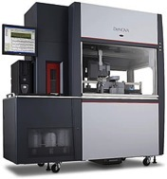
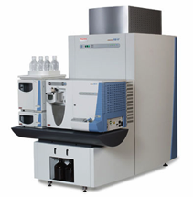
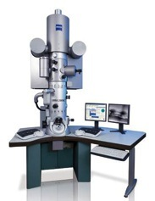
We generate data faster than we can deposit it
Network file transfer rate
24 hours
100 Mb
DNA sequencing
~100 GB
~5 hours
Mass spectrometry
~4 TB
~4 days
Microscopy
~4 TB
~4 days
21
Notes:
We are generating data faster than we can transfer it.
Even with faster lines we are talking major computational bottlenecks in file transfer.
Technology get cheaper and faster
~15.000 hospital
~4.000 universities
~2.000 life sciences research institutes
How much data we will produce? How we will store it?

Slide 22
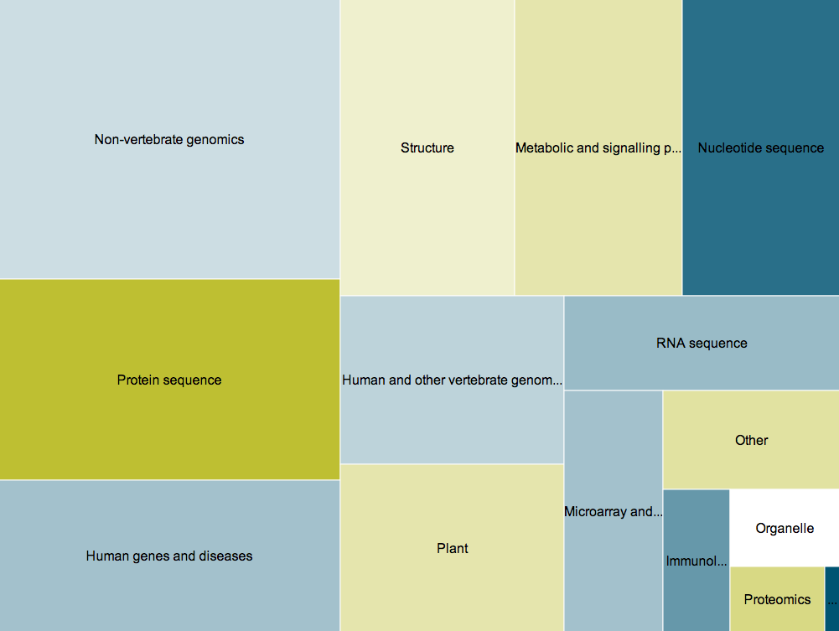
Data resources in life science
1800
Diverse
Plentiful
Disperse
databases
Nucleic Acids Research annual Database Issue
and the NAR online Molecular Biology Database Collection in 2012.
MY Galperin, GR Cochrane – Nucleic Acids Research, 2011
Notes:
Each colour in the blocks represents a different type of database category: genomics, protein sequences, proteomics, gene expression, structural data, computational models of biological processes, and so forth.
The size of the squares relate to how many of them are there.
The many databases used to store the wide diversity of data produced in life-science experiments are dispersed throughout the world, and serve many different research communities.
Just keeping track of the vast quantity is a job in itself.
We need a combination of the best people, financing and experience to solve the life science data challenges that lay ahead if we are going to reap the rewards of new technology.
Furthermore no one institute or organisation can deal with all this data. We need a distributed federated infrastructure to deal with the data challenges.

Slide 23
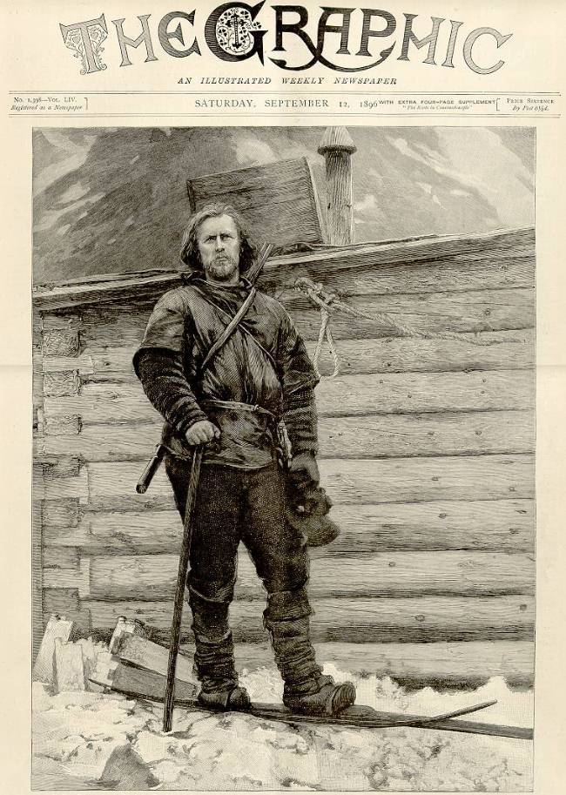
Interactive Data Exploration

Slide 24

Our Research Goal

Slide 25



Interactive Data Exploration
Data exploration = “play with data”
  No prior hypothesis
Interactive
  Human - computer
  Short response times (seconds or milliseconds)
Computers helps by ordering data and making predictions
Combined with (proper) hypothesis testing

Slide 26
Interactive Data Exploration Requirements
Human experts for data analysis
Interactive user interface
Analysis methods and models
Data management and backend processing
Compute and storage resources

Slide 27
Interactive Visual User Interface
Visualization tool to map NOWAC case-control gene expressions to known biology
Existing visualization tools not flexible enough
Developed with NOWAC data analysts
Approach:
  One specialized tool per analysis project
  Framework that makes it easy to implement tools

Slide 28
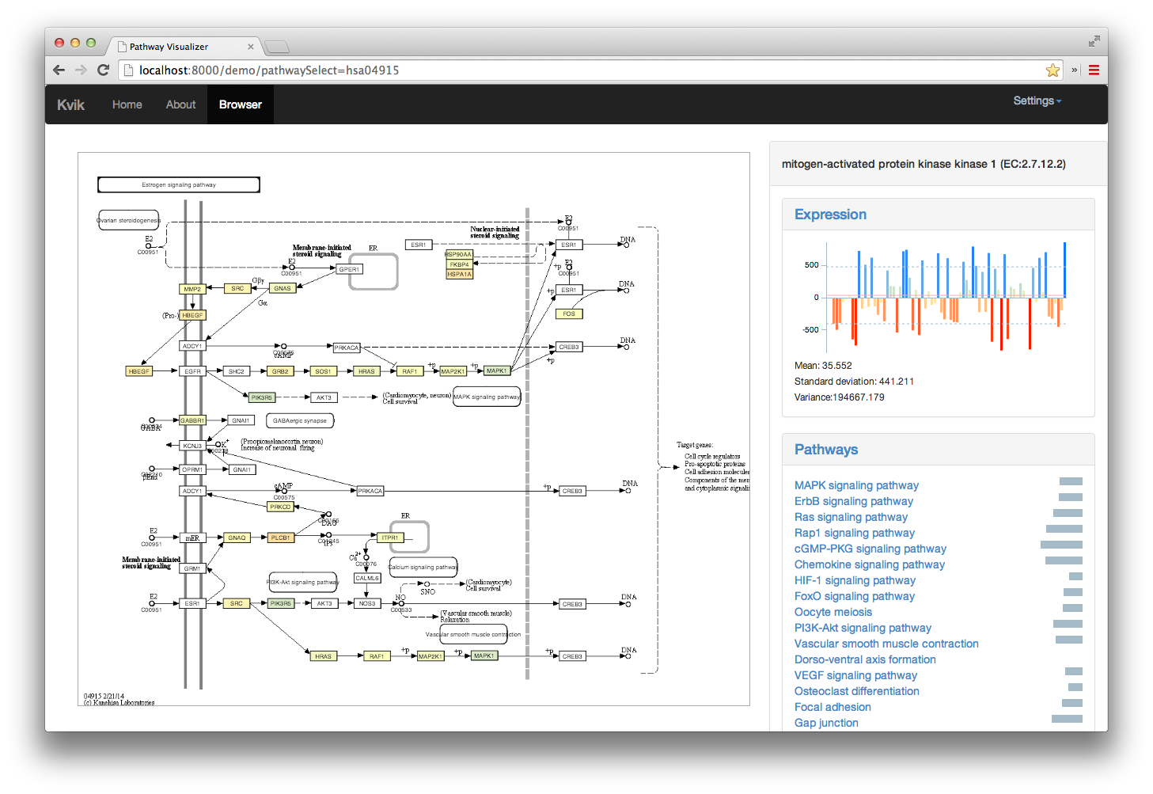
Kvik– NOWAC Pathways

Slide 29
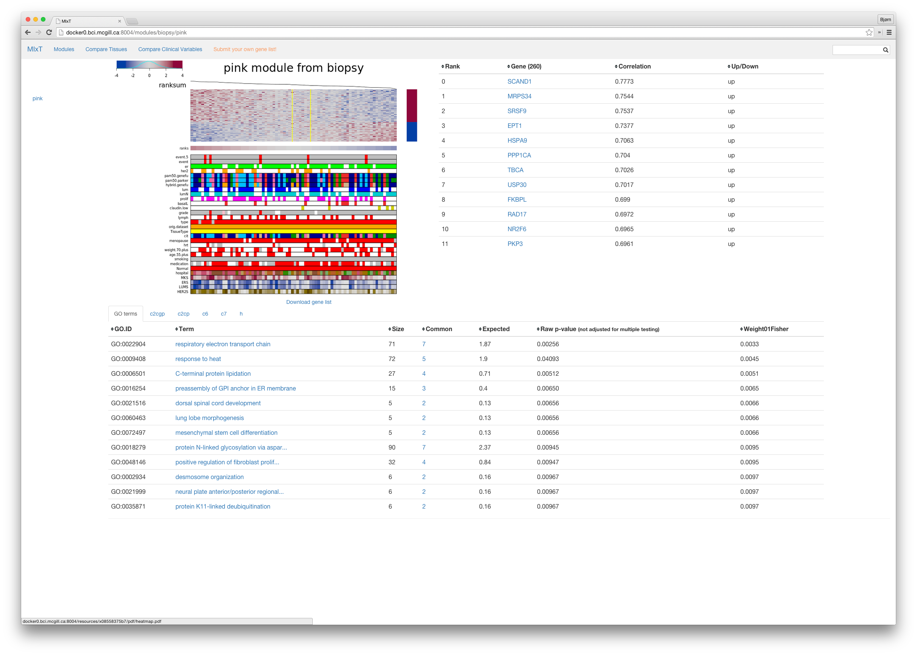
Kvik - MIxT

Slide 30
Kvik – NOWAC Data Exploration
Currently used for:
  NOWAC pathway analysis
  NOWAC stress data
  NOWAC blood-tissue analysis
Publically available and open-sourced:
  kvik.cs.uit.no
  github.com/fjukstad/kvik
  Docker containers
Bjørn Fjukstad

Slide 31
Freia
Use Unity (game) development framework for data exploration
Questions:
  Can we map biological data to game engine data structures?
  Is our data different?
  Does it scale better than alternative frameworks?
Kenneth Knudsen

Slide 32

Data Cleaning Toolchain
Data cleaning important, but time consuming (and boring)
Good data cleaning tools for textual and tabular data
  Not suited for scientific data cleaning
Approach
  R scripts generates images with visualizations
  Interactively group and sort images
  Compare related images

Slide 33
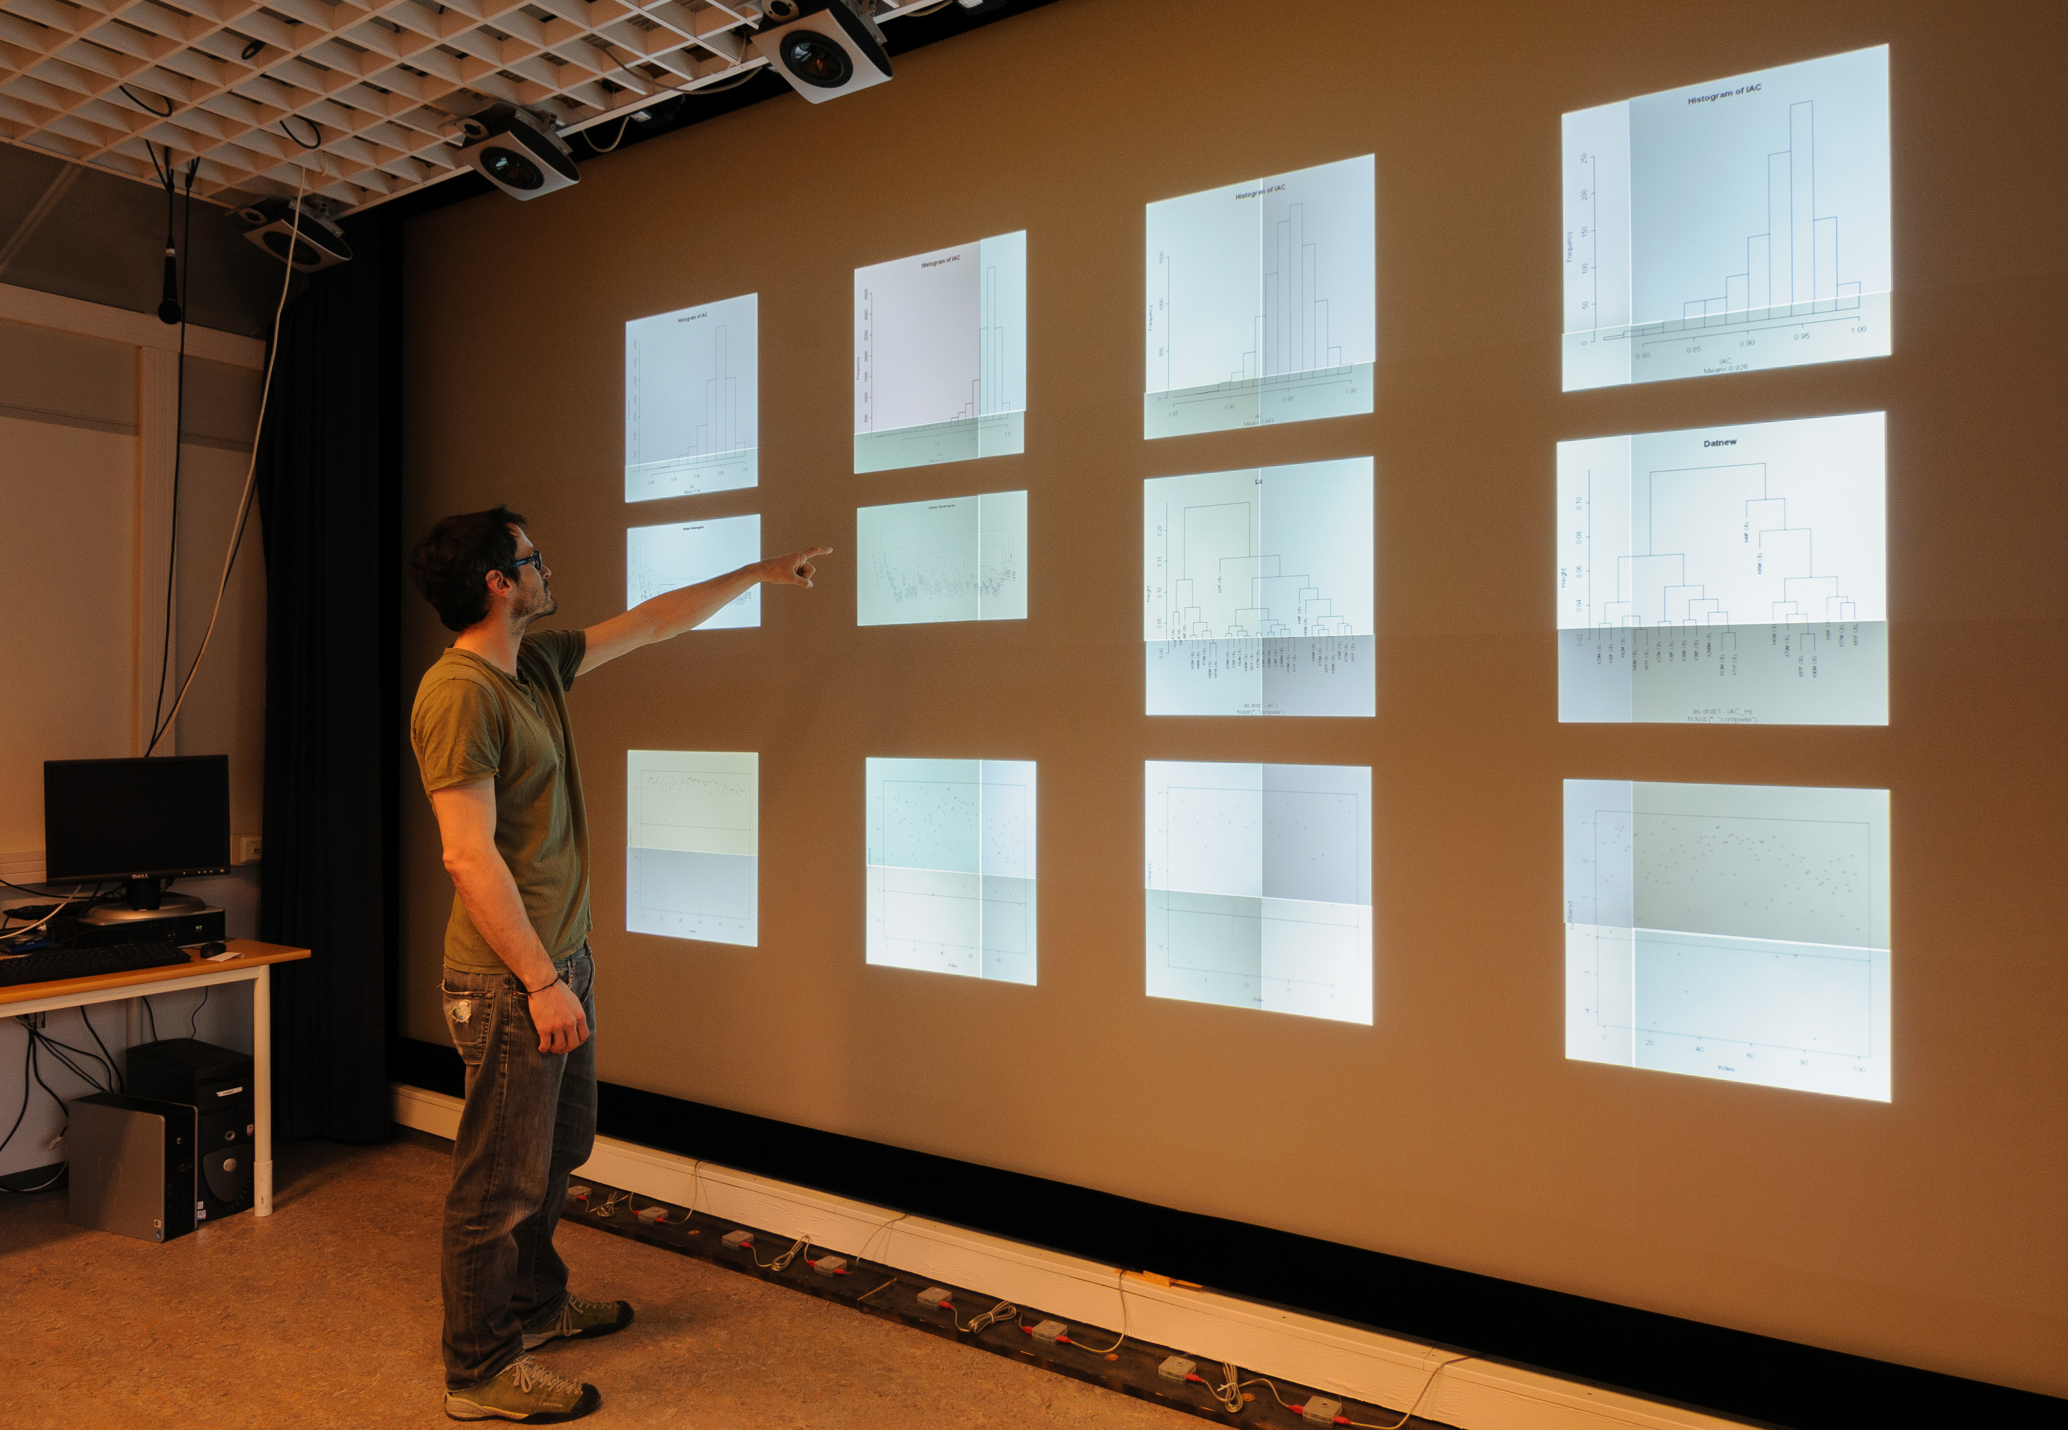
Mr. Clean – Data Cleaning

Slide 34
Mr. Clean – Data Cleaning
Gesture based interaction with many visualizations
  Use case: NOWAC outlier removal
  Use case: computer vision algorithm development
Availability:
  github.com/UniversityofTromso/mrclean
  youtu.be/NFUDsPQRwqE
  Proc. of VISSOFT’14
Giacomo Tartari & Einar Holsbø

Slide 35
Pippelinen
Standardized pipeline for NOWAC data
  Data cleaning
  Normalization
  Outlier removal
Documentation
Bjørn Fjukstad, Einar Holsbø, Hege Bøvelstad

Slide 36
Data Analysis
How to find signals in the data?
Use machine learning classification and prediction as input for data exploration
But make it possible to understand underlying biology

Slide 37
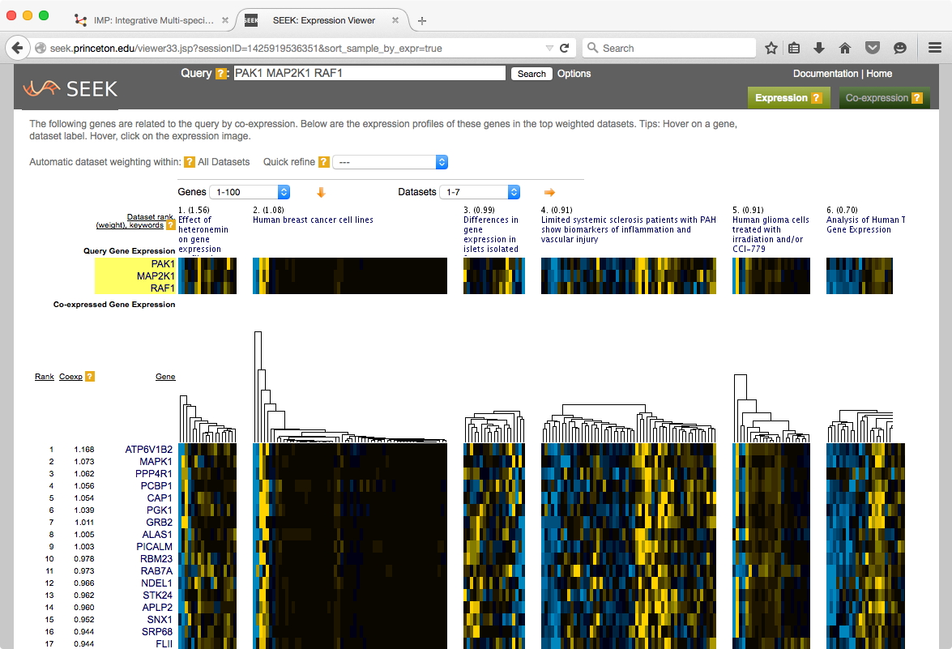
http://seek.princeton.edu/
Nature Methods (2015), Mar;12(3):211-4

Slide 38
Data Analysis Methods
Methods
  Metastasis prediction for NOWAC data
  Distributed cross-validation
  Machine learning algorithm optimizations for epidemiological data
  Novel machine learning algorithms for few-samples many-dimensional data
Backend for executing data analysis methods
  Computationally demanding
  Must be very fast
  State-of-the-art infrastructure systems
Einar Holsbø

Slide 39
Meta-database Management
How to use state-of-the-art data-intensive computing systems for biological data processing?
Problems:
  Meta-databases are large: 1TB per version
  Updated often => should update results
  Processing may take weeks
Approach:
  Scalable incremental updates
  Unmodified data analysis tools
  Integrated with Galaxy
  Utilize data-intensive computing systems

Slide 40
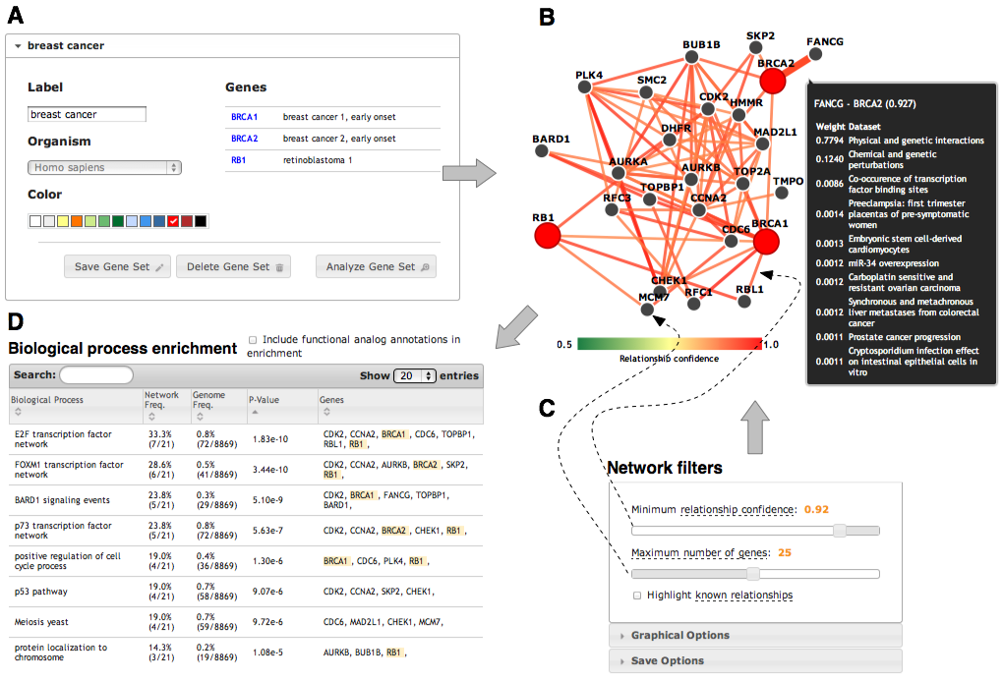
http://imp.princeton.edu/
Nucleic Acids Research. July 2012 & PLoS Comput Biol 9(3). 2013

Slide 41
Meta-database management
File-based: wrapper around tools
  Relatively few file formats
  Detect relevant updates
  Fix and merge outputs
Plugin framework
Implemented using HDFS, MapReduce & Hbase
Edvard Pedersen (PhD student)
  github.com/EdvardPedersen/GeStore
  In Proc. of. EurPar’13, CIBB’14, PDP’15

Slide 42
META-pipe 2.1
Supercomputer workflow manager run on Stallo
  Production system
Intermediate data in a universal formats
Intermediate representation of workflow (JSON)
Supports:
  Unit test
  Multiple schedulers / queuing systems
  Adding new functionality to a workflow
  Debugging / visualization
  Adding validation / fail early
Inge Alexander Raknes (ongoing work, Elixir)
Jarl Fagerli (master student)

Slide 43
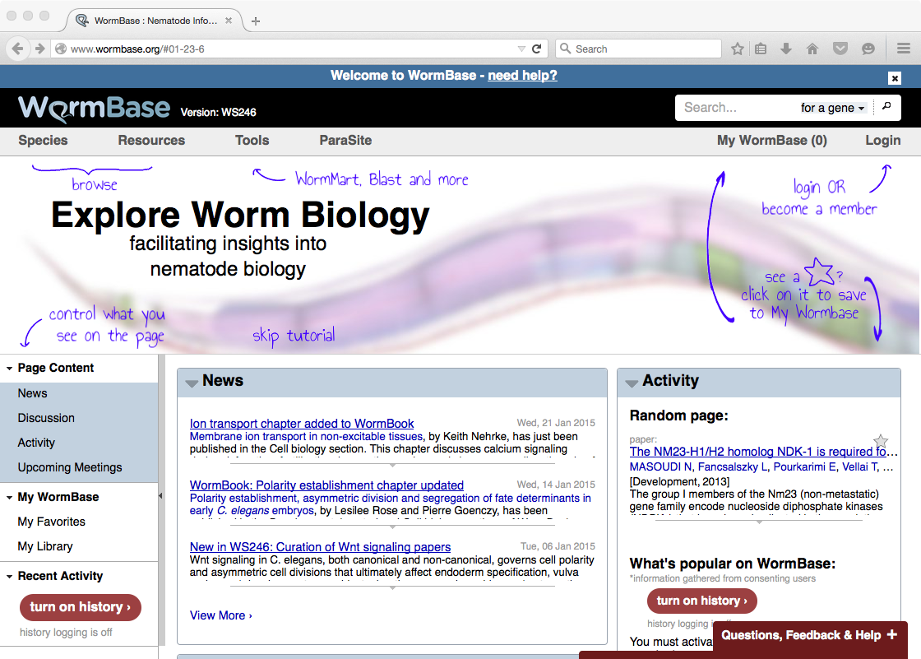

Slide 44
SparkSPELL
Distributed search engine
SPELL algorithm: hard to parallelize
Implemented using Spark
  Integrated old sequential Java code
  Optimizations
Very scalable
Search time <1s
Inge Alexander Raknes (master project)

Slide 45
MORTAL
New programming language for scientific computing
  Multiparadigm: connect the mathematical formulae written by scientist to algorithms implemented by the software engineer
Self hosting compiler
Initial evaluation: similar performance as C
Ove Kåven (master project)
http://sourceforge.net/projects/mortal/

Slide 46
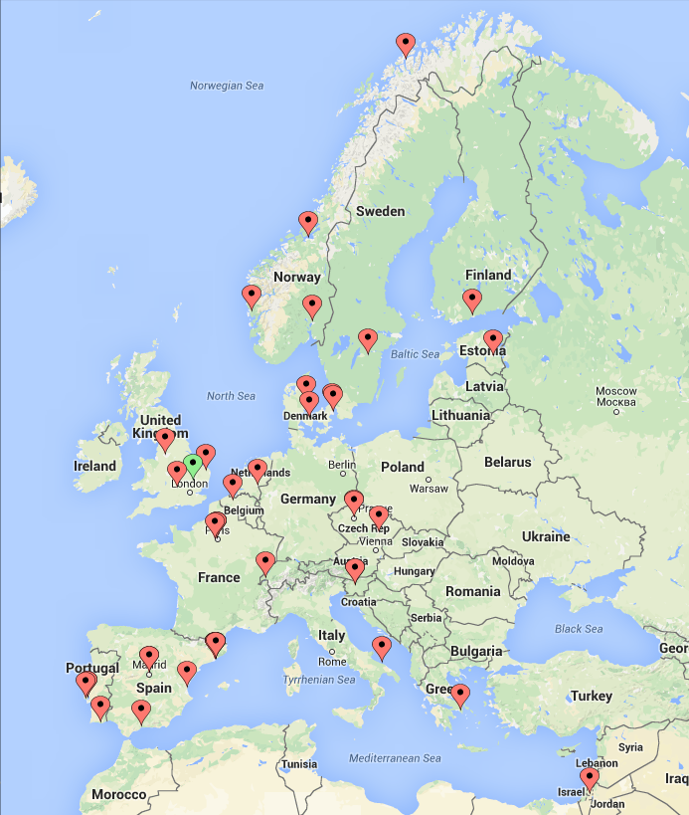

EXCELERATE consortium
41 partners
15 countries

Slide 47
UiT’s Role
ELIXIR Excelerate: 19M EUR project
UiT leader for one of four scientific use cases
  Marine metagenomics
We will be used as demonstrator for technical services (AAI, cloud, data replication, …)

Slide 48
UiT Marine Metagenomics Vision
EBI
UiT
ENA
Marineref DB
1. Deposit data
2. Select pipeline
3. Run analysis
4. Compare to other
results
MGP or META-pipe?
MGP
META-pipe
Integrate results

Slide 49
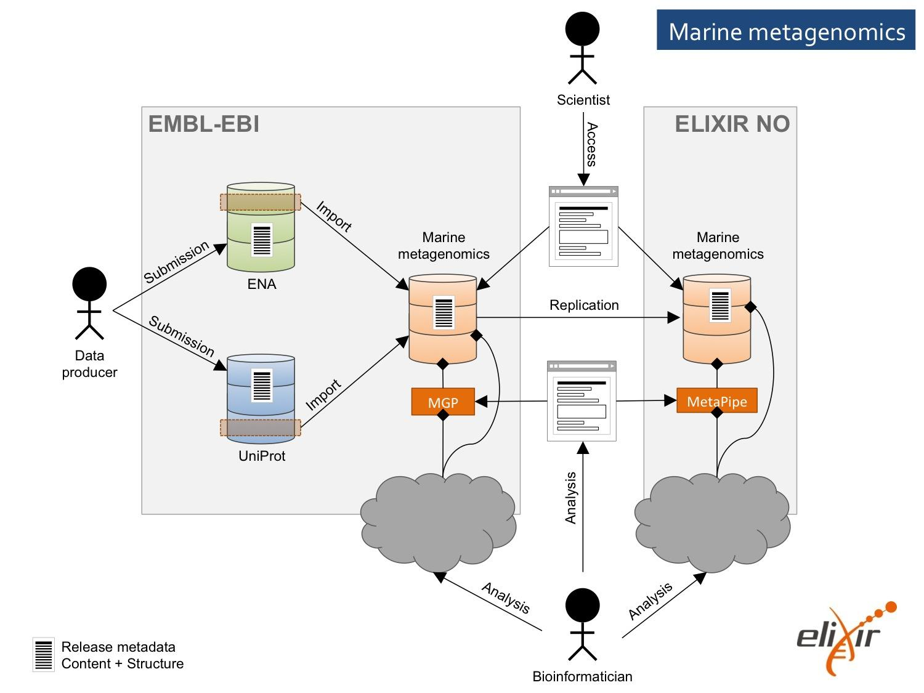
Use Case Architecture

Slide 50
UiT Advantages
Expertise:
  Marine
  Computer science (systems)
Important demonstrator
  Elixir (AAI, data transfer, storage, compute, …)
  Interactive workload at Stallo
  Cloud (CSC, Finland)
New approach: distributed services

Slide 51
Hardware and Software Stack
Ice2: 15 node research cluster
  Distributed storage (45TB raw storage)
  32 or 48 GB DRAM per node
  2 NAS boxes (46TB raw storage)
  Hadoop/ Spark software stack
Burn: large memory node (256GB DRAM)
Stormbringer: VMs with externally exposed services
Stallo
  HPC software stack
  (Spark)
cPouta cloud
  OpenStack
  HDFS/ Spark
Amazon EC2
EMBL-EBI Embassy Cloud / Google Cloud

Slide 52
New Possibilities (Grant Mania)
SFF: System Epidemiology (Lund/ Busund)
SFF: Antibiotic resistance (Svendsen)
Jebsen: Signals from Death (Lund/ Busund)
Jebsen: Antibiotic resistance (?)
IKTPLUSS Fyrtårn: Precsion2Practice (NTNU/ Bongo)
? Digital Life: (?/ Bongo?)
Sigma2 AUS: META-pipe (ITA/ SfB)
Sigma2 AUS: Bioinformatics (ITA/ SfB)
EGI AUS: META-pipe (SfB)

Slide 53
IKTPLUSS Fyrtårn
Integrative data analysis
Precision medicine tools
Prostate and breast cancer
Image and molecular data
Partners: NTNU, UiT, UiB, SINTEF, UNN, St. Olavs, Sectra, Idletech, HEMIT, HN-IKT
UiT (approx. 20% of budget):
  WP5 lead: ICT Services
  WP7 lead: Communications, industry and community engagement
  Use cases: blood test, digital pathology
  Lead on breast cancer

Slide 54
Challenges ➔ suggested solution
# problems to solve > # people to solve them
  ➔More people
Scalability issues, close to maximum lab size
  ➔Additional faculty
Engineers produce publishable results, but no time to write papers
  ➔Postdoc(s)
Interdisciplinary projects have overhead
  ➔“Pliktarbeid” for PhD students
Writing big grants is time consuming
  ➔Reward for effort (as done in MH, NTNU, …)
  ➔Postdoc that can be hired to (help) write grant
Many positions are financed as PMs
  ➔Team of people to use PMs on

Slide 55
Summary
Advances in scientific instruments + compute capacity + storage capacity ➔ big biological data
Need complex systems for analysis
Biological data analysis:
  Unique computer science research challenges
  Requires a distributed infrastructure
Our interdisciplinary research
  Computer science skills ➔ competitive advantage
  ..and in great need

