Slide 1


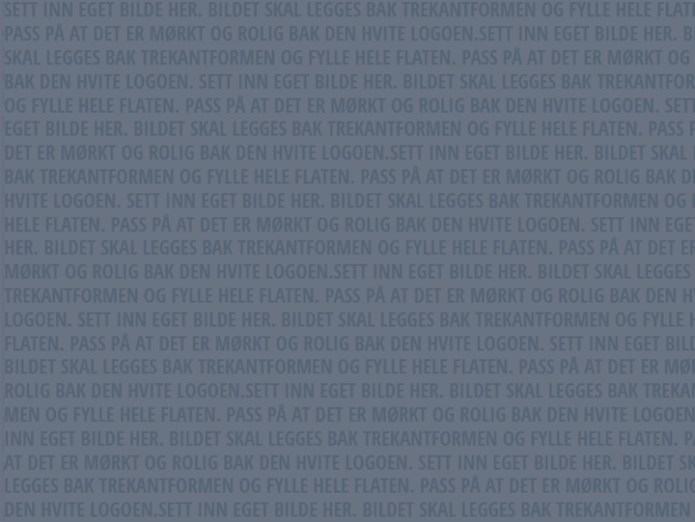
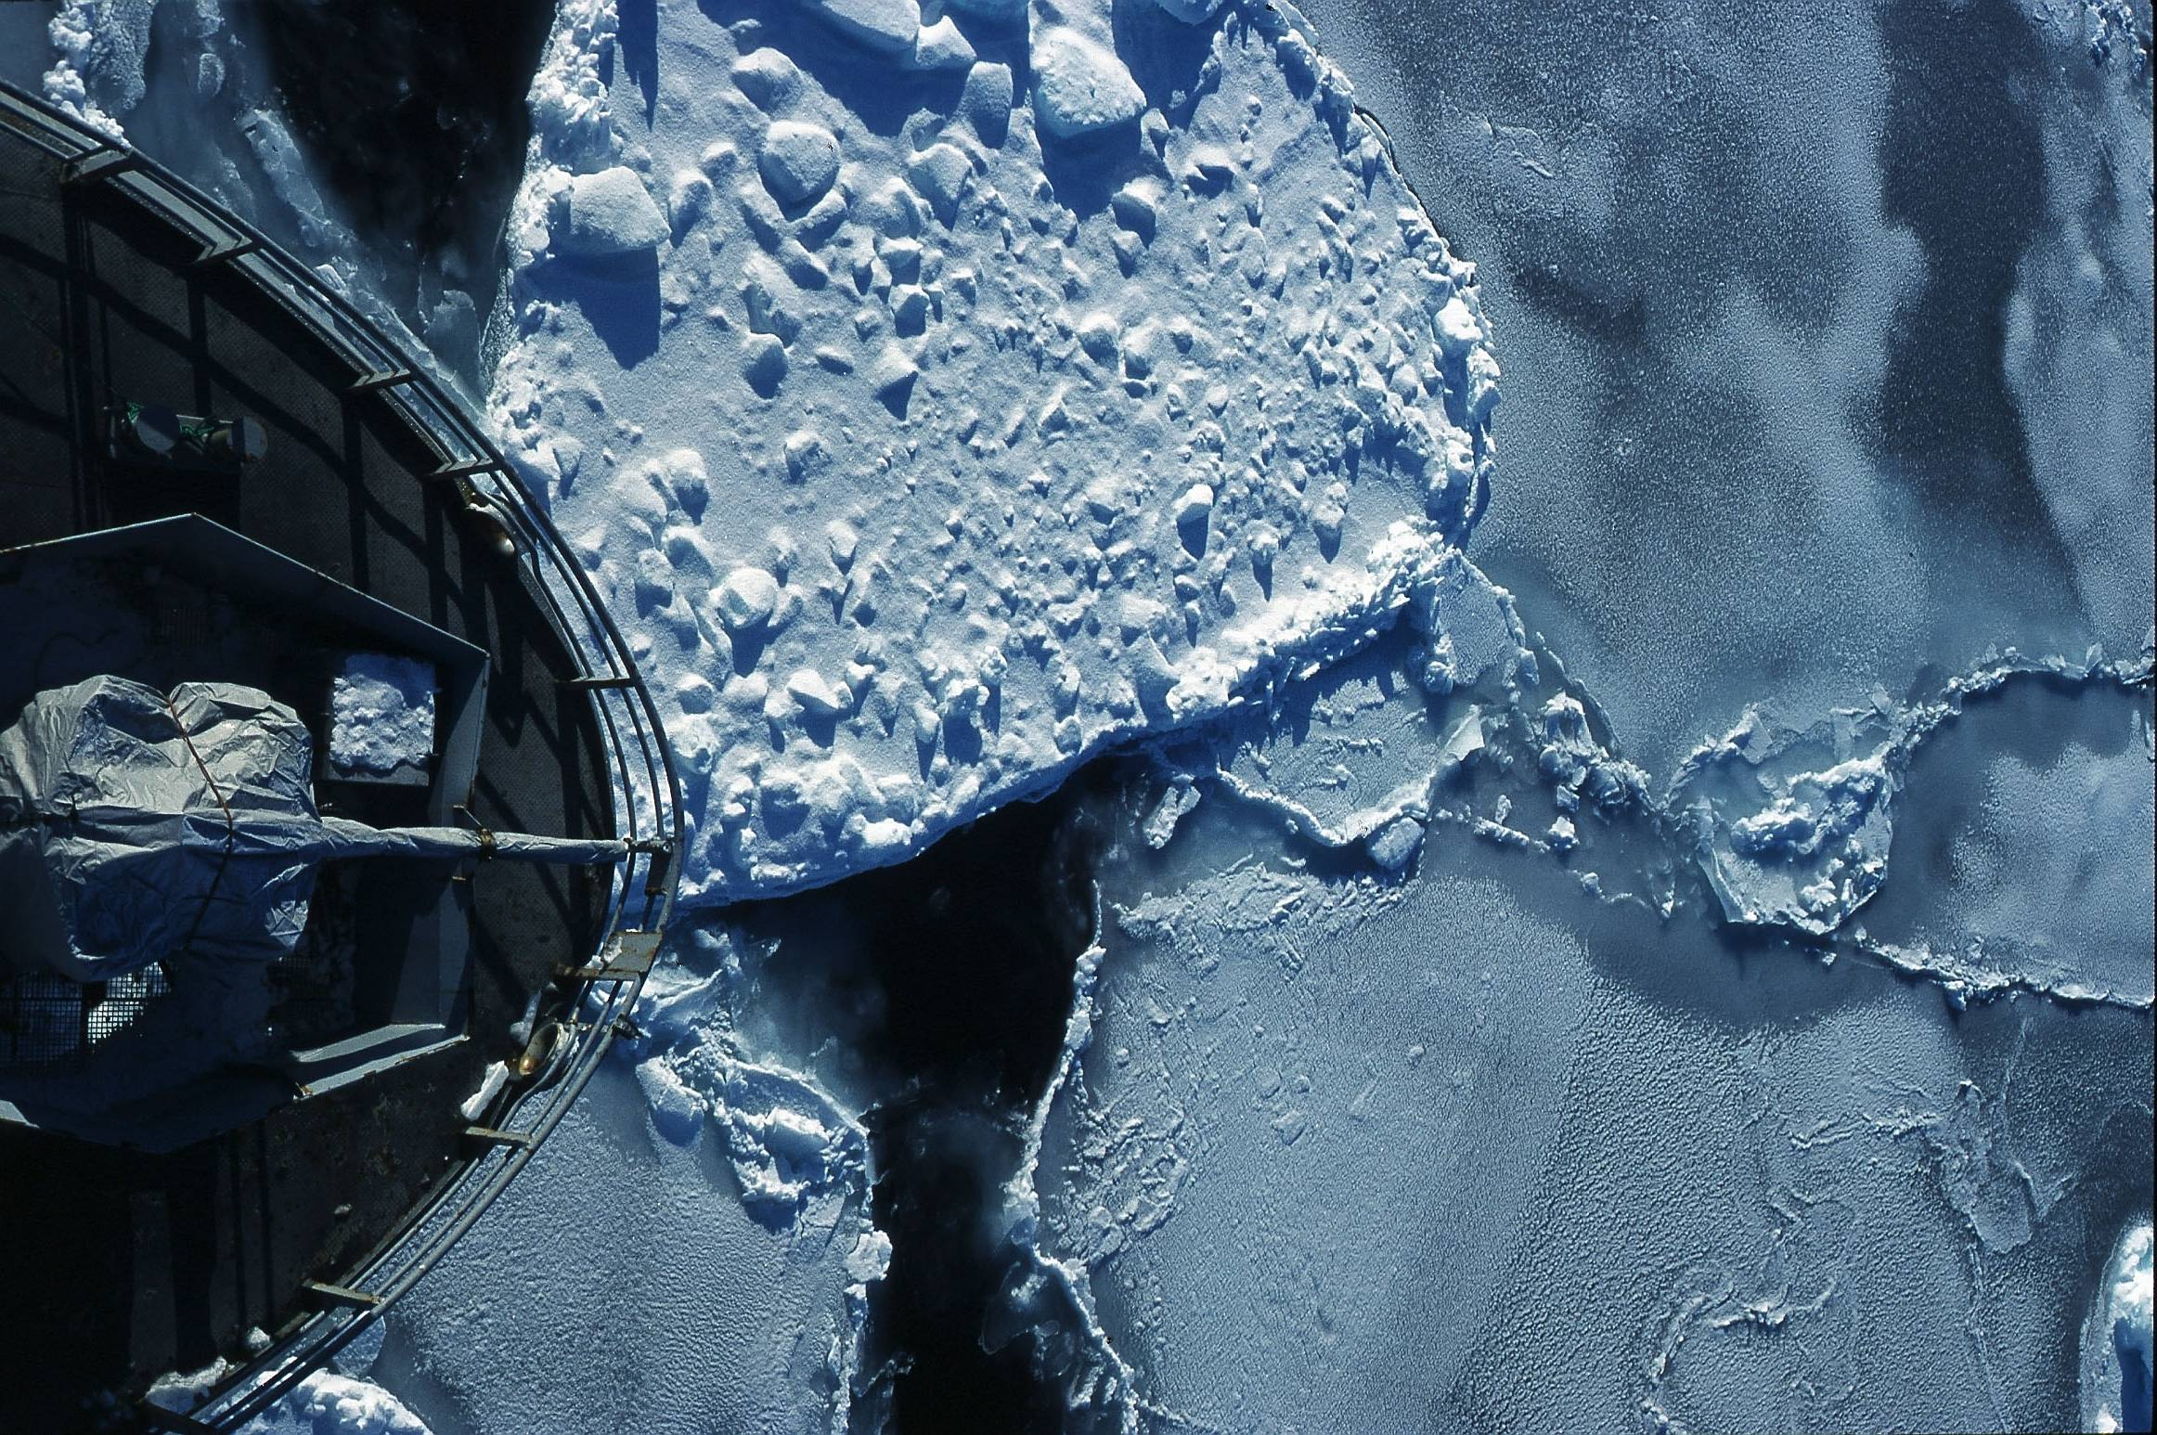



Our cloud usage - and not
Lars Ailo Bongo
(larsab@cs.uit.no)
Photo: Jo Jorem Aarseth

Slide 2

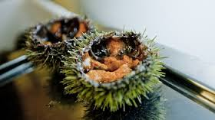
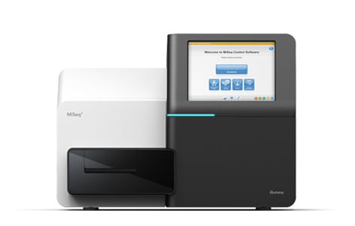
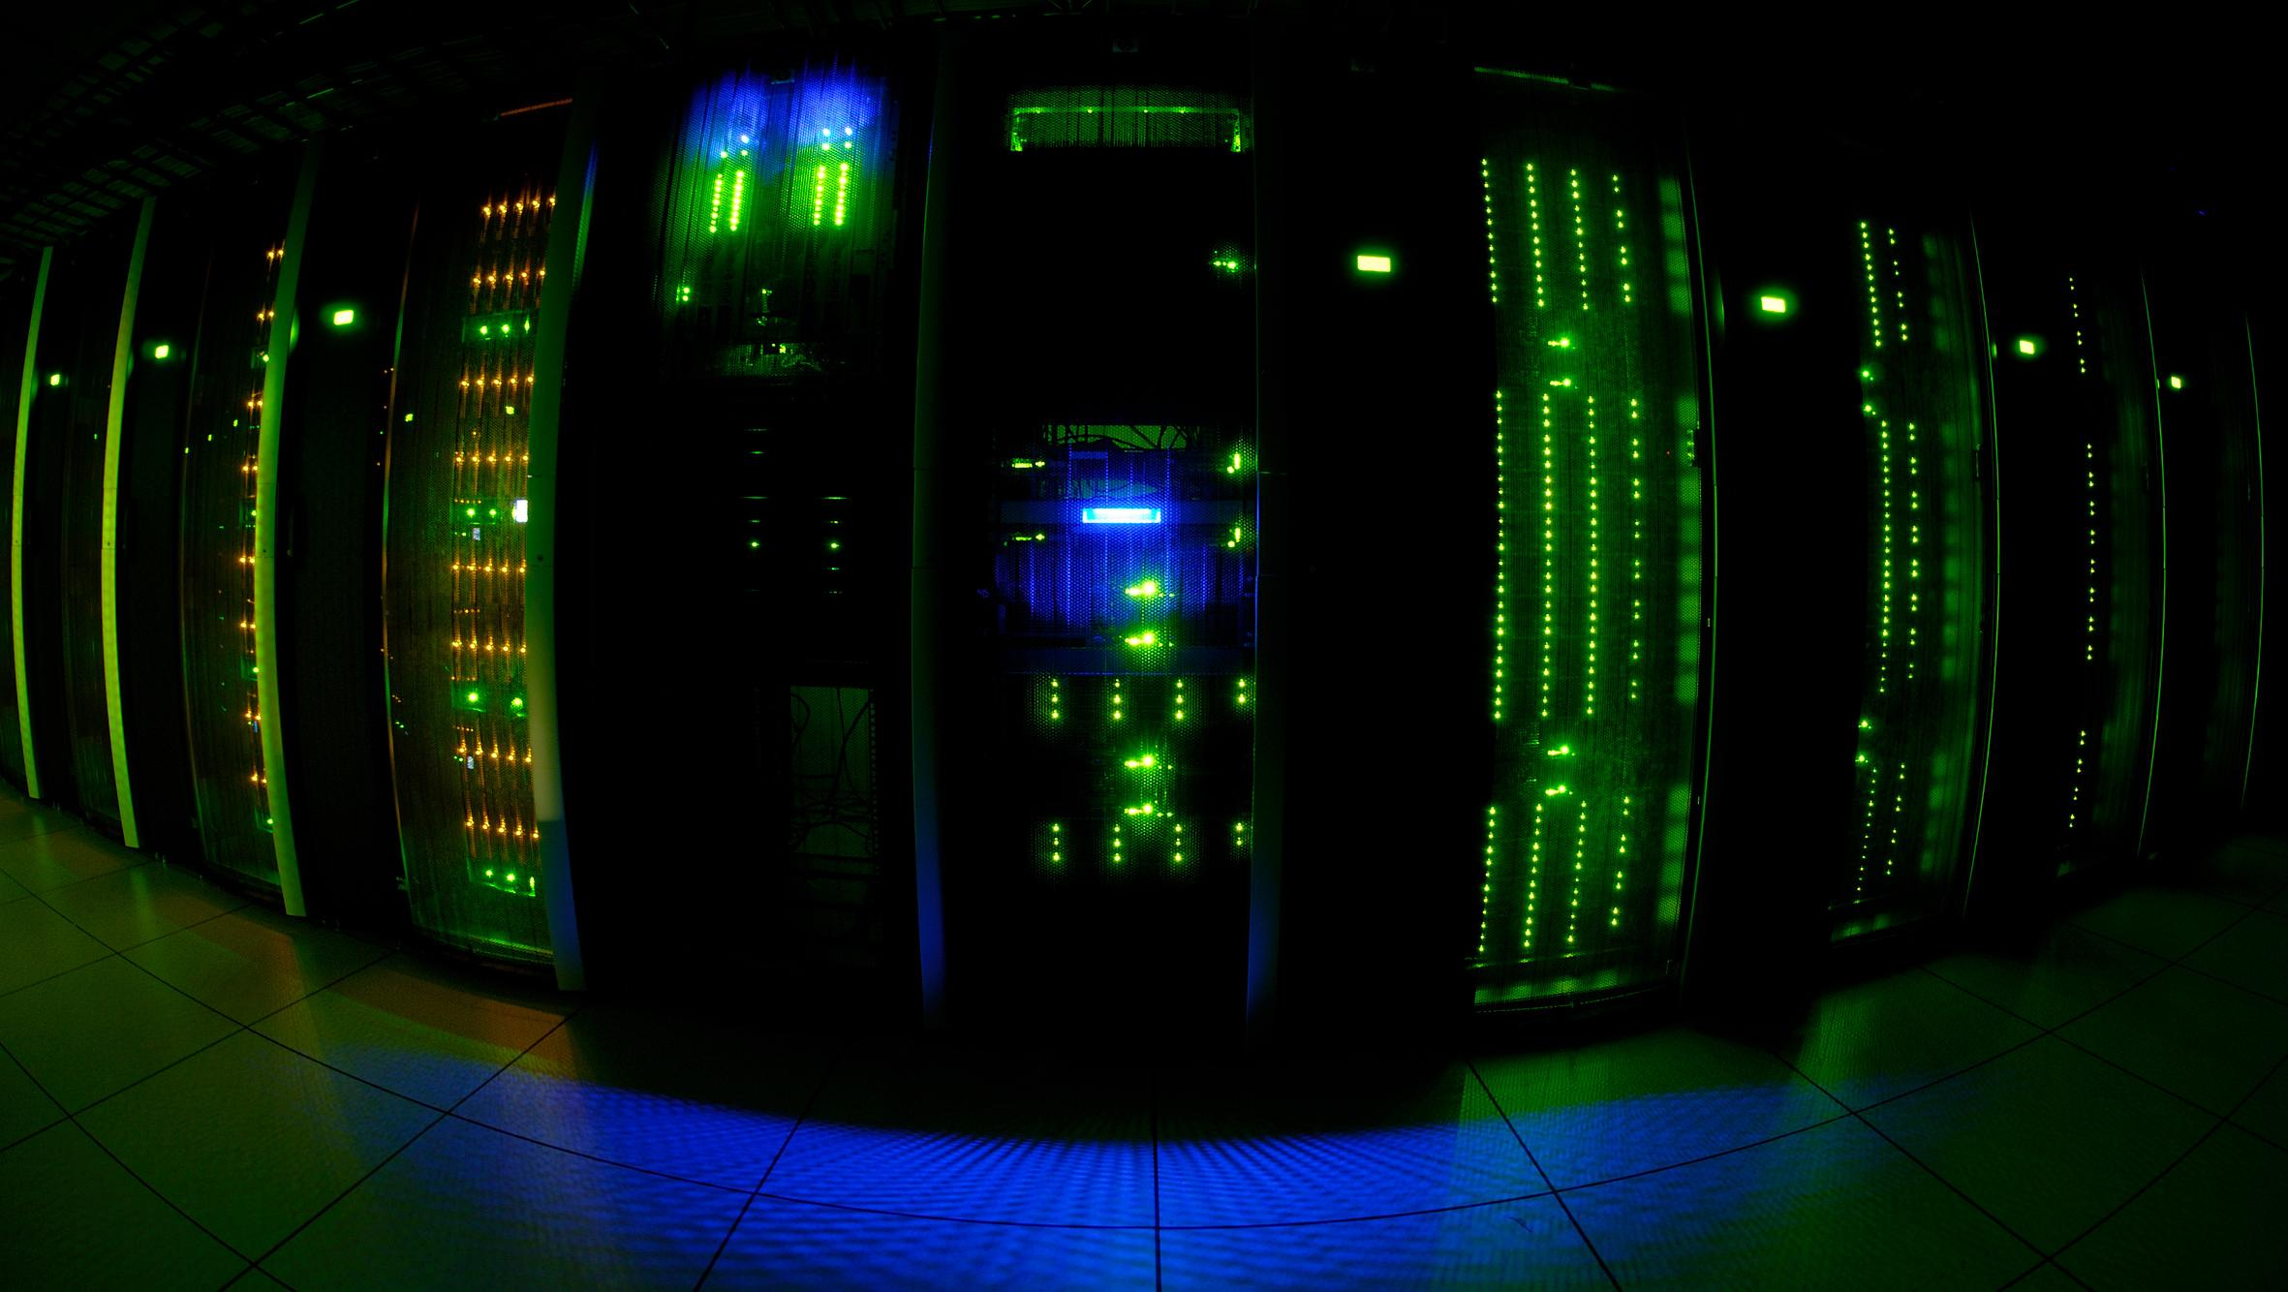
Center for Bioinformatics (SfB)
Interdisciplinary research and services
  Computer science
  Biotechnology
  Bioinformatics
Special focus on marine metagenomics
~15 people
  6 from computer science
http://sfb.cs.uit.no

Slide 3
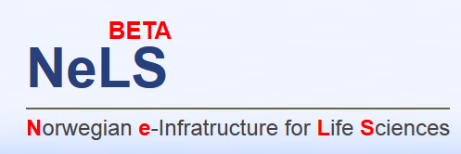
Bioinformatics services for Norwegian users
  Tools
  Pipelines
  Compute resources
  Storage resources (project & archive)
UiT, UiB, UiO, NTNU, NMBU
  UiT participating in all work packages
Financed by NFR Infrastruktur grant
  New grant submitted
https://nels.bioinfo.no/

Slide 4
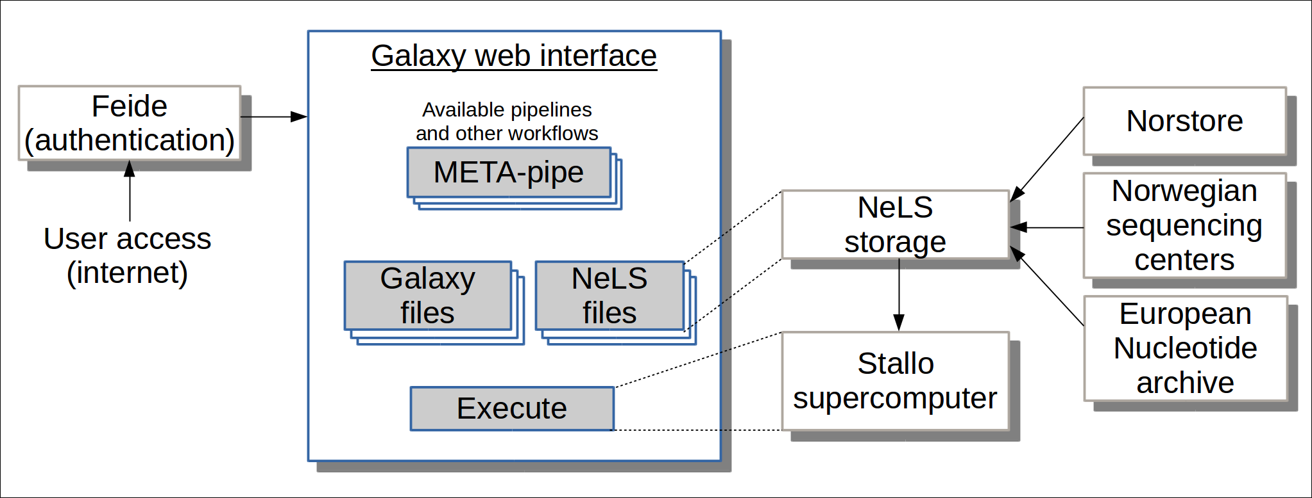
NeLS architecture

Slide 5
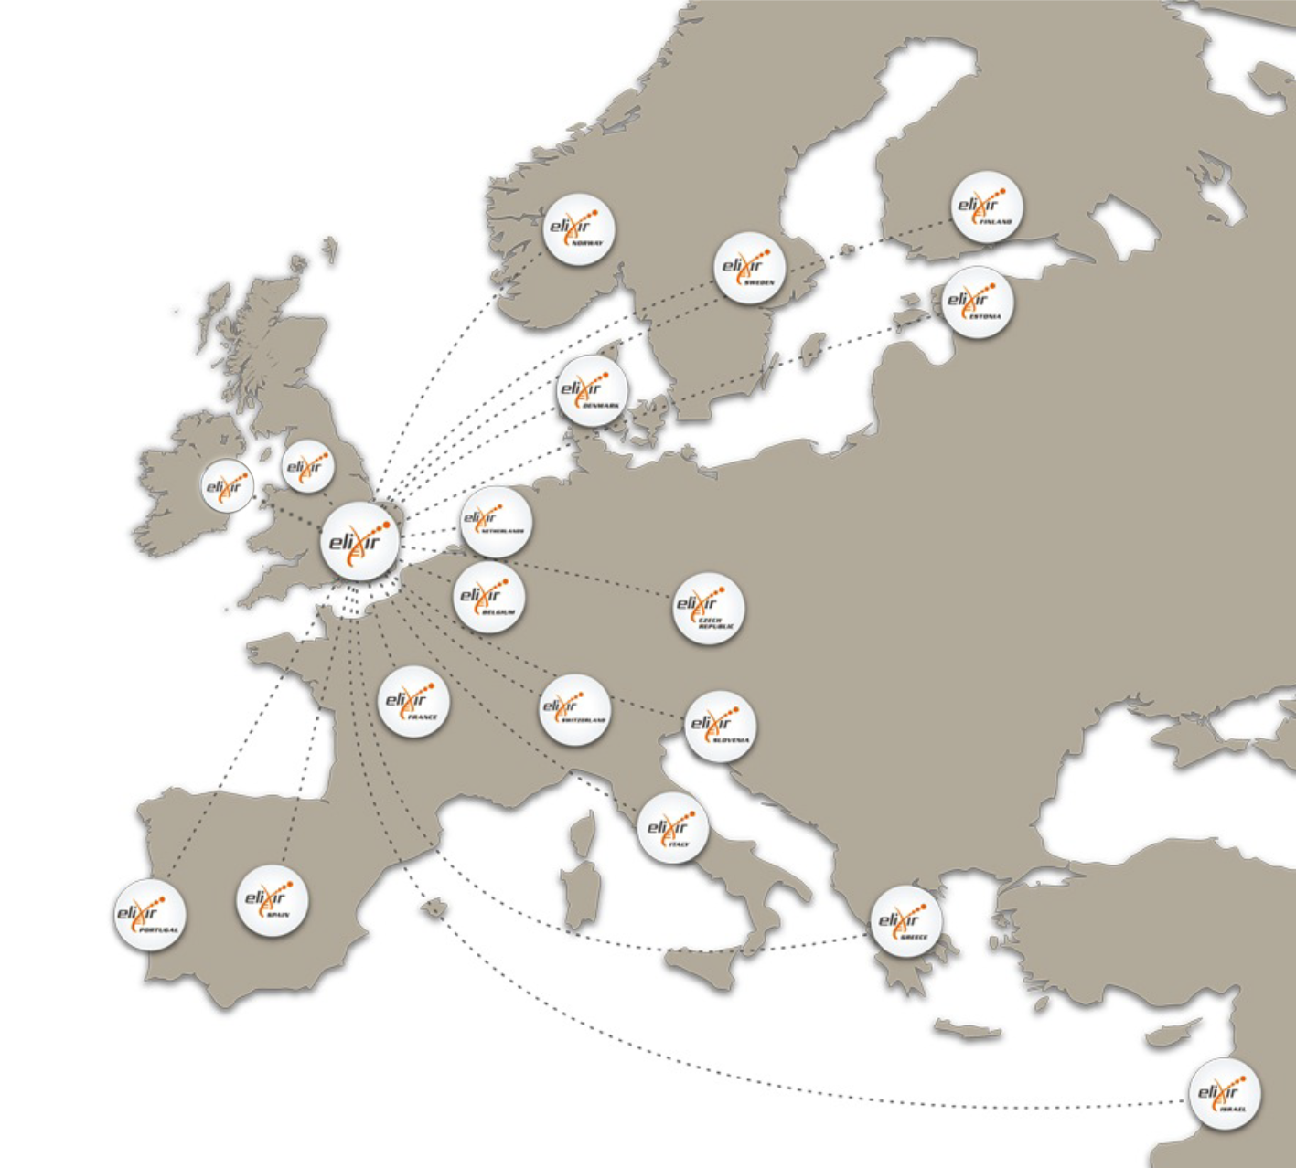









ELIXIR: An international distributed infrastructure for biological data
Technical platforms
Data
Standards
Tools
Compute
Training
User communities
Marine metagenomics
Crop and forest plants
Human data
Rare diseases

Slide 6
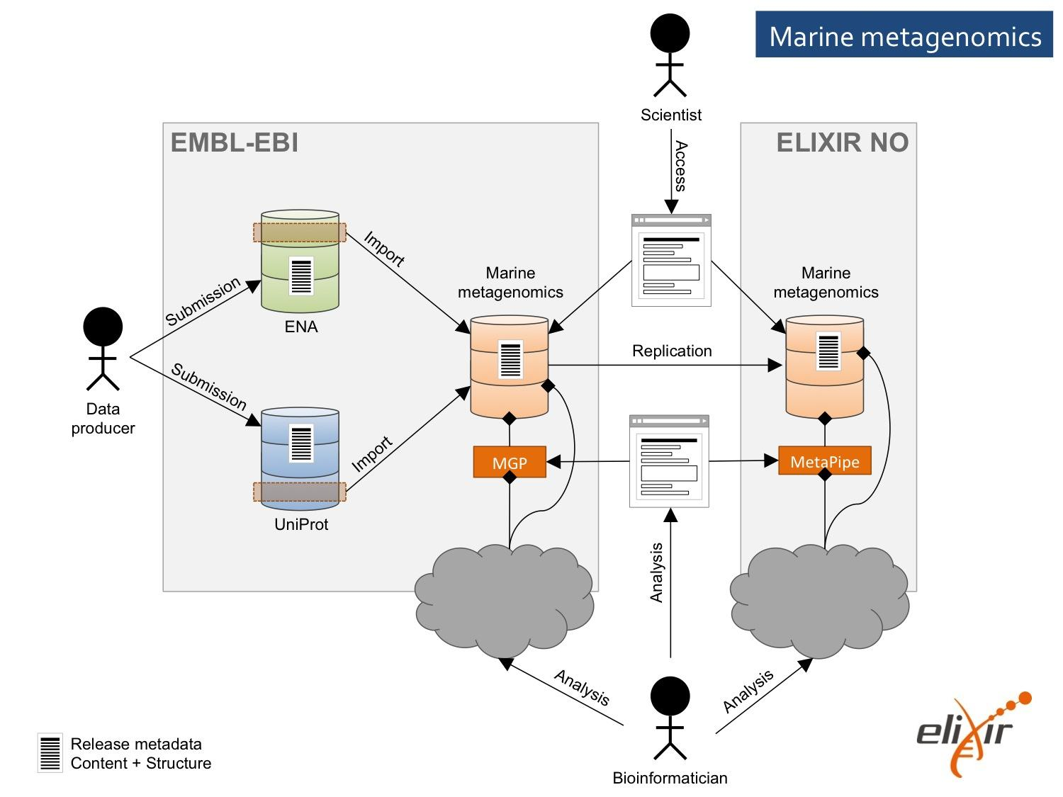
Technical Architecture

Slide 7
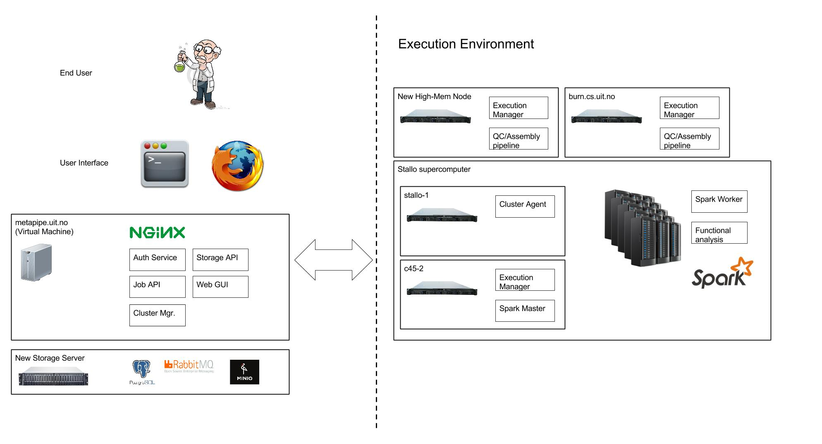
Backend Architecture

Slide 8
Cloud Deployment

Slide 9
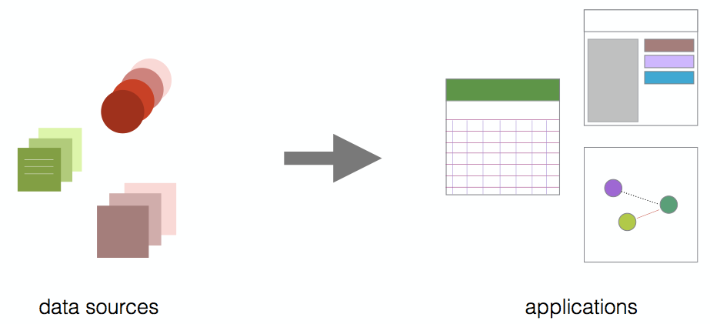
Norwegian Woman and Cancer (NOWAC)
Large and unique biobank of blood samples
Understand development of cancer (and how to avoid it)
Develop diagnosis approaches
Develop or improve treatment
http://site.uit.no/nowac/

Slide 10

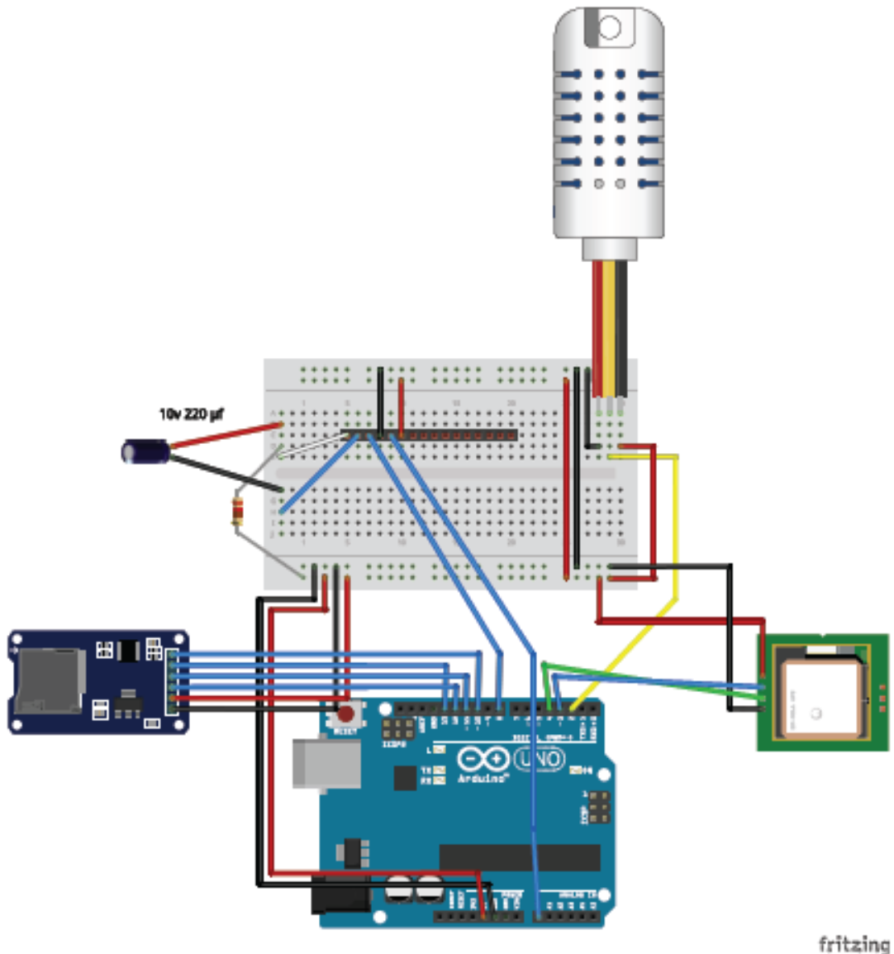
Lung sounds
1000s of recordings (Tromsøundersøkelsen)
Machine learning based classification
Air pollution
Mobile air pollution measurements
Orchestrate crowd sourcing

Slide 11
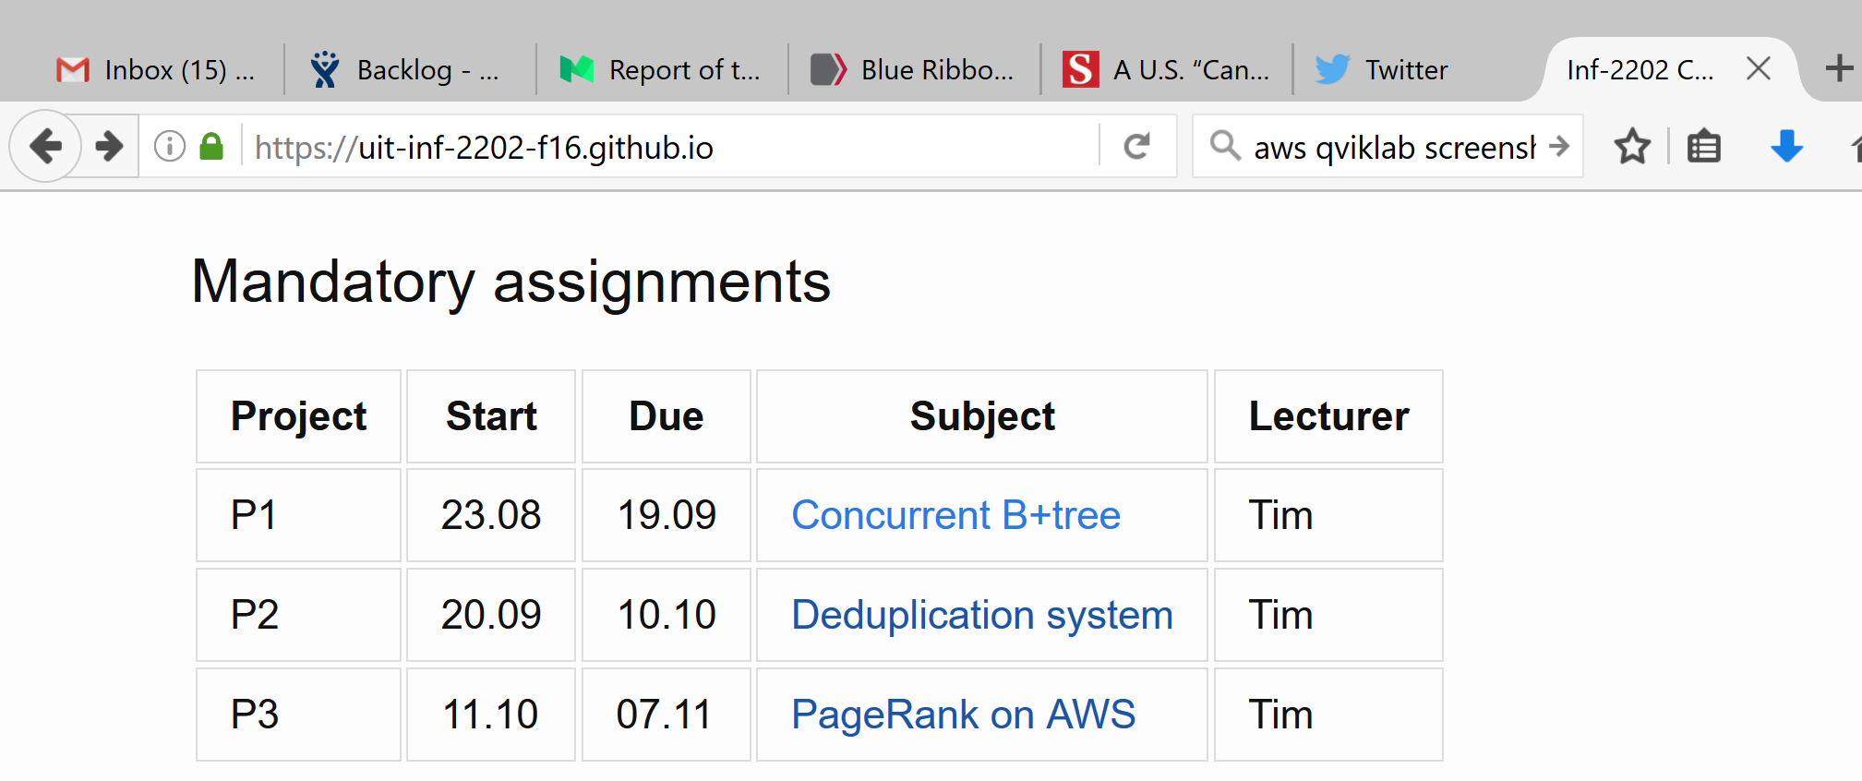
inf-2202

Slide 12
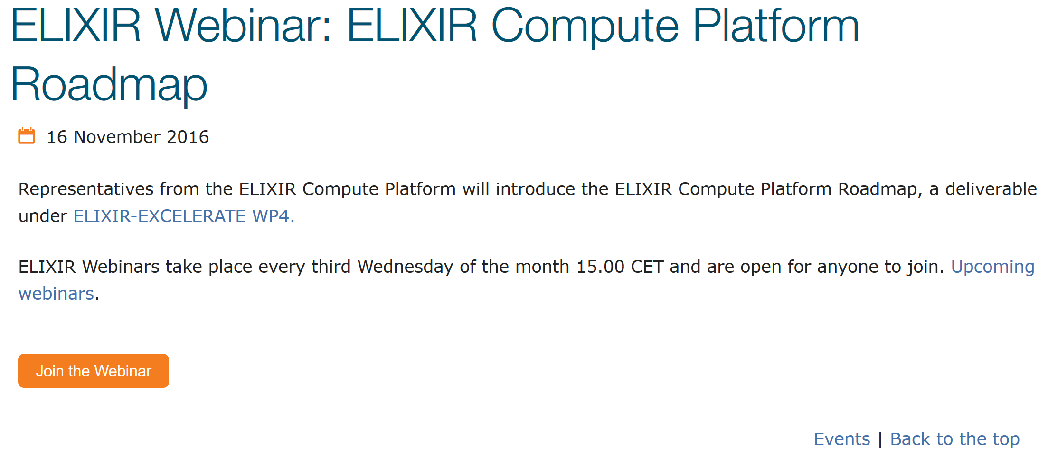
Outreach

Slide 13
Cloud use in our research
Focus: build cloud technologies
Technologies: Hadoop, HBase, Spark, Pachyderm, …
AWS: Scalability evaluation
(Uninett) Kubernetes (or Azure, GCP): Scalable pipelines with built-in data versioning
AWS (or Azure, Tensorflow): Deep learning
Heroku: Data management for air pollution
Github: open source repositories
Google docs: paper writing
Slack: chat
…

Slide 14
Cloud NOT used in our research
Data analyses on data we cannot move out of Stallo
Gitlab for not (yet) open sourced software
SharePoint for paper writing
Developer cluster
  But testing a virtual machine based cluster
Virtual reality

Slide 15
Cloud use in infrastructure development
Focus: deliver data analysis services
Technologies: Spark, OpenStack, AppImage, Jenkins
OpenStack: portable Spark based backend for research clouds
ELIXIR cloud platform: run anlyses
AWS (or Azure, GCP): scalability evaluation
Jenkins: application deployment
Jira: project coordination
Bitbucket: private repositories
Github, slack, Google docs, ….

Slide 16
Cloud NOT used in infrastructure development
Stallo backend
Servers
Data storage
De-novo assembly

Slide 17
Cloud use in teaching
Focus: computer science education
Technologies: Spark, Docker, Tensorflow, …
GitHub and GitHub Classroom: course materials
AWS Education: big data analysis in an undergraduate course

Slide 18
Cloud NOT used in teaching
“In person” activities
Developer machines
All but one course
Digital exam?
Mailing lists

Slide 19
Cloud use in outreach
We just created a Twitter account
Webinars in youtube
Lær kidsa å kode activities

Slide 20
Cloud NOT used in outreach
“In person” activities
Webpage hosted locally

Slide 21
Summary
Cloud in research:
  Must in computer science
  Need in life science
Cloud in life science analysis services:
  Must to provide a good service
  Easier to develop and maintain services
Cloud in teaching:
  Should for computer science
  Should for other courses
Cloud in outreach
  Must and should

Slide 22
Summary - Issues
Who can develop the services?
Who pays for the use of services?
How to overcome cloud skepticism?
Research vs. other usage?
Ethical, legal, and political problems

Slide 23
The Team
NOWAC
  Einar Holsbø
  (PhD student)
  Bjørn Fjukstad
  (PhD student)
  Morten Grønnesby,
  (PhD student)
Lung sounds, and others
  Johan Ravn (master student)
  Frode Opdahl (master student)
  Nina Angelvik (master student)
Center for Bioinformatics (SfB)
  Edvard Pedersen
  (PhD student)
  Espen Robertsen
  (PhD student)
  Inge Alexander Raknes (engineer)
  Giacomo Tartari (engineer)
  Aleksandr Agafonov (engineer)
  Jon Ivar Kristiansen (system administrator)

