Slide 1
META-pipe
Architecture and design

Slide 2
Outline
Architecture
Authorization Server
Background: Spark
What happens when a user submits a job?
Failure handling

Slide 3
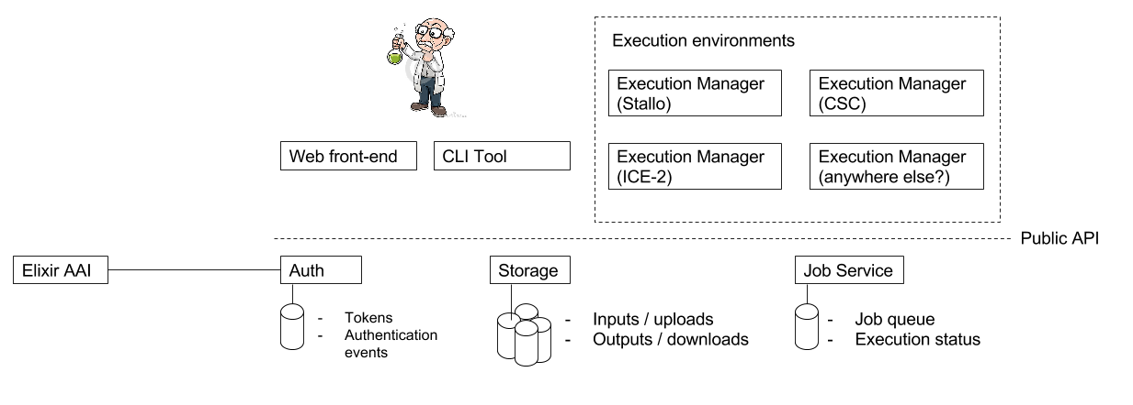
Architecture

Slide 4
authorization server
AAI: SAML/OAuth2.0 Integration

Slide 5
Overview

Slide 6
Authorization server
Features
Techonologies
SAML 2.0 integration designed for the Elixir AAI
OAuth 2.0
Implicit flow
Authorization code grant
Client Credentials (special clients only)
Bearer Token introspection
OIDC UserInfo-endpoint
Mapping table between internal user IDs and remote use IDs at the IdP
Simple authorization based on uri-prefix
storage/users/alex authorizes storage/users/alex/test.txt
YAML-based configuration
Dropwizard web framework
Apache Oltu OAuth library
Spring Security SAML
Hibernate ORM
PostgreSQL

Slide 7
Background: Spark

Slide 8
Spark
“Apache Spark is a fast and general engine for large-scale data processing” - Spark Website
Provides interactive response times to large amounts of data
Written in Scala, but can also be used from Java python Python and R
Fault tolerant

Slide 9
RDD - Overview
Immutable representation of a dataset
Deterministic instantiation and transformation
Distributed (partitions)
Instantiated by
transforming another RDD
from an input source, like a file on HDFS
Computation close to the data
Fault tolerant (based on lineage)

Slide 10
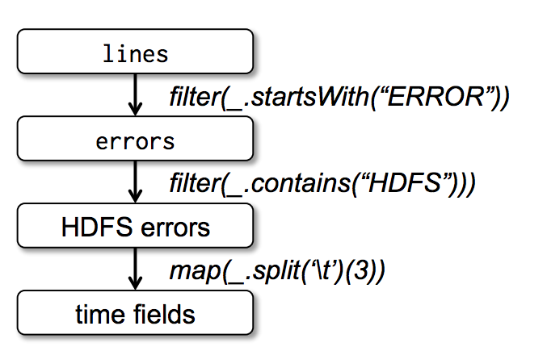
RDD - Example
val lines = spark.textFile("hdfs://...")
val errors = lines.filter(_.startsWith("ERROR"))
errors.persist()
// Returns Seq[String]
errors.filter(_.contains("HDFS"))
.map(_.split('\t')(3))
.collect()
(taken from Spark paper)
Notes:
Function serialization

Slide 11
RDD – Transformations and actions
Method | Signature
map(f: T => U) | RDD[T] => RDD[U]
filter(f: T => Bool) | RDD[T] => RDD[T]
groupByKey() | RDD[(K, V)] => RDD[(K, Seq[V])]
join() | (RDD[K,V],RDD[K,W]) => RDD[(K, (V, W))]
partitionBy(p: Partitioner[K]) | RDD[(K, V)] => RDD[(K, V)]
Method | Signature
count() | RDD[T] => Long
collect() | RDD[T] => Seq[T]
reduce(f: (T, T) => T) | RDD[T] => T
save(path: String) | Outputs RDD to a storage system, e.g., HDFS, Amazon S3

Slide 12
submitting a job

Slide 13
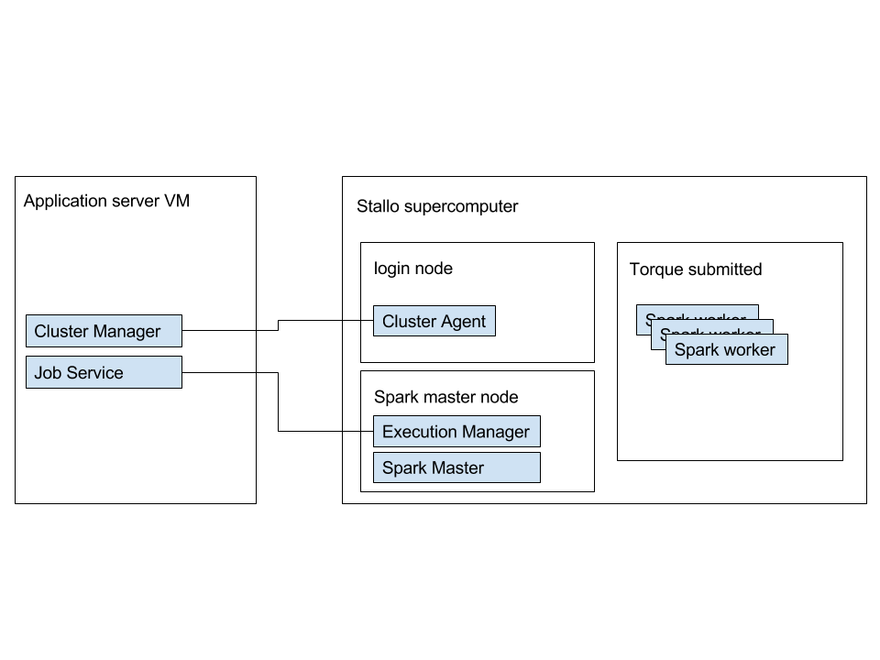
Spark on Stallo

Slide 14
JobService
Service that sits between user interface and execution backend
Isolates back-end errors from the end user
Keeps track of:
Which jobs (with parameters) have been submitted by which users
References to input- and output datasets
Different attempts to run a job (retries)

Slide 15
Job service workflow

Slide 16
Causes for failure
Systems becoming unavailable
Stallo reboot
Shared file system unavailable
Power outage
Administration
Re-deployment of META-pipe (new version, tool update)
Reboot of Spark cluster after configuration update
Bugs
Tool parser errors
Unexpected exceptions
Invalid input
The FASTQ file turned out be a video file. How to recover?

Slide 17
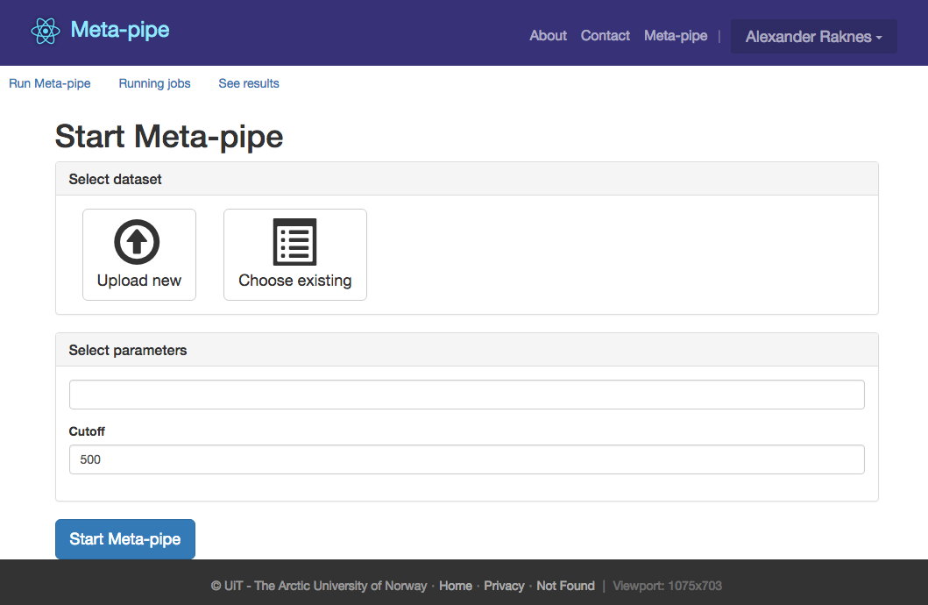
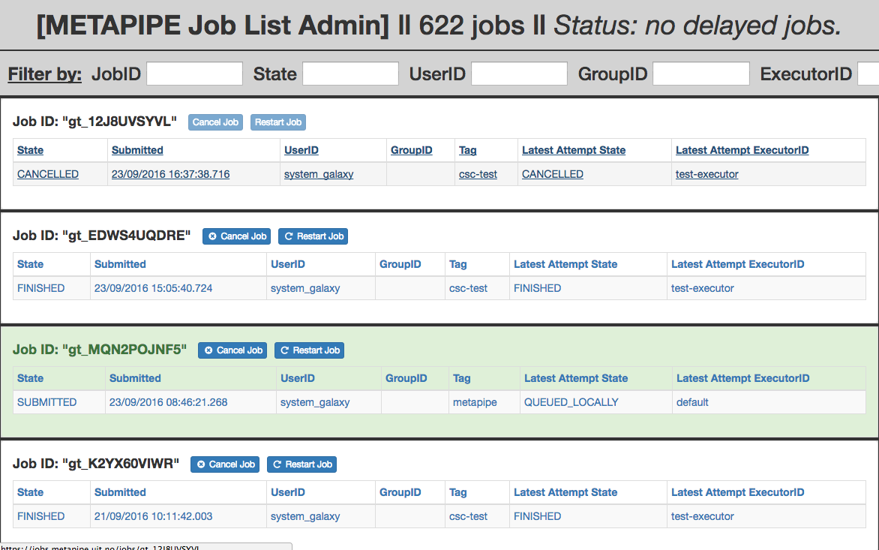
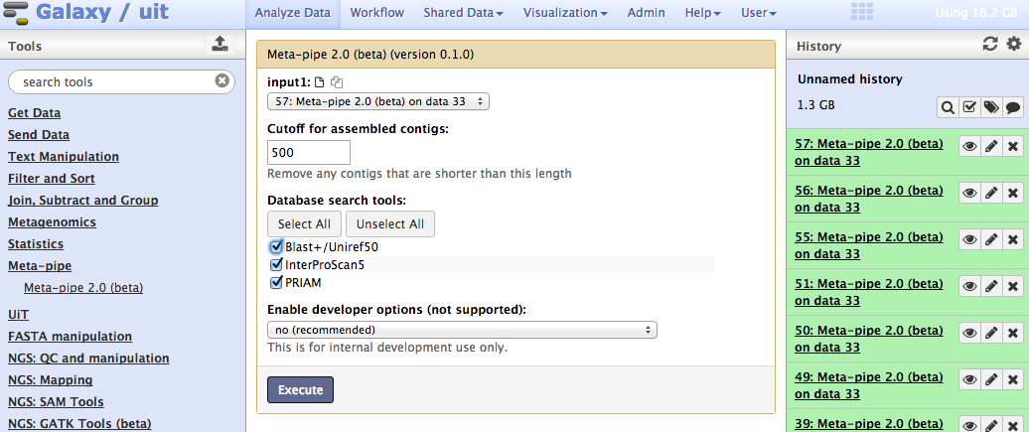
User Interfaces

Slide 18
User submits a job

Slide 21
Submitting in a new process
qsub
spark-submit (cluster mode)
VM creation

Slide 23
Snapshotting
Spark tool RDDs are dumped to disk when computed
Simple if-test to see if a tool has already run

Slide 24
Challenges (TODO)
Automatic scaling based on queue size
Monitoring and logging
Big Data

