Slide 1
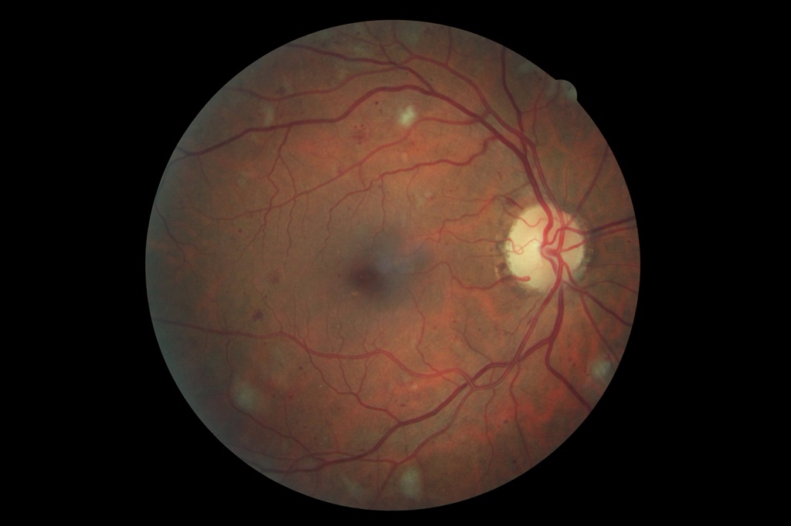
Diabetic retinopathy detection on Titan GPUs
Mike Voets, Lars Ailo Bongo,
Department of Computer Science
(larsab@cs.uit.no)
Faggruppe for Skyteknologi, Trondheim, 23.11.17

Slide 2
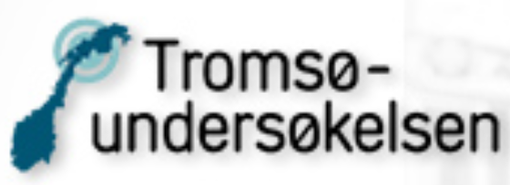
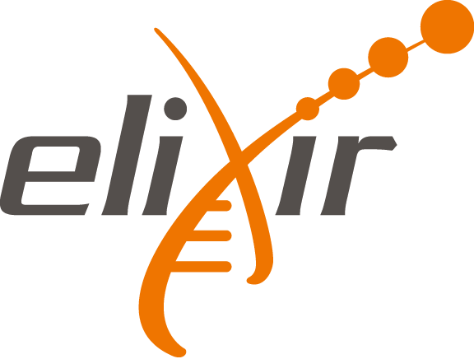
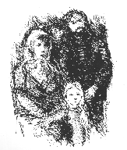
Machine learning @ BDPS lab (UiT)
Our main expertise is systems engineering
Distributed systems, parallel programming
“Big data”
Many interdisciplinary projects
Machine learning projects:
Abnormal lung sound detection
Breast cancer metastasis prediction (NOWAC)
Taxonomic classification of bacteria
Handwritten census data transcription
(Mammogram analysis)
Diabetic retinopathy detection
http://bdps.cs.uit.no/

Slide 3
End-to-end data analysis for accessible cancer diagnosis tests
Forskningsrådet’s IKTPLUSS program
2-phase projects; phase 1 financed
Objectives:
Provide cheap blood based breast cancer diagnosis test.
Deliver platform for cheap, portable, and secure bioinformatics analyses.
Deliver system for integrating functional genomics data with medical images.
Deliver ethical guidelines for use of functional genomics tests in Norway.
Demonstrate how the technologies can be used to implement a blood + image test for Norwegian breast cancer screening.

Slide 4
Breast cancer and retina images?
Phase 1 objective:
Provide a pilot study implementation of diabetic retinopathy screening detection using published methods, images from Salauno, and cloud resources at Sigma2
Focus is on technology development and evaluation.
Retina images instead of mammograms since there is a large public dataset and there are published methods.
Same approaches and technologies as for mammogram analysis.
Cloud resources: Sigma2 deep learning cluster with 4x Titan X GPUs
Started as small project with Salauno company
Notes:
See. Live. Transform.

Slide 5
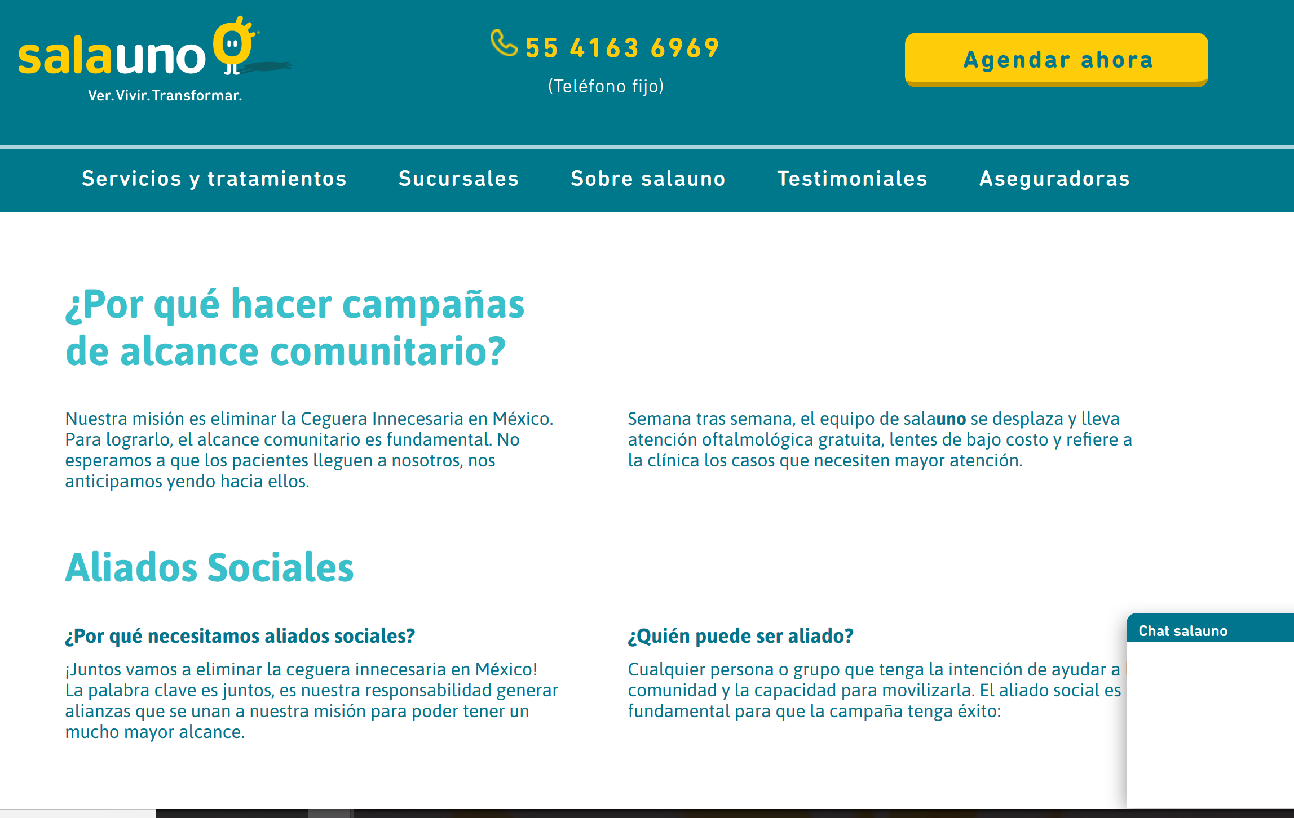

Slide 6
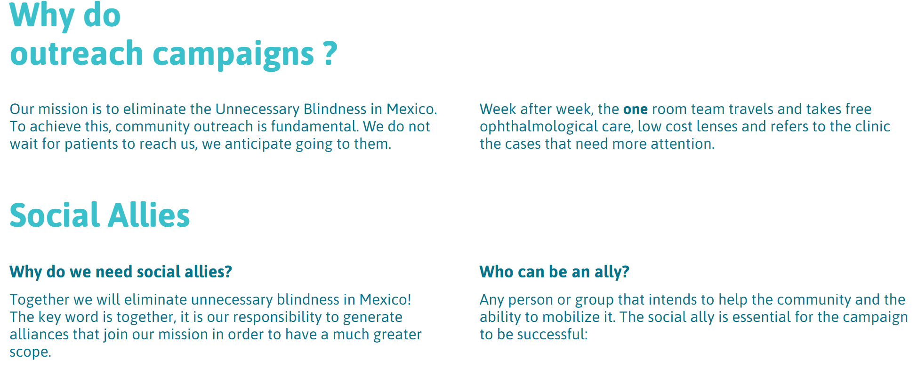
Google translated

Slide 7
Outline
Background:
Deep learning for medical images
Solutions for scalable computation
Case study: diabetic retinopathy detection
Future cloud and resource needs

Slide 8
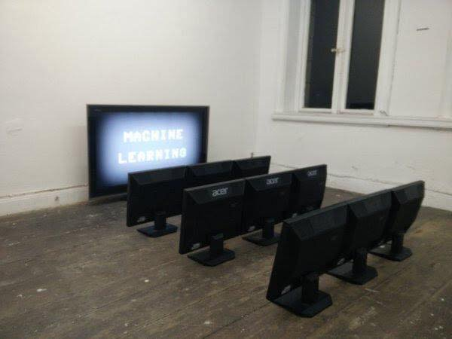
Machine learning

Slide 9
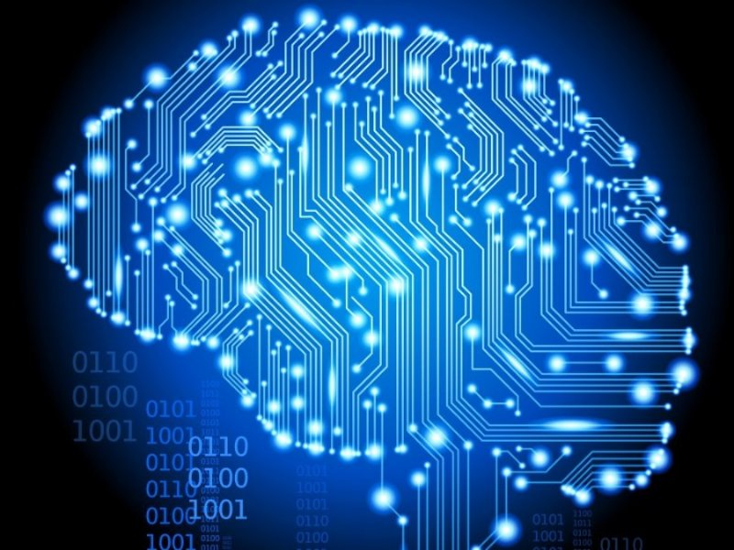
Deep learning
Deep learning
learning based on deep neural networks
popular solution to complex learning problems
machine learning – feature engineering
lots of data + neural networks + lots of computing
Researched by companies: Deepmind, Google, Facebook, OpenAI, Baidu, Microsoft, Apple, IBM, … and most most universities
Many computer applications

Slide 10
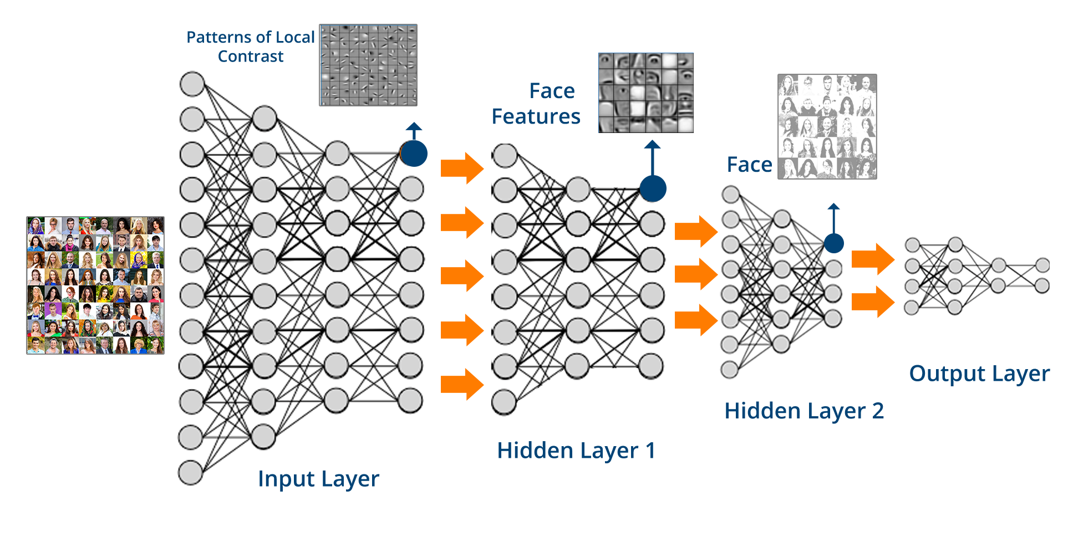
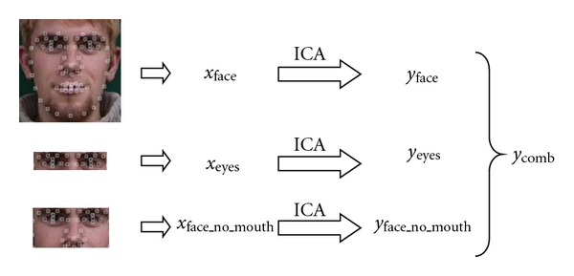
Deep learning
Image from: https://www.edureka.co/blog/what-is-deep-learning
Notes:
Useful introduction to deep learning: https://www.edureka.co/blog/what-is-deep-learning

Slide 11
Example: cat videos
Notes:
Google example
Unsupervised learning
Systems + machine learning

Slide 12
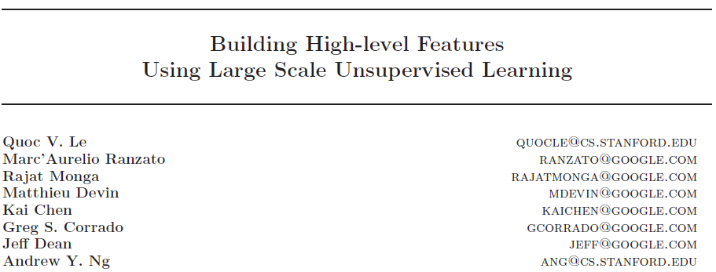
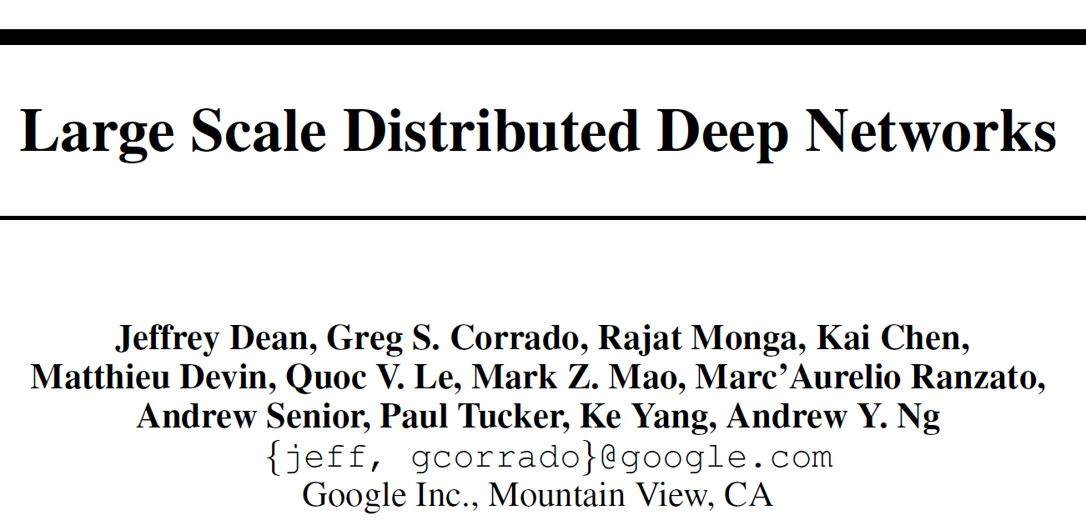
Cat videos
DistBelief (2012)
10M unlabeled images
1.7B connections
16.000 CPU cores
3 day training time

Slide 13
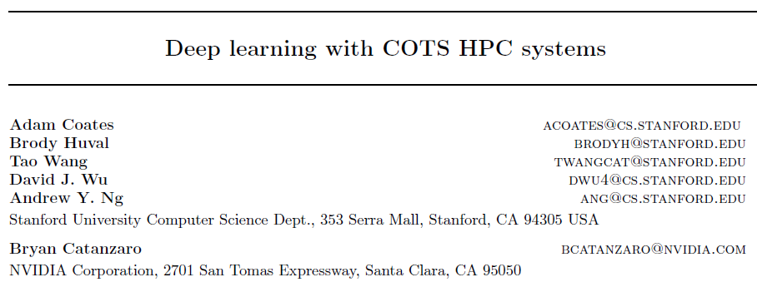
GPUs
2013 paper
DistBelief on 3 servers with 4 GTX680 GPUs
GTX680: 3.1TFLOPS; 192 GB/s memory bandwidth
GTX1080: 8.9TFLOPS; 320 GB/s.
Titan X: 11TFLOPS; 480 GB/s
11B parameters on 16 x 4 GPUs
Notes:
http://www.cs.stanford.edu/~acoates/papers/CoatesHuvalWangWuNgCatanzaro_icml2013.pdf

Slide 14
Tensorflow
Software tool/library for numerical computations
Designed for building machine learning models, i.e. deep learning models
Originally developed by engineers and developers at Google
Currently most popular machine learning framework

Slide 15
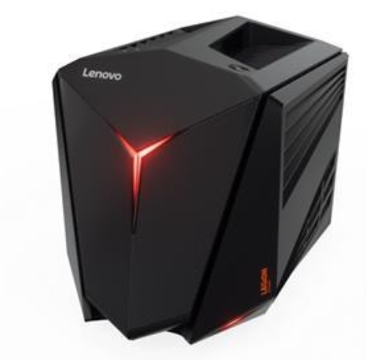
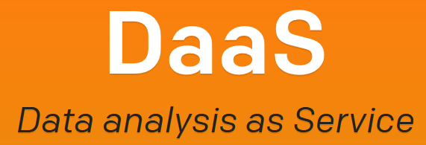
GPUs, Clouds, FPGAs, TPUs
(Nvidia K80)
Gaming PC w. GTX1080 19.000
Notes:
GTX1080
Cloud
Sigma2 cluster
Tensorflow

Slide 16
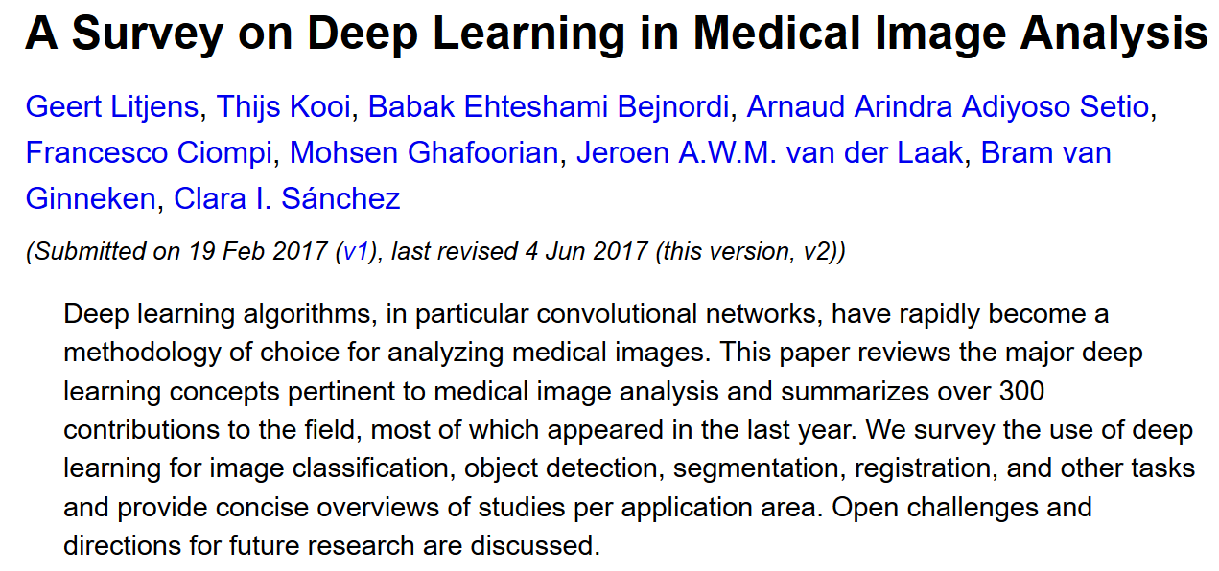
Notes:
https://arxiv.org/abs/1702.05747
Opportunities
Research interest
How they differ vs non-medical images

Slide 17
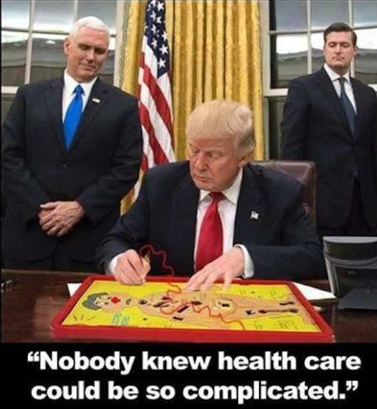
Medical image analysis challenges
Getting data
Data sensitivity
Class imbalance
Weak signal
Interpretation and validation
Consequence of errors
Deployment (clinical trials)
…

Slide 18
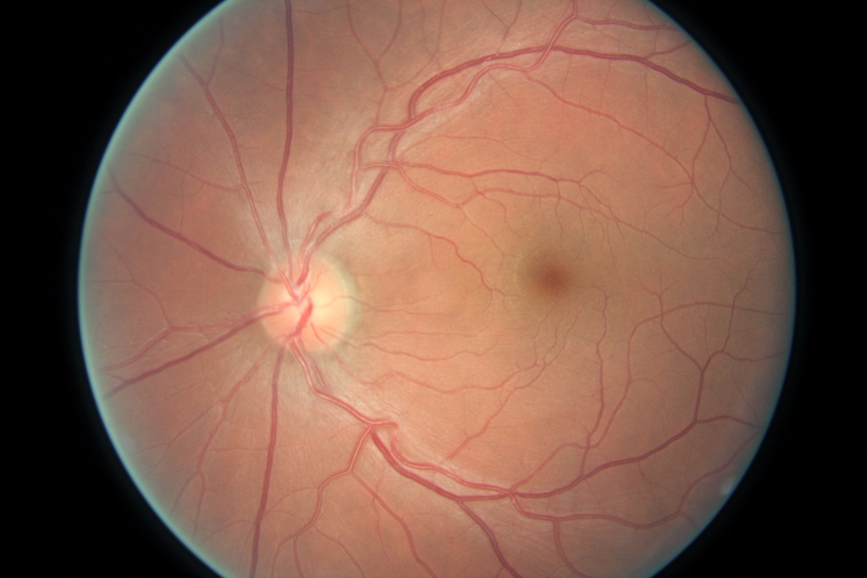
Example: diabetic retinopathy analysis
Diabetic retinopathy (DR) an increasing problem due to more diabetes
Blood vessels in eyes reveal diabetes (and other health conditions)
DR analyzing retinal fundus images is a repetitive job
Machine learning to predict DR
Train an algorithm by a given retina data set in order to predict DR
Severe diabetic retinopathy
Normal

Slide 19
Example: diabetic retinopathy

Slide 20
Kaggle
Platform for predictive modeling and analytics competitions
Anyone can participate with the goal of producing the best predictive models
Data sets are made available through Kaggle
Diabetic retinopathy competition closed 2 years ago
No 1 performer achieved score of 0.86 (quadratic weighted kappa)
EyePacs retina data set available through Kaggle
88.700 images
5 grades

Slide 21
Google method (JAMA 2016)
Predictive model for retinal fundus data sets
Used EyePacs data set + 34K additional images
Neural network optimized for image classification (deep convolutional network)
128K images, graded 3 – 7 times by licensed ophthalmologist
Distributed stochastic gradient descent implementation (“DistBelief”)
No source code
Results:
Human level accuracy
High specificity setting: 98.1% (90.3% sensitivity) (EyePacs-1)
High sensitivity setting: 97.5% (93.4% specificity) (EyePacs-1)
Result validated by 7 US board-certified ophthalmologists

Slide 22
Our research
Goal: replicate JAMA 2016 results using Kaggle data
EyePacs data set
88.700 images from Kaggle
5 grades
Slightly unbalanced data set: 75% are normal
Realistic: varying image quality, noise, and out of focus
Preprocessing: centering, scaling and normalizing
Further development and analysis in progress
Preliminary results
Specificity: 85%, sensitivity 72%
(vs. (98%, 90%) & (93%, 98%))

Slide 23
Our implementation
Tensorflow, Sklearn, Keras, hyperopt, Matplotlib, PIL
JAMA article’s model and results:
Deep convolutional neural network based on network optimized for image classification
InceptionV3 with weight parameters from training on ImageNet data set
Some important details are missing!
Computation:
Nvidia Geforce GTX1080 GPU
Sigma cluster: 4 Nvidia Titan X GPUs available
Training time: days (GTX1080)
No speedup on Titans…looking into it
Prediction time: 10 ms per retinal image

Slide 24
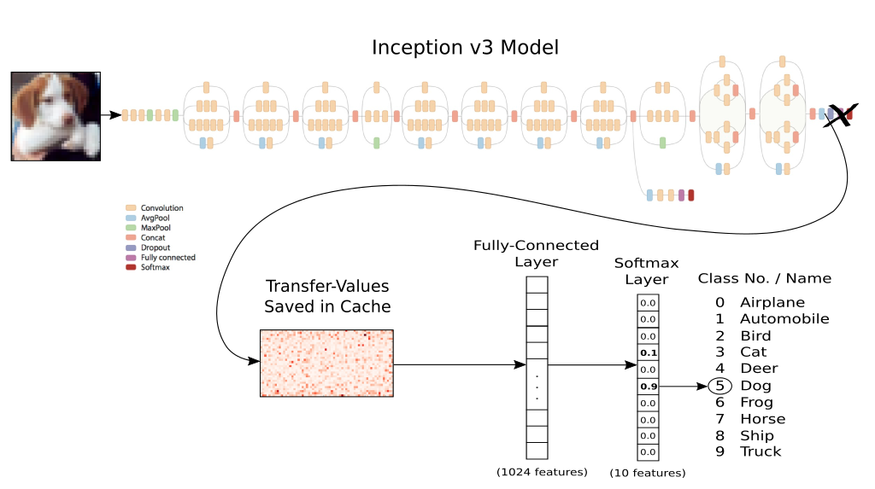
Our implementation (transfer learning)

Slide 25
Medical image analysis: data management and analysis challenges
PC
Easy
Not scalable; data management up to user
Commercial cloud
Cheap and powerful
Data management up to user
Academic resource
Scalable
Data management taken care of
Sensitive data service
Cumbersome
Secure data management

Slide 26
Medical image analysis: data management and analysis challenges
Download from Internet
Not sensitive
Use easiest/ cheapest solution
Get from a guy in Mexico
Different data regulations in Norway vs Mexico
May be tied to a cloud solution
Get from a Norwegian researcher
May be sensitive
May have to use secure storage and processing services
May not be allowed to move data out of institution/ country
Beg for data from a hospital
Sensitive, but can be anonymized
May not be allowed get copy of data
Move computation to data?

Slide 27
Data management and analysis challenges
many studies with varying needs (sensitivity, scale…)
commercial use of Tromsøundersøkelsen data
NOWAC: technological changes make data sensitive
provide resources for European users
big data (several millions of images)
data anonymization & permission management
integration with commercial services (EHR, AI, …)

Slide 28
Conclusions
Deep learning for medical image analysis very hot topic
Lost of data…but not necessarily available
More compute (usually) gives better results
Diabetic retinopathy detection:
Challenging to replicate JAMA article’s model due to lacking details about preprocessing retina data set
Preprocessing the data set is 90% of the work!
Compute needs is for training
Erfaringer med bruk av Sigma-cluster med Titans
God: enkel å bruke, god support, bra setup
Men ikke klar enda til å utnytte for fullt

