Slide 1
Challenges and approaches for providing a pipeline as a service
Lars Ailo Bongo (ELIXIR-NO)

Slide 2
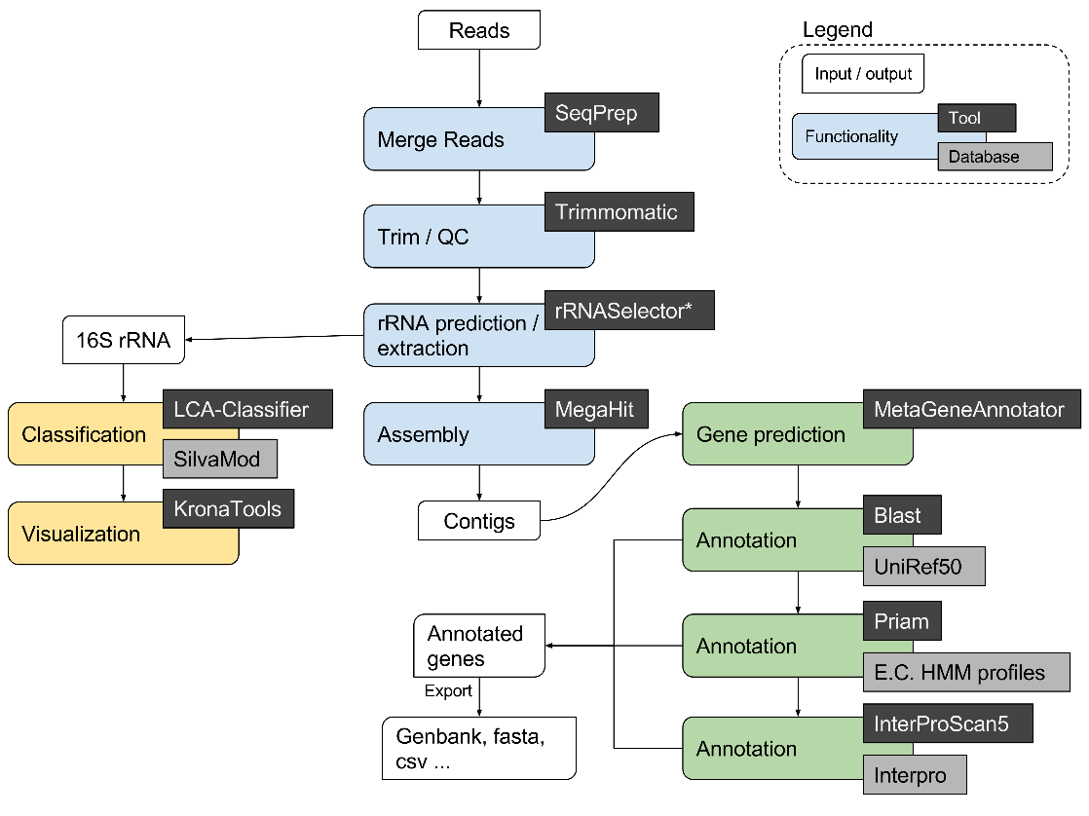
META-pipe: marine metagenomics analysis pipeline
2 as-a-service interfaces:
  Galaxy interface for Norwegian users (since 2015)
  Web app interface (to be released in 2017)
Compute intensive
Small team
Academic setting

Slide 3
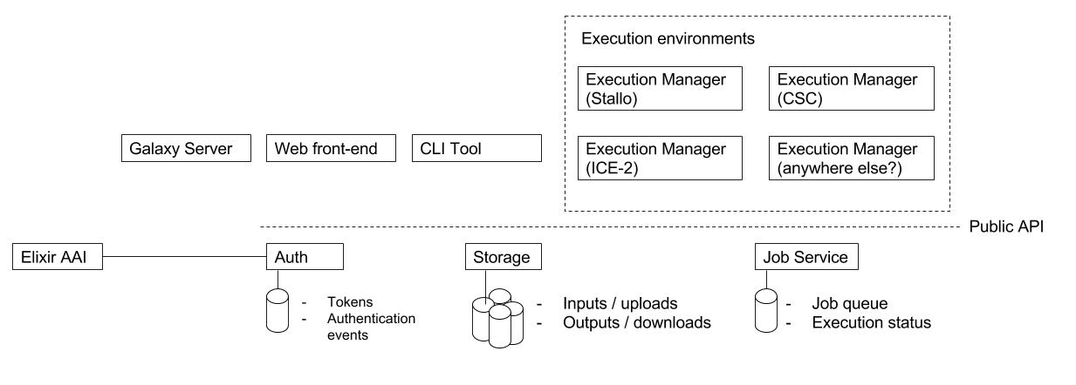

META-pipe backend architecture

Slide 4
Challenges
What should be exposed to users?
  Trade-off: flexibility vs responsibility
  as-a-VM = more flexible, but users must install, allocate resources, handle failures…
  as-a-service = less flexible, but service provider takes more responsibility
Issue:
  What to do when the analysis fails?
  Who should do it?

Slide 6
Challenges - examples
Number of pipeline parameters
  More => better analysis results
  Fewer => easier to predict resource needs
Resource allocation
  By user => can use national resources
  By service provider => easier to maintain service
Failure handling
  By user => difficult to detect, understand and resolve
  By service provider => more complicated backend

Slide 7
META-pipe: Galaxy pipeline
Standardized Galaxy interface:
  + flexible, extensible, powerful
  - big and complicated software stack
Norwegian research infrastructure resources are pre-allocated
  + Not visible for users and easy to administer
  - Supercomputers not ideal for workload, industry and non-Norwegian users need to pay
Failure handling is mostly left to users (red boxes)
  + Simpler backend
  - Difficult to understand failures, wasted resources due to restarts, more support work

Slide 8
META-pipe: Web app
Web app interface:
  + Easier resource allocation, simpler software stack
  - Just META-pipe, limited configuration possibilities
Bring your own cloud resources
  + Can use cheapest (/free) resources
  - Failure handling and support on external resources
Failure handling is mostly hidden for users
  + Easy to understand job status
  - Backend must group together jobs, restart parts of failed jobs, and may need manual intervention

Slide 9
Summary
Our goal: provide a service where resource allocation and failure handling is hidden from user
Our approach:
  Backend designed to hide failures
  Abstract, layer, and simplify where possible
Our challenges:
  Resources outside of our control (failure detection, handling, and support)
  Job structure (mix of high-memory and compute intensive)
  3rd party tools (software quality issues, security issues)

Slide 10
Acknowledgments
META-pipe team:
  Nils P. Willassen, Lars Ailo Bongo, Erik Hjerde, Espen M. Robertsen, Inge Alexander Raknes, Aleksandr Agafonov, Terje Klemetsen, Giacomo Tartari …
ELIXIR-NO
  NeLS
ELIXIR-FI and ELIXIR-CZ
  AAI, cloud setup
EXCELERATE WP6

