Slide 1
Distributing META-pipe on ELIXIR compute resources
Lars Ailo Bongo (NO)

Slide 2
Outline
META-pipe
  Biological functionality
  Resource requirements
  User interface demo
META-pipe backend
  Design choices
  User management using ELIXIR AAI
  Distributed execution on ELIXIR compute cloud platform
Future plans
Notes:
30 min

Slide 3
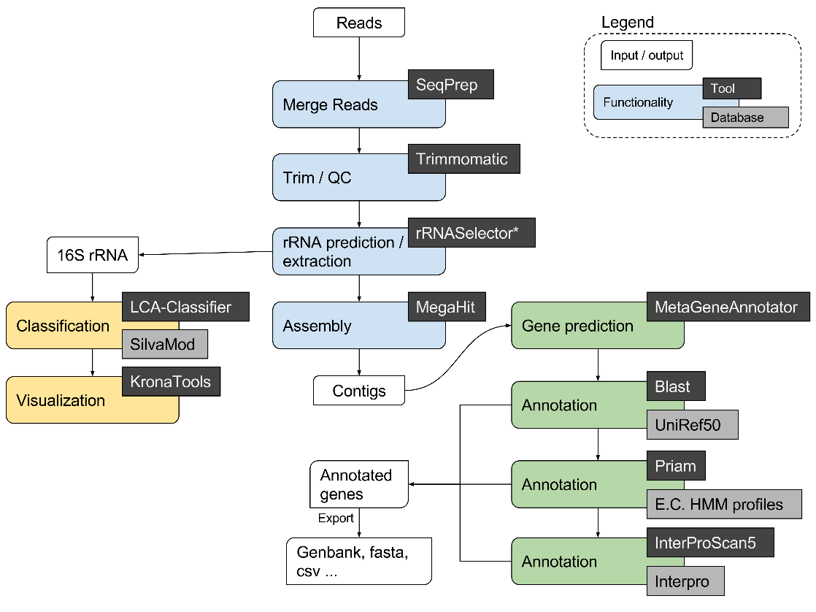
META-pipe: marine metagenomics analysis pipeline
QC and assembly, taxonomic classification and functional assignment
Focus on full-length genes and the marine domain
Outputs Genbank files and Krona charts; more formats being implemented
Generates data for MarCat

Slide 4
META-pipe: resource usage
QC and assembly
  Memory intensive
  Parallel but not distributed
Taxonomic classification
  Very low resource usage
Functional analysis
  Computationally intensive
  Low memory usage
  Data-parallel (scales well)
Resource usage is dataset size dependent
  For big 2x7GB (paired-end, compressed) dataset…
  …5-6 hour QC assembly on 12 cores
  …24 hour functional analysis on 20x20 vcores
More machines/cores => reduced execution time

Slide 5
META-pipe: resource requirements
Compute resources
  High-memory machine for assembly
  Lots of cheap compute (virtual) machines for functional analysis
Storage resources
  Bytes << cycles
  Network transfer time not an issue
  Not human data (not sensitive)
Summary
  Need more than one server/ VM
  Can move data to compute resources

Slide 6
META-pipe backend architecture

Slide 7
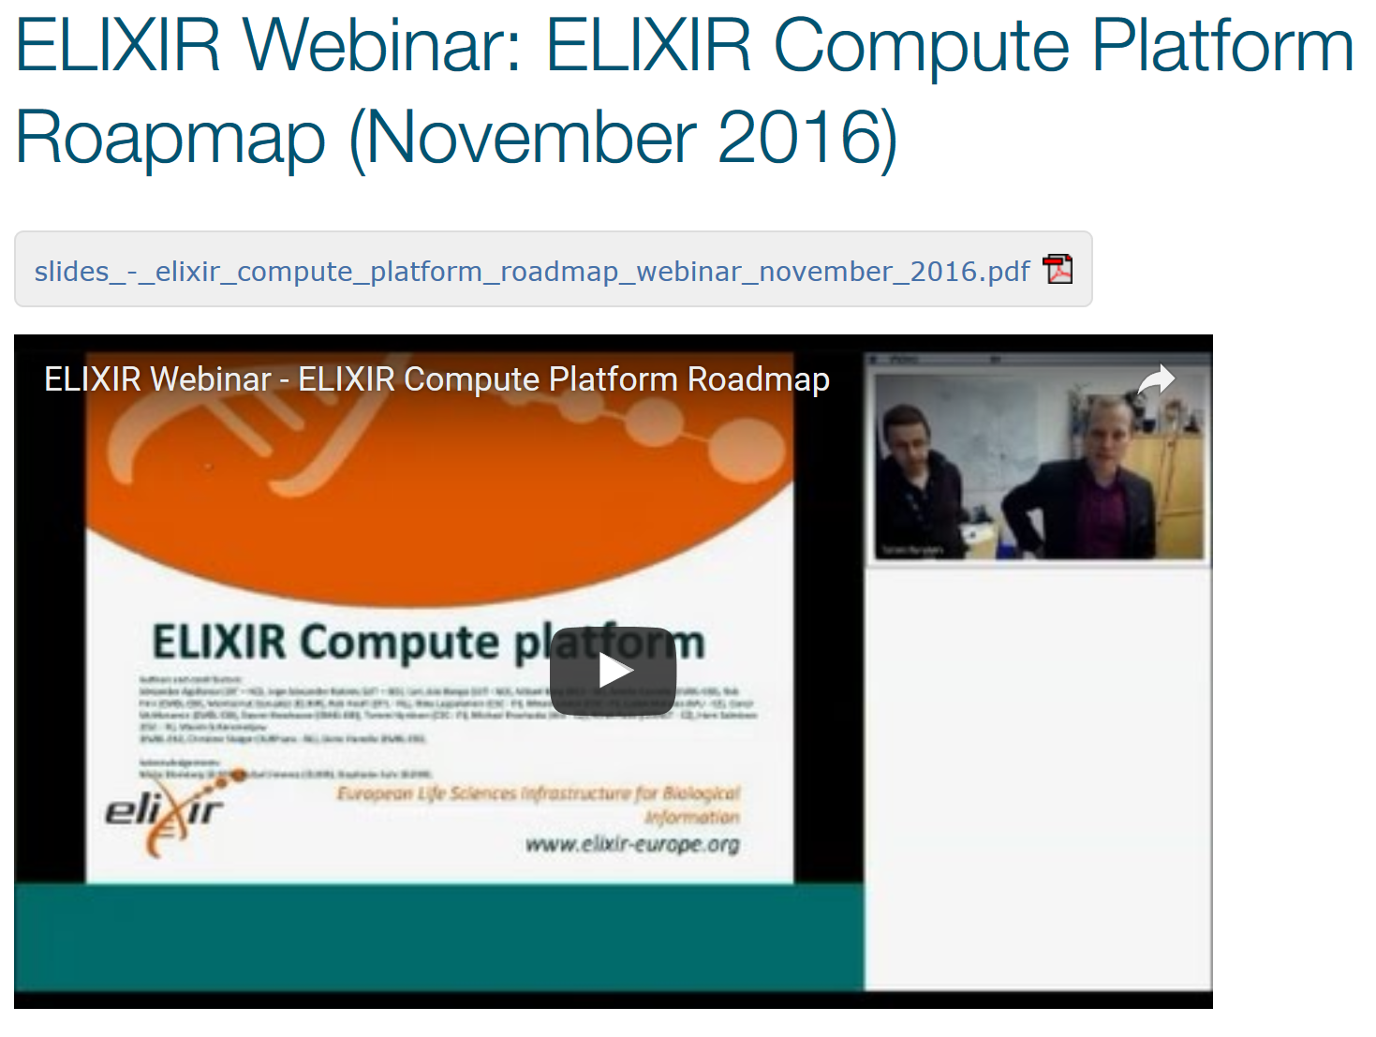
Demo
https://www.elixir-europe.org/documents/elixir-webinar-elixir-compute-platform-roapmap-november-2016

Slide 8
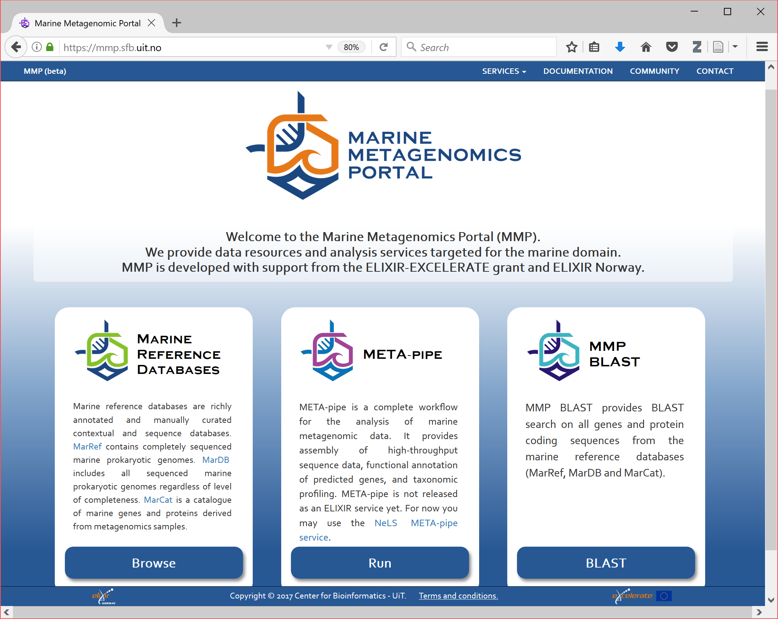

Slide 9
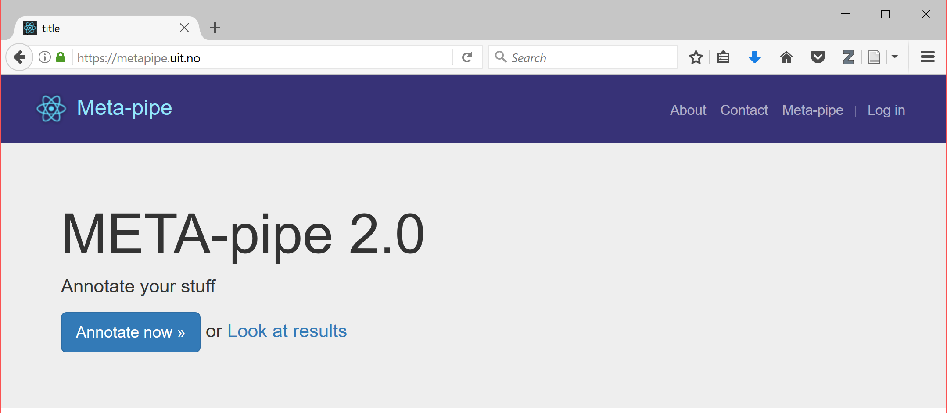

Slide 10
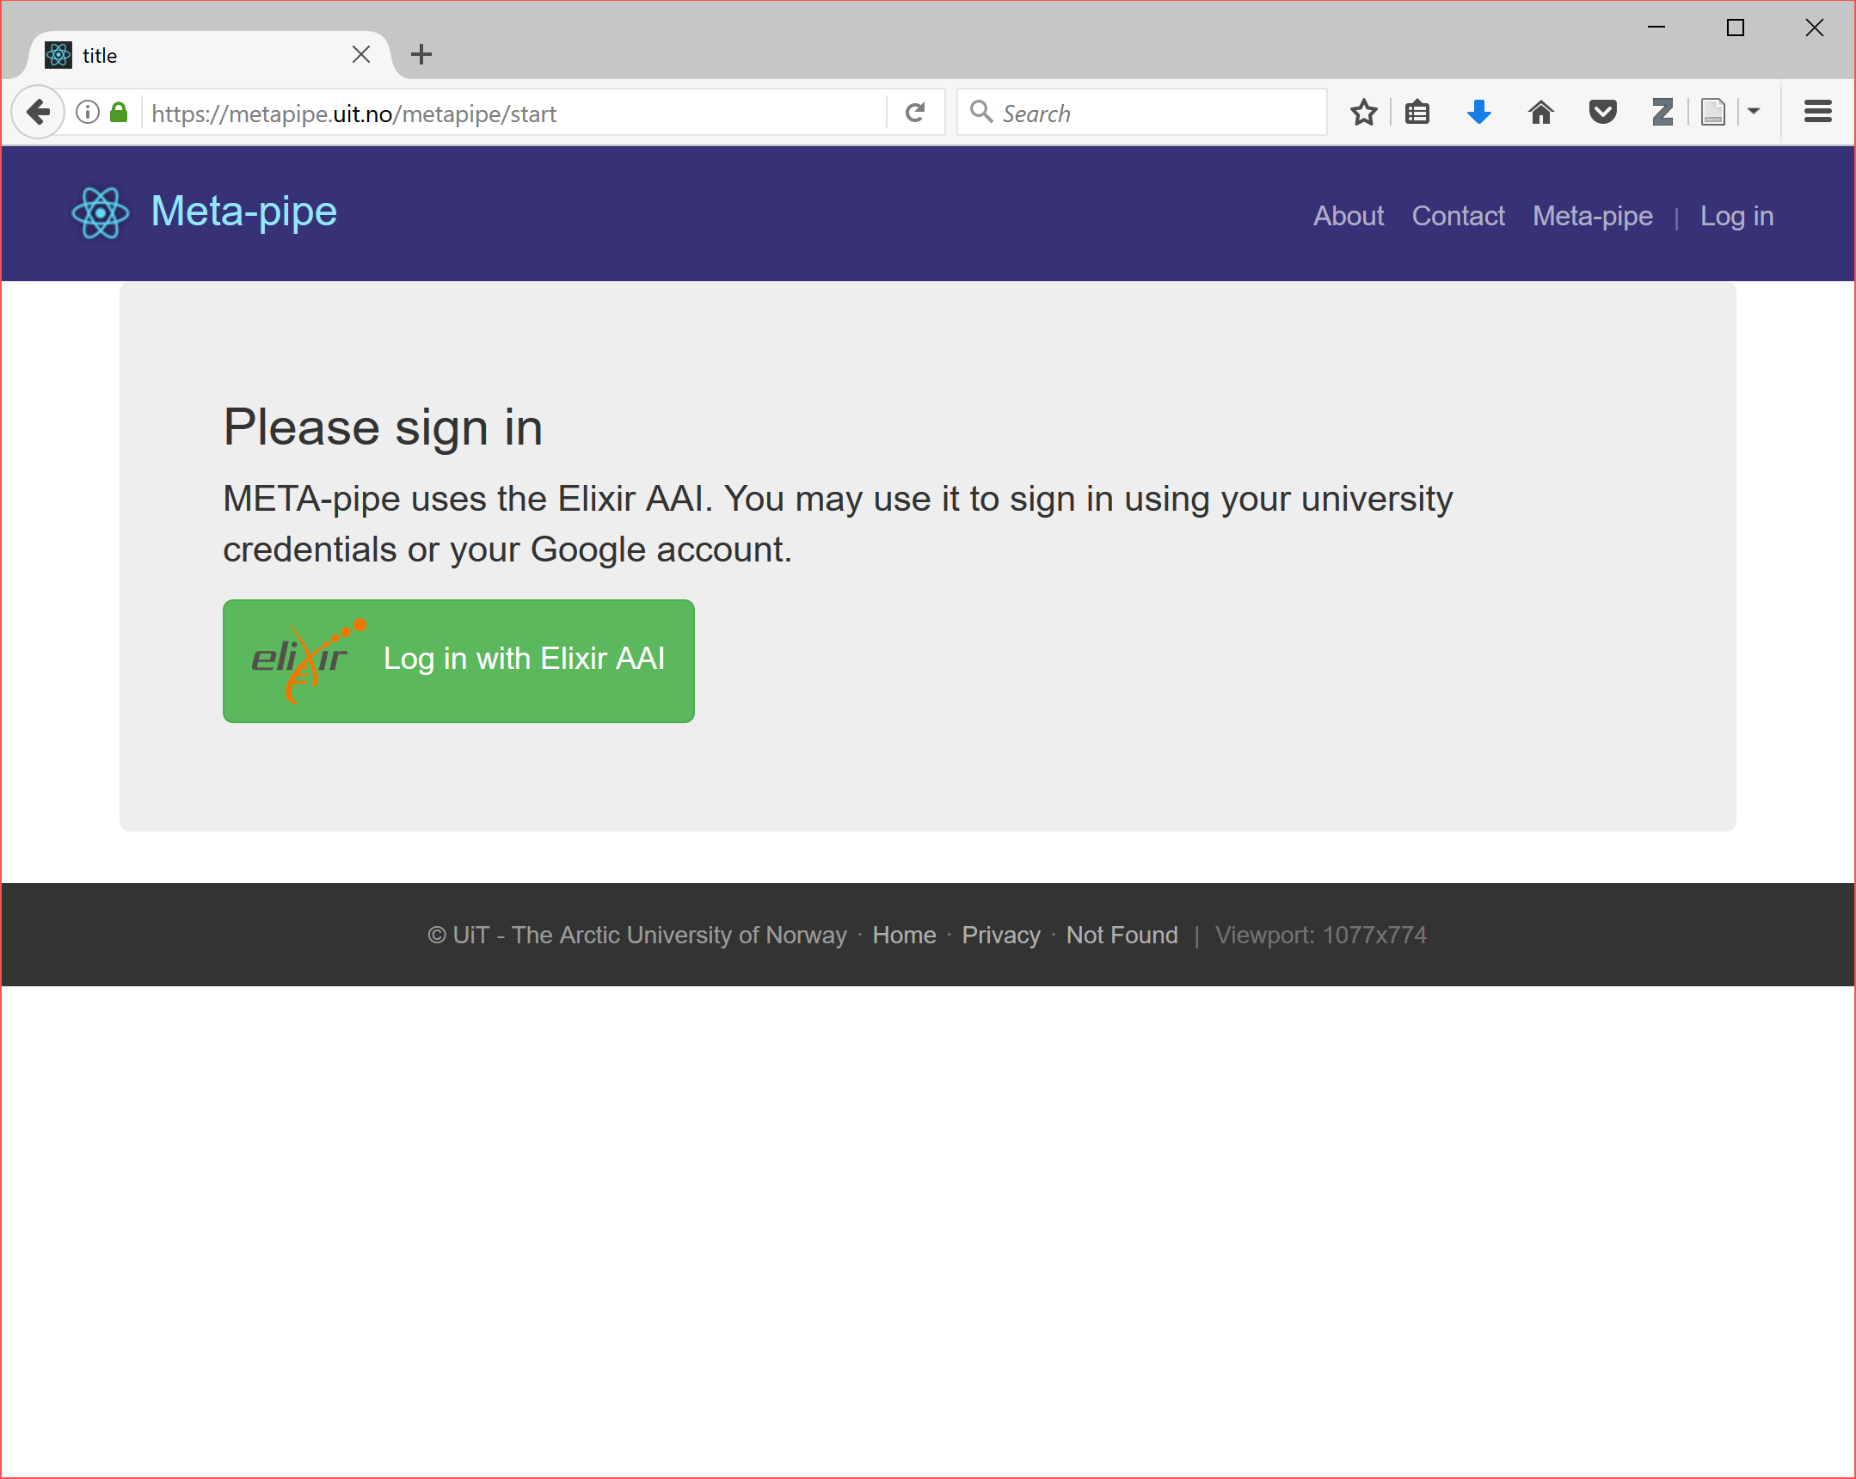

Slide 11
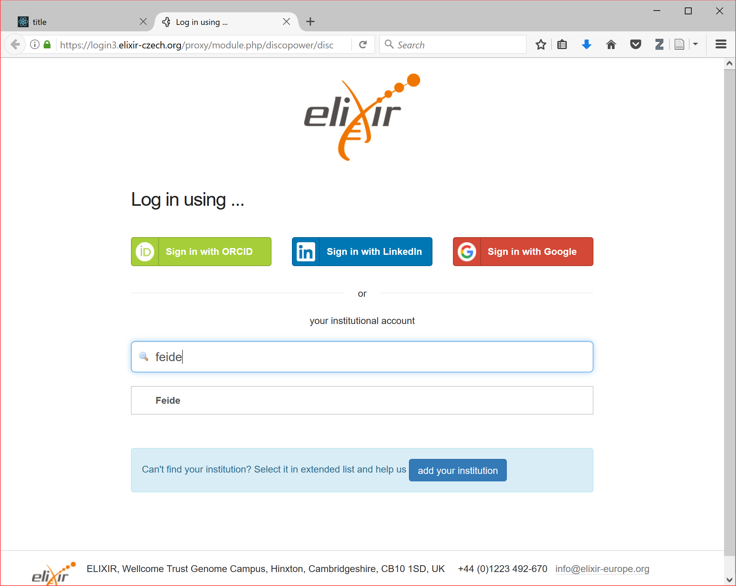

Slide 12
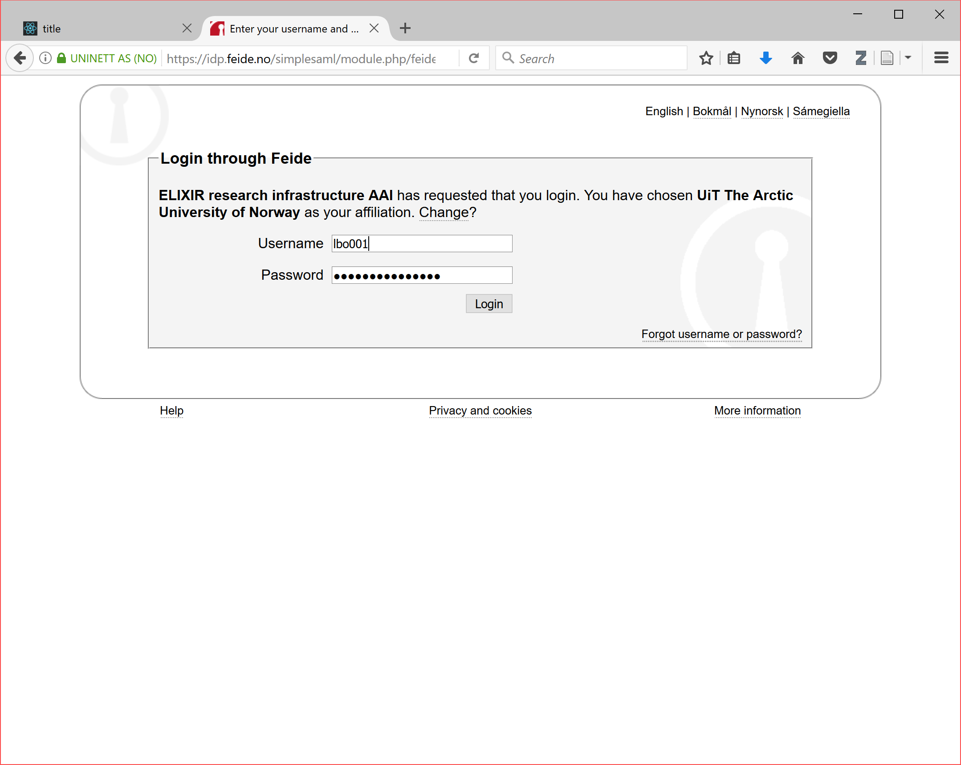

Slide 13


META-pipe backend architecture

Slide 14
Authentication using ELIXIR AAI
For user
  Single sign-on using home institution credentials
For analysis service provider
  Information from ELIXIR AAI: user ID, name, e-mail, (home institution, persistent ID, affiliation)
  Use information to implement authentication between our servers
  Resource monitoring and accounting (and payment?)
  Integration with ELIXIR data storage and transfer systems?
  Integration with other ELIXIR services?

Slide 15
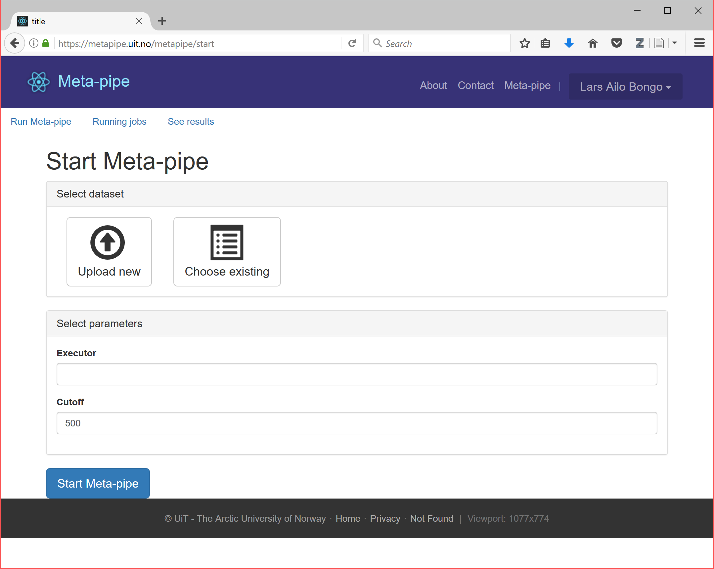

Slide 16
META-pipe backend architecture

Slide 17
File upload
Using web browser
  Incoming! plugin to support large Gigabyte files
    But multi-GB files requires lots of compute resources!
  (In Norwegian NeLS: “ssh” between national infrastructure centers)
Stored on a META-pipe storage server
  Currently one physical machine
  Object store (minio, S3 compatible)
  Not used during job execution
  Capacity most important

Slide 19
Job execution
On our Stallo Supercomputer
  Press execute button
On cPouta (FI) or CESNET (CZ)
  Administrator runs script to setup backend on cPouta or CESNET (once)
  Specify cPouta or CESNET as a tag for the job (for each job)
  Press execute button (for each job)
In the future?
  User selects Elixir supported compute cloud resource (for each job)
  Backend automatically setup execution environment (for each job)
  Press execute button (for each job)

Slide 20
META-pipe backend architecture

Slide 21
Execution environment layers
Pipeline
  META-pipe 2.0 tools, tool dependencies, and reference DBs
Pipeline specification
  Spark program (+ our pipeline abstractions)
Analysis engine
  Spark, NFS
Cloud setup
  Ansible
  Terraform

Slide 22
Execution environment nodes
Bastion node
  Cluster setup/ teardown scripts, cache with META-pipe tools and DBs
Master node
  NFS server, Spark driver
  NFS volume:
    Java, Scala, Spark
    META-pipe tools and dependencies
    Reference databases
    Spark job input files
Worker nodes
  Spark workers
  Local storage (reference DBs, Spark temporary files)

Slide 23
cPouta cloud setup
cPouta is an OpenStack cloud at CSC (FI)
We provide a tool for setting up the execution environment
Work done in collaboration with ELIXIR-FI and ELIXIR compute platform
Create environment (once)
  Create security group and ssh keys, setup network, setup bastion host
  Download META-pipe tools, dependencies and databases from our artifact server
  Create persistent volume with artifacts (used to initiate NFS disk on master)

Slide 24
cPouta cloud setup and META-pipe job execution
Create virtual cluster
  Cluster provisioning and configuration
  Master: Install and setup Java, Scala, and Spark (generic)
  Master: setup NFS, provision and mount cached volume
  Workers: mount NFS, setup Spark worker
Launch a job
  Get a job tagged with cPouta from META-pipe job server
  Copy input files from META-pipe storage server to master:/tmp/
  Run Spark job on virtual cluster
  Copy results from master:/tmp/ to META-pipe storage server

Slide 25
cPouta cloud teardown
Virtual cluster teardown
  Deprovision cluster and remove temporary files
Environment cleanup (once)
  Remove security group and keys, delete META-pipe volume

Slide 26
Elixir compute cloud setup
ELIXIR-CZ has created Terraform configurations for setting up META-pipe on Elixir compute clouds (OCCI endpoints)
  Based on our OpenStack cluster setup tool
Create environment and setup master and slaves
Provision hosts, install backend, and install META-pipe tools (as for cPouta)
Launch job (as for cPouta)
Cleanup

Slide 27
Backend design choices
Scalable distributed execution of jobs
  One job is distributed over many machines in a (virtual) cluster
  Many virtual clusters may run at the same time
Centralized servers reduce complexity
  Lightweight and portable execution managers
Layered architecture
  Reuse, optimize separately
Spark based backend
  “Cloud standard” with active software ecosystem

Slide 28
Future work
Technical
  Elastic resource allocation (at scale)
  Assembly + functional analysis as a single job
  Reliable resource allocation for “bring your own cloud”
  Automatic failure handling
  Improved security
Administrative
  Off-load monitoring and management
  User support on distributed resources
  Accounting

Slide 29
Integration with other ELIXIR platforms
META-pipe in Common Workflow Language
Bioschemas

Slide 30
Summary
META-pipe
  Compute intensive workload
  Distributed backend
  Layered (reusable) architecture
ELIXIR AAI integration
ELIXIR compute cloud ready

Slide 31
Acknowledgments
META-pipe team:
  Nils P. Willassen, Lars Ailo Bongo, Erik Hjerde, Espen M. Robertsen, Inge Alexander Raknes, Aleksandr Agafonov, Terje Klemetsen, Giacomo Tartari …
ELIXIR-NO
  NeLS
ELIXIR-FI and ELIXIR-CZ
  AAI, cloud setup
EXCELERATE WP6

