Slide 1
WP6: Marine metagenomics
Inge Alexander Raknes, Giacomo Tartari (ELIXIR-NO)
ELIXIR All Hands, 8-9 March 2016, Barcelona, Spain

Slide 2
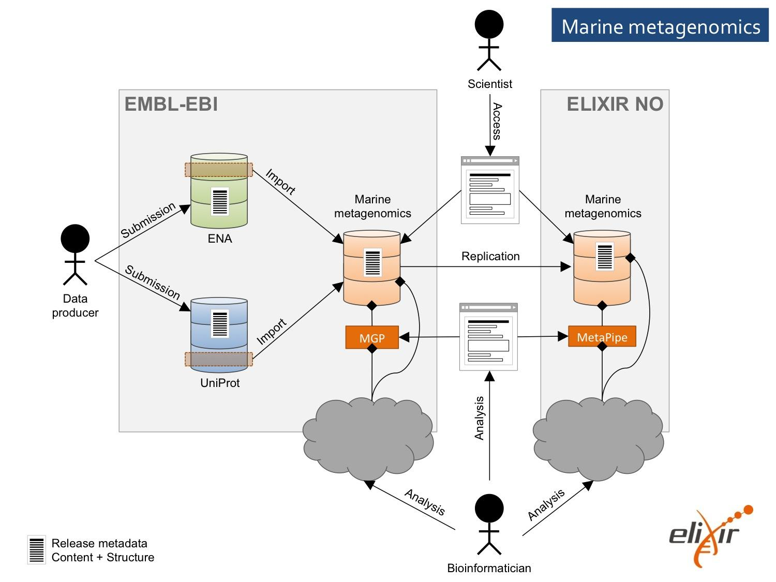
Use case architecture

Slide 3
Database
Tier 1 - MarRef
  Gold Standard and build upon complete marine prokaryotic, eukaryotic and virus genomes available in UniProt proteome database. Manually curated.
Tier 2 – MarDB
  Includes all prokaryotic, eukaryotic and virus genomes independent of whether they are complete or not. Manually curated at the beginning. Later there will be standards to avoid manual curation.
Tier 3 - MarCat
  Based upon annotation of assembled marine metagenomics and metatransciptomics reads.

Slide 4
Tier 1
Tier 1 – MarRef (Gold standard – complete genomes )
ENA/Genebank/DDBJ
RefSeq
Manual curation and enrichment
MarRef
Nucleotide
MarRef
MarRef
Protein

Slide 5
Tier 2
Tier 2 – MarDb marine genome database
Genome Projects
ENA/Genebank/DDBJ
MarDb
Nucleotide
MarineDb
MarDb
Protein

Slide 6
Tier 3
Tier 3 – Marine gene catalogue
Marine metagenomics reads
EBI metagenomics
ENA
Marine metatranscriptome reads
ENA
Tier1 database
Tier2 database
META-pipe
MarCat
Nucleotide
MarCat gene catalogue
MarCat
Protein

Slide 7
Data Storage Architecture

Slide 8
Data Transfers
Transferred 36 projects/studies from ENA to Tromsø
  Temporarily parked data on NorStore staging area
Thanks to Tony Wildish and Thierry Toutain
Not the expected speed
  investigation in progress

Slide 9
Pipelines
EMG/MGP: porting to cloud (Embassy cloud or Amazon EC2)
META-pipe: adapting to Apache Spark
Defining set of tools for benchmarking
Defining data standards

Slide 10
Meta-pipe architecture

Slide 11
AAI Integration

Slide 12
Spark Meta-pipe
Currently have a set of tools that are individually submitted to Torque
Implement the workflow execution of Meta-pipe in Spark
Already have most of the Meta-pipe codebase written in Scala

Slide 13
Cloud Deployment
Use cPouta as a computational backend for Meta-pipe
Other environments could be Amazon, etc.
Looking into technologies like AppImage to make it more easily deployable

Slide 14
Tasks
March - June
  AAI Integration
  Spark backend for Meta-pipe
  cPouta evaluation
  Tool Benchmarking
June - December
  Prototype database

Slide 15
Conclusions
Design document for the DataBase
  https://github.com/uit-no/elixir-excelerate/blob/master/reference-database.md

