Slide 1
WP6: Marine metagenomics
WP4 Meeting, Heathrow, 26.01.2016 Lars Ailo Bongo, ELIXIR-NO

Slide 2
Main goals
Develop long-term, sustainable metagenomics infrastructures to enhance research and industrial innovation within marine domain
Tasks in 2016 | Lead partner | Champion
Organize workshop on metagenomics stakeholder requirements (Task 6.1) | EMBL-EBI | Guy Cochrane
Define requirements for databases specific for marine metagenomics (Task 6.2) | ELIXIR-NO (UiT) | Nils Peder Willassen
Define requirements and technical architecture for META-pipe (Task 6.3) Define gold standard tools and pipelines (Task 6.3) Define tools and pipeline integration points (Task 6.3) | EMBL-EBI ELIXIR-NO (UiT) | Rob Finn Lars Bongo
In collaboration with WP11 building training workshops for end-users (Task 6.4) | ELIXIR-PT (CCMAR) | Pedro Fernandes

Slide 3
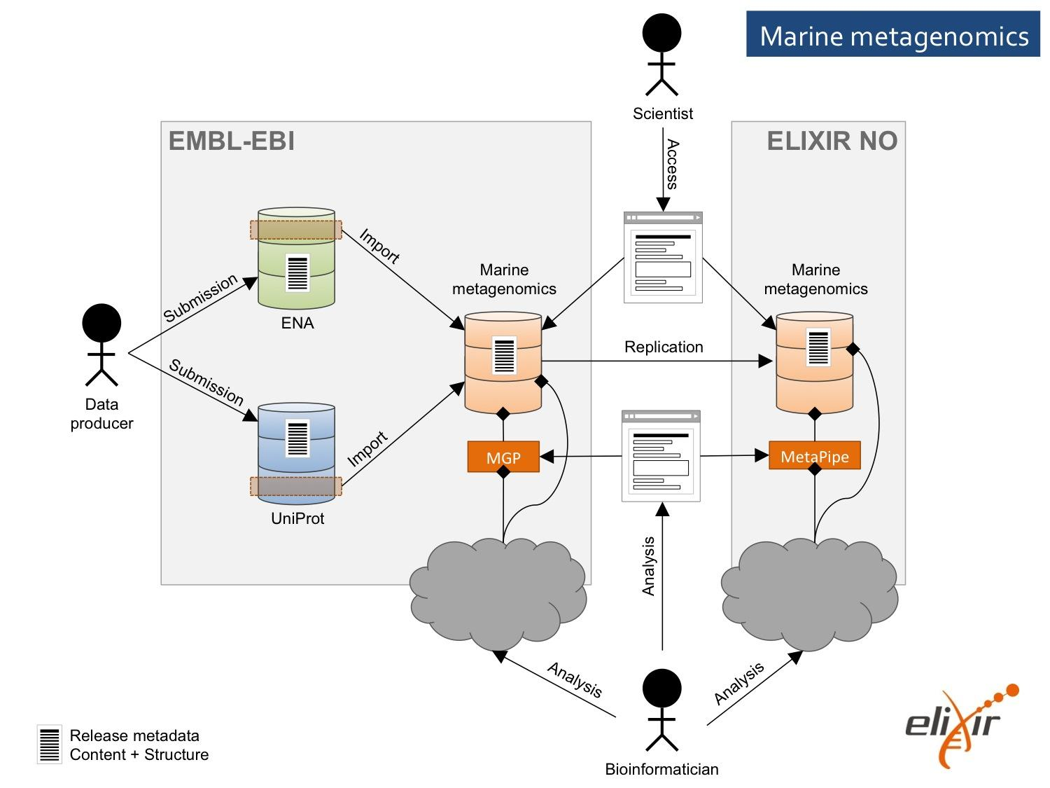
Use case architecture
https://docs.google.com/document/d/1gMKFrcbzuN9BSREU1VDnlml-bl6KSOnfyQbJGh20L5s/edit#

Slide 4
EMBL-EBI Reference Databases
ELIXIR Norway
ENA
Reference
Genomes
MetaG
UniProt
Large Volume Replication
ENA
InterPro
Marine
Ref
UniProt
Rfam
InterPro
Marine
Ref
Extended
Analysis
Tools
Reference
DBs
Green-
genes
EBI Metagenomics Portal
Marine
Ref
}
EMG
Amplicon
MetaG/T
InterPro
Green-Genes
META-PIPE
}
Rfam
}
Replication
Small Volume Replication
Assemblies &
Summary
Files
EAT
Large Volume
Replication
Summary
Files
EMG
Interoperability
META-Pipe
Users
Tool Integration
Processed Data Out
Data In
Datasets
Tools/Pipelines
Direct Sequence
Submission

Slide 5
Status - Database
Requirements due by all-hands meeting
ENA
Single genomes (annotated)
Metagenomes (raw seq. reads)
META-pipe
Nucleotides
Reference data
(taxonomic)
Proteins

Slide 6
Status – MGP pipeline
Existing pipeline tied to EMBL-EBI infrastructure
Ongoing work to make better abstractions
Plan to move to OpenLava job scheduler
Collaborating with Embassy cloud team
Storage solution unclear; start with a simple solution.

Slide 7
Status – META-pipe pipeline
Feide
Nor Store
Stallo
Currently
By Helsinki (prototype)
Galaxy
Galaxy LWR
Torque, NFS
Future
META-pipe tools
Web app
Spark, VMs
HDFS, OpenStack
Elixir AAI
Elixir Storage
Elixir Cloud
Elixir Registry

Slide 8
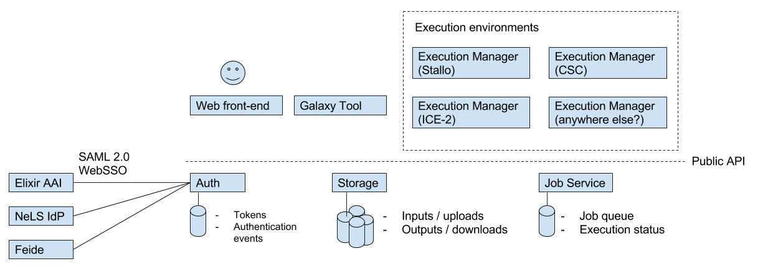

Slide 9
Status – Search engine
Initial discussion started.
No concrete plans yet.

Slide 10
WP6 ➔ AAI
META-pipe has authentication server
OAuth 2.0, JSON, SAML, Apache Oltu, Client Oauth 2, Dropwizard, Hibernate
➔Ongoing work: integrate with Elixir AAI
Need: support, hello world, test setup
MGP authentication is through ENA
➔ Adapt META-pipe AAI solution

Slide 11
WP6 ➔ Cloud
META-pipe is running on HPC system
➔Plans to deploy on CSC cPouta (ELIXIR-FI)
We have account and allocated resources at cPouta
cPouta has OpenStack architecture
VMs with “new OS”
HDFS/ Spark backend
Automatic deployment scripts
Web app frontend (in NO?)
cPouta setup should be portable to any cloud
Ansible based
But need to be configured. Who does this?

Slide 12
WP6 ➔ Cloud (2)
MGP is running on HPC system
➔Working to deploy on EBI Embassy Cloud
OpenStack architecture
Plan to start this week
Start really small for prototype

Slide 13
WP6 ➔ Storage
WP6 storage requirements are 10s of TB
Need: backup, replication, and versioning
But! Data volumes are rapidly increasing!
WP6 data transfer requirements mostly for raw sequence reads
Need: transfer services
Need privileged access to ENA data
We will use MGP data initially
NO: will copy all publically available marine metagenomes to our development cluster
Now!
Experiment with storage systems and data structures
We have been in contact with task 10.2

Slide 14
WP6 ➔ Registry
We will start benchmarking tools for gold standard after all-hands meeting
These may be put into the registry

