Slide 1

ELIXIR activities in Norway
(and Europe)
Lars Ailo Bongo (ELIXIR-NO, UiT)
Gard Thomassen (ELIXIR-NO, UiO)
NorduGrid 2017, 29 June 2017,
Tromsø, Norway

Slide 2
Outline
ELIXIR
  Background
  Platforms
  Use cases
  META-pipe pipeline and backend
ELIXIR-Norway
  Services
  Norwegian eInfrastructure for Life Sciences (NeLS)

Slide 3
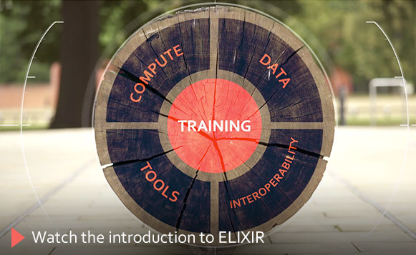
ELIXIR

Slide 4
ELIXIR’s mission
To build a sustainable European infrastructure for biological information, supporting life science research and its
translation to:
medicine
environment
bioindustries
society

Slide 5
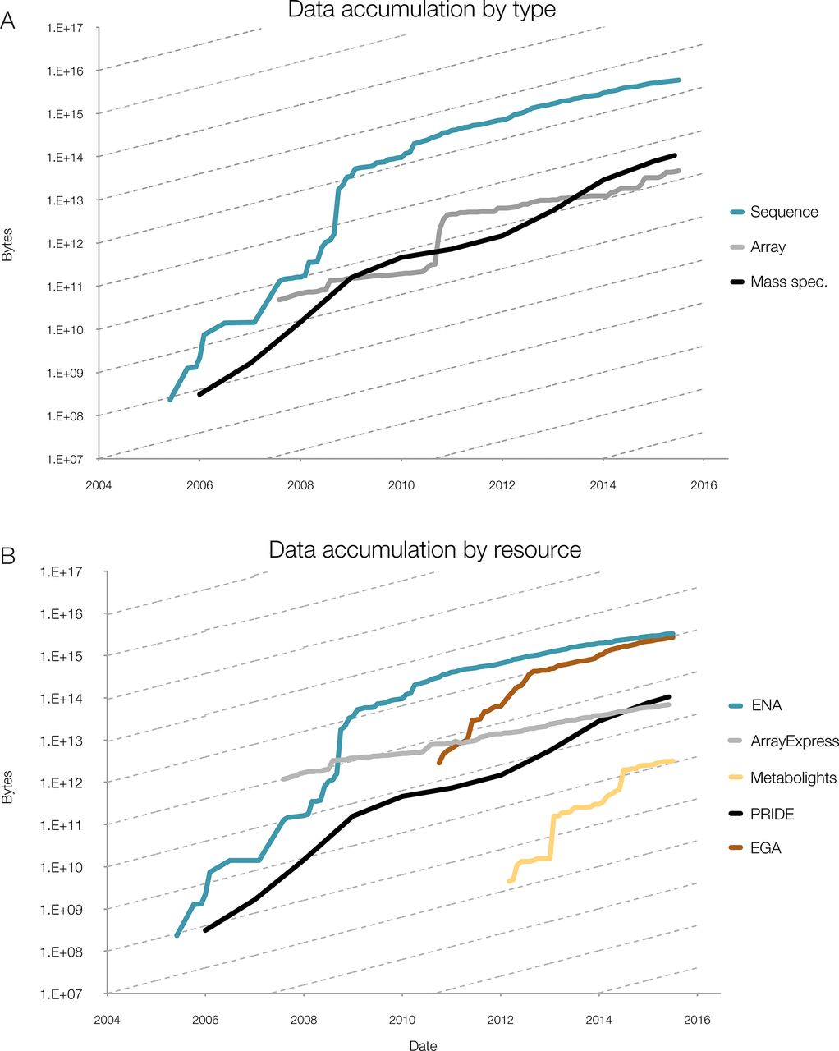
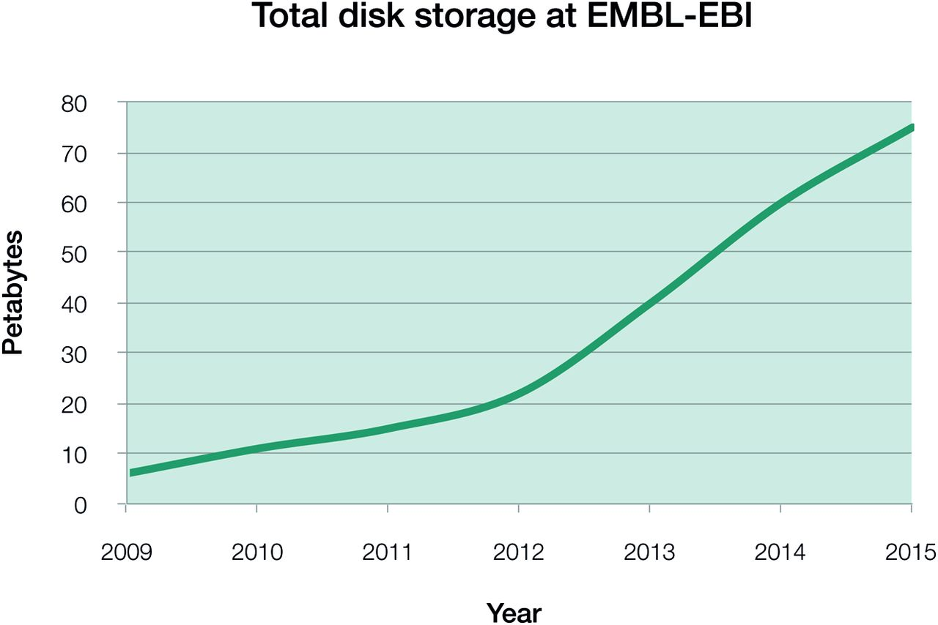
Data growth in the life sciences
Data growth at EMBL-EBI
Source: Charles E. Cook et al. Nucl. Acids Res. 2016;44:D20-D26
Notes:
Phenomenal data growth – dotted lines represents doubling every twelve months
(A) Data accumulation at EMBL-EBI by data type, for example mass spectrometry (MS); (B) Data accumulation by dedicated resource, for example PRIDE. The y-axis is log-scale, with the slope of the dashed lines indicating a 12-month doubling time. Continued data growth is seen in all types of data at EMBL-EBI and all data resources. In all data resources shown here, growth rates are predicted to continue increasing, with notable sustained exponential growth in PRIDE, the European Genome-phenome Archive (EGA) and MetaboLights: all have doubling times of around 12 months. All three contributing platforms show rates that are increasing over time, with data growing exponentially with around a 12-month doubling time.
EGA – European Genome-phenome Archive, PRIDE – Proteome identification database

Slide 6
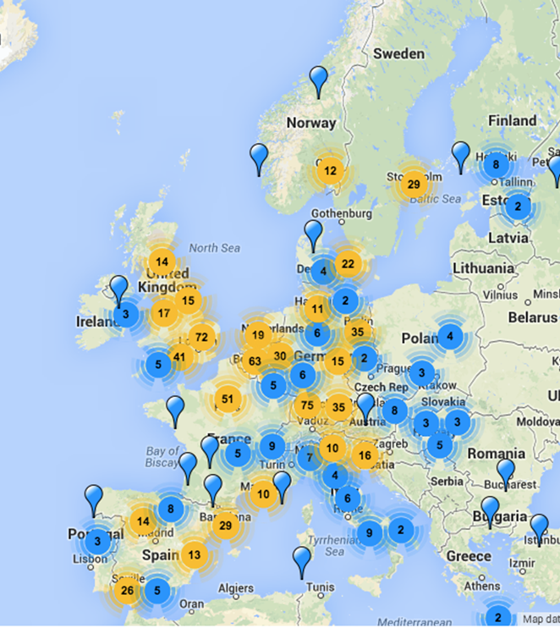
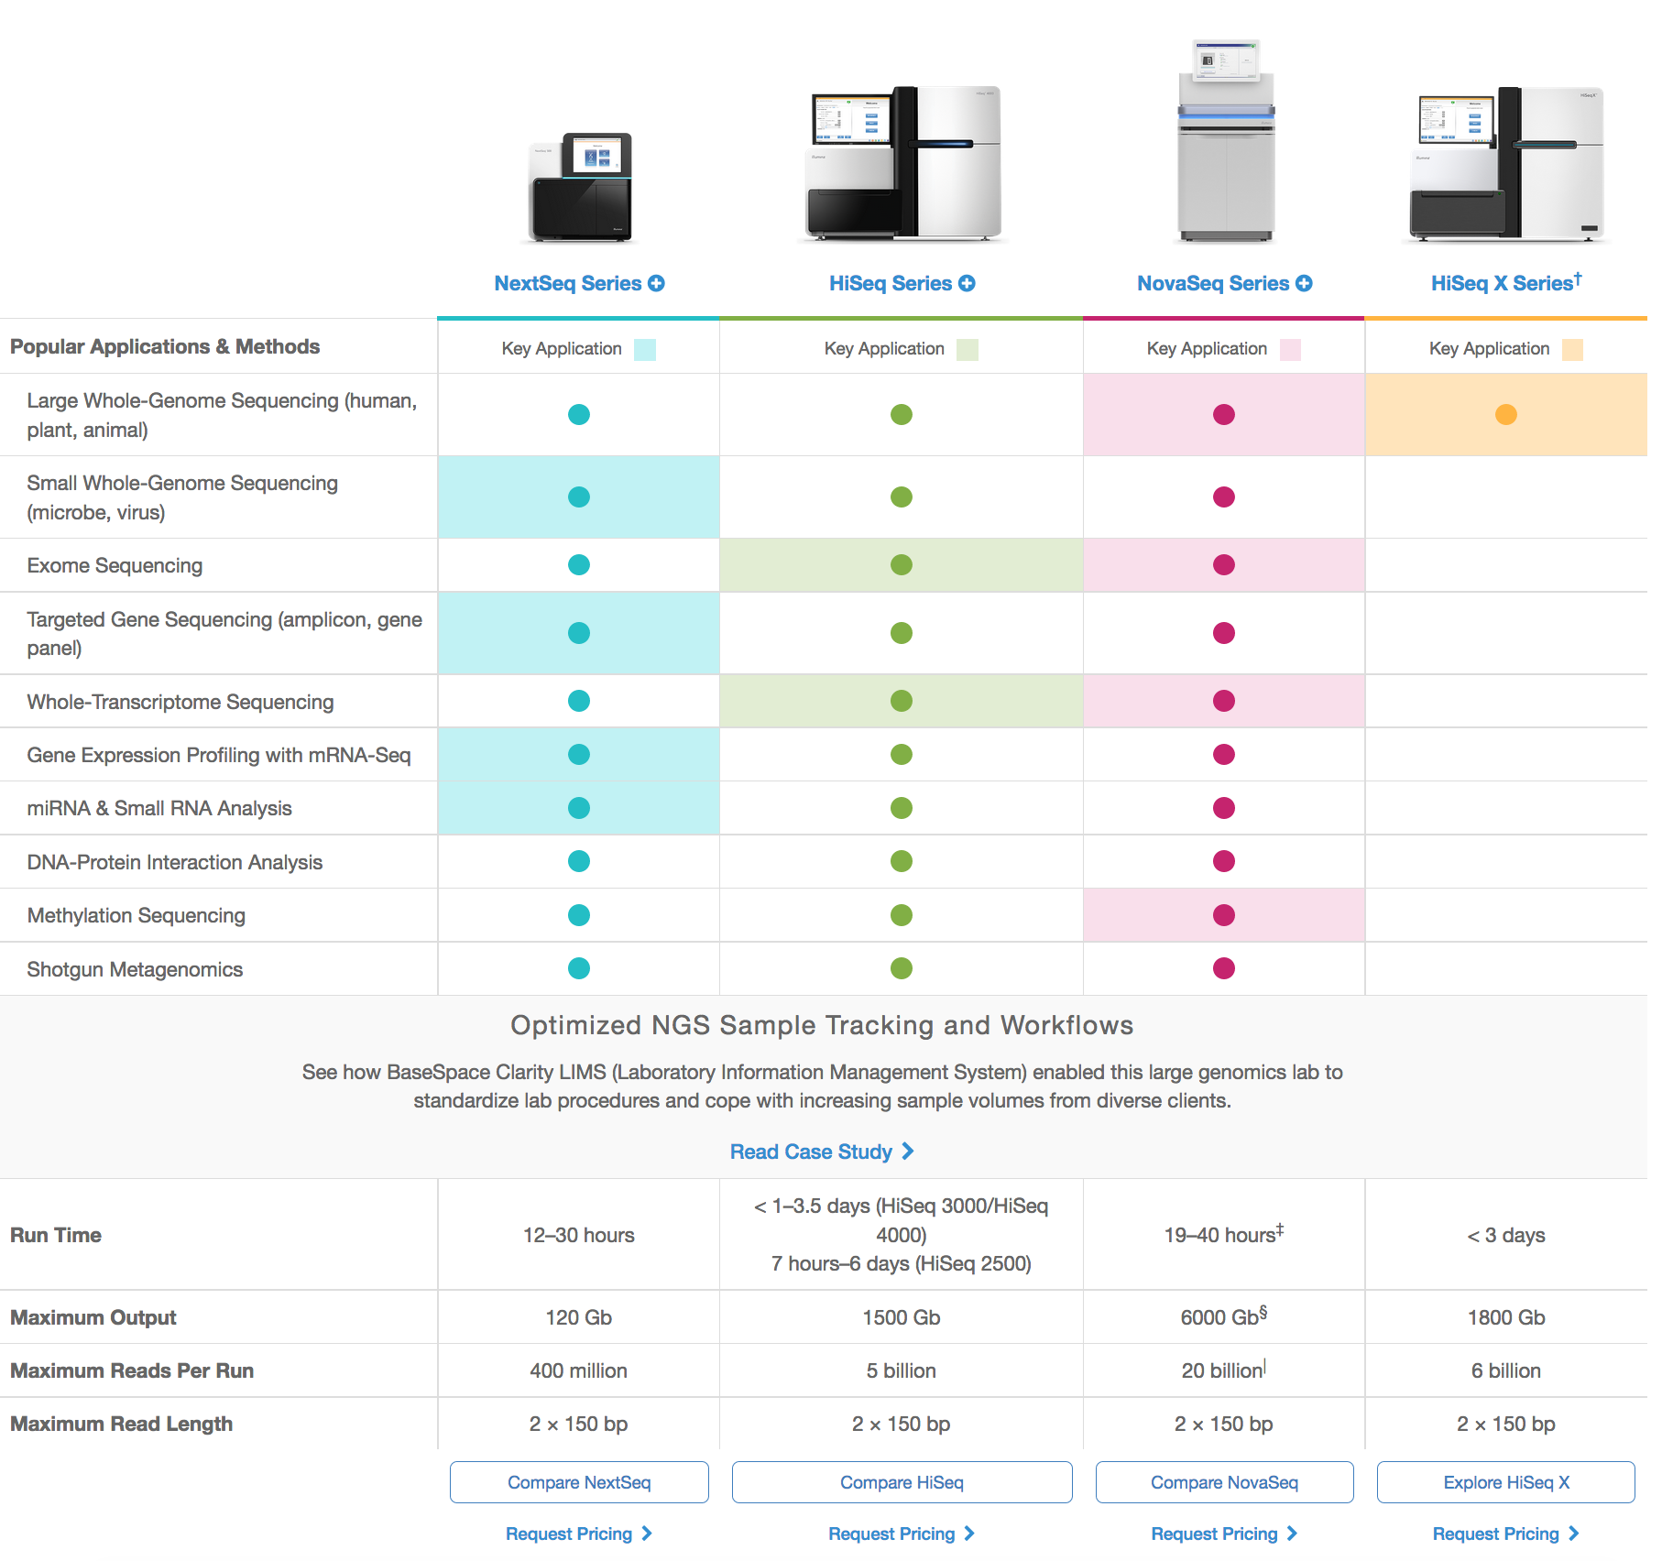
The data challenge: Geographic spread
http://omicsmaps.com
http://www.illumina.com/systems/sequencing-platforms.html

Slide 7
Summary
Large amounts of biological data is produced
Need to distribute analysis services across Europe
Elixir is the solution

Slide 8
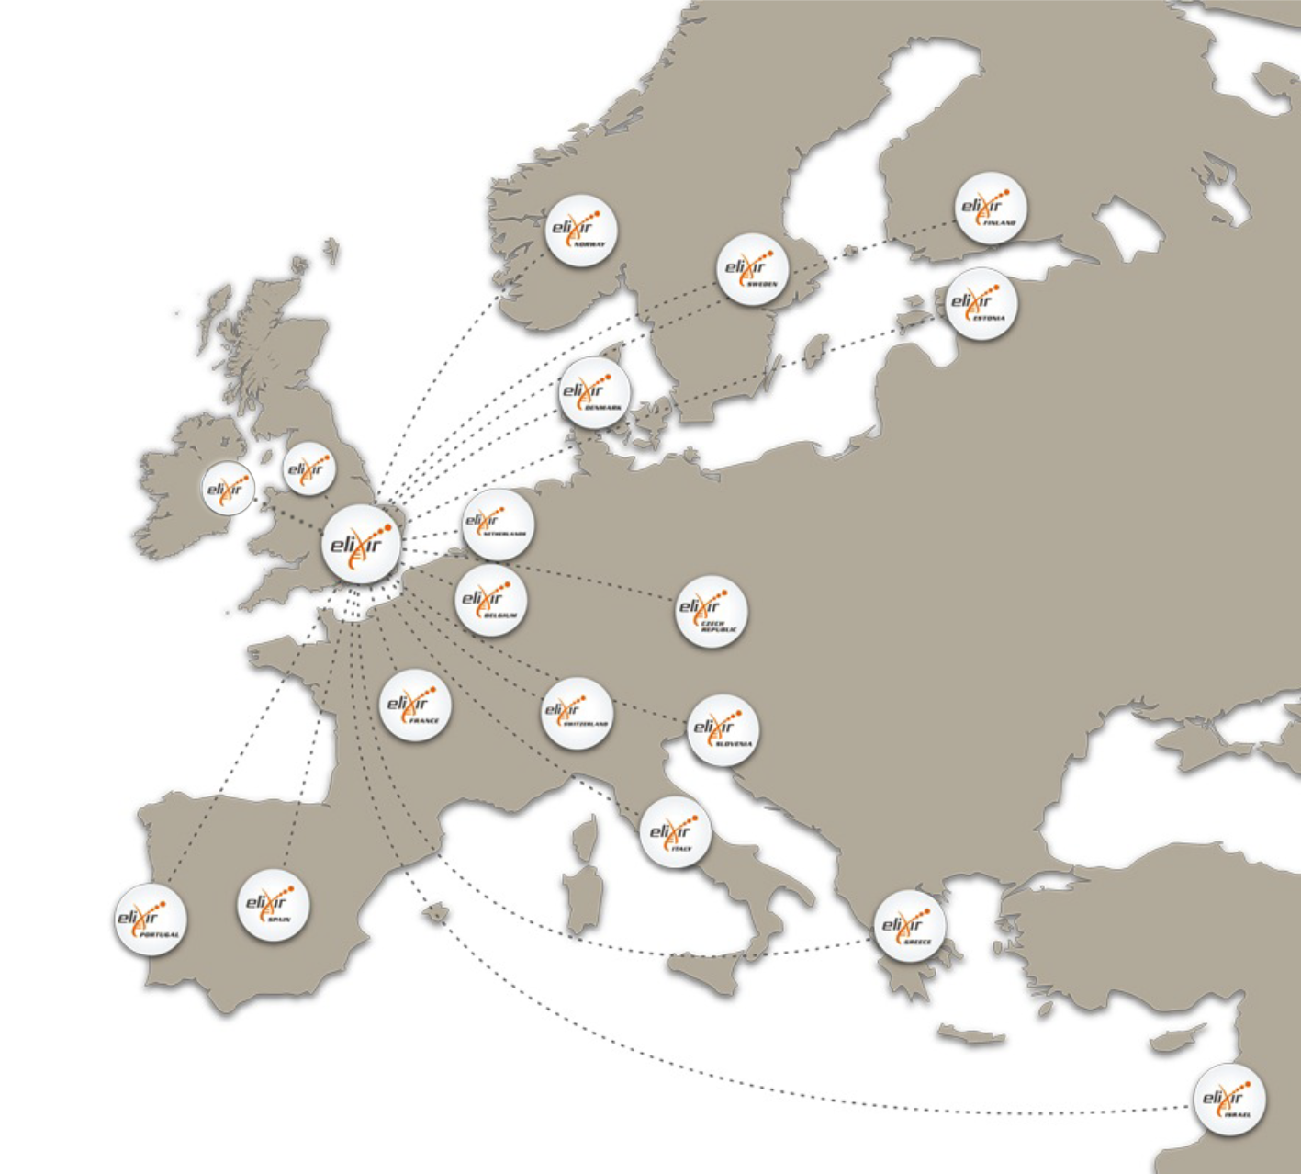










ELIXIR: An international distributed infrastructure for biological data
Technical platforms
Data
Standards
Tools
Compute
Training
User communities
Marine metagenomics
Crop and forest plants
Human data
Rare diseases

Slide 9
Platforms
Compute platform
  Services to store, share, and analyze large datasets.
Interoperability platform
  Standards to describe life science data.
Training platform
  Organize training workshops.
Data platform
  Identify key data resources, link data with literature.
Tools platform
  Help researchers find the best tools for their data.
https://www.elixir-europe.org/platforms

Slide 10
ELIXIR Compute Platform
Authentication and authorization infrastructure
  Single login for all ELIXIR services
Cloud and compute
  Standardized way to setup backend for analysis services
  Setup analysis environment in secure platforms
Storage and data transfer
  Replicate reference databases
Infrastructure services registry
Help desk
https://drive.google.com/file/d/0B0KXZdVao0kqUE9BbXVrc3ZLY1E/view

Slide 11
Scientific use cases
Marine metagenomics
Human data
Rare diseases
Plant sciences
(Training)
https://www.elixir-europe.org/use-cases

Slide 12
Marine metagenomics
Define a comprehensive metagenomic data standards environment
  The metagenomic data life-cycle: standards and best practices, Gigascience 2017
Create marine reference databases
  The Marine Metagenomics Portal (MMP)
Implement pipelines for marine metagenomics analyses
  EBI EMG
  UiT META-pipe (used to generate data for MMP)
Provide training and workshops
  Metagenomics training using META-pipe on CSC cPouta cloud

Slide 13
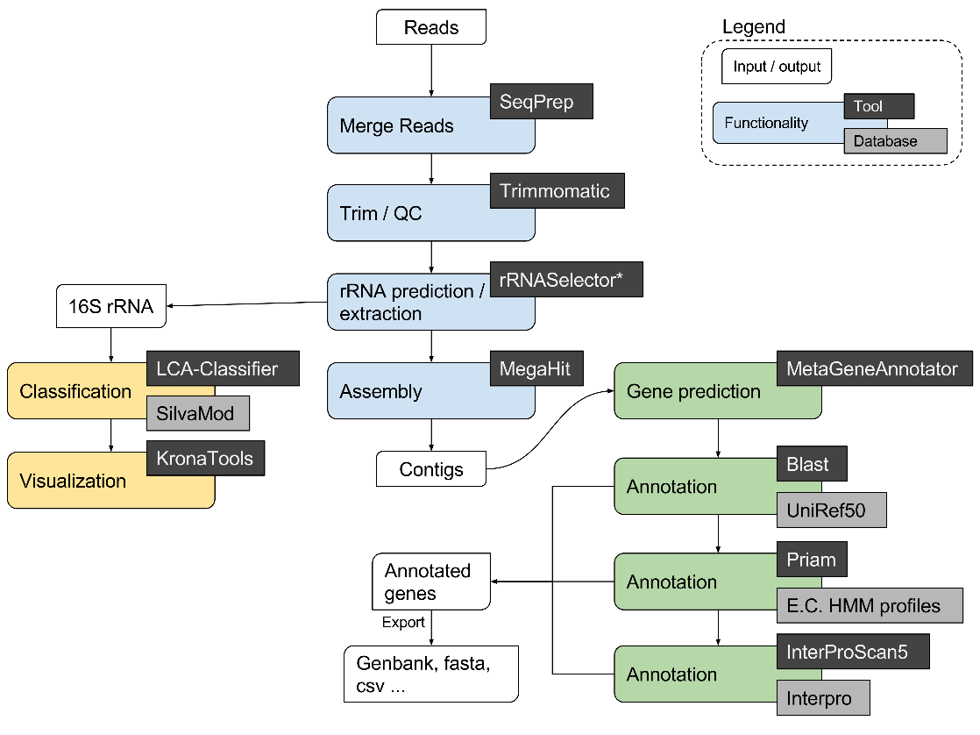
META-pipe: marine metagenomics analysis pipeline

Slide 14
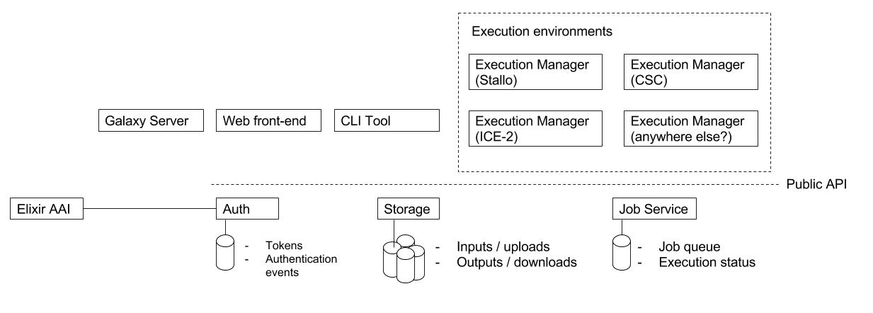
META-pipe: architecture
https://github.com/uit-no/elixir-excelerate/blob/master/meta-pipe.md

Slide 15
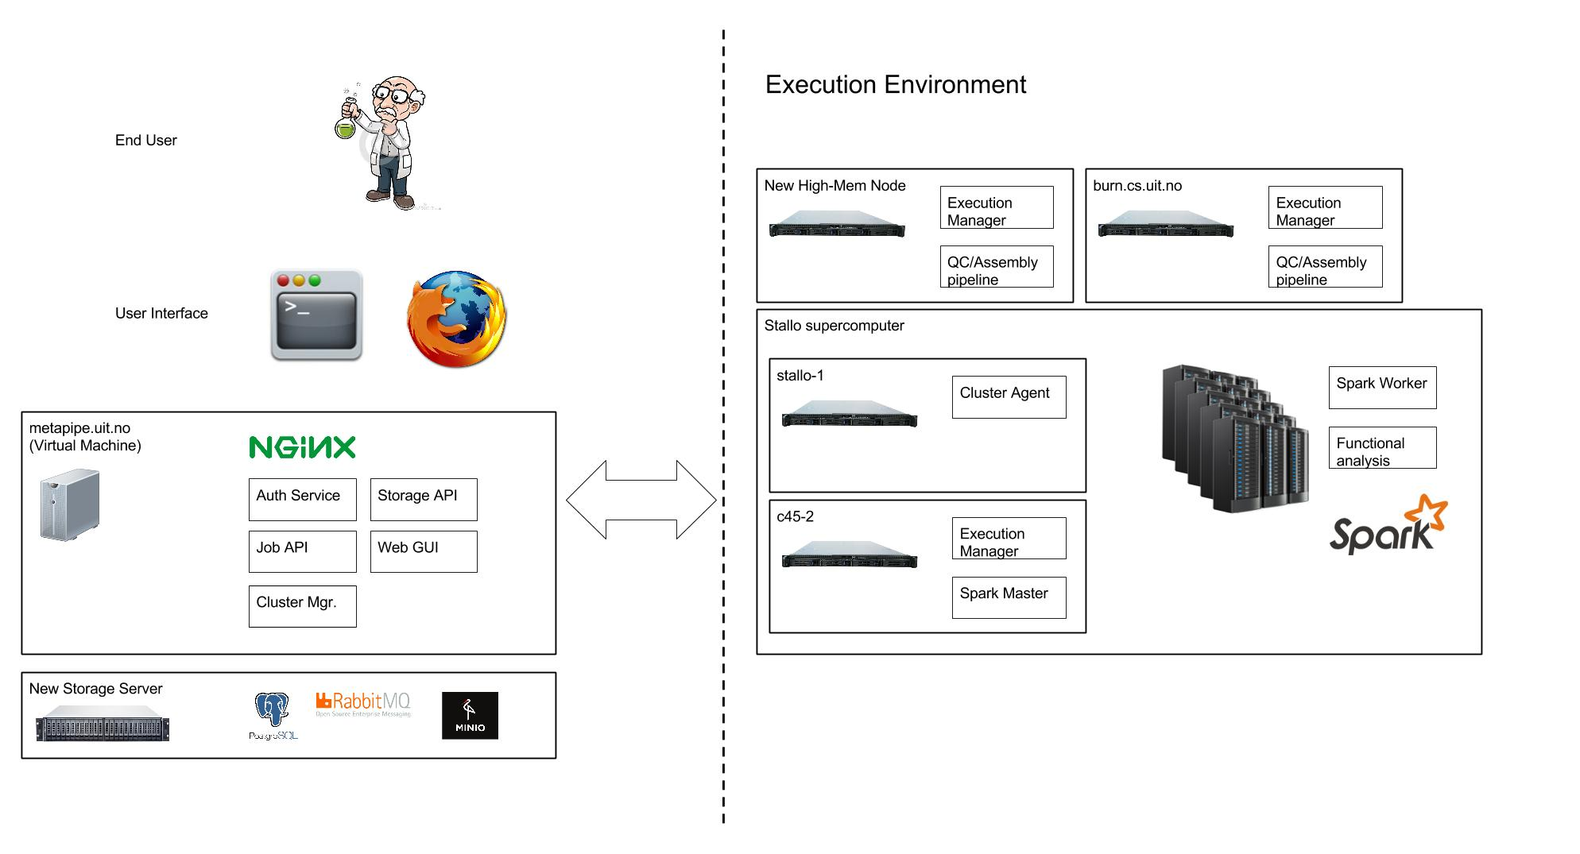
META-pipe physical architecture

Slide 16
META-pipe: cloud execution
Pipeline tools & reference DBs:
  Mostly 3rd party binaries
  Hundreds of GB of reference DBs
  Packaged in META-pipe Jenkins server
  Not in a container/ VM (no benefits for now)
  Ongoing: standardize provenance data reporting
Spark program
  Regular spark program + abstractions/interfaces for running 3rd party binaries
  Ongoing: better error detection, logging, and handling
  TODO: more secure execution
  TODO: accounting and payment

Slide 17
META-pipe: cloud execution
Spark, NFS execution environment:
  Standalone Spark
  NFS since some tools need a shared file system
  Ongoing: optimize execution environments
  Ongoing: test scalability
  Ongoing: test AWS
cPouta ansible playbook
  Setup Spark and NFS execution environment on cPouta OpenStack
  Setup execution environment on CESNET Open Nebula
  Ongoing: testing setup on EGI Federated Clouds (OCCI)

Slide 18
MMG EOSC Pilot
Marine metagenomics use case, Elixir Compute Platform, EGI Elixir Competency Center
Aims:
  Evaluate the performance of META-pipe and EMG at scale using EOSC resources.
  Cost-optimize the analyses on EOSC.
  Evaluate the use of elasticity in EOSC for execution of job queues.
  Develop a full-service delivery model and potential business model between the stakeholders and entities involved.
Not funded
Next step: Nordic Open Science Cloud?
https://docs.google.com/document/d/124x5ygyE5xIUVHJOq94TwoqLxHgABxGhmrawEmXdN5w/edit#

Slide 19
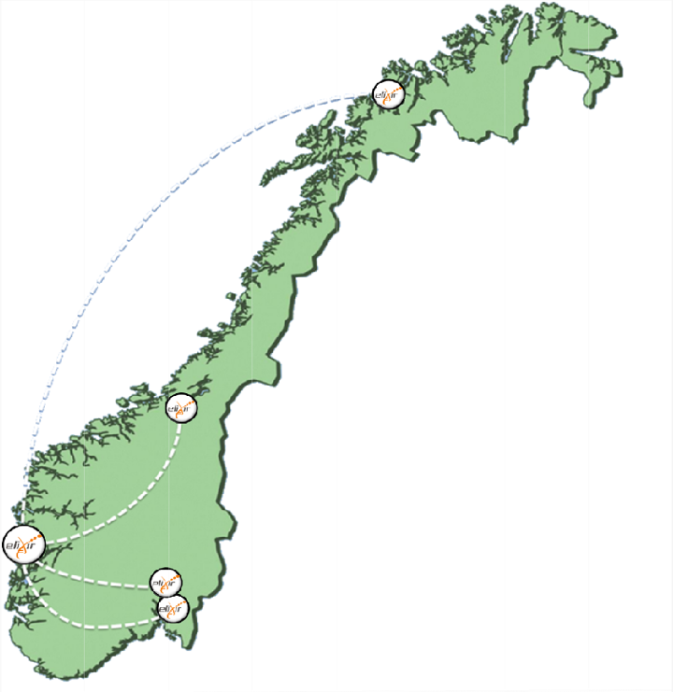










ELIXIR Norway
Bioinformatics services for Norwegian users
  Tools
  Pipelines
  Compute resources
  Storage resources (project & archive)
  Sensitive data storage and analysis
  Common Galaxy interface
  User profile management

Slide 20
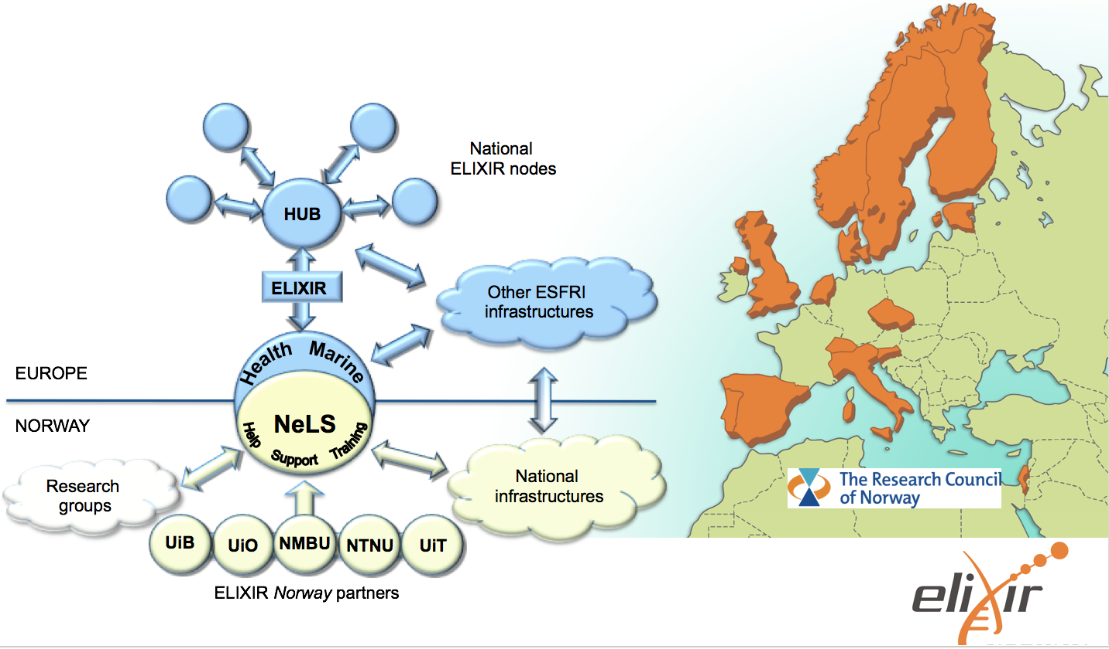
ELIXIR Norway and Norwegian Bioinformatics Platform

Slide 21
ELIXIR Norway:
Data life cycle management

Slide 22
ELIXIR-Norway 2
WP8 ELIXIR Europe deliverables
WP7 Help Desk
WP3
Microbial Genomics
WP4
Non-human Genomics
WP5
Biomedicine
WP6
Systems Biology
WP1 Project
Management
WP2 NeLS
Sigma2
TSD

Slide 23
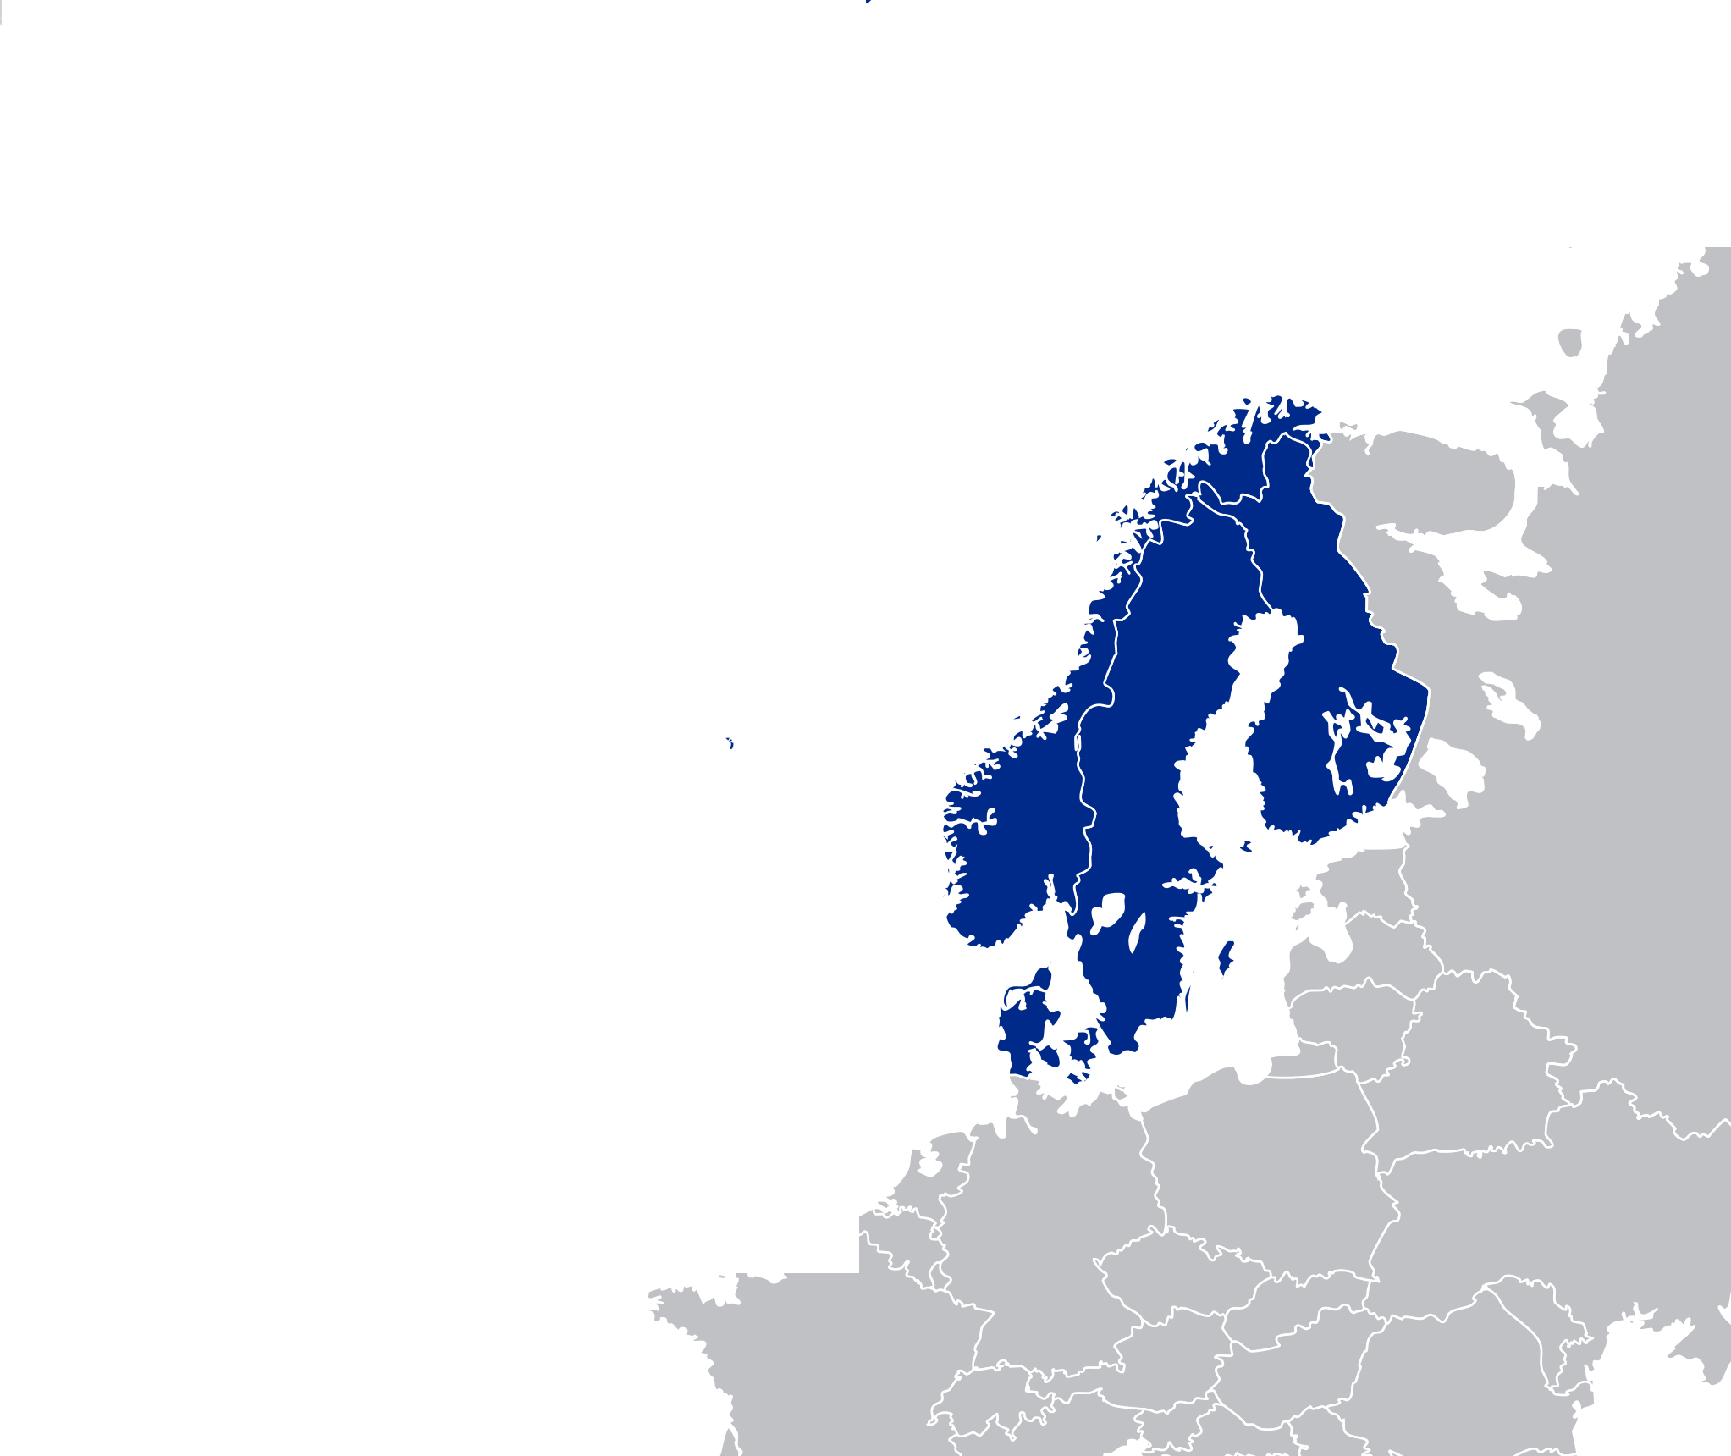

Tryggve2 project
COLLABORATION FOR SENSITIVE BIOMEDICAL DATA
Project aims to strengthen biomedical research by facilitating use of sensitive data in cross-border projects
Partners and funders are NeIC and ELIXIR Nodes in Denmark, Finland, Norway and Sweden
3-year project with volume of ca. 200 PMs /year (starts 2017)
Project builds on strong existing capacities and resources in Nordic countries

Slide 24
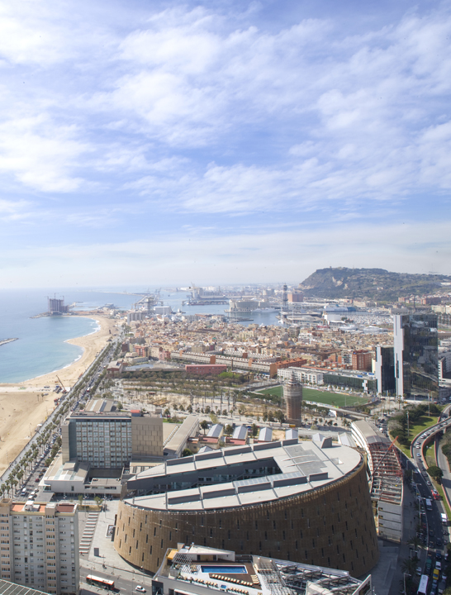

Project goal
European Genome-Phenome
archive (EGA)
Project goal:
To transform the EGA to a joint project (in the context of ELIXIR Europe) to have a real impact in the development of personalized medicine
The EGA was created in 2008 by the EBI

Slide 25





The EGA contains a growing amount of data
>3.5 PB*
~760,000 files*
July-2010
Oct-2016
* Files encrypted in different formats are counted only once

Slide 26

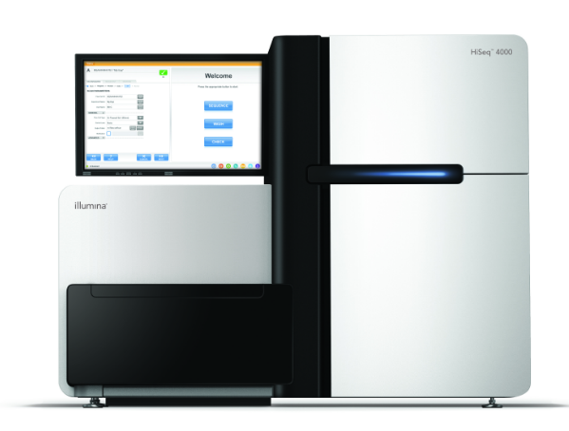








TSD Services for sensitive data/Elixir distribution
Safe handling of sensitive data
High performance computing
Analytical tool facilitation
Data staging
Institution
security
CF-proj
login
CF-users
Colossus
Internet
encrypted data
rw
file lock
fx01
USER-
proj
file lock
fx03
End-users

Slide 27
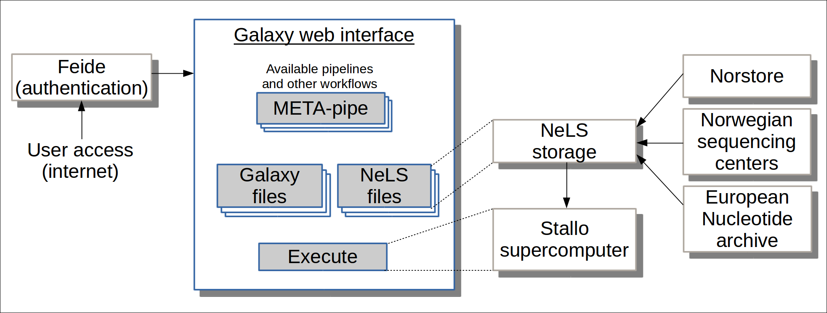
META-pipe on NeLS

Slide 28
Summary
ELIXIR: distributed infrastructure for life science data analysis
Marine metagenomics is a demonstrator for ELIXIR platforms
META-pipe marine metagenomics analysis pipeline
  Spark based backend
  Portable execution on different clouds
ELIXIR-Norway provides services for Norwegian users
  Galaxy analysis pipelines and project management
  Access to storage and compute
  Sensitive data in TSD, TRYGGVE, and Local EGA
  End-to-end solution for Norwegian life scientists

