Slide 1
NeLS Norwegian e-Infrastructure for Life Sciences
Overview and recent developments
Lars Ailo Bongo
NBS meeting
Tromsø, Jan 23, 2016
https://nels.bioinfo.no/

Slide 2
Acknowledgements
Many of the slides are copied (and somewhat edited) from presentations by:
Sveinung Gundersen (UiO)
Kidane M. Tekle (UiB)
Kjell Petersen / Wei Zhang (UiB)
David Fredman (UiB)
Kjetil Klepper (NTNU)

Slide 3
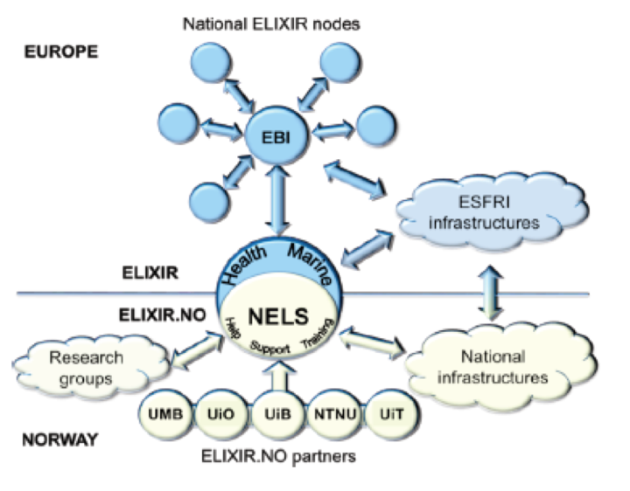
ELIXIR.NO
Norwegian node of the european ELIXIR project
Financed by the Norwegian Research Council until 2017

Slide 4
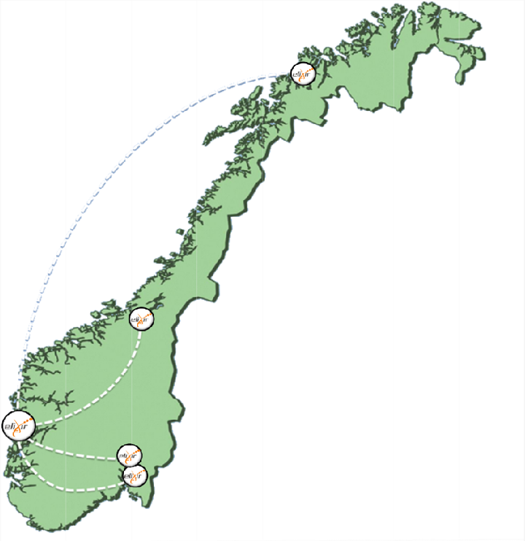
NeLS - Norwegian e-Infrastructure for Life Science

Slide 5
Use case
data
CPU
tool
?
Collaborators
Access rights
Accounting
…
Backup
Archiving
Sensitive
Transfer
…
Scalability
Wait time
Accounting
Cost
…
Best tool(s)
Quality management
Installation
Upgrade
Repeatability
…
Who to ask
Where to learn
…

Slide 6
Use case
data
CPU
results
!
NeLS Norwegian e-Infrastructure for Life Sciences

Slide 7
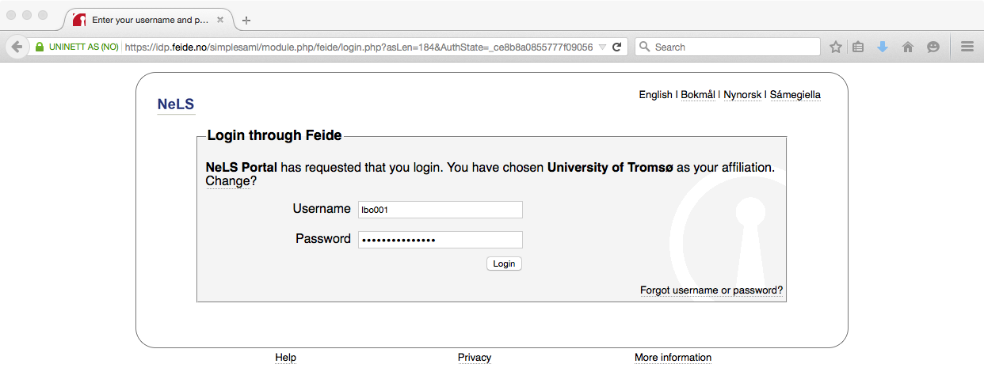
User view
data
CPU
tool
?

Slide 8
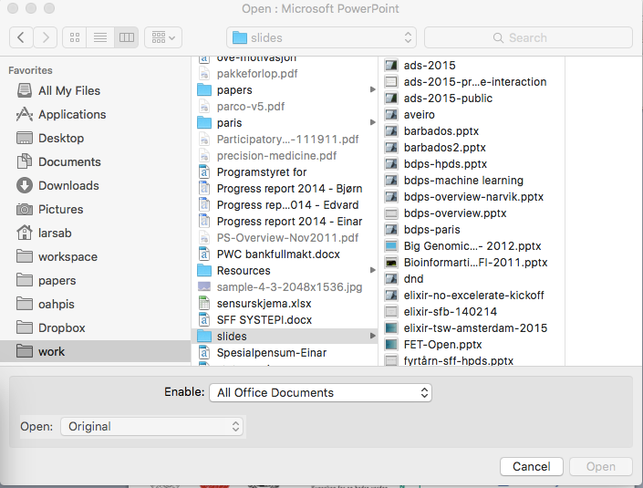
User view
data
CPU
tool
?

Slide 9
User view
data
CPU
tool
?
(transparent)

Slide 10
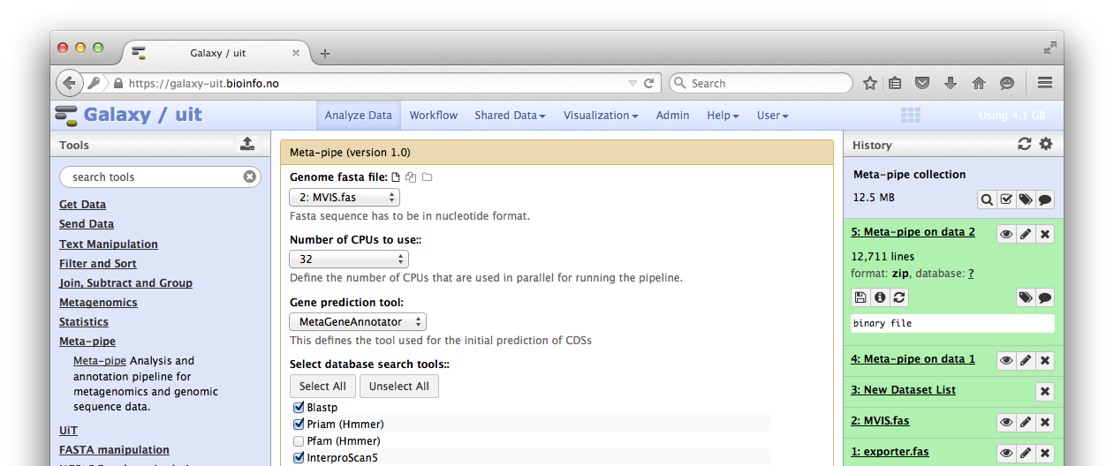
User view
data
CPU
tool
?

Slide 11
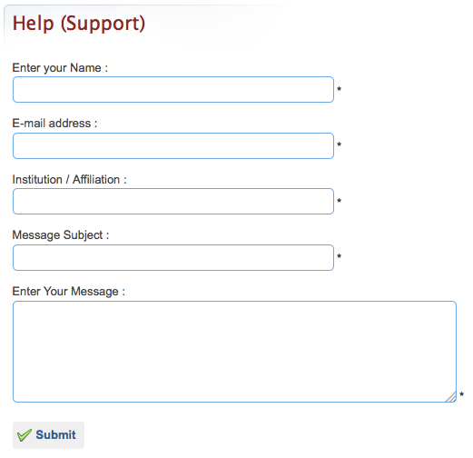
User view
data
CPU
tool
?

Slide 12
Technology view
data
CPU
tool
?
TSD

Slide 14
Project status and future plans
Development
Key services
Selected pipelines
Key infrastructure
Production
Initial users
Scale-out
More users
More pipelines
Better services
Integration with more infrastructures

Slide 15
NeLS portal
Current status
Access NeLS storage and core NeLS functionality
File upload & download
Share files in project areas
Privileged access for help desk users
Current work
Up/downloading to/from StoreBioInfo

Slide 16
NeLS pipelines
RNA-seq
Eukaryote (paired and single-end)
Prokaryote
Variant calling
Germline
Somatic
Metagenomics

Slide 17
Pipelines to be developed
ChIP-seq
small RNA (incl. miRNA) annotation
miRNA prediction (mirMiner)
Update RNA-seq pipelines with Quality Control, and downstream analyses (GO term enrichment...)
Better visualization options (e.g. genome browsers)
Possibly:
DNA metylation
EBI/Ensembl genome annotation pipeline
Proteomics
Sequence assembly

Slide 18
Other pipeline work
Making sure that the pipelines are being used and are relevant for users
Quality assurance
Keeping the pipelines up to date
Making sure that parameters/tools make sense
User support

Slide 19
NeLS galaxies
Main platform for running workflows (pipelines)
Web-based platform
Tools run on single server or computer clusters
5 national Galaxy installations
Single authentication for users:
Use NeLS portal to share data between Galaxies

Slide 20
Galaxy within TSD
Prototype Galaxy within TSD
More streamlined Galaxy deployment solution is under development

Slide 21
Collaboration with sequencing providers
Main ambition for spring 2016:
Allow sequencing providers (core facilities) to transfer sequencing data to NeLS
Help researchers to further analyze their data using Galaxy tools/pipelines or other solutions,
Help with archiving using StoreBioInfo

Slide 22
Data flow overview
Customer info,
Data,
[Analysis]
1. Core facility
scp / sshfs
Dropbox
2. Elixir Helpdesk
Shared NeLS project
Durable archive
3. User
Online Access

Slide 23
Ease of use
NeLS enables you on one place to access all your data
TSD
Galaxy
NeLS Storage
NeLS portal
StoreBioInfo

Slide 24
3-layer design and different user roles ensure data safety
Galaxy
TSD
NeLS portal
1. Users work on active data here
NeLS storage
Data curation into structured storage
TSD file lock server
project
2. Structured data to keep
StoreBioinfo
NorStore
archive

Slide 25
Summary
In production use
Key services for data management and analysis
Hide messy and boring details
Help desk and training
We want (and need) more users
Many new, and useful, features in production

