Slide 1

META-pipe: marine metagenomics data analysis service
Lars Ailo Bongo (CS, UiT)
PDS 2017, 17 August 2017,
Sommarøya, Norway

Slide 2
BDPS lab
Research
  Build systems for bioinformatics analysis
  Interdisciplinary projects
  Norwegian Woman and Cancer study
  Tromsø lung study
Infrastructure
  ELIXIR and ELIXIR-NO
Commercialization
  Medsensio startup
Outreach
  Crowdsourced air pollution data
http://bdps.cs.uit.no/

Slide 3
Outline
Computer science research challenges in life sciences
ELIXIR
  Distributed infrastructure for life science data analysis
  Big European research infrastructure project
META-pipe and the Marine Metagenomics Portal
  Our contributions to ELIXIR
  Marine metagenomics data analysis
  Reference databases
  Backend system design
Security and privacy hand-waving

Slide 4
ELIXIR’s mission
To build a sustainable European infrastructure for biological information, supporting life science research and its
translation to:
medicine
environment
bioindustries
society

Slide 5
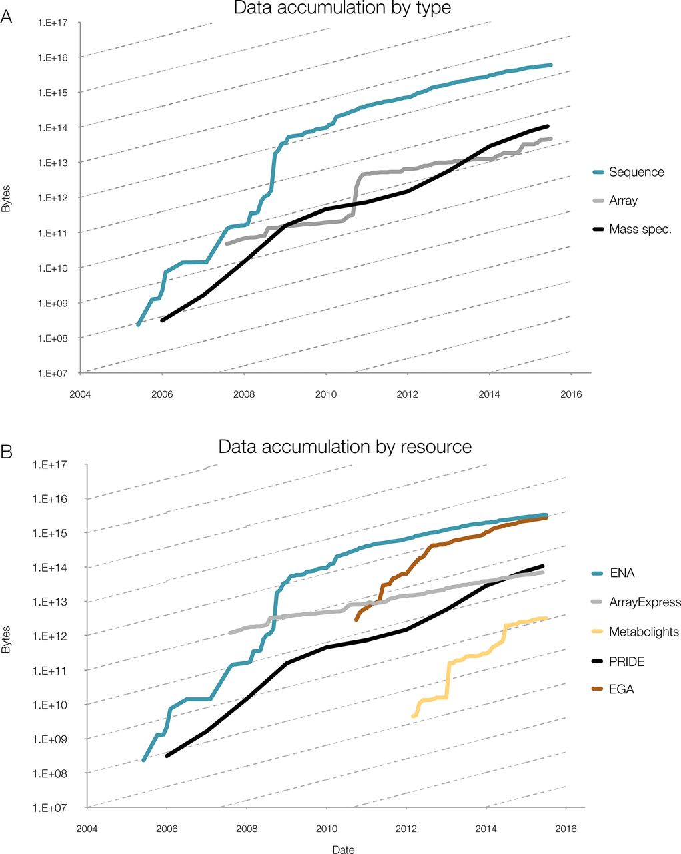
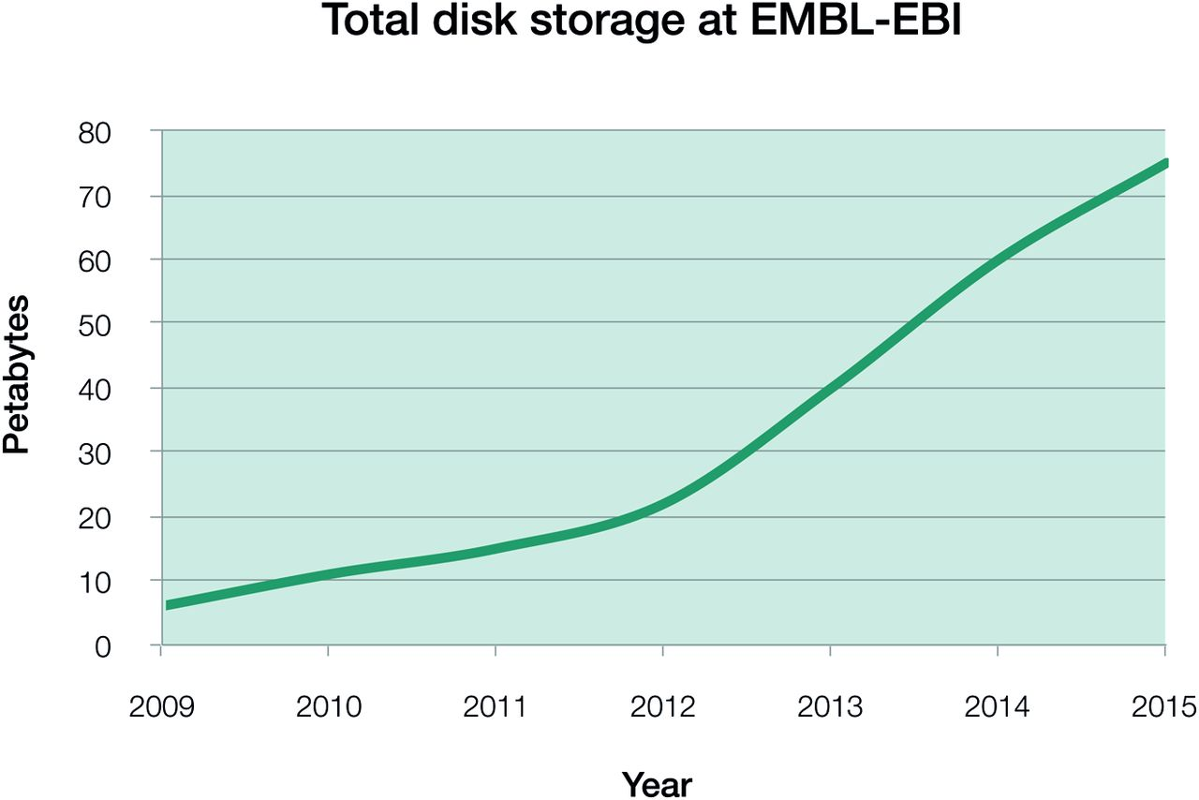
Data growth in the life sciences
Data growth at EMBL-EBI
Source: Charles E. Cook et al. Nucl. Acids Res. 2016;44:D20-D26
Notes:
Phenomenal data growth – dotted lines represents doubling every twelve months
(A) Data accumulation at EMBL-EBI by data type, for example mass spectrometry (MS); (B) Data accumulation by dedicated resource, for example PRIDE. The y-axis is log-scale, with the slope of the dashed lines indicating a 12-month doubling time. Continued data growth is seen in all types of data at EMBL-EBI and all data resources. In all data resources shown here, growth rates are predicted to continue increasing, with notable sustained exponential growth in PRIDE, the European Genome-phenome Archive (EGA) and MetaboLights: all have doubling times of around 12 months. All three contributing platforms show rates that are increasing over time, with data growing exponentially with around a 12-month doubling time.
EGA – European Genome-phenome Archive, PRIDE – Proteome identification database

Slide 6
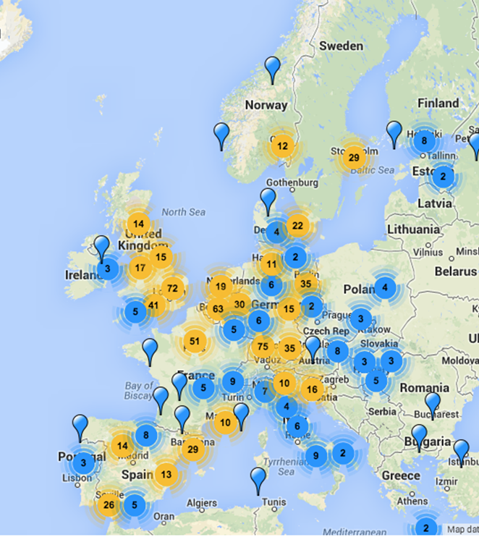
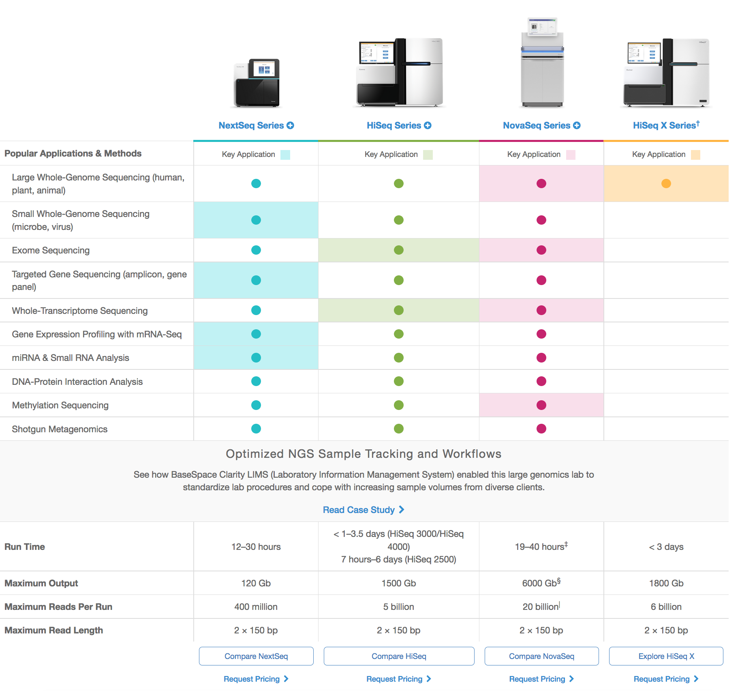
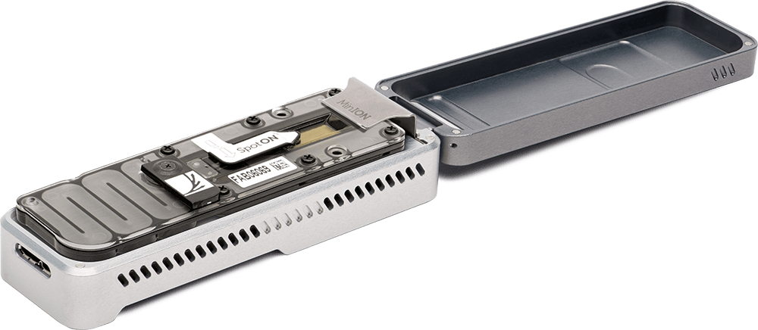
The data challenge: Geographic spread
http://omicsmaps.com
http://www.illumina.com/systems/sequencing-platforms.html

Slide 7
ELIXIR goals
Issue: many services built in projects with short term financing
Solution: deliver services with long term financing
  Core data resources
  Commissioned services (our long term goal)
  Elixir node (country) services
Issue: data and services at one (few) location
Solution: scale by distributing
  Data
  Computation
  Analysis services (development)
  Data curation
  Training

Slide 8
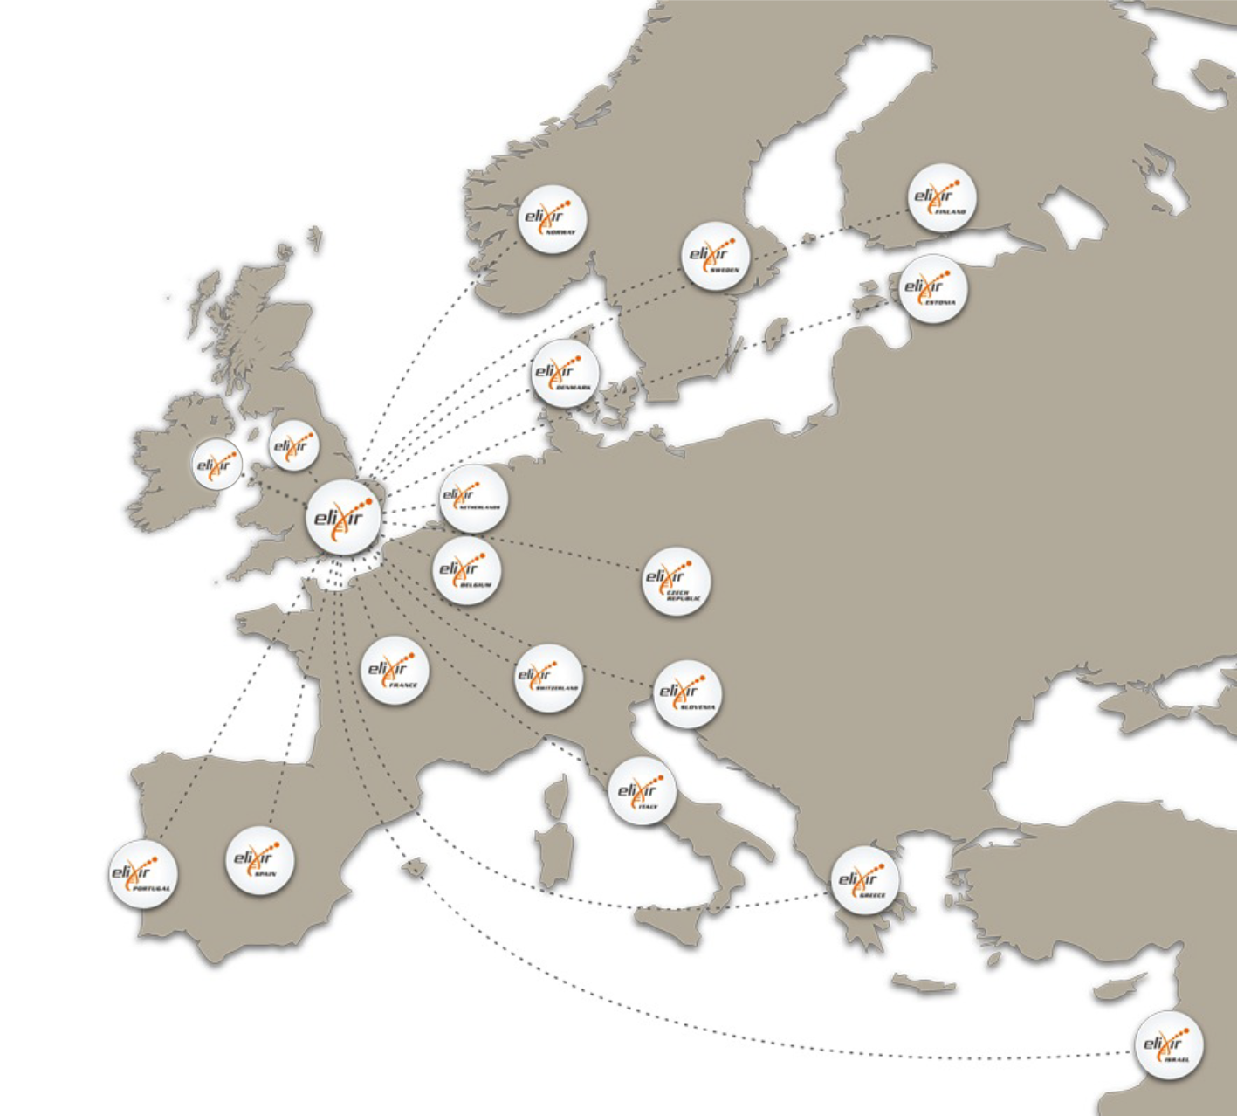










ELIXIR: An international distributed infrastructure for biological data
Technical platforms
Data
Standards
Tools
Compute
Training
User communities
Marine metagenomics
Crop and forest plants
Human data
Rare diseases

Slide 9
Platforms
Compute platform
  Services to store, share, and analyze large datasets.
Interoperability platform
  Standards to describe life science data.
Training platform
  Organize training workshops.
Data platform
  Identify key data resources, link data with literature.
Tools platform
  Help researchers find the best tools for their data.
https://www.elixir-europe.org/platforms

Slide 10
Scientific use cases
Marine metagenomics
  Led by: Rob Finn (EBI) and Nils P Willassen (UiT)
  Delivered services with many users
  Demonstrator for many ELIXIR services
Human data
Rare diseases
Plant sciences
https://www.elixir-europe.org/use-cases

Slide 11
Microbiomes and metagenomics
Metagenomics = genetic analysis of microbiome samples
Microbiome: microorganisms in a particular environment
Microorganisms: bacteria, viruses, fungi
  They have no privacy rights
  Not even human stool samples(?)
Environments:
  Human intestines and skin
  Food
  Oceans
  …everywhere else

Slide 12
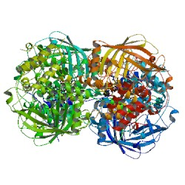
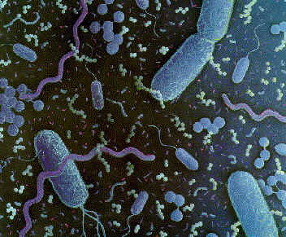
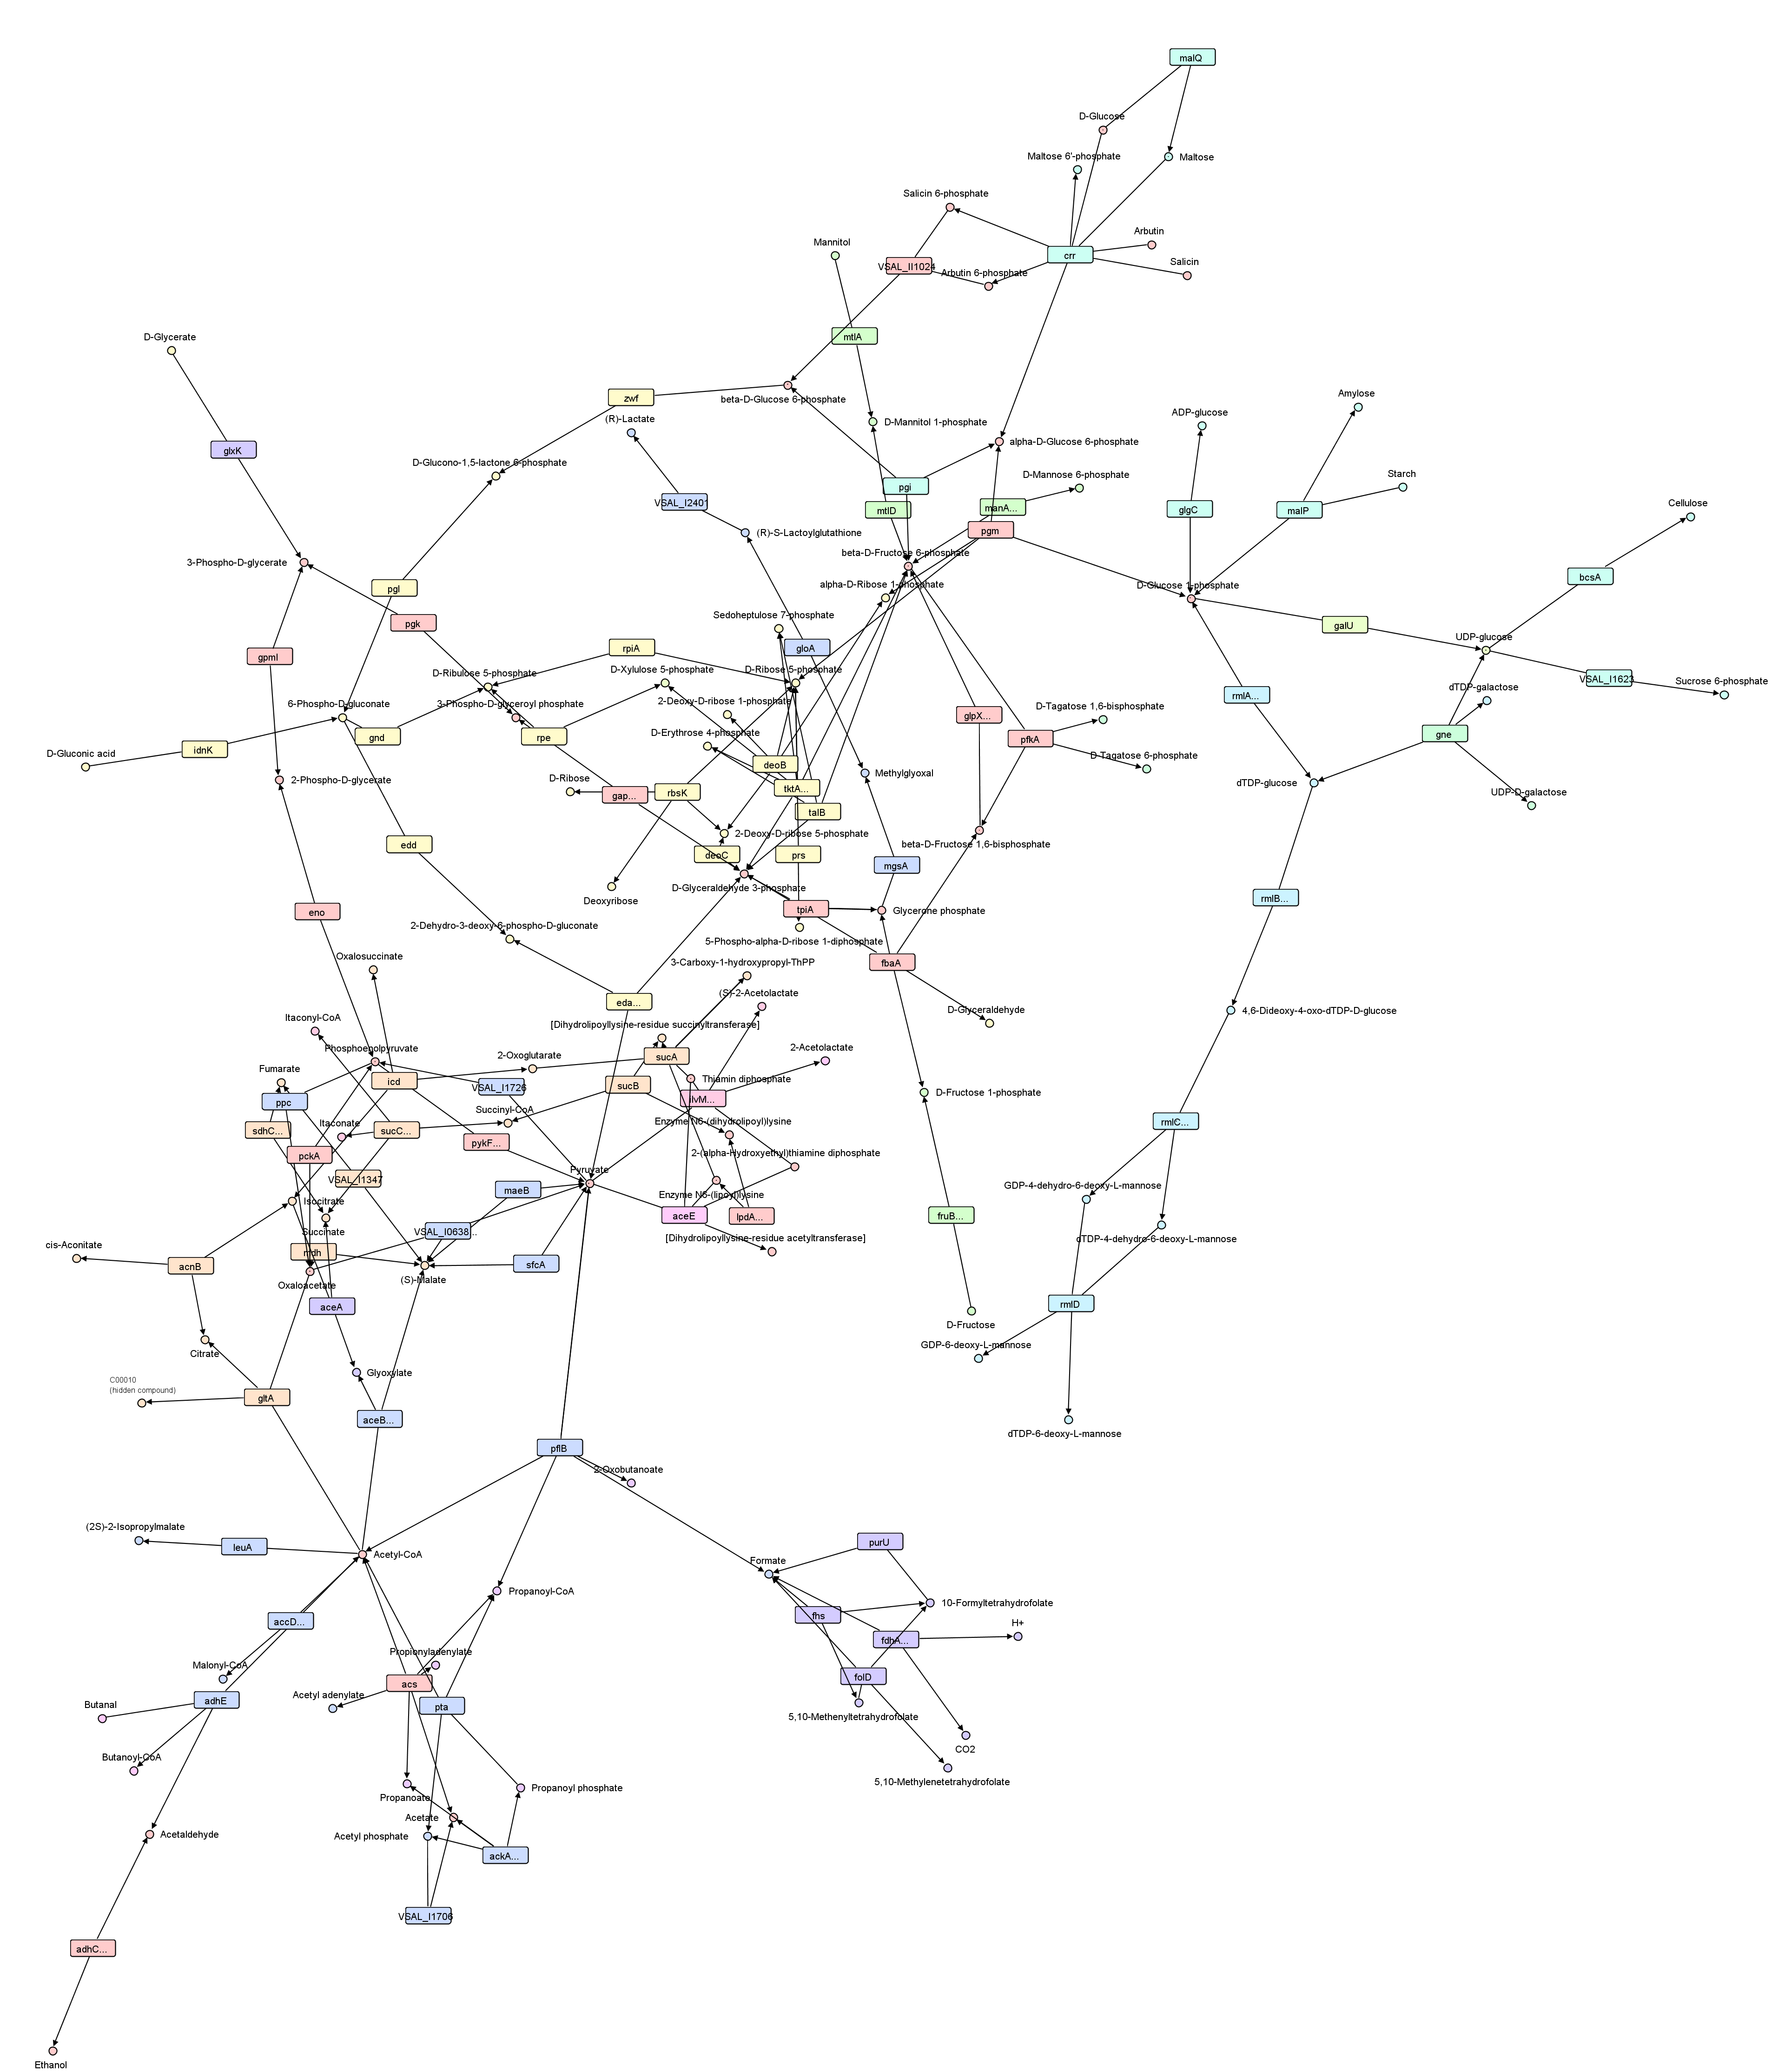
Metagenomics
Who
is there?
What are they doing?
How are they doing it?

Slide 13
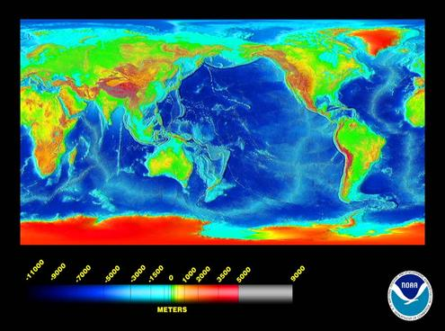
Marine
Big and deep
Many microorganisms
Mostly unexplored
Example of analyses:
  Understand ecosystem
  Fish farming
  Enzymes for industry

Slide 14
Metagenomics data analysis
Analysis done by tools in a pipeline
Pipelines:
  Deep: 10-20 tools
  Specialized to analysis needs
Tools:
  Process text files
  Many use reference databases
  Mostly unmodified 3rd party tools
  Often implemented by bioinformaticians and not well tested
  Memory constrained, or compute bound, or I/O bound

Slide 15
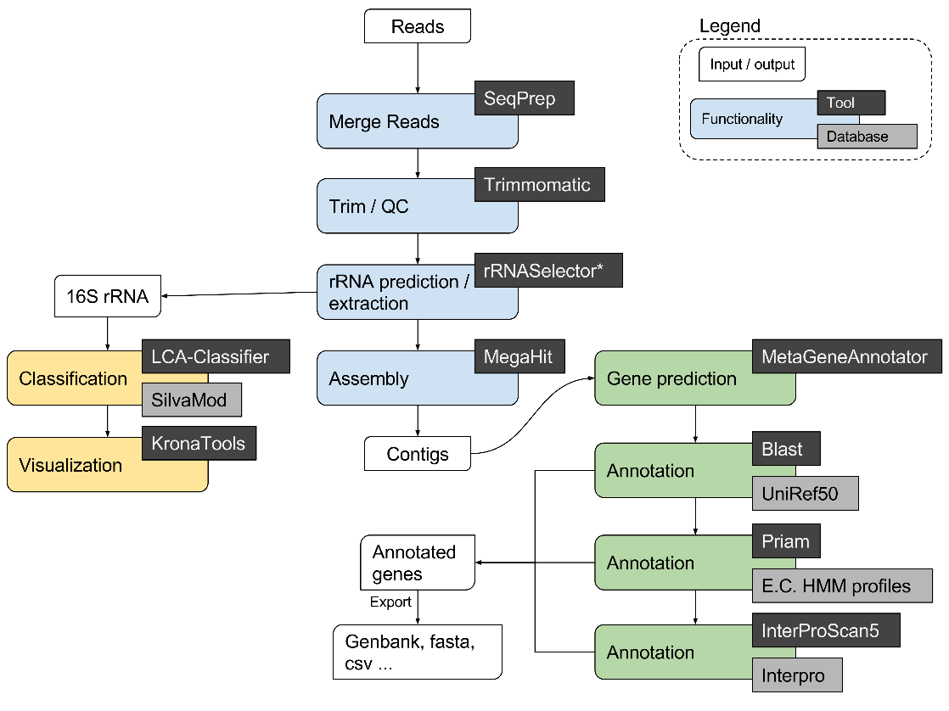
META-pipe: marine metagenomics analysis pipeline
2 as-a-service interfaces:
  Galaxy interface for Norwegian users (since 2015)
  Web app interface (to be released in 2017)
Compute intensive
Small team
Academic setting

Slide 16
Marine metagenomics WP
Define a comprehensive metagenomic data standards environment
  The metagenomic data life-cycle: standards and best practices, Gigascience 2017
Create marine reference databases
  The Marine Metagenomics Portal (MMP)
Implement pipelines for marine metagenomics analyses
  EBI Metagenomics
  UiT META-pipe (used to generate data for MMP)
Provide training and workshops
  Metagenomics training using META-pipe on CSC cPouta cloud

Slide 17

Marine Metagenomics Portal (MMP)
META-pipe analysis service (web app)
Marine reference databases:
  MarRef: human curated full genomes
  MarDB: human curated genes (automating curation soon)
  MarCat: META-pipe annotated genes
    Everything marine metagenomics (~5TB compressed)
    A few M CPU/hours processing time
  Currently 0.0000001% coverage
MarBLAST
  Bioinformatics search tool
https://mmp.sfb.uit.no/

Slide 18

Dataflow
Annotations
Sequence data
+ meta-data
ENA
MarRef
scripts
MarDB
Other pipelines
Sequencing machines
META-pipe
MarCat
Sequence
data

Slide 19
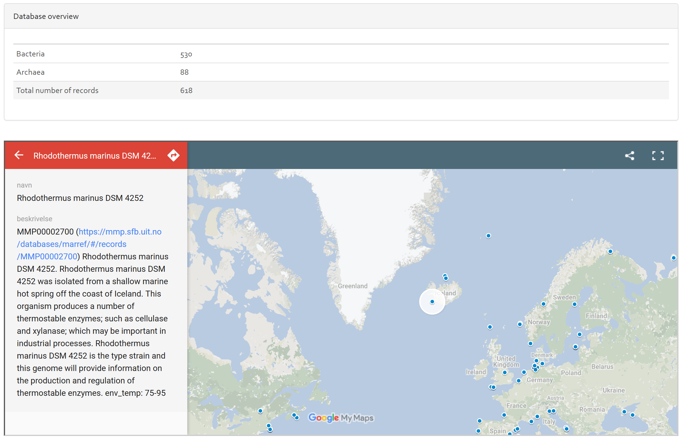
MarRef

Slide 20
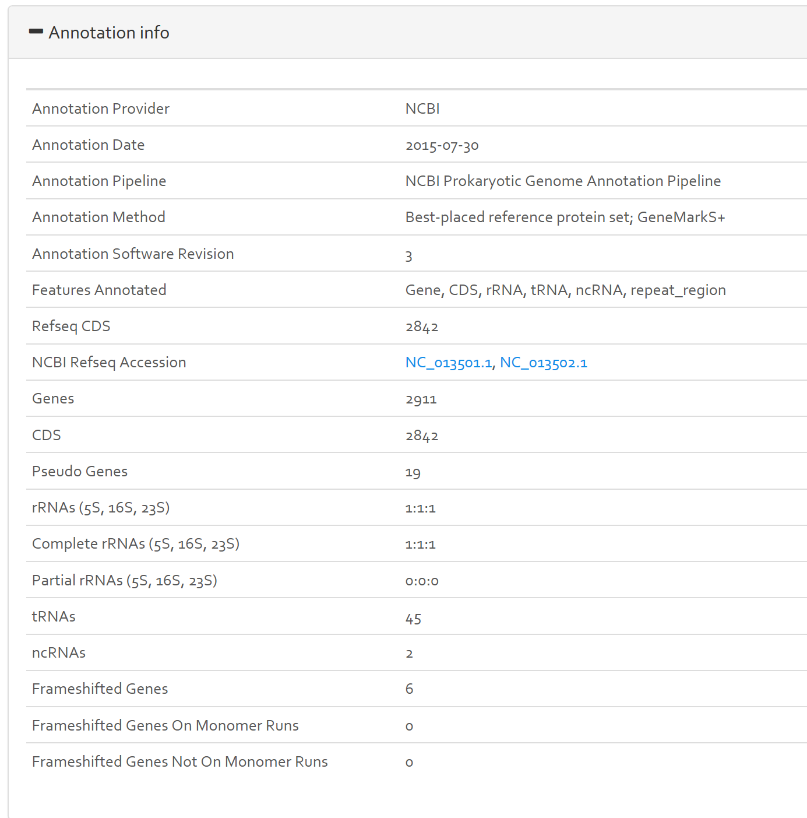
MarRef

Slide 21
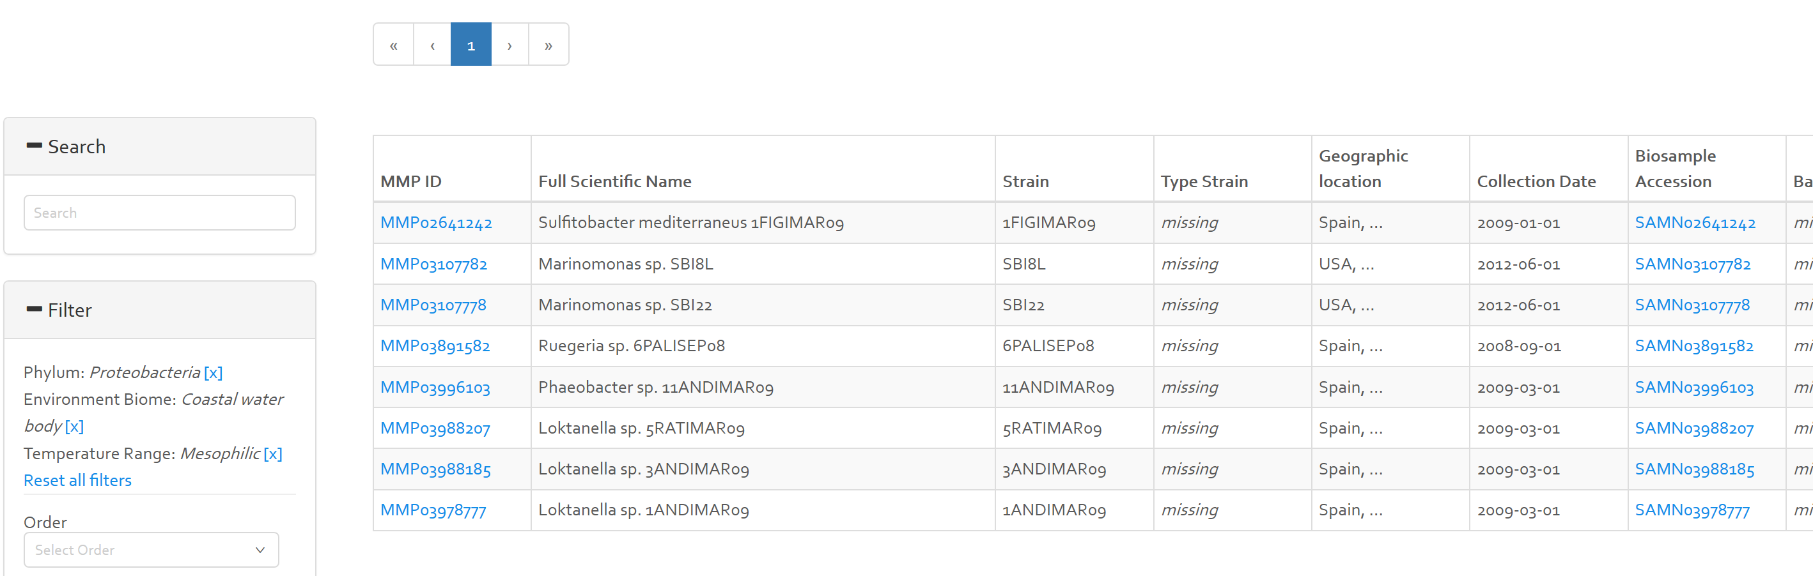
MarDB

Slide 22
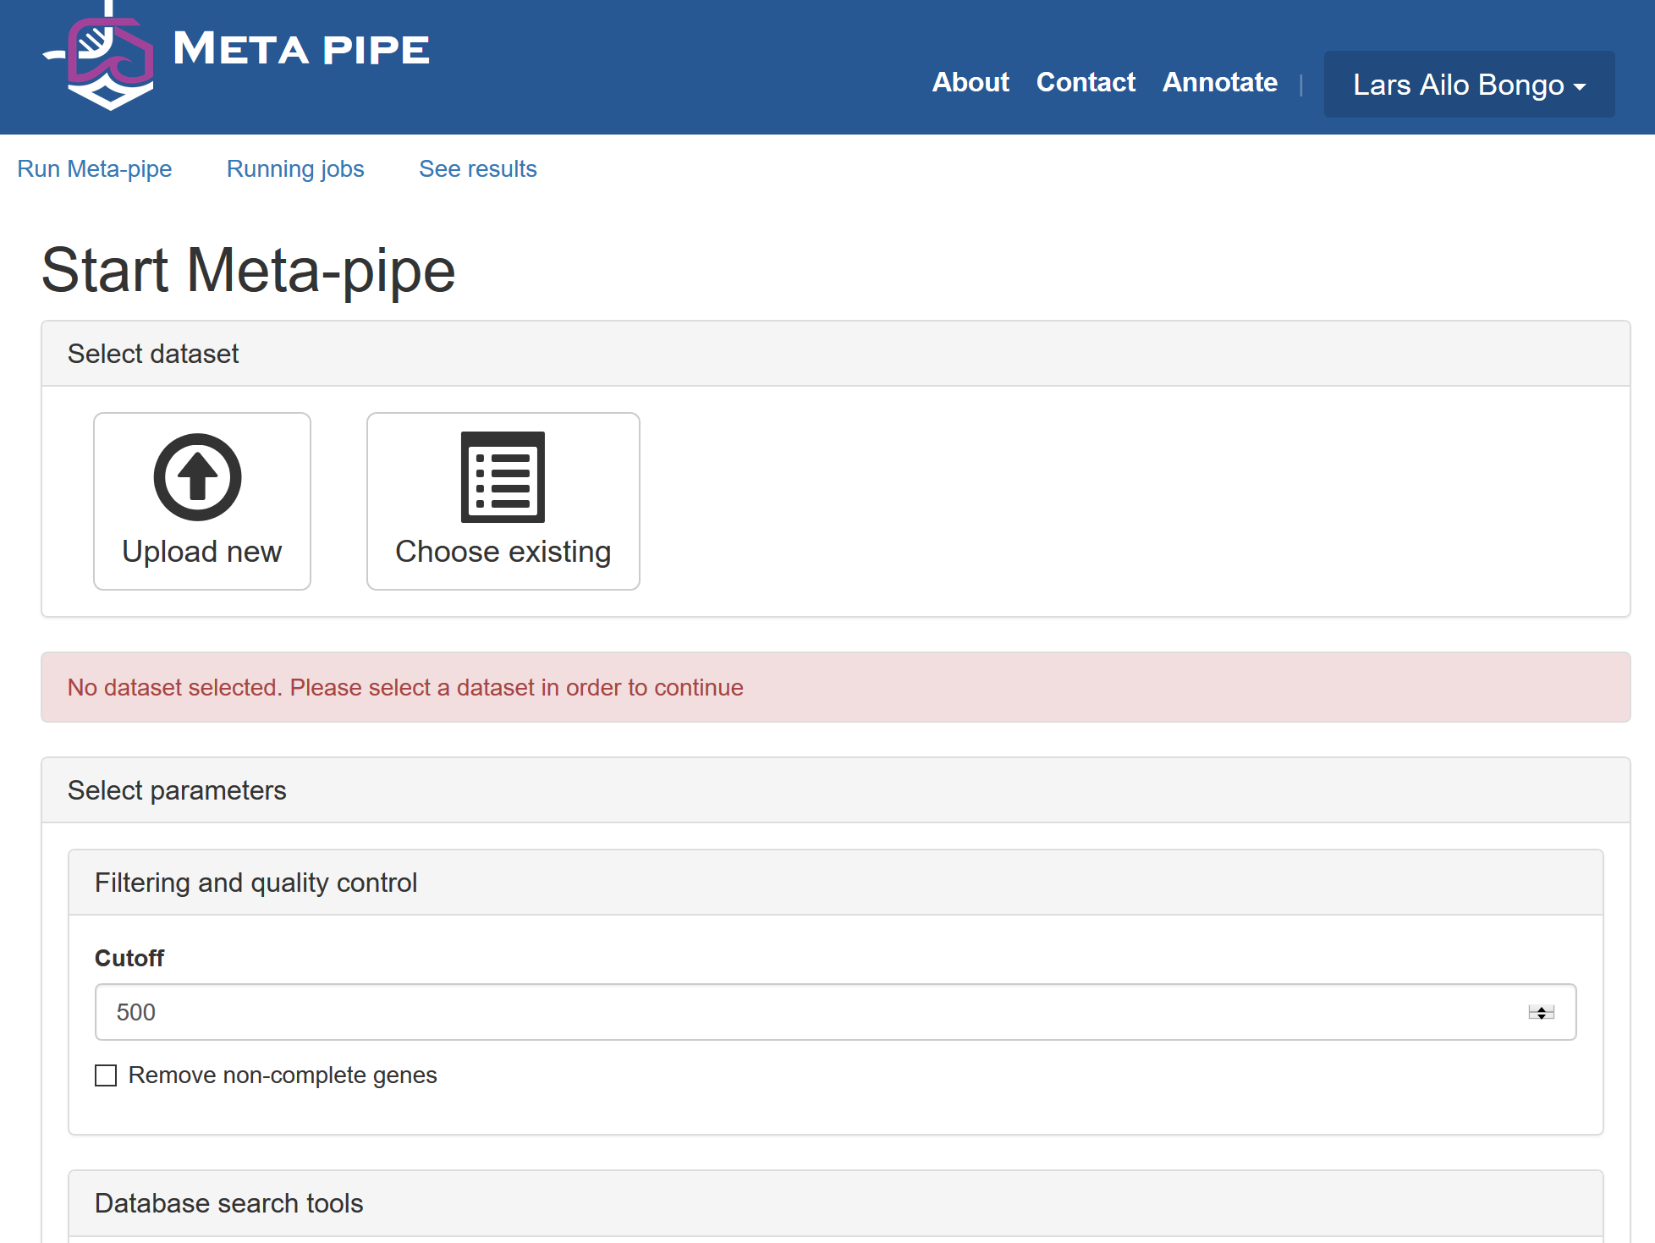

Slide 23
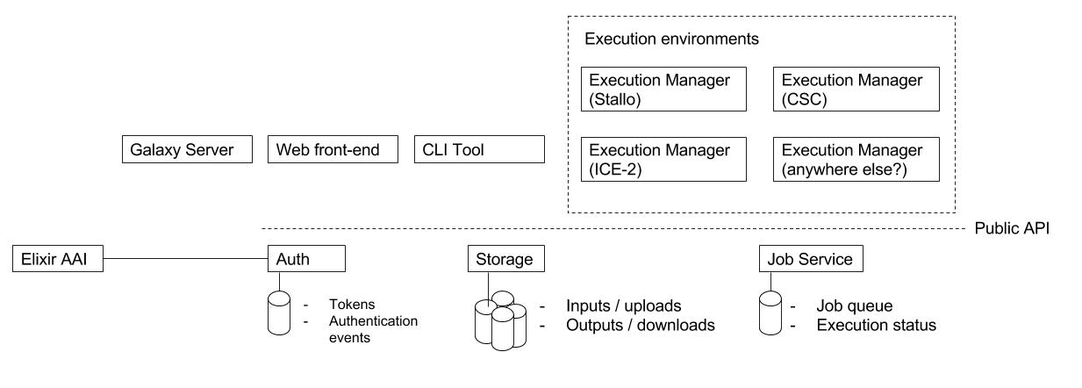
META-pipe: architecture
https://github.com/uit-no/elixir-excelerate/blob/master/meta-pipe.md

Slide 24
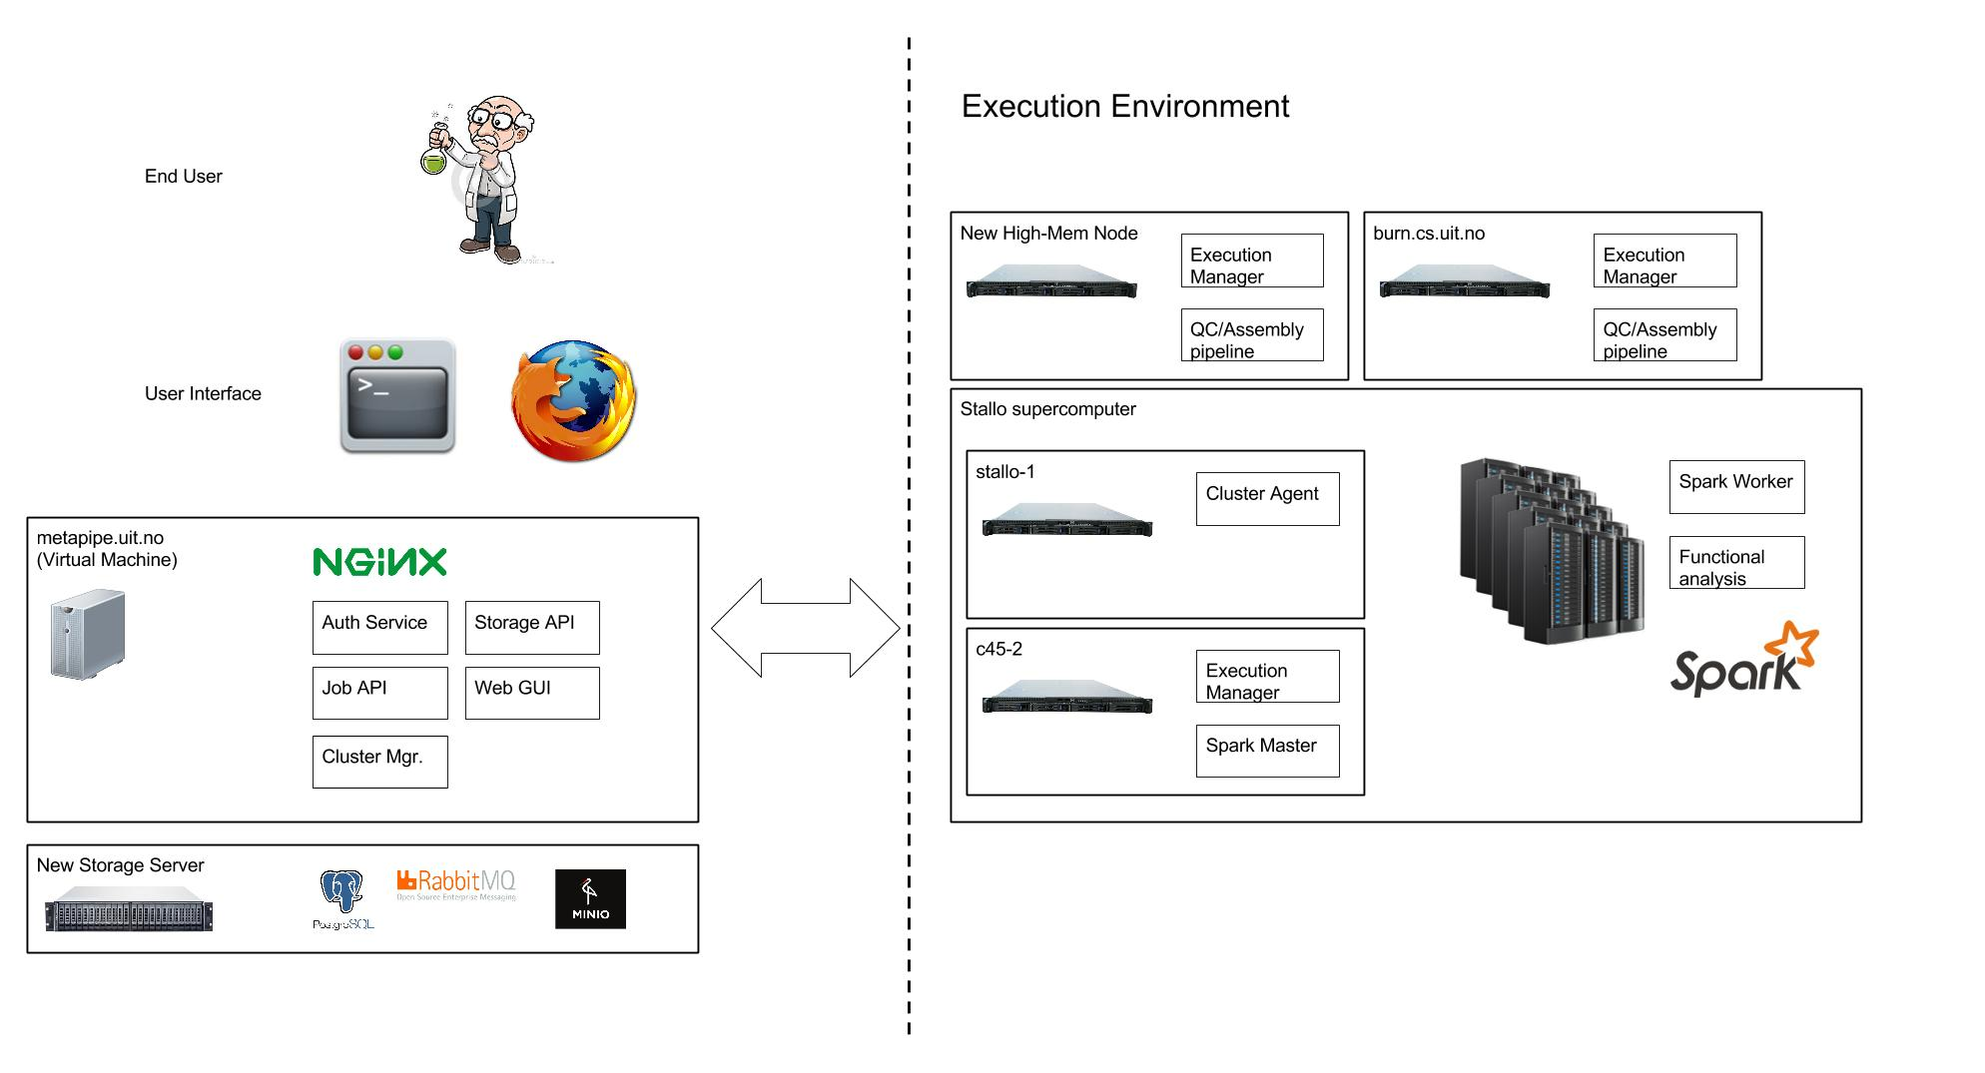
META-pipe physical architecture

Slide 25
META-pipe Auth server
Feide
edugain
Execution environment
Google
ORCID
Facebook
Authorization
Storage server
Authentication
ELIXIR
AAI
META-pipe Auth Server
Job server
Federated
user DB
Single login
site
Tokens
Authentication
events
Tokens with
scope

Slide 26
META-pipe: cloud execution
Pipeline tools & reference DBs:
  Mostly 3rd party binaries
  Hundreds of GB of reference DBs
  Packaged in META-pipe Jenkins server
  Not in a container/ VM (no benefits for now)
  Ongoing: standardize provenance data reporting
Spark program
  Regular spark program + abstractions/interfaces for running 3rd party tools
  Ongoing: better error detection, logging, and handling
  TODO: more secure execution
  TODO: accounting and payment

Slide 27
META-pipe: cloud execution
Spark, NFS execution environment:
  Standalone Spark
  NFS since some tools require a shared file system
  Ongoing: optimize execution environments
  Ongoing: test scalability
  Ongoing: test Amazon EMR elasticity
cPouta ansible playbook
  Setup Spark and NFS execution environment on cPouta OpenStack
  Setup execution environment on CESNET Open Nebula
  Setup Spark on EMR
  Ongoing: testing setup on EGI Federated Clouds (OCCI)

Slide 28
Security concerns
Issues:
  many 3rd party tools
  that are not well tested or implemented
  that process user submitted text files
  run by a single user on behalf of all users
  on someone else's hardware

Slide 29
Security solution
Hope and prayers
Isolation
  A pipeline execution can only access one input dataset
  Teardown execution environment after each pipeline execution
End-user authentication
  Academic institution, ORCID credentials

Slide 30
Some additional challenges
Job resource requirements
  One large memory machine (for assembly)
  Just I/O
  Lots of computation (embarrassingly parallel)
Hide execution (and failure) details from end-users
  Using external resources
  User submitted data
  Small team
Flexibility vs. resource usage predictability
  Users like to use tools and parameters of choice
  Parameters impact resource usage

Slide 31
Some additional challenges
Nobody wants to pay for computation
  Push problem to us and our users
Performance optimizations
  (Monetary) cost of computation is a problem
  Cheaper analysis is a competitive advantage
European counties do not want to spend money abroad
  No commercial clouds…but we use GCP and AWS
  Want to build own mini-clouds…we have a portable backend
Plan to use our backend for human data

Slide 32
Summary
ELIXIR distributed infrastructure
MMP and META-pipe
  Well designed backend = competitive advantage
  Reference databases = power
  Non-sensitive data = technological lead
Many open research challenges
  Most life science data is from humans
ELIXIR services have high impact

Slide 33
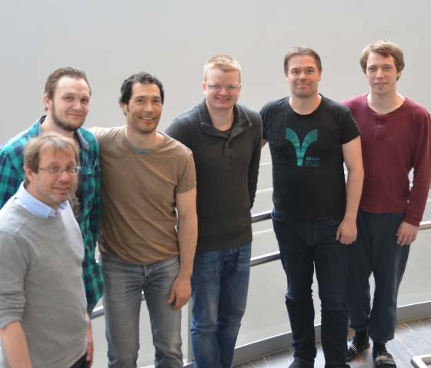
META-pipe team

Slide 34
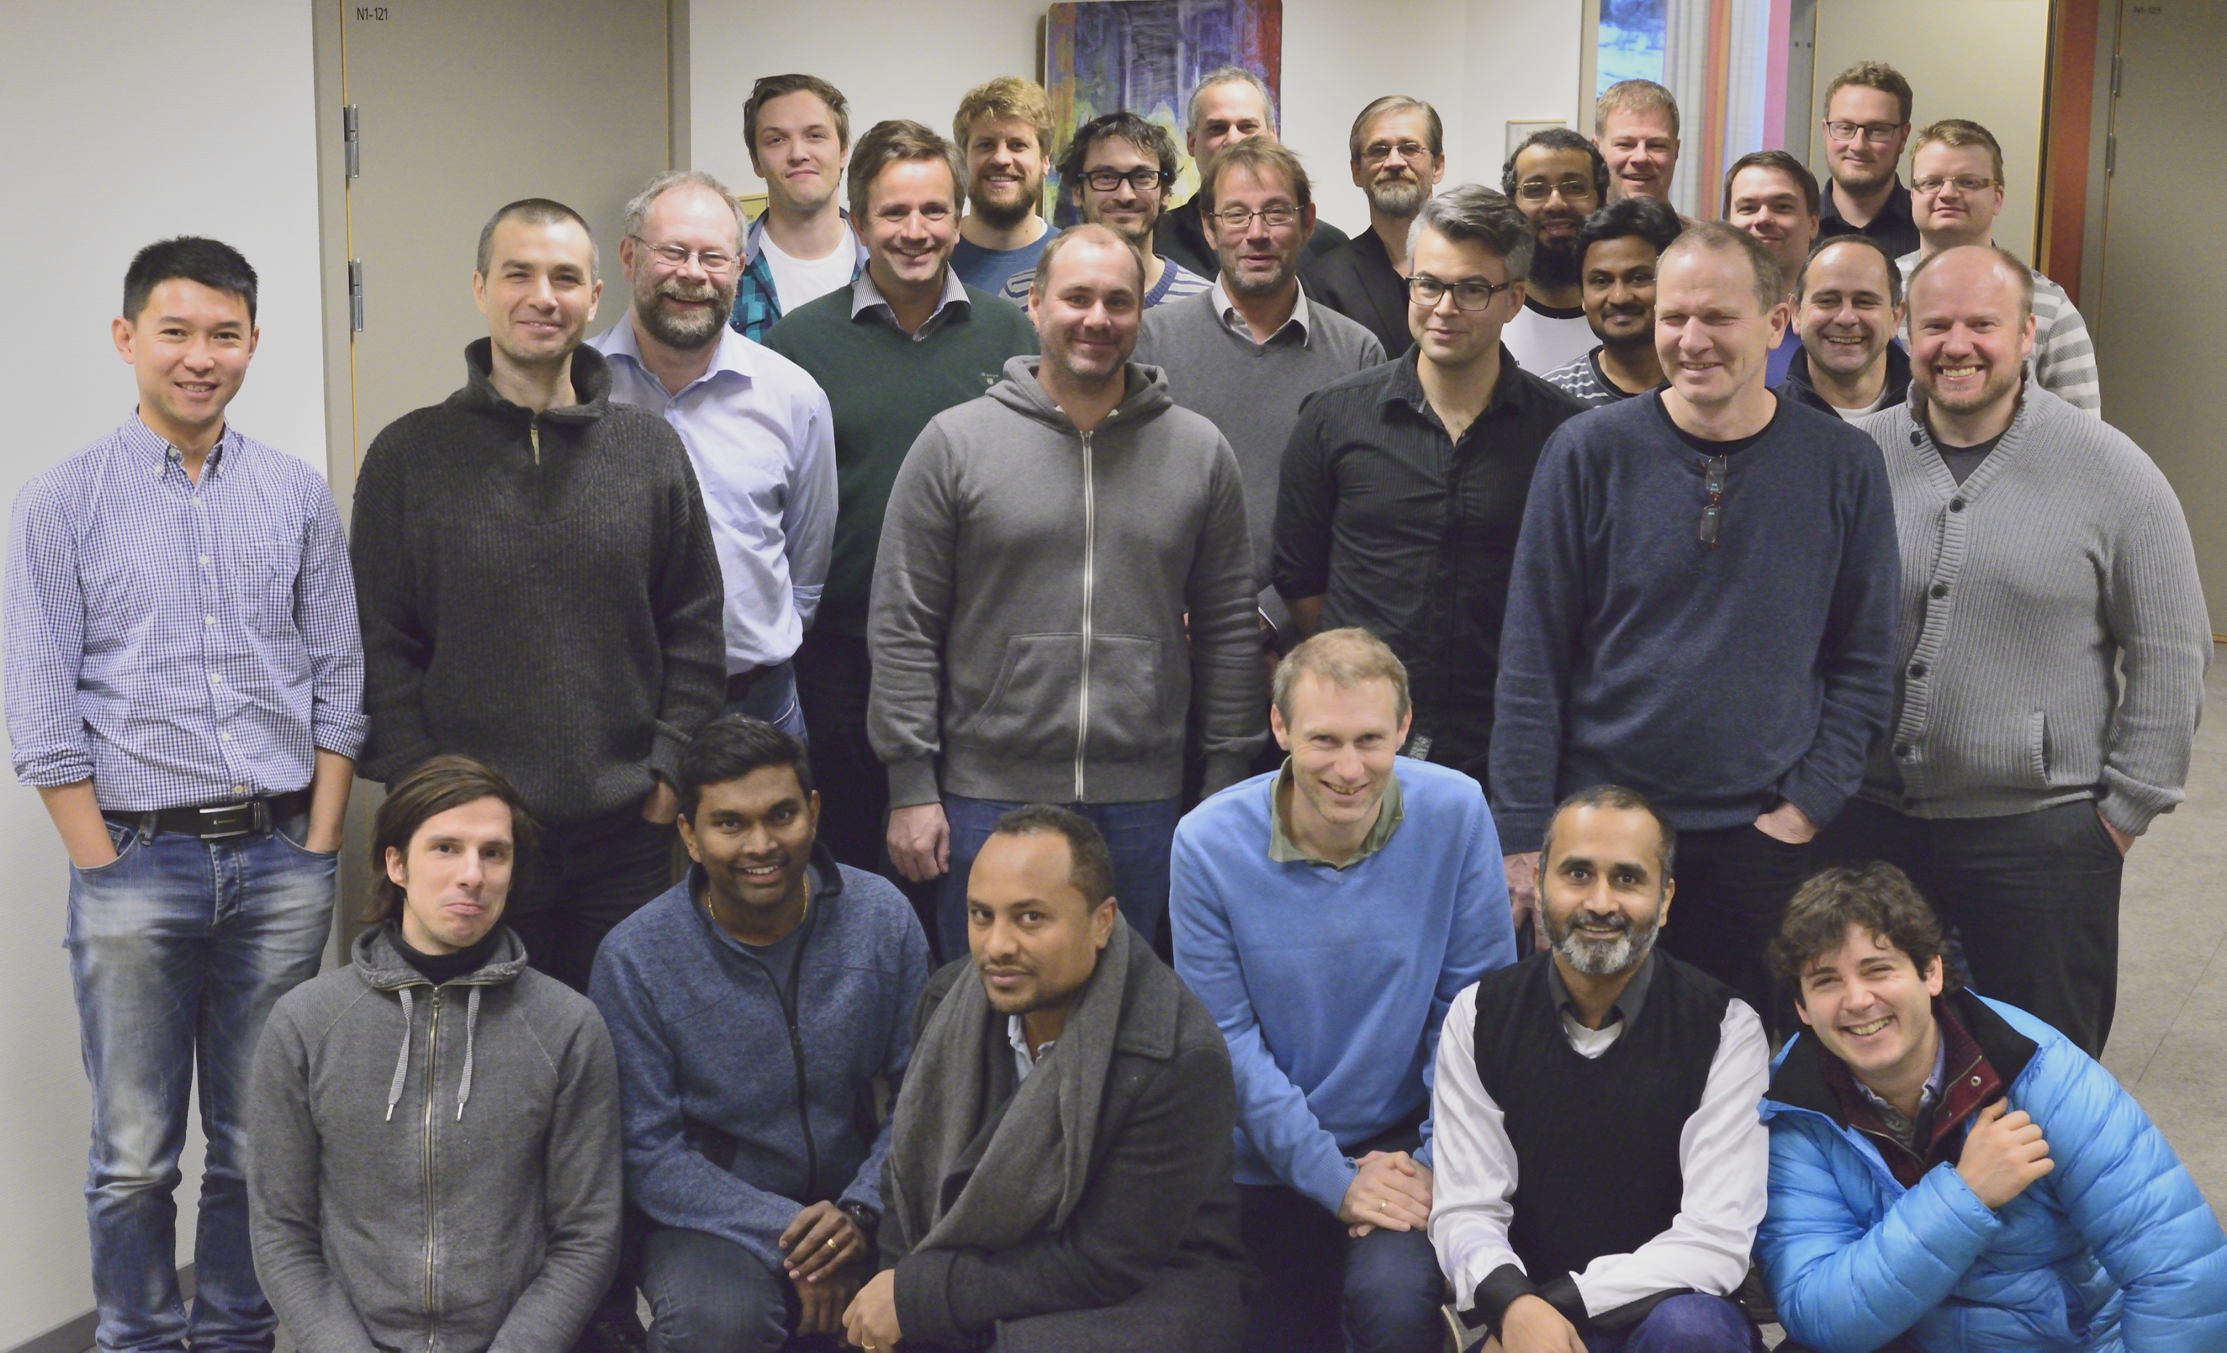
ELIXIR-NO

Slide 35
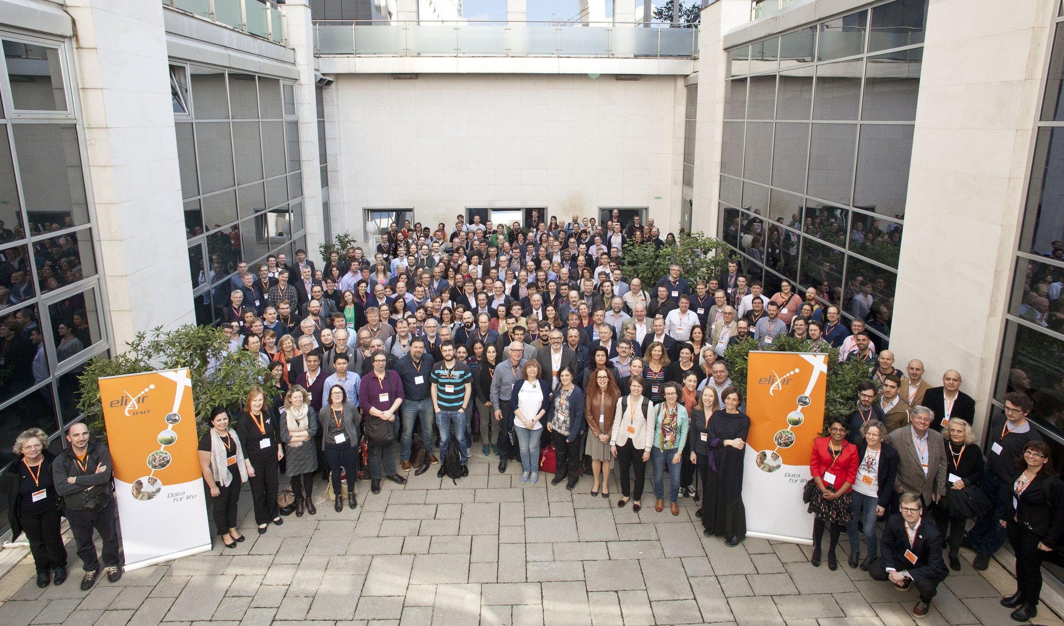
ELIXIR

Slide 36
Acknowledgments
META-pipe team:
  Nils P. Willassen,
  Erik Hjerde,
  Espen M. Robertsen, Inge Alexander Raknes, Aleksandr Agafonov, Terje Klemetsen, Giacomo Tartari,
  Tim A. Teige …
ELIXIR-NO
  UiB, UiO, NTNU, NMBU
Elixir compute platform
  ELIXIR-FI and ELIXIR-CZ
EXCELERATE WP6
  EBI, ELIXIR-DE

