Slide 1
META-pipe
WP6 Kick-off Lars Ailo Bongo, ELIXIR-NO

Slide 2
Task 6.3: Gold standards for metagenomics analysis
58PM (UiT, EMBL-EBI, IT, FR, PT)
Evaluation and implementation of new tools and pipelines:
Community structure, genetic and functional potential for environmental applications
Identification of gene products and pathways for industrial applications
Publically available through:
UiT META-pipe, EBI Metagenomics Portal (MGP), EMBL Embassy Cloud, …
Web based search engine for the interrogation of marine metagenomics results from MGP
Web services, back-end search, comparison tools, …
Federated search over MGP, META-pipe, and other pipeline results
Notes:
Task 6.3: Gold-standards for metagenomics analysis (58PM)
The majority of existing metagenomics analysis platforms, while providing insights into the prokaryotic
taxonomic diversity and functional potential for individual samples, but lack the tools that enable discoverability
across samples and industrial innovation. This task will focus on the evaluation and implementation of new tools
and pipelines in order to accelerate research, discoverability and innovation, reducing time to market for new
products. In combination with new standards and databases developed in Task 6.1 and Task 6.2, respectively,
new tools for community structure (microbial biodiversity), genetic and functional potential will be evaluated and
implemented for environmental applications. For industrial application tools and pipelines for the identification
of gene products (e.g. enzymes and drug targets) and pathways will be implemented and made publicly available.
The evaluation and implementation will be performed in near collaboration with end-users (research groups,
environmental centres, biotech companies) to ensure usability for the end user community in order to improve
quality, productivity and functionality, as well as reduction of costs for the end-users. New tools and pipelines
will be made publicly available through the e.g. META-pipe (ELIXIR-NO), EBI Metagenomics Portal (EMBLELIXIR)
and/or EMBL Embassy cloud technology. Technical requirements will be mapped by WP3 and
implemented to meet the requirements of the ELIXIR community.
The continued advancement of sequencing technologies and the growing number of public marine metagenomics
projects means that it is becoming increasingly difficult to mine these vast datasets. In this task, initially a webbased
search engine will be developed for the interrogation of marine metagenomics results available from the
EBI Metagenomics Portal, based on combinations of queries to our web services (already in existence, or to be
built as part of existing projects outside ELIXIR-EXCELERATE) for the discovery of data through metadata,
taxonomic and functional fields. This will extend the back-end search functionality that is to be developed as part
of on-going efforts. In addition to being downloadable, we will enable search results to flow into an expanded
comparison tool (currently limited to gene ontology terms from samples in the same project), to allow more indepth
analysis of a user selected datasets, allowing functional and taxonomic comparisons.
In the second phase of this task, the search engine will build upon the data exchange formats in Task 6.1, and
federate the search across different pipeline results sets (e.g. META-pipe), so that different results based on the
same underlying dataset, can be amalgamated into a single search. This will dramatically enhance the
discoverability across different marine datasets, allowing the identification of common trends and/or differences.
These tools will be developed using user-experience testing and in collaboration with end users to ensure they are
fit for purpose.
Partners: NO, EMBL-EBI, IT, FR, PT

Slide 3
Outline
META-pipe
Norwegian infrastructure integration and deployment
Marine metagenomics pilot project
Use case architecture
Current status and future plans

Slide 4
META-pipe goals
Enhance research and industrial innovation within the marine domain
Build reference pipeline for marine metagenomics
Provide the required tools, services, data, and resources for the analysis
Tight integration with EBI MGP, archives, databases, and pipelines

Slide 5
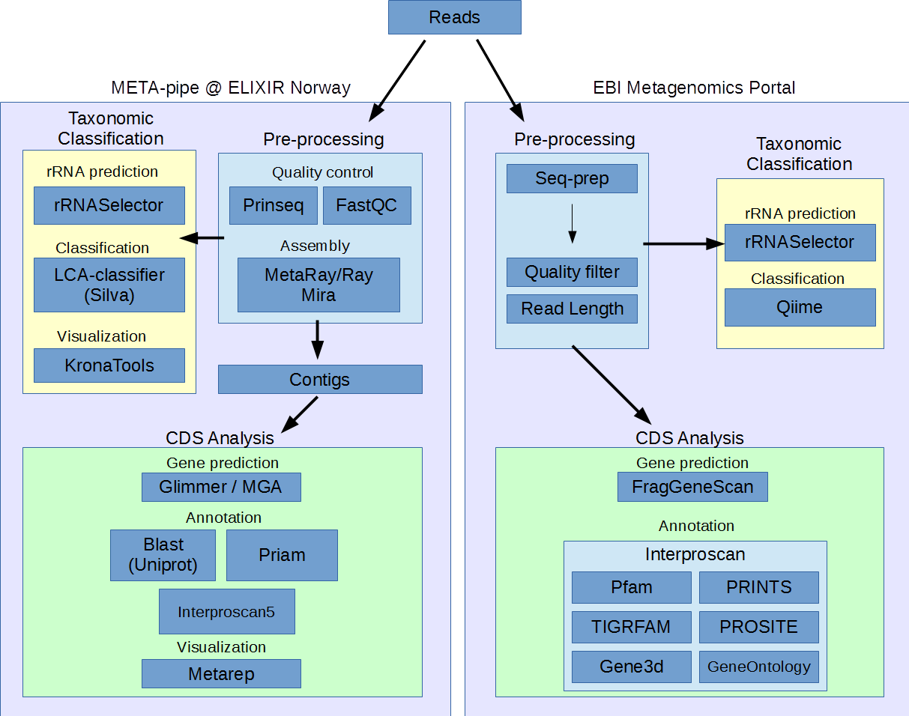
Pipeline overview

Slide 6
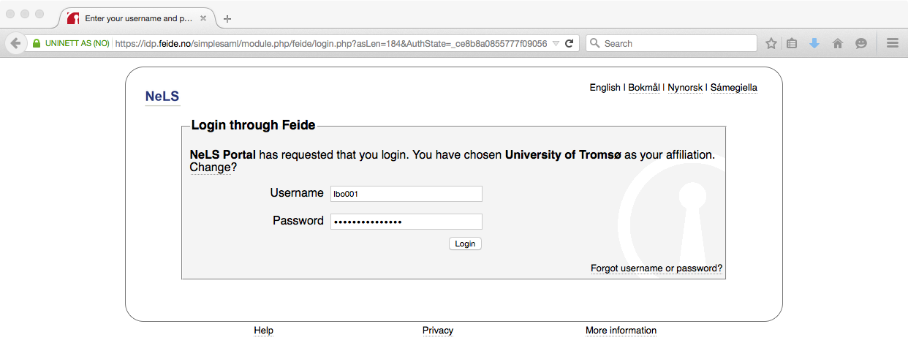
Feide AAI
Notes:
AAI = Authentication and Authorization Infrastructure

Slide 7
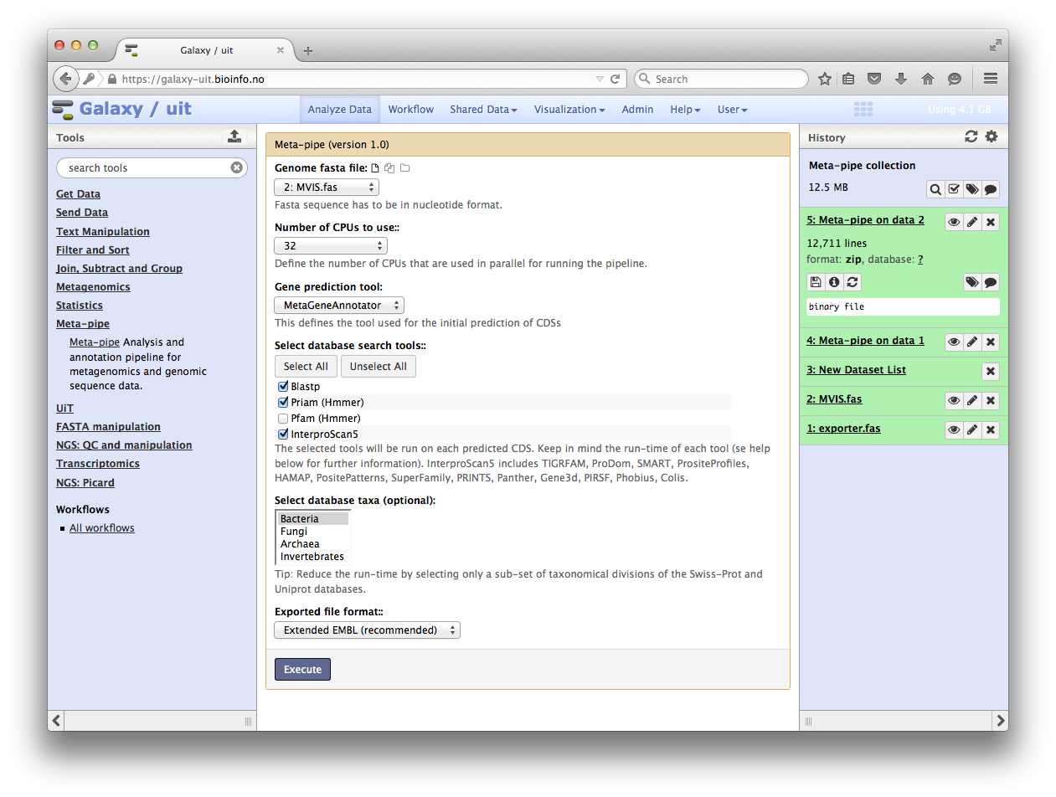
Galaxy workflow

Slide 8
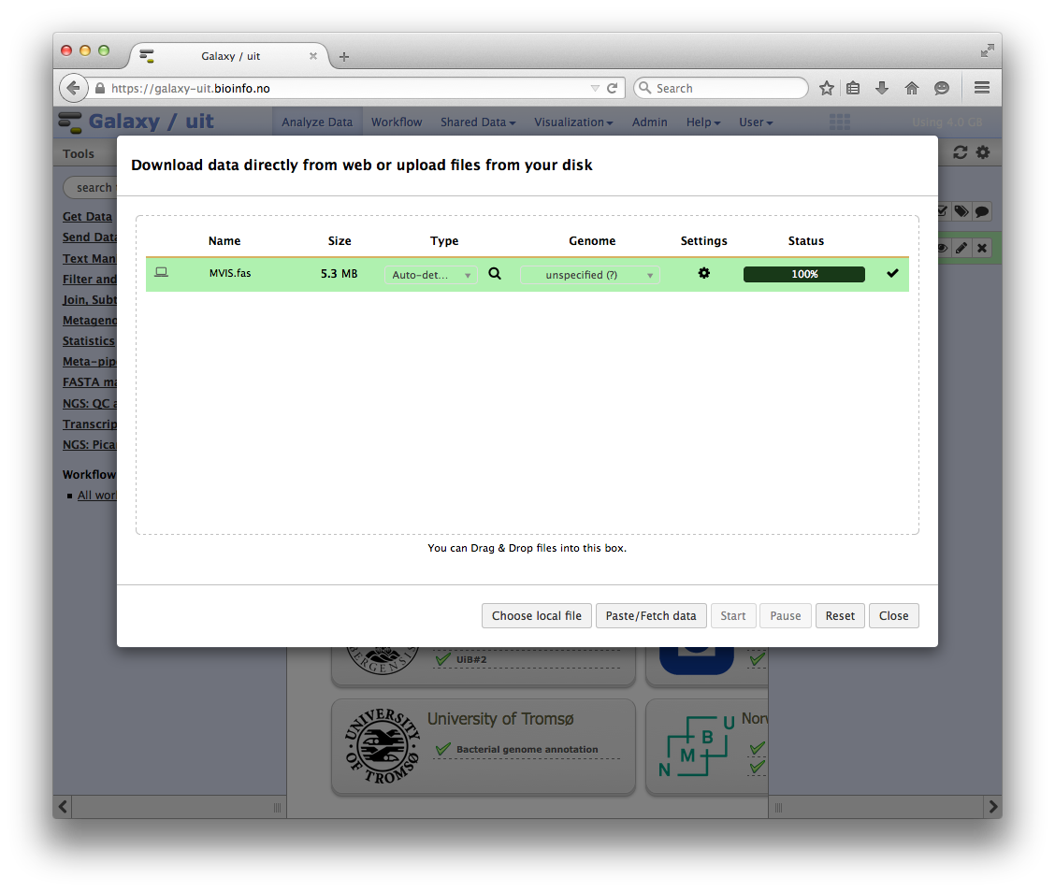
NorStore data storage
+ backend solution for big datasets over a high-bandwidth network

Slide 9
Stallo Supercomputer
Galaxy (VM)
LWR / Pulsar
Stallo
qsub / scripts
Meta-pipe
Galaxy Tool
NeLS, FEIDE
Notur, NorStore…

Slide 10
Marine Metagenomics Pilot
Deliverables
Harmonizing existing metagenomics pipelines (EBI metagenomics, META-pipe) and agreement of data formats, to ensure interoperability
Assessing new functionally specialized databases and evaluate if these resources can enhance or enrich the functional output.
Investigate the use of other approaches for taxonomic assignment, expanding beyond prokaryotic assignments
Explore and prototype with EMBL-EBI cloud-based technologies
Report on gap analysis related to establishment of reference genomes for the marine environment
Report about the needs for specific investment in connection to services for the marine sector.

Slide 11
Harmonizing pipelines

Slide 12
Embassy Cloud
Embassy Cloud = EMBL service
We created a virtual cluster
Software stack: Ubuntu, Slurm, Blast+
Conclusion: Meta-pipe can be run efficiently in a cloud environment
Also identified several Embassy Cloud issues

Slide 13
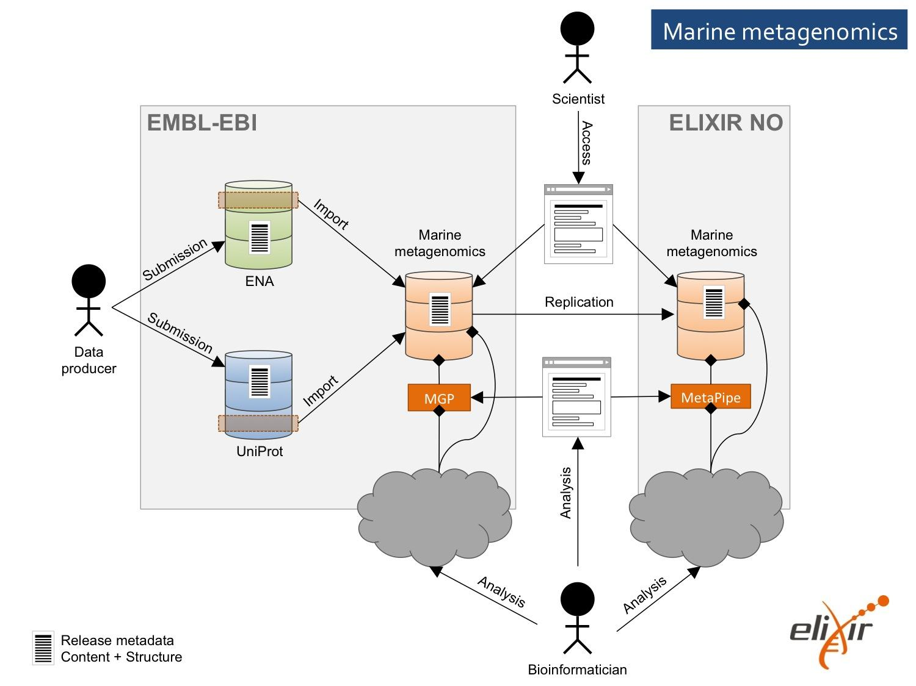
Use case architecture (WP4 version)
https://docs.google.com/document/d/1gMKFrcbzuN9BSREU1VDnlml-bl6KSOnfyQbJGh20L5s/edit#

Slide 14
ELIXIR Excelerate implementation project
Builds on ELIXIR task forces :
Cloud, AAI and Storage&data transfers
What can WP4 do for us?
WP4 Technical Services
ELIXIR cloud offerings and services; Secure data access and exchange; Resource management and exchange policies; Technology watch and e-infrastructure synergies. (€2M)
Key challenge: positioning. W.r.t. European e-Infrastructure; ELIXIR nodes

Slide 15
Current status
META-pipe is one of NeLS pipelines
Integrated with NeLS services (AAI, Galaxy, storage)
Running on a Supercomputer (compute)
Running in production mode
META-pipe harmonized with EBI MGP

Slide 16
META-pipe v2 (work in progress)
Standalone web GUI
Better integration with Supercomputer
Tool development and evaluation
Elixir AAI
Transfer/ replication/ staging of large datasets
(Semi) automated archiving
Cloud deployment

