Slide 1


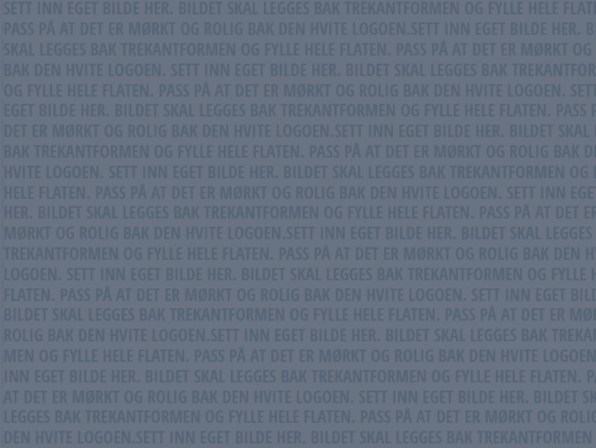
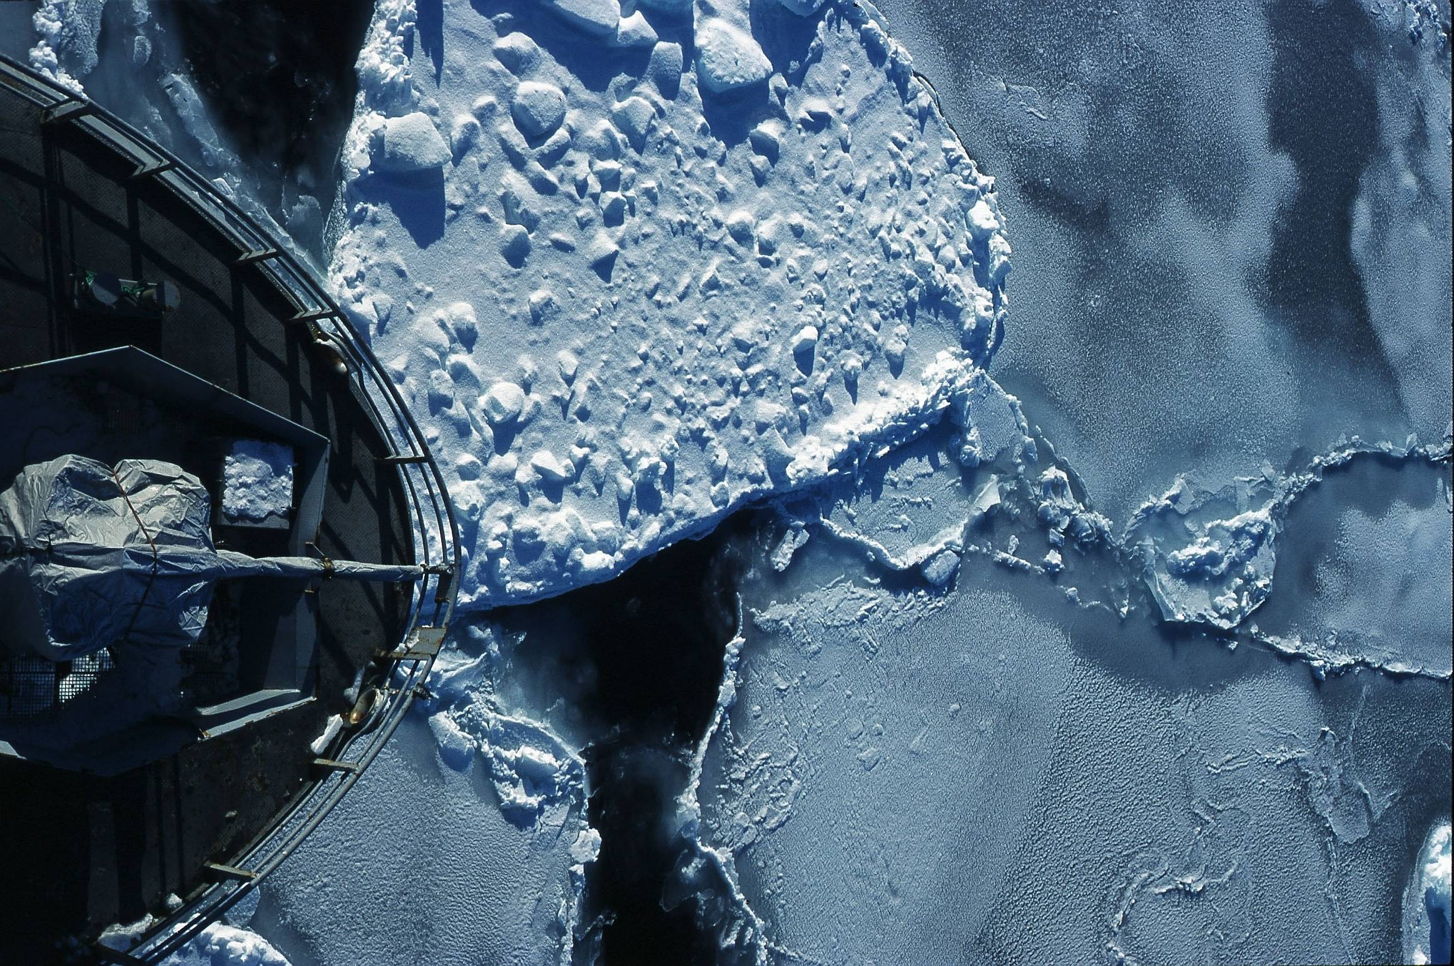



Big Biological Data
Lars Ailo Bongo
Dept. of Computer Science & Center for Bioinformatics,
University of Tromsø, Norway
http://bdps.cs.uit.no
Photo: Jo Jorem Aarseth

Slide 2
Big Data
How big?

Slide 3
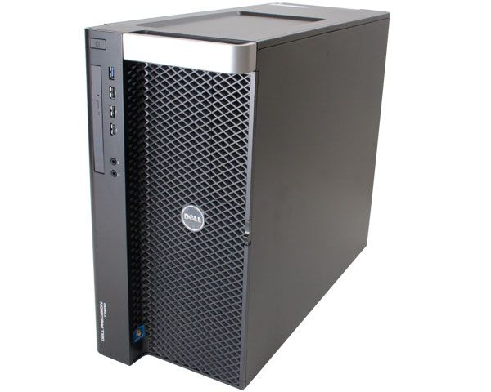
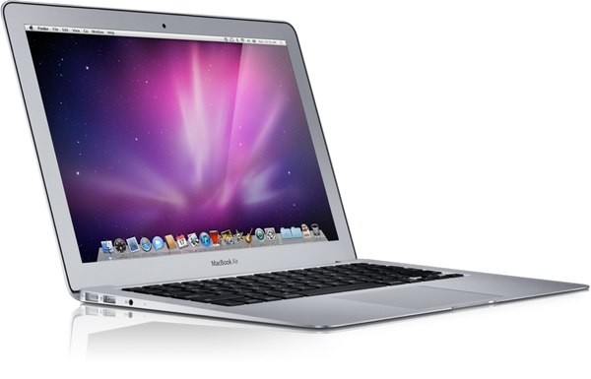
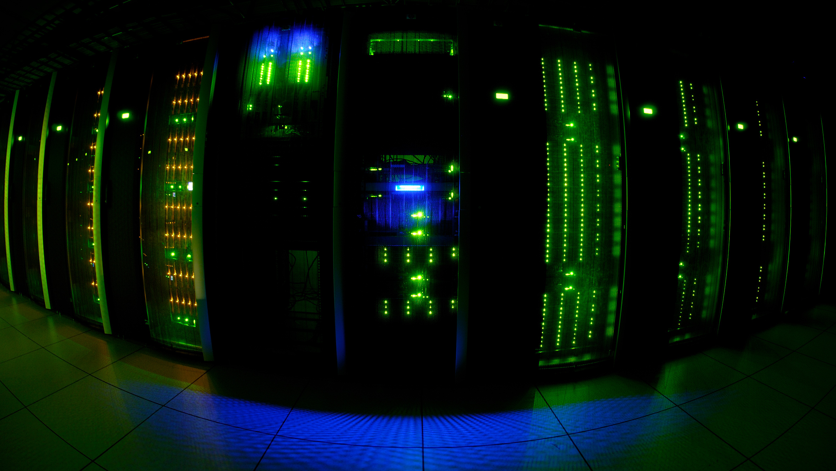
Dataset Size
< 4GB
< 512GB
TBs
PBs

Slide 4
Dataset Size (NxM)
Billions of samples & few dimensions, or
Billions of samples & thousands of dimensions, or
Thousands of samples & thousands of dimensions

Slide 5




Data Analysis Tool

Slide 6
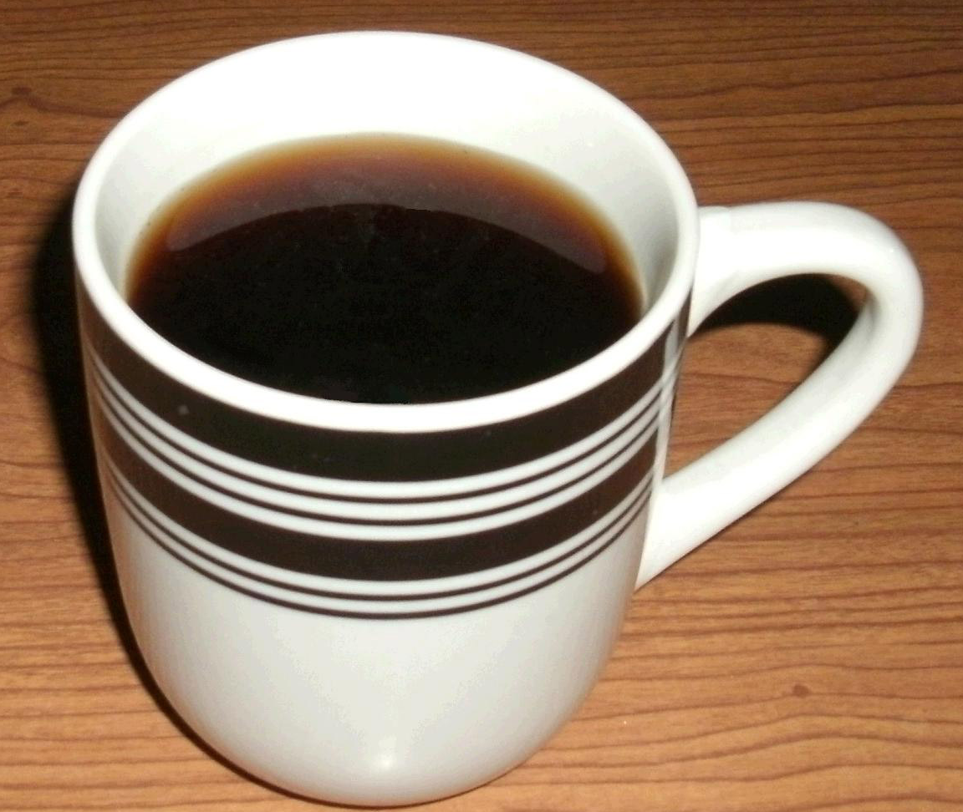
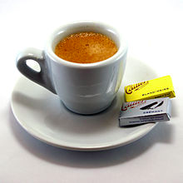
Computation Time
<100ms
seconds
minutes
hours
weeks

Slide 7
Optimizations
R or Matlab implementation
Algorithm parameter tuning
C++/ Java / … implementation
Data structure optimization
Multi-threaded parallelization (single machine)
Distributed parallelization (multiple-machines)

Slide 8
Outline
History of Big Data + Biology
My research
  Interactive data analytics
  Elixir infrastructure
  Other interesting stuff

Slide 9
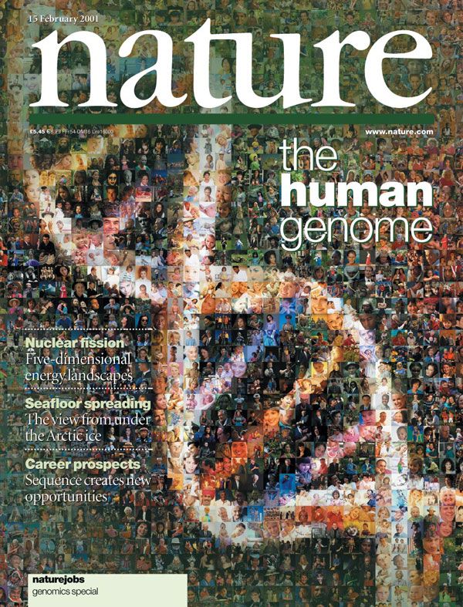
Notes:
2001

Slide 10
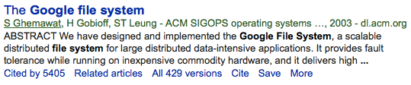
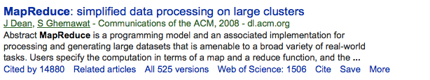
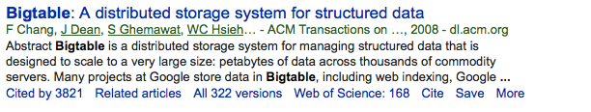
Notes:
Google founded: 1998
GFS: 2003
M/R: 2004
BigTable: 2006
Hadoop: 2005ish

Slide 11
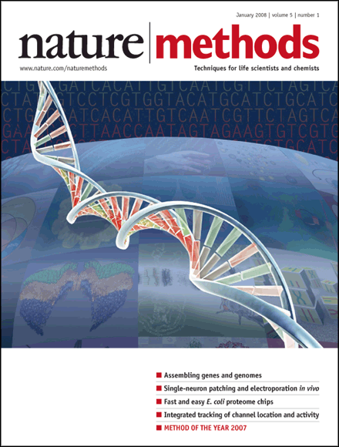
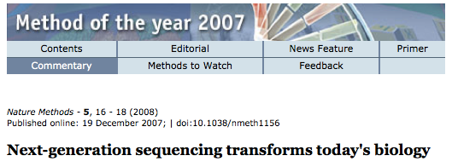
Notes:
2008

Slide 12
Notes:
Published in 2009
Jim Gray’s talk 2007
Empirical
Theoretical
Computational
Data exploration

Slide 13
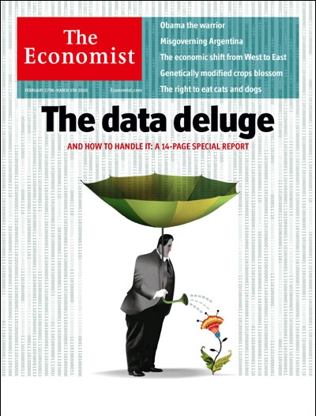
Notes:
2010

Slide 14

Notes:
2011

Slide 15
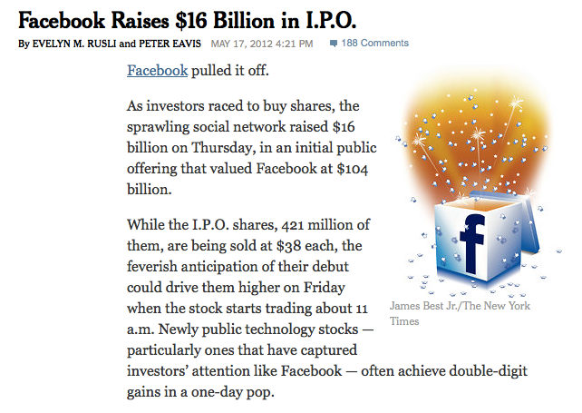
Notes:
2012

Slide 16
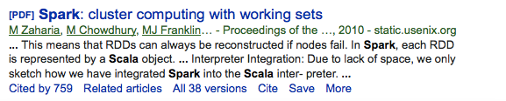
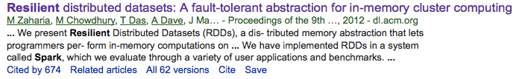
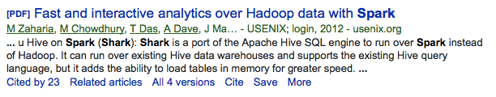
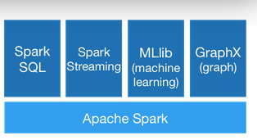
Notes:
Spark: 2010/ 2012

Slide 17
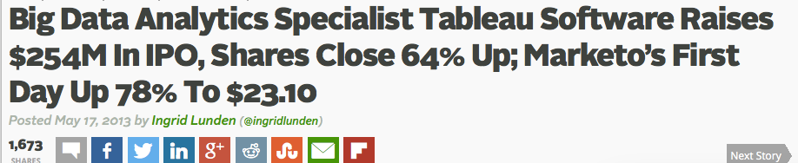
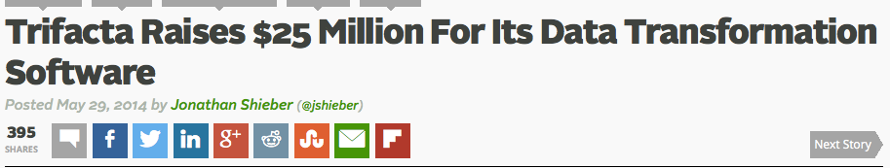
Notes:
Tableu IP: 2013
Trifacta startup: 2014

Slide 18
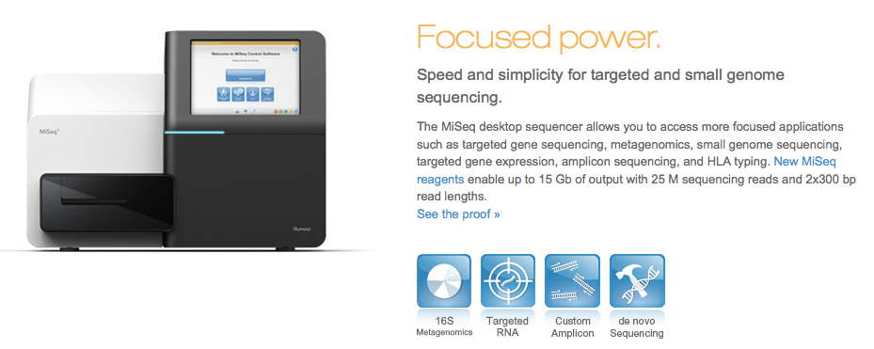
Notes:
2011: launched
UiT got one in 2013?

Slide 19
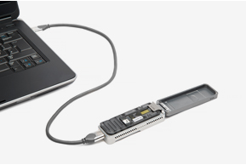
Notes:
Oxford nanopores: MinION

Slide 20

Notes:
2013: Special issue on cancer genomics

Slide 21
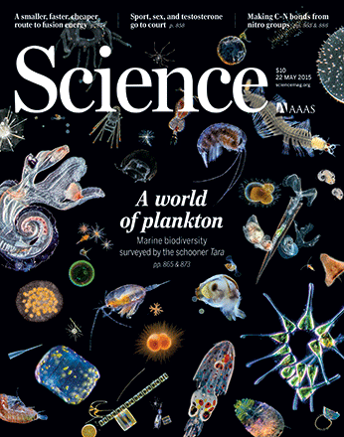
Notes:
2015: marine metagenomics

Slide 22
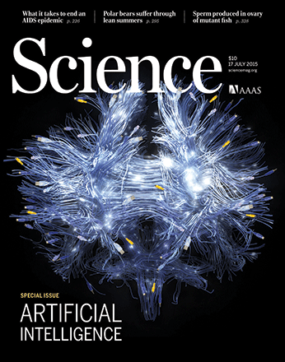
Notes:
2015: AI

Slide 23
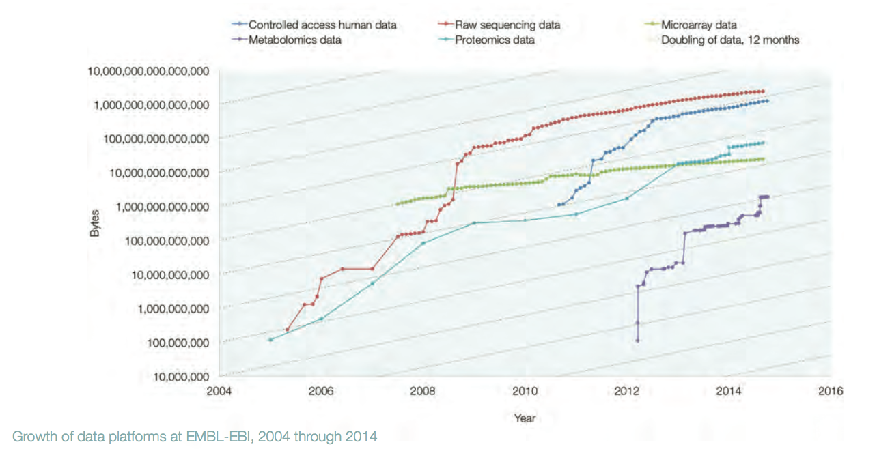
PB

Slide 24
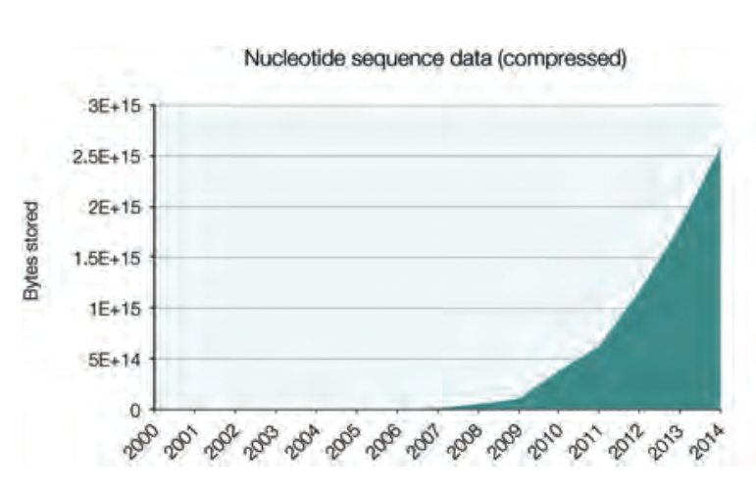
PB

Slide 25
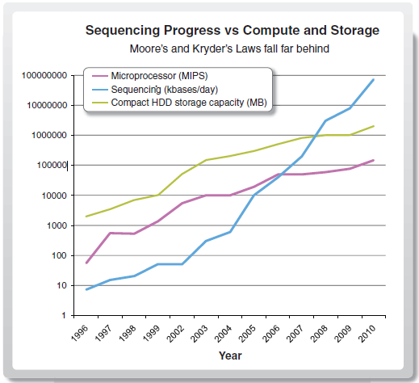
Increase in bionformaticians?

Slide 26
Me
2002: Siv. ing. Informatikk, UiT
2008: Ph. D., Computer Science, UiT
2008: Post doc, Functional Genomics, Princeton
2010: Associate Professor, CS, UiT
  2010: Bioinformatics
  2011: Norwegian Woman and Cancer
  2013: Center for Bioinformatics
  2013: Searas Bongo
  2014: Elixir infrastructure project
  2015: Lung sounds, …

Slide 27
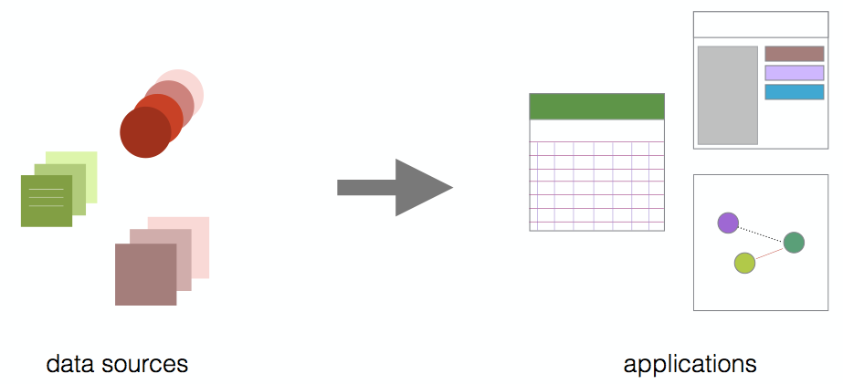
Norwegian Woman and Cancer (NOWAC)
Large and unique biobank of blood samples
Understand development of cancer (and how to avoid it)
Develop diagnosis approaches
Develop or improve treatment
http://site.uit.no/nowac/

Slide 28
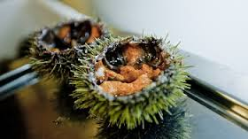
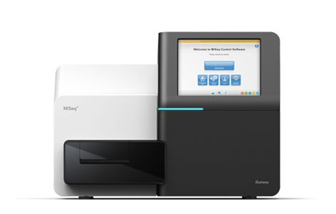

Center for Bioinformatics (SfB)
Interdisciplinary research and services
  Computer science
  Biotechnology
  Bioinformatics
Special focus on marine metagenomics
Commercial exploitation of marine resources
http://sfb.cs.uit.no

Slide 29
My Lab
Biological Data Processing Systems Lab
3 + 1 PhD students
  Edvard Pedersen, Einar Holsbø, Bjørn Fjukstad + Espen Mikal Robertsen
2 engineers
  Inge Alexander Raknes, Giacomo Tartari
3 master students
  Kenneth Knudsen, Morten Grønnesby, Jarl Fagerli
http://bdps.cs.uit.no

Slide 30

Research Goal

Slide 31
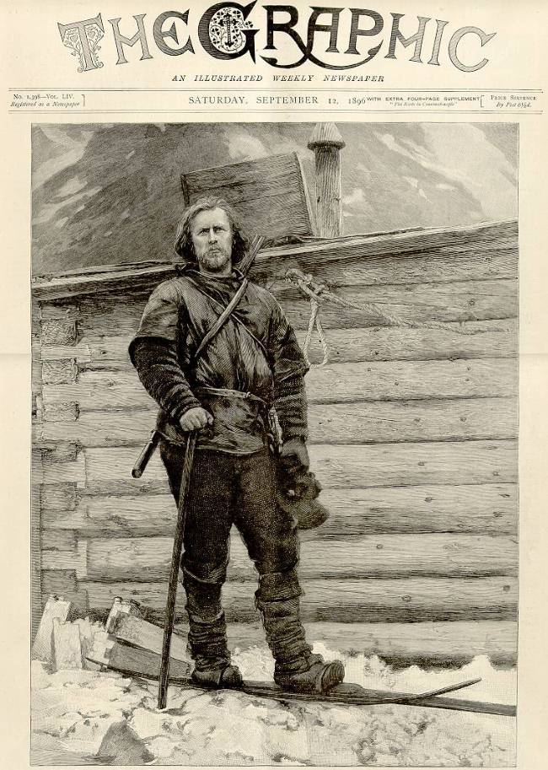
Interactive Data Exploration

Slide 32



Interactive Data Exploration
Data exploration = “play with data”
  No prior hypothesis
Interactive
  Human - computer
  Short response times (seconds or milliseconds)
Computers helps by ordering data and making predictions
Combined with (proper) hypothesis testing

Slide 33
Interactive Data Exploration Requirements
Human experts for data analysis
Interactive user interface
Analysis methods and models
Data management and backend processing
Compute and storage resources

Slide 34
Interactive Visual User Interface
Visualization tool to map NOWAC case-control gene expressions to known biology
Existing visualization tools not flexible enough
Developed with NOWAC data analysts
Approach:
  One specialized tool per analysis project
  Framework that makes it easy to implement tools

Slide 35
Requirements: Solutions
Flexible: 3-tier architecture and R based backend
Interactive performance: good implementation
Scalable: parallel or distributed backend & optimized data structures
Familiar visualizations: KEGG pathways, heatmaps,…
Easy-to-use: web app
Secure data storage: backend runs on secure server

Slide 36
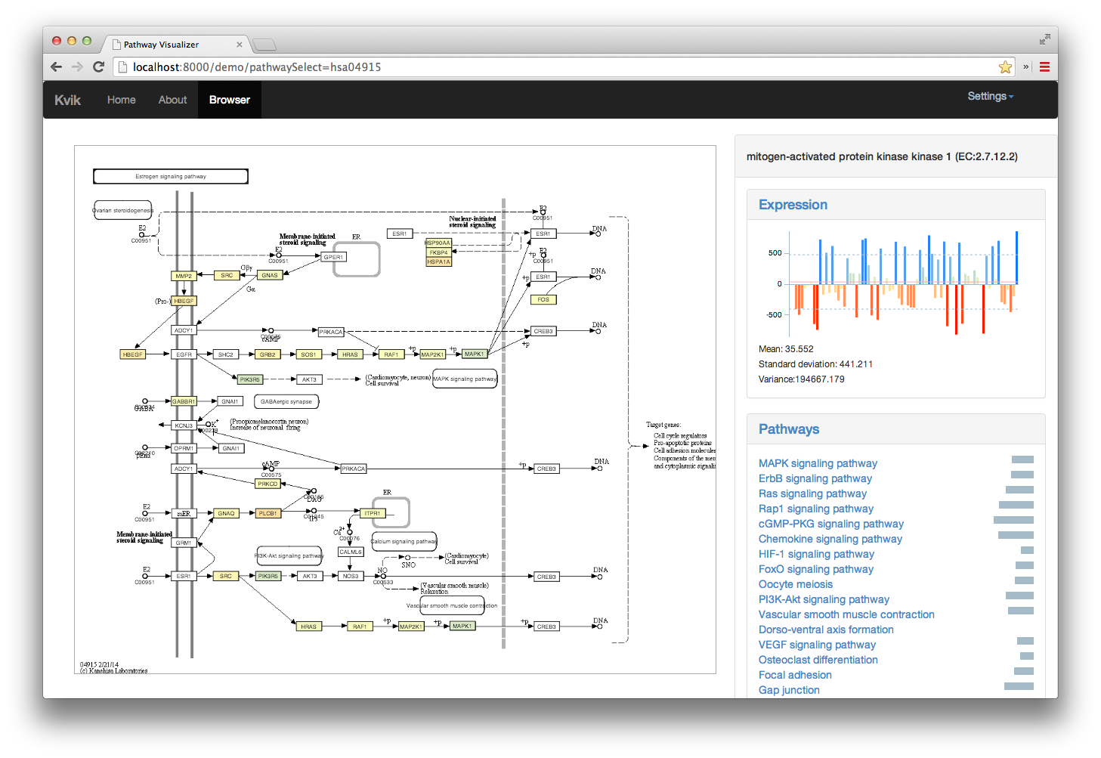
Kvik– NOWAC Pathways

Slide 37
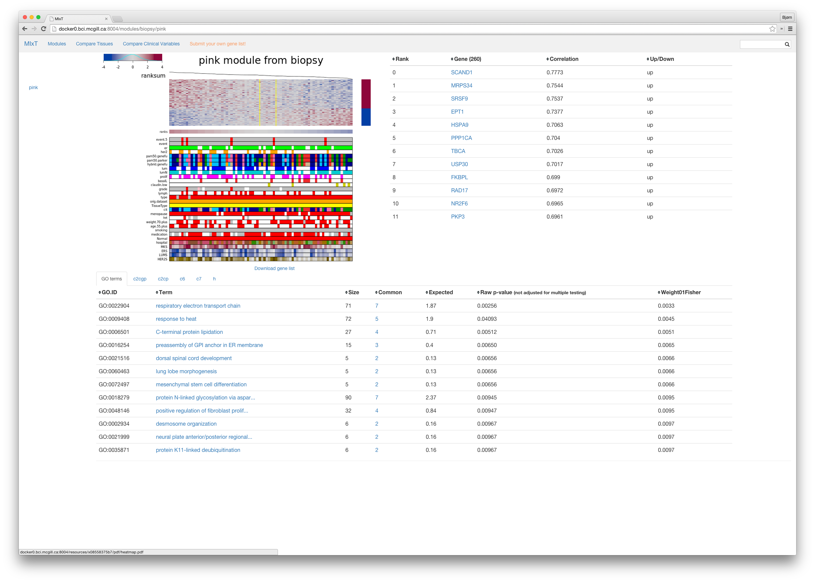
Kvik - MIxT

Slide 38
Kvik – NOWAC Data Exploration
Currently used for:
  NOWAC pathway analysis
  NOWAC stress data
  NOWAC blood-tissue analysis
Publically available and open-sourced:
  kvik.cs.uit.no
  github.com/fjukstad/kvik
  Docker containers
Bjørn Fjukstad

Slide 39
“Kviklunsj”
Use Unity (game) development framework for data exploration
Questions:
  Can we map biological data to game engine data structures?
  Is our data different?
  Does it scale better than alternative frameworks?
Kenneth Knudsen (ongoing master project)

Slide 40

Data Cleaning Toolchain
Data cleaning important, but time consuming (and boring)
Good data cleaning tools for textual and tabular data
  Not suited for scientific data cleaning
Approach
  R scripts generates images with visualizations
  Interactively group and sort images
  Compare related images

Slide 41
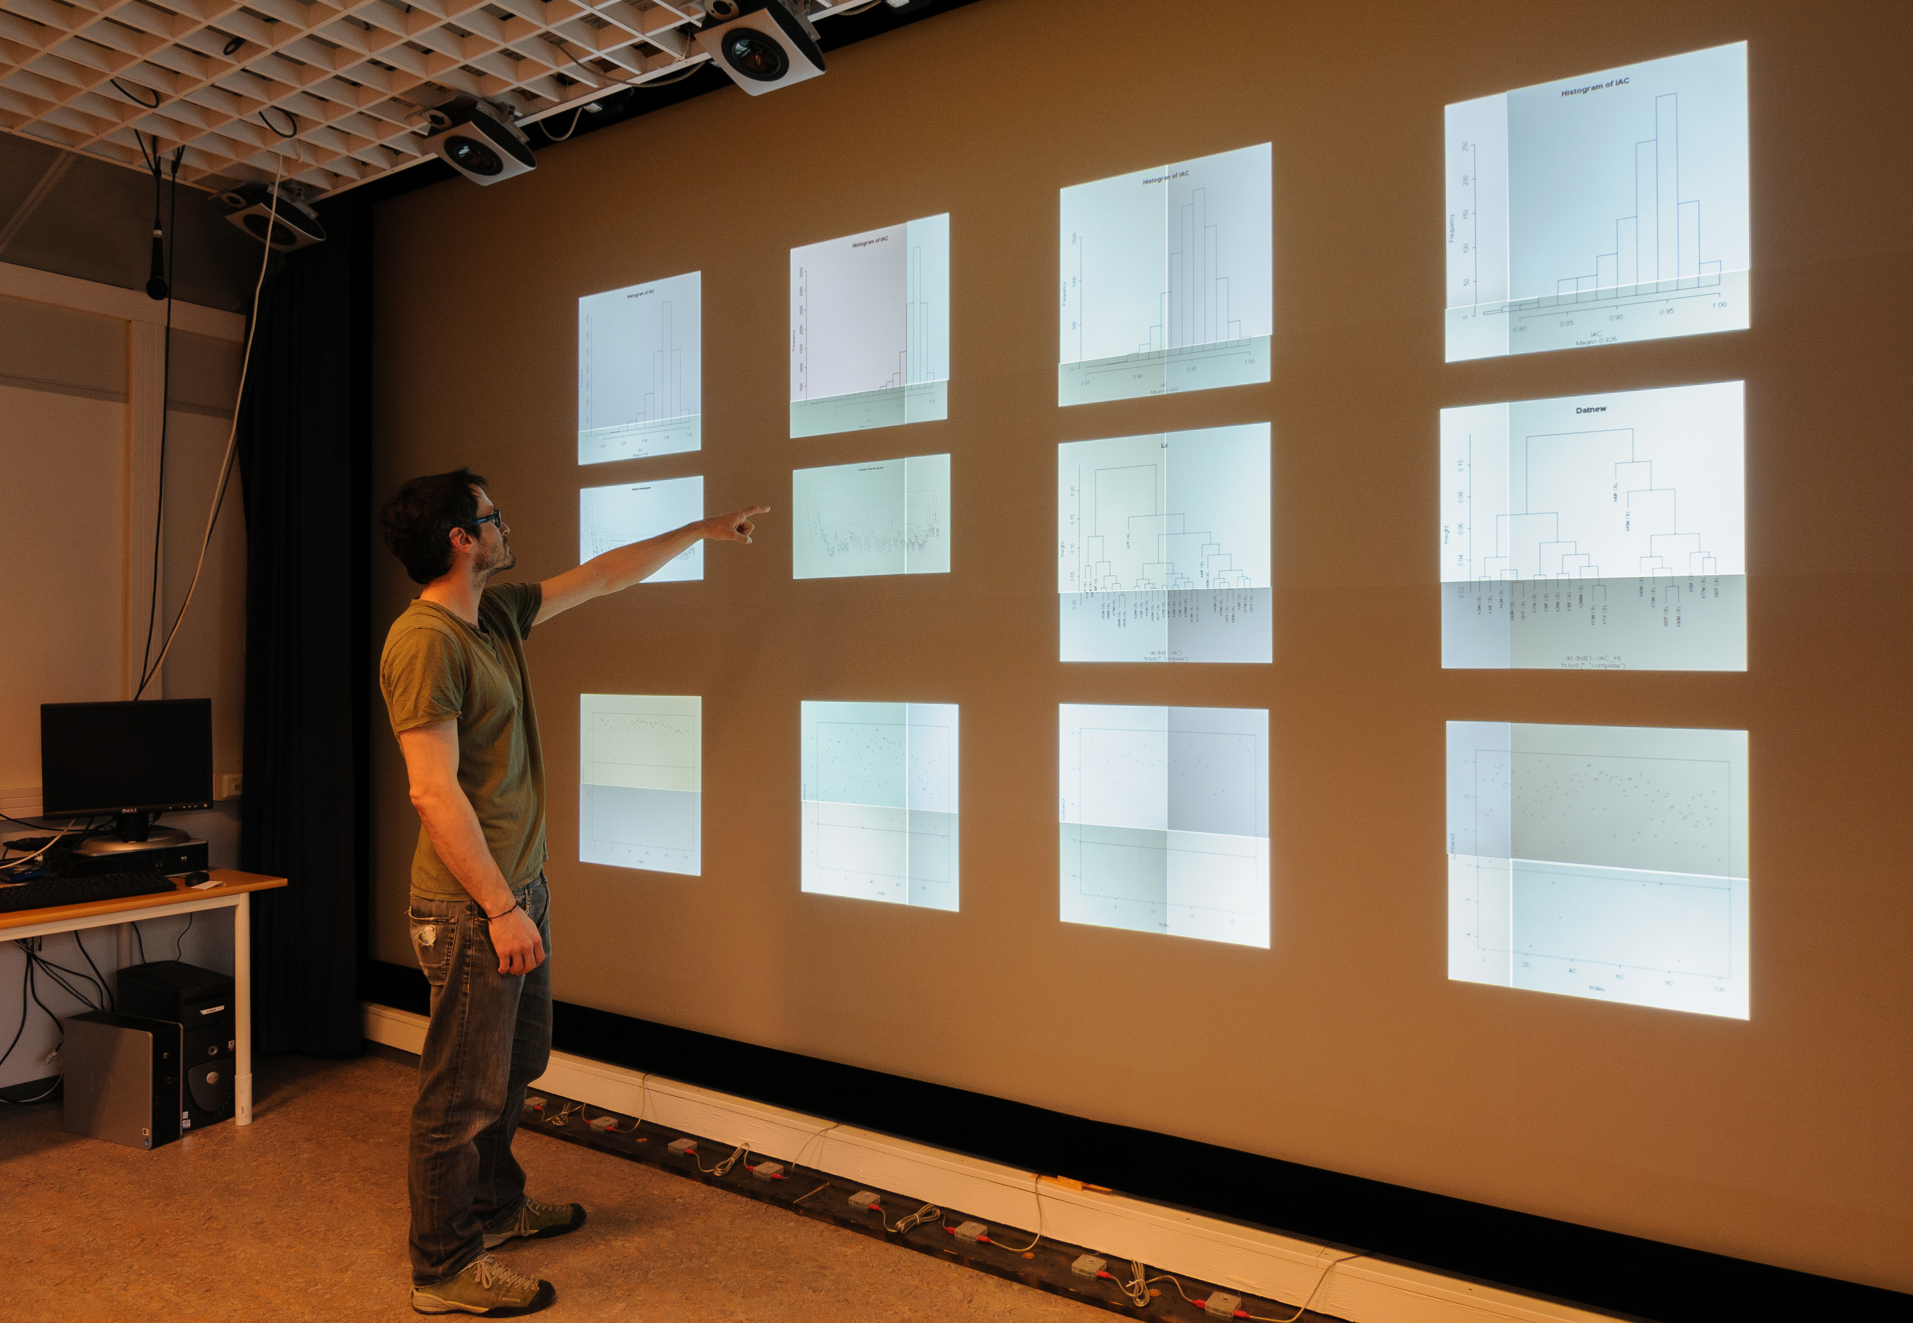
Mr. Clean – Data Cleaning

Slide 42
Mr. Clean – Data Cleaning
Gesture based interaction with many visualizations
  Use case: NOWAC outlier removal
  Use case: computer vision algorithm development
Availability:
  github.com/UniversityofTromso/mrclean
  youtu.be/NFUDsPQRwqE
  Proc. of VISSOFT’14
Giacomo Tartari & Einar Holsbø

Slide 43
Data Analysis
How to find signals in the data?
Use machine learning classification and prediction as input for data exploration
But make it possible to understand underlying biology

Slide 44
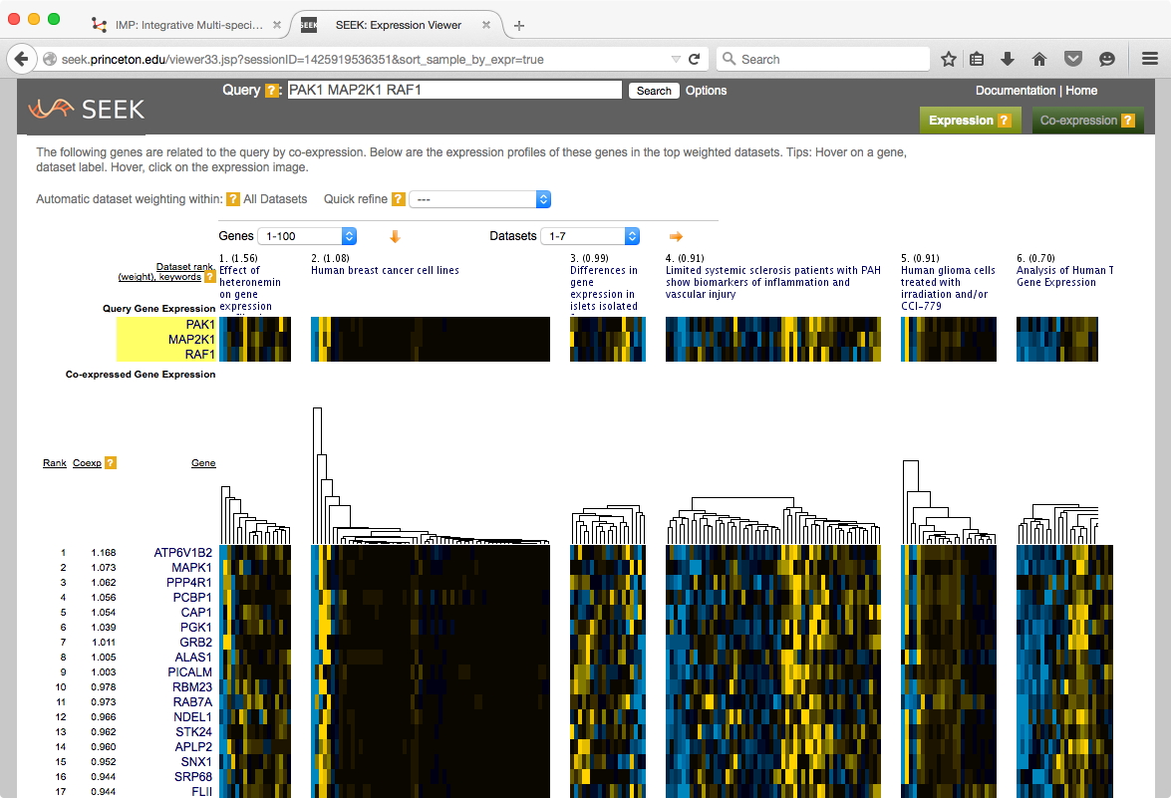
http://seek.princeton.edu/
Nature Methods (2015), Mar;12(3):211-4

Slide 45
Data analysis methods
Methods
  Metastasis prediction for NOWAC data
  Distributed cross-validation
  Machine learning algorithm optimizations for epidemiological data
  Novel machine learning algorithms for few-samples many-dimensional data
Backend for executing data analysis methods
  Computationally demanding
  Must be very fast
  State-of-the-art infrastructure systems
Einar Holsbø

Slide 46
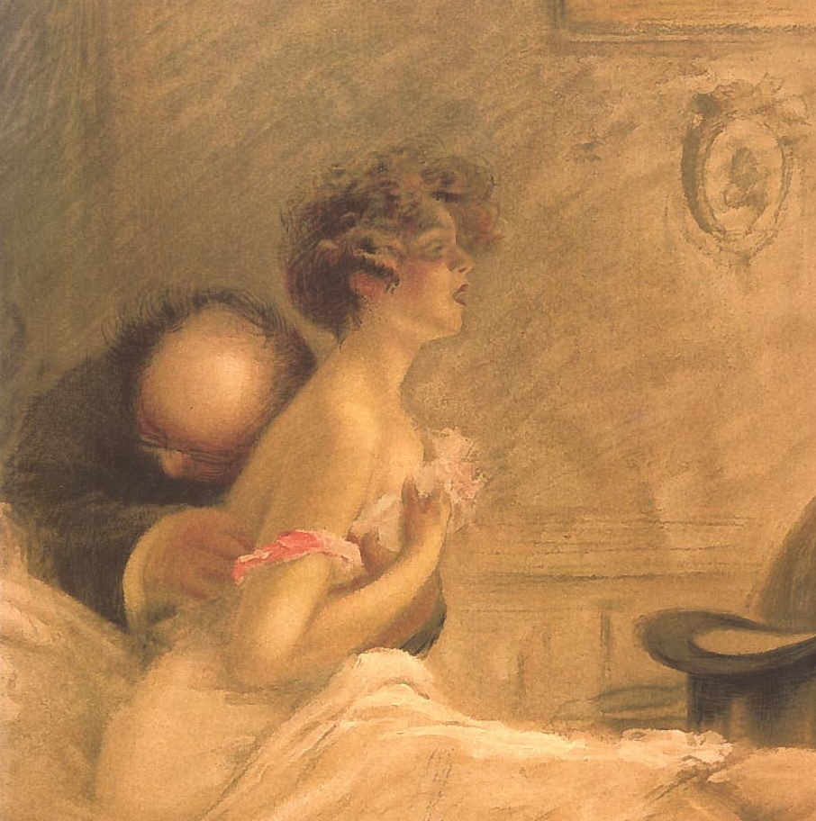
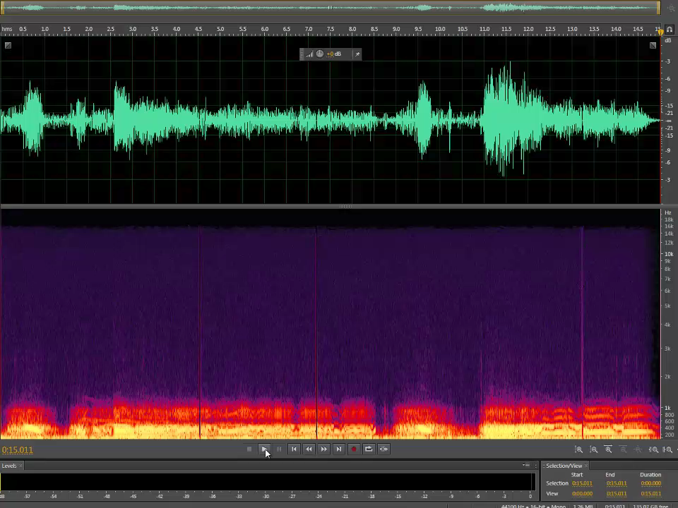
Lung sounds
Widely used
Subjective
Not for diagnostics, but may be used for referral
1000s of recordings (Tromsøundersøkelsen)
Machine learning based classification
Morten Grønnesby (master project)

Slide 47
Meta-database Management
How to use state-of-the-art data-intensive computing systems for biological data processing?
Problems:
  Meta-databases are large: 1TB per version
  Updated often => should update results
  Processing may take weeks
Approach:
  Scalable incremental updates
  Unmodified data analysis tools
  Integrated with Galaxy
  Utilize data-intensive computing systems

Slide 48
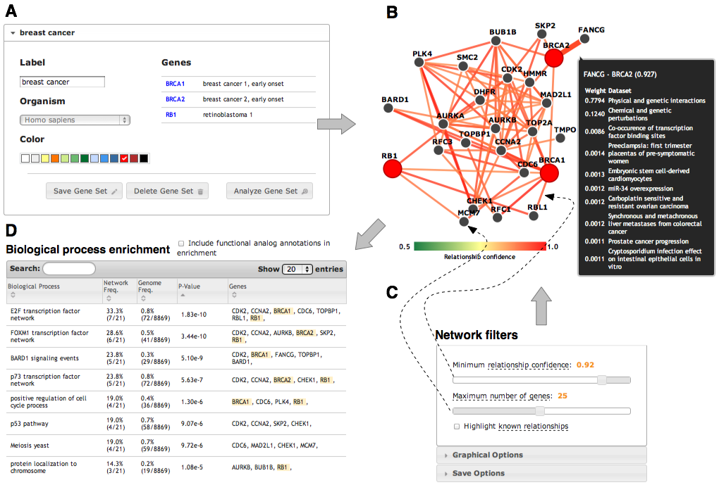
http://imp.princeton.edu/
Nucleic Acids Research. July 2012 & PLoS Comput Biol 9(3). 2013

Slide 49
Meta-database management
File-based: wrapper around tools
  Relatively few file formats
  Detect relevant updates
  Fix and merge outputs
Plugin framework
Implemented using HDFS, MapReduce & Hbase
Edvard Pedersen (PhD student)
  github.com/EdvardPedersen/GeStore
  In Proc. of. EurPar’13, CIBB’14, PDP’15

Slide 50
“Newpan”
Supercomputer workflow manager run on Stallo
  Production system
Intermediate data in a universal formats
Intermediate representation of workflow (JSON)
Supports:
  Unit test
  Multiple schedulers / queuing systems
  Adding new functionality to a workflow
  Debugging / visualization
  Adding validation / fail early
Inge Alexander Raknes (ongoing work, Elixir)

Slide 51
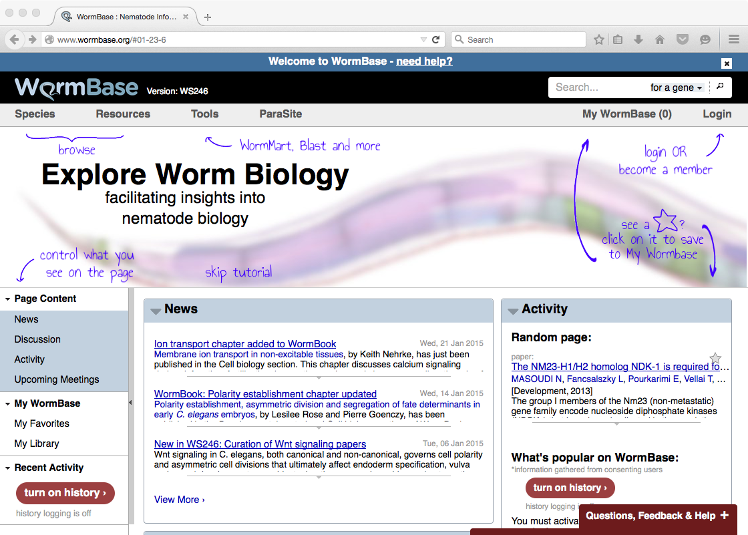

Slide 52
SparkSPELL
Distributed search engine
SPELL algorithm: hard to parallelize
Implemented using Spark
  Integrated old sequential Java code
  Optimizations
Very scalable
Search time <1s
Inge Alexander Raknes (master project)

Slide 53
MORTAL
New programming language for scientific computing
  Multiparadigm: connect the mathematical formulae written by scientist to algorithms implemented by the software engineer
Self hosting compiler
Initial evaluation: similar performance as C
Ove Kåven (master project)
http://sourceforge.net/projects/mortal/

Slide 54
Infrastructure
Compute and storage resources
  Systems for data management, parallel execution, accounting, data transfer, data integration, security…
  Per lab? Per university? National?

Slide 55
ELIXIR’s mission
To build a sustainable European infrastructure for biological information, supporting life science research and its
translation to:
medicine
environment
bioindustries
society

Slide 56

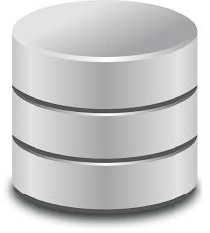
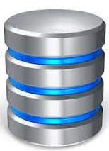
Current situation
Data
Data
Compute
Storage
Services
EBI

Slide 57
Future
Marine
metagenomics
Clinical genomics
Rare
diseases
Data
Compute
Storage
Data
Compute
Storage
EBI

Slide 58
UiT’s Role
ELIXIR Excelerate: 19M EUR project
UiT leader for one of four scientific use cases
  Marine metagenomics
We will be used as demonstrator for technical services (AAI, cloud, data replication, …)

Slide 59
META-pipe Goals
Enhance research and industrial innovation within the marine domain
Build reference pipeline for marine metagenomics
Provide the required tools, services, data, and resources for the analysis
Tight integration with EBI archives, databases, and pipelines
http://galaxy-uit.bioinfo.no/ (FEIDE login)

Slide 60
Stallo Supercomputer
Galaxy
(VM)
LWR / Pulsar
Stallo
qsub / scripts
META-pipe
Galaxy Tool
NeLS,
FEIDE
Notur, NorStore…

Slide 61
UiT Marine Metagenomics Vision
EBI
UiT
ENA
1. Deposit data
2. Select pipeline
3. Run analysis
4. Compare to other
results
MGP or META-pipe?
MGP
META-pipe
Integrate results

Slide 62
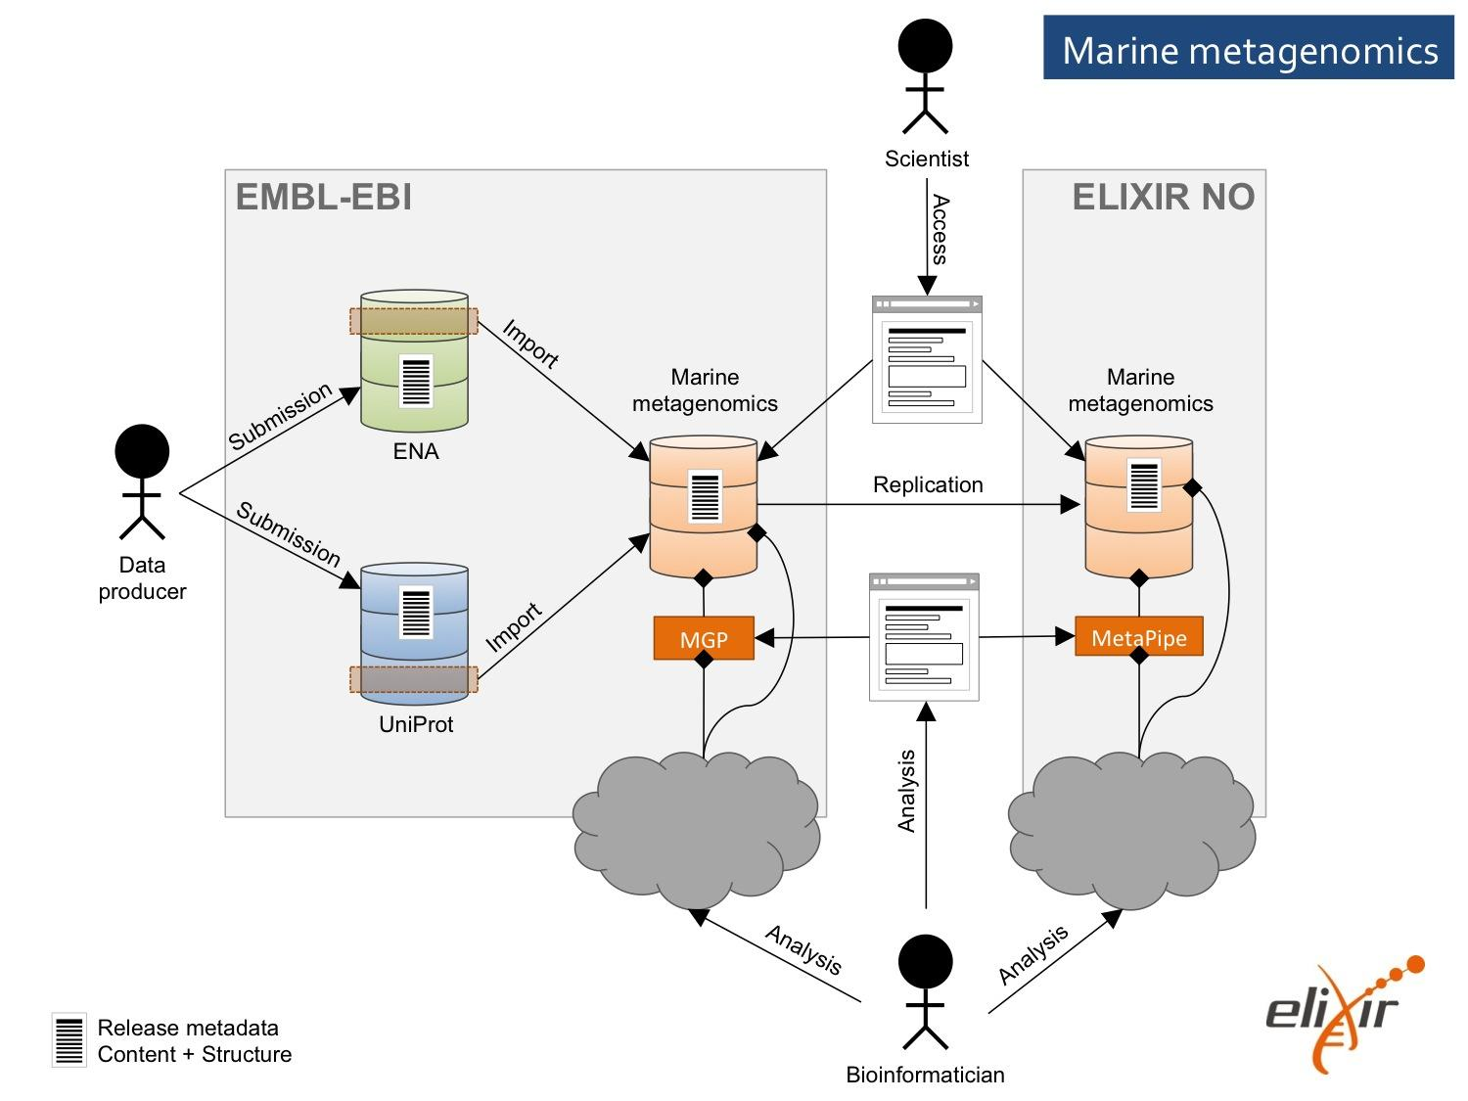
Use Case Architecture

Slide 63
UiT Advantages
Expertise:
  Marine
  Computer science (systems)
Important demonstrator
  Elixir
  Interactive workload at Stallo
  Cloud (CSC, Finland)
New approach: distributed services

Slide 64
Big Data @ IFI
Research (PhD, master)
Services (bioinformatics)
Advanced courses
New undergraduate course: INF-2202
  Concurrent and Data-Intensive Computing
  2nd assignment: deduplication of 1TB dataset
  3rd assignment: Spark on Amazon AWS
  http://uit-inf-2202.github.io/

Slide 65
Summary
Advances in scientific instruments + compute capacity + storage capacity ➔ big biological data
Complex systems for analysis (often from industry)
Biological data analysis:
  Unique computer science research challenges
  Requires a distributed infrastructure
Our interdisciplinary research
  Computer science skills ➔ competitive advantage
  ..and in great need

Slide 66
BDPS Lab Members
NOWAC
  Einar Holsbø
  (PhD student)
  Bjørn Fjukstad
  (PhD student)
  Kenneth Knudsen
  (master student)
Lung sounds
  Morten Grønnesby (master student)
Center for Bioinformatics / ELIXIR
  Edvard Pedersen
  (PhD student)
  Espen Robertsen
  (PhD student)
  Inge Alexander Raknes (engineer)
  Giacomo Tartari (engineer)
  Jarl Fagerli
  (master student)
  Jon Ivar Kristiansen (system administrator)

Slide 67
Collaborators
NOWAC
Prof. Eiliv Lund (PI)
Prof. Etienne Birmelé
(Paris Descartes)
Prof. Mike Hallett (McGill)
Dr. Karina Standahl Olsen
Dr. Vanessa Dumeaux
(McGill/ Tromsø)
Dr. Hege Bøvelstad
(Oslo/ Tromsø)
Mie Jareid
Knut Hansen
Center for Bioinformatics
Prof. Nils Peder Willassen
(Center leader)
Prof. Peik Haugen
Prof. Olga Troyanskaya
(Princeton & Simons Foundation)
Dr. Rob Finn (EBI)
Roy Drageseth (HPC@IT-avd)
Dr. Erik Hjerde
NeLS team
Elixir teams
Lung sounds: Prof. Hasse Melbye and Juan Carlos Aviles Solis

