Slide 1
Data intensive computing
Inf-2202 Concurrent and System Level Programming
University of Tromsø, Fall 2013
Lars Ailo Bongo (larsab@cs.uit.no)

Slide 2
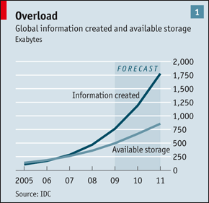
“Data, data everywhere”
Source: The Economist [http://www.economist.com/node/15557443?story_id=15557443]

Slide 3
Big Data Sources
Human produced content
Videos, photos, audio…
Involuntary produced content
Online activity logging, tax records…
Scientific instruments
CERN LHC, Sloan Digital Sky Survey, DNA sequencers…
Sensor data
Deborah Estrin

Slide 4
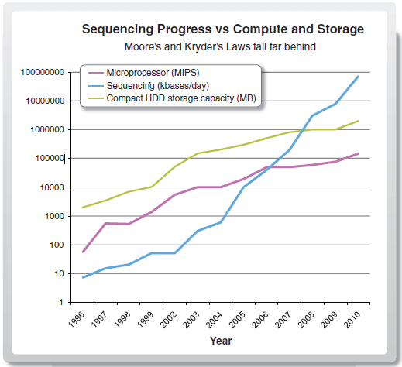

Slide 5
Outline
Today:
Introduction
Case-study: life science data
My research
15.10:
Storage
Batch processing
22.10
Analytics
Interactive processing

Slide 6
Big data players
Industry:
Google, Facebook, Twitter, Amazon, Netflix, Visa, …
Use data to provide services
Use data to make money
Has developed (most of the) technology for managing and processing peta-scale datasets
Government:
NSA, Skatteetaten, Kartverket, e-resept, …
Use data to make (hopefully) informed decisions
Make data available for public and commercial services
Science
Jim Gray´s last talk
4th paradigm book

Slide 7
Outline
Today:
Introduction
Case-study: life science data
Biology
Biotechnology
Computer science challenges
My research
15.10:
Storage
Batch processing
22.10
Analytics
Interactive processing

Slide 8
Biology

Slide 9
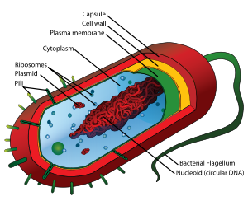
1. Cell
Source: wikipedia

Slide 10
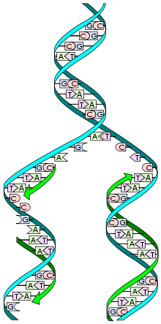
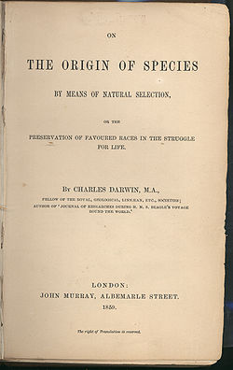
2. Evolution
Source: wikipedia

Slide 11
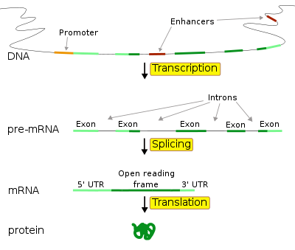
3. Genes
Unit of heredity
Encoded in DNA
Provides some function to the cell
Source: wikipedia

Slide 12
4. Homeostasis

Slide 13
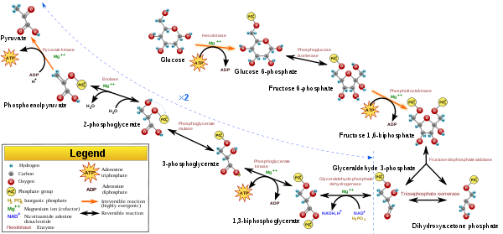
5. Energy
Source: wikipedia

Slide 14
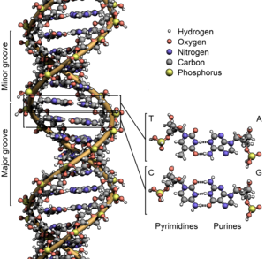
DNA
Blueprint for the development and function of all organisms
Double helix structure
Four base pairs: A, C, G and T
Also other forms of “DNA”: RNA, mRNA, etc
Source: wikipedia

Slide 15
Human Genome
3 billion base pairs
About 23.000 protein-coding genes
First sequenced in 2001
Ten years later more than 600 persons sequenced
Many “personal genomics” startups (such as 23andMe)
Will all Norwegian cancer patients be sequenced in 10 years? 20 years?
Cost: $3.000.000.000
Cost: $10.000 (per person)

Slide 16
Genomics
Reading a DNA sequence is relatively easy and cheap
Hard part is to understand what it does
Annotation
Function prediction
Regulation prediction
Methods:
Statistics and machine learning = Bioinformatics

Slide 17
Genomics Instruments
Really old days: selective breeding
Example: breading of reindeers
Old days: systematic selective breeding
Example: study of mutation inheritance in fruit flies
Up to a few years ago: microarrays
Machine to read gene expression values
Current: next-generation sequencing
Machine to read DNA sequences

Slide 18
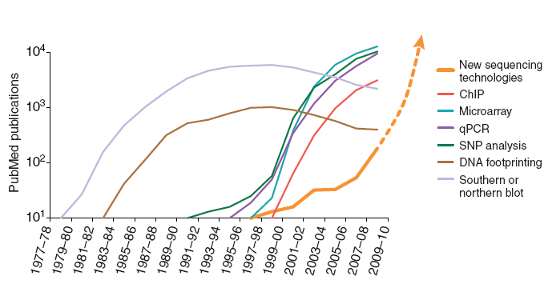
Microarrays to Next-generation Sequencing
Microarrays: innovation is at end of pipeline
Next-generation sequencing: still learning to use technology

Slide 19
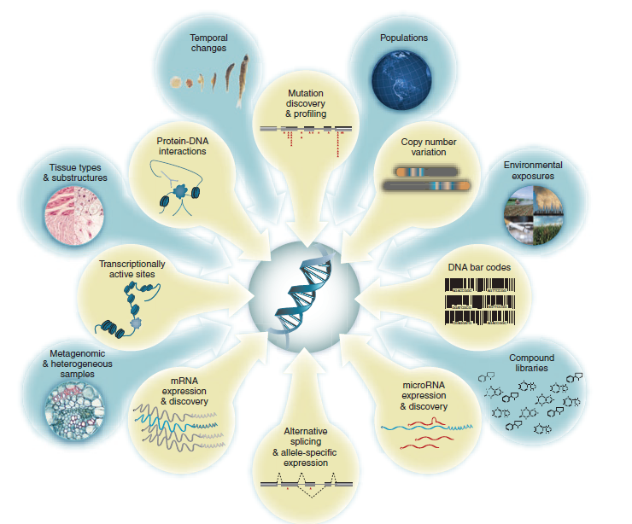
“What would you do if you could sequence everything?”

Slide 20
Next Generation Sequencing (simplified)
Get some DNA to sequence
Chop DNA into millions of pieces
Replicate the pieces
Distribute pieces into a matrix on a chip
Put chip in a sequencing machine
Read sequence in each matrix element in parallel
Output millions of short reads
Do multiple reads to ensure improve quality
Use parallel processing to combine short reads

Slide 21
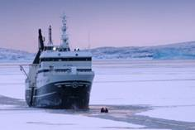
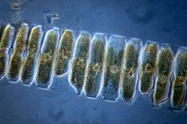
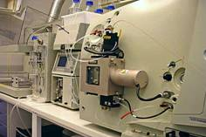
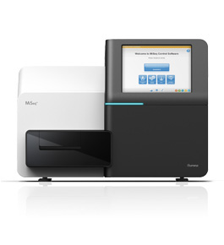
Biology (again)
Top-row images from Mabcent-SFI: http://www0.nfh.uit.no/mabcent/
Illumina MiSeq image from: www.illumina.com

Slide 22
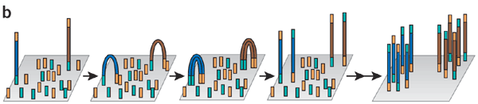
Chemistry
“Cluster generation” on Illumina (Solexa) sequencing
A flow cell covered with primers is sparsely populated with single-stranded fragments for amplification
Cut DNA into many small parts (of 100-1000 bases)
Replicate parts
Add parts to chip
Read bases of each small part in parallel
Key point: parallel technology with good scalability and low cost

Slide 23
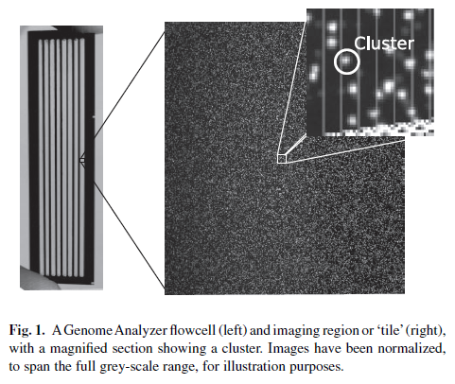
Astronomy
Use astronomy grade cameras
800 tiles imaged in four channels
One image per base
Typically 37 cycles
➔ 118 400 images
2048x1794 16-bit grey-scale TIFF
Best compression algorithm, and expected ratio?

Slide 24
Image Analysis
Goal: measure intensity of each tile for each base
Background subtraction: make signal clearer
Image correlation: correct camera skew or lens artifacts
Object identification: detect cluster representing tile and measure intensity
Easy to parallelize?

Slide 25
Base Calling
Goal: read bases in each short DNA piece
Crosstalk correction: signal “leaks” between bases
Phasing correction: signal “leaks” between cycles
Chastity filtering: tiles may overlap
Base calling

Slide 26
Gabor Marth

Slide 27
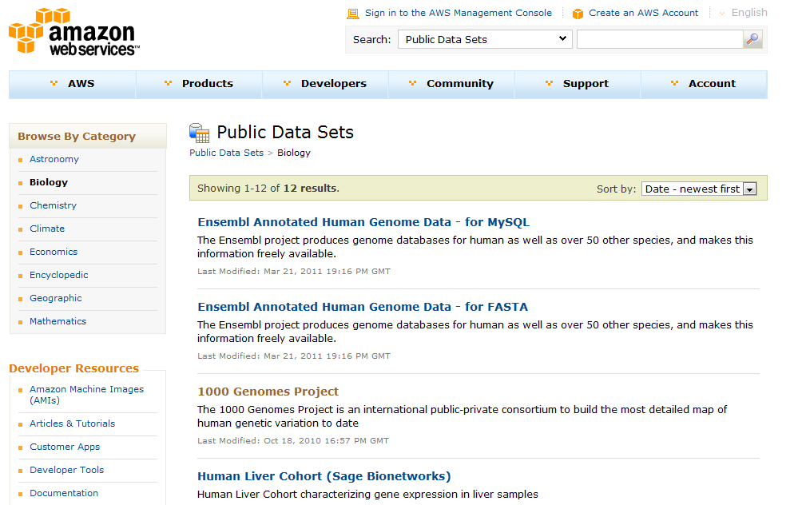
Amzon AWS

Slide 28
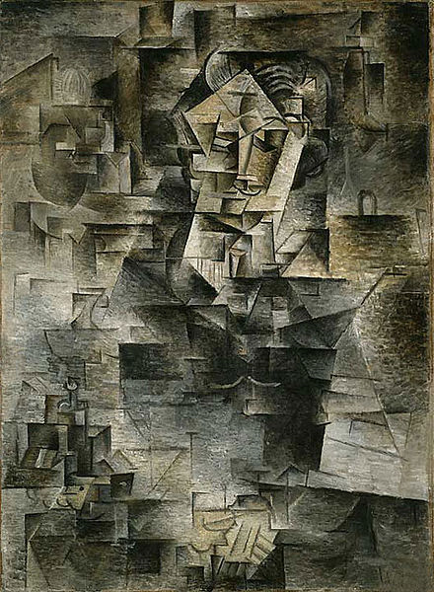
Gabor Marth

Slide 29
End-File Format (FASTQ)
@x7001_6_1_892_763
ATGTTATGTATTGGAAATGAGCATACGATAAA
+x7001_6_1_892_763
^^^^^^^^^^^^^^^^^^^]\\\\\\\V\\YX
@x7001_6_1_887_763
TTAGCAGCATCTGCTTCAACATATACCAAAGC
+x7001_6_1_887_763
^^^^^^^^^^^^^^^^^^^]\\\\\\\X\\YX
Quality scores:
int quality = (int) q + 33;
Notes:
Becoming de facto standard

Slide 30
Sequence Analysis
Do an interesting analysis
Publish paper
Publish experiment data in a repository
Curators integrate results with existing knowledge

Slide 31
Big Data in Life Science

Slide 32
How Bad Is It?
New machines produce more than 1TB of data per experiment and can run one experiment per day
Norwegian High-Throughput Sequencing Centre has 4
There is one in Bodø
Dep. Of Chemistry has one
UNN plans to buy at least one in near future
Let’s compare a microarray data analysis pipeline with a short-read sequencing analysis pipeline
Beijing Genomics Institute (ca. 2008)
30 sequencers
500 node (dedicated) supercomputer
10TB raw data processed each 24 hours
In 2010 they bought 128 additional sequencers

Slide 33
Microarray Pipeline
Microarray
machine
Image
Image analysis
Values+ quality scores
Pre-processing
Matrix
Clustering, etc.
Visualization
Graph
Bayesian interference
“Data-base”

Slide 34
Microarray Pipeline
Maunally: one week (single machine,
no parallelism)
Microarray
machine
Image
Image analysis
Values+ quality scores
Pre-processing
1-2 GB
per image
Matrix
MBs
Clustering, etc.
Visualization
Graph
Bayesian interference
“Data-base”
<5 TB (everything)

Slide 35
Next-generation sequencing pipeline
Next gen. sequencing
machine
Images
Image analysis
Values+ quality scores
Base-calling
Short reads
Alignment or assembly
New tools
Browsing and annotation
Sequence

Slide 36
Next-generation sequencing – pipeline (per Experiment)
One experiment:
One day (big machine,
parallelism)
Next gen. sequencing
machine
Images
Image analysis
Values+ quality scores
Base-calling
700GB in hundreds of images
Short reads
200-300GB
in text files
200-300GB
in text files
Alignment or assembly
Data exploration
Browsing and annotation
Sequence
5-10GB
in text files
(per experiment)
Notes:
Research groups working on these projects are finding that the ability to generate large volumes of sequence data has quickly outpaced the ability to analyze it. As Tim Hubbard, head of the informatics team of the human genome-analysis group at the Wellcome Trust Sanger Institute told BioInform last January, it is “going to become cost effective to sequence anything in biology, but not necessarily cost effective to annotate it.”
That shift toward high-throughput sequencing has entailed a “major investment” in IT infrastructure to support the sequencing workflow at large genome centers. Hubbard said that the Sanger Center installed 340 terabytes of disk cache just to handle the temporary processing of data coming off of the machines.
Source: http://www.genomeweb.com/informatics/second-generation-sequencing-stayed-bioinformatics-driver%E2%80%99s-seat-2008

Slide 37
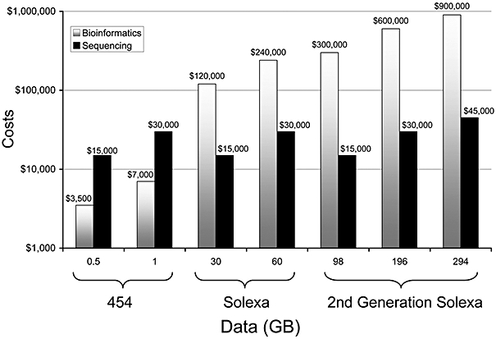
Cost of Sequence Based Screening (on Amazon EC2)
Heidelberg, KB, Gilbert, JA and Joint, I (2010) Marine genomics: at the interface of marine microbial ecology and biodiscovery. Microb Biotechnol. 3(5): 531–543

Slide 38
Big Data in Science
Generally accepted that industry is ahead
HDFS, MapReduce, Hbase being adapted
Many custom built systems
CERN CASTOR
Design is typically not published in systems papers
Exception: Sloan Digital Sky Survey & Jim Gray
System requirements may differ from industry
Scientific big data is more interesting than industry big data!

Slide 39
Scientific Storage Systems
Source: http://www.usenix.org/events/lisa10/tech/slides/cass.pdf

Slide 40
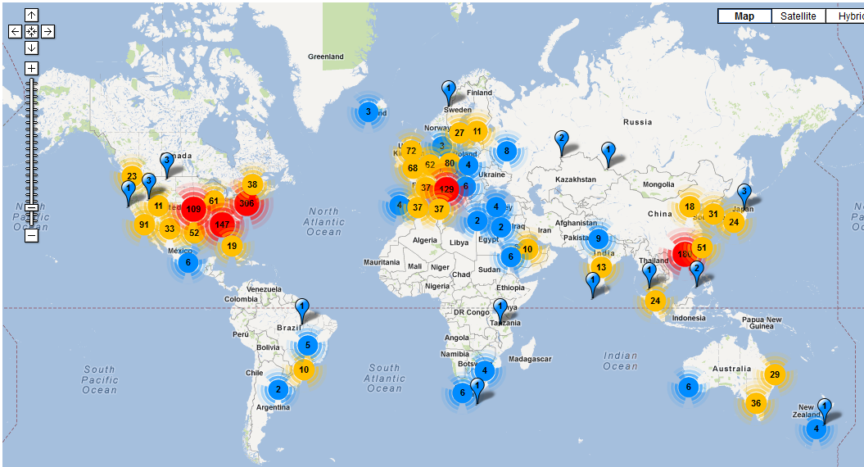
Life Sciences (in 2010)

Slide 41
LHC vs. Life Sciences
LHC
One very expensive instrument
Dedicated compute, storage, and network bandwidth
Computer infrastructure planned for many years
Life science
Many cheap instruments
Computation, storage, and data transfer often afterthought
Compute infrastructure will not be in place for many years

Slide 42
Life Science eInfrastructure
Pipeline
Pipeline
Pipelines
Data feeders
Processed data storage
Data feeders
Data feeders
Parser
Cleaning tool
Batch processed
Data flow
Interactive
Data search and exploration
GUIs
Data exploration services
Single node
Distributed and parallel

Slide 43
Outline
Today:
Introduction
Case-study: life science data
My research
15.10:
Storage
Batch processing
22.10
Analytics
Interactive processing

Slide 44
Main goal

Slide 45
Motivation
Increase in bionformaticians?
@UiT

Slide 46
My Research Goals
Observation: the people analyzing genomics data are the main bottleneck for novel scientific insight
Make bioinformatics more efficient
System support for data management
System support for next-generation bioinformatics algorithms
Tools for data exploration
Take care of scalability, replication, fault-tolerance, data communication, performance, resource allocation…

Slide 47
Google for Bioinformatics
http://imp.princeton.edu/
IMP parts:
Interactive visualization
Prediction algorithm
Data integration pipeline
Tens of terabytes of data
Collaboration with Profs. Olga Troyanskaya and Kai Li (Princeton)
Our parts:
Scalable visualization
Parallel prediction algorithm
Scalable pipeline
Data management
What is missing?
Automated testing of pipeline data
Better fault tolerance in pipeline
Graphical user interface

Slide 48
Computer Science Challenges
Data storage and compression
Collaborator Kai Li is expert on compression and storage systems (among other things)
Data cleaning and management
Challenging to integrate all available data
Data analytics on peta-scale heterogeneous datasets
Support for advanced machine learning applications
Data exploration tools
Scalability and easy to use (all tools are used by biologists)

Slide 49
Marine bioprospecting
Galaxy (computation specification)
Sequencer
METApipe
MetaRep
DB´s
GeStore (incremental updates)
(Interactive data processing, Iterative pipeline steering)

Slide 50
Compute Science Challenges
Data management
Multiple users in research and industry
Simple and flexible workflow management
Users have different needs
Simple and flexible data exploration and visualization
Cost-effective processing
Integration with national supercomputing resources

Slide 51
A cure for cancer
NOWAC
Statistical analysis
Statistical analysis
Visualization
Statistical analysis
Data cleaning and parameter tuning

Slide 52
Computer Science Challenges
Data analytics
User interfaces
For analytics and data management
Very large interactive 3D visualizations

Slide 53
Summary
Big data opportunities and challenges
Next-generation sequencing data
Domain background
Technology producing data
Challenges for building infrastructure
My own research
Next week: systems for storing and processing all the data

