Slide 1
Parallel Program Performance Evaluation
Inf-2202 Concurrent and System Level Programming
Fall 2013
Lars Ailo Bongo (larsab@cs.uit.no)

Slide 2
Outline
Parallel program evaluation
PARSEC

Slide 3
Recap - Steps for a performance evaluation study
State the goals of the study and define the system boundaries
List system services and possible outcomes
Select performance metrics
List system and workload parameters
Select factors and their values
Select evaluation techniques
Select the workload
Design the experiments
Analyze and interpret the data
Presents the results. Start over, if necessary
Notes:
Box 2.2 in The art of computer systems performance analysis. Raj Jain. Wiley. 1991.

Slide 4
Step 1 – System boundary and goals
Application
System software
Real machine
System or architecture ideas and trade-off
Goals?

Slide 5
Step 2 – System services and outcomes
Parallel application services?
Parallel application outcomes?
Parallel system/architecture services?
Parallel system/architecture outcomes?

Slide 6
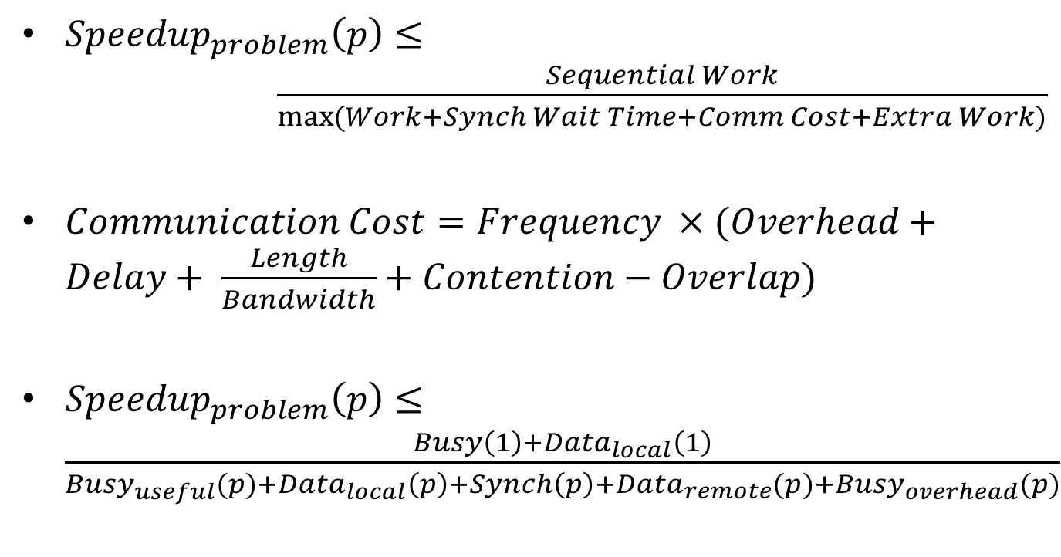
Recap – Programming for performance
${Speedup}_{problem}\left(p\right)≤ \frac{Sequential Work}{\max{(Work+Synch Wait Time+Comm Cost+Extra Work)}}$
$Communication Cost=Frequency ×(Overhead+Delay+ \frac{Length}{Bandwidth}+Contention−Overlap)$
${Speedup}_{problem}\left(p\right)≤\frac{Busy\left(1\right)+{Data}_{local}\left(1\right)}{{Busy}_{useful}(p{)+{Data}_{local}\left(p\right)+Synch\left(p\right)+{Data}_{remote}(p)+{Busy}_{overhead}(p)}}$

Slide 7
Step 3 - Metrics
Wall-clock time
Speedup = Time(1 thread) / Time(t threads)
Amdahl´s law
Gustafson´s law
  ➔ scalability

Slide 8
Speedup
Speedup = time(1 core) / time(c cores)
How to measure time(1 core)?
  Parallel program on one core on parallel machine
  Sequential program on one core on parallel machine
  Best sequential program on one core on parallel machine
  Best sequential program on standard machine

Slide 9
Scalability
User-oriented properties:
  Domain specific
    Example: number of rows in table
Resource-oriented properties
  Problem-constrained scaling
    Problem size is fixed
    Speedup = Time(1 thread) / Time(t threads)
  Time-constrained scaling
    Wall-clock time is fixed
    Speedup = Work(t threads) / Work(1 thread)
    How to measure work?
  Memory-constrained scaling
    Memory usage per thread is fixed
    Speedup = (Work(t threads) / Time(t threads)) x (Time(1 thread) / Work(1 thread))
    = Increase in work / increase in wall-clock time
  “Others”

Slide 10
Step 3 - Metrics
Application:
  Concurrency
  Communication-to-computation ratio
  Synchronization and I/O frequency
  Temporal and spatial locality
  (Message size)
System/ hardware:
  Absolute performance (wall-clock time, time breakdown,…)
  Speedup
  Processing rate (FLOPS, queries/sec,…)
  Utilization (CPU load, network load…)
  Problem size (parallel efficiency, …)
  Percentage improvement in performance (not recommended)

Slide 11
Step 4 – System and workload parameters
System:
  #cores
  #nodes (if distributed system)
  Memory size, cache sizes, processor frequency, multi-threading, bus bandwidth,…
  Cache coherency scheme
  Synchronization primitive implementation, concurrent data structures
  Programming languages
  …

Slide 12
Step 4 – System and workload parameters
Workload:
  Problem size
  Communication-computation ratio
  Execution time breakdown in different parts
  Load balance
  Temporal locality
  Spatial locality

Slide 13
Step 5 – Factors and their values
System:
  #cores: 1, 2, 4, 8, 16,…, N
  #nodes: 1, 2, 4, 8, 16,…,N
  Machine A vs. Machine B, vs. Machine C
  Cache design A vs. proposed design B
  De-facto standard systems vs. my system
  Go vs. C
  …

Slide 14
Step 5 – Factors and their values
Workload:
  Problem size:
    High-level goals (new meteorological model)
    Simulator, small, medium, large (predefined)
    Realistic sizes
  Inherent behavioral:
    Stress different parts of the system (many problem sizes)
    Most realistic usage
  Temporal and spatial locality:
    Realistic working sets

Slide 15
Step 6 – Evaluation techniques
Real machine or system: performance measurements
Architectural or system idea or trade-off: simulation
Application design ideas: modeling or simulation

Slide 16
Step 7 – Select workload
Kernels, applications, or application suites
Input data size and algorithm parameters
Important properties:
  Representativeness
  Coverage of behavioral properties
  Enough concurrency and load balanced

Slide 17
Optimization
How much should benchmarks be optimized?
  Different levels stress different parts of system
Types of optimizations:
  Algorithmic (decomposition and assignment)
  Data structuring
  Data layout, distribution, and alignment
  Orchestrating of communication and synchronization

Slide 18
Step 8 – Design the experiments
Performance isolation (microbenchmarks)
  Processing (non-memory accessing operations)
  Local memory (latencies at different cache levels)
  I/O (disk read/write)
  Communication (remote reads/writes)
  Synchronization

Slide 19
Steps 9 and 10 – analyze, interpret, and present results
Will skip this part

Slide 20
Exercise
PARSEC

Slide 21
Summary
Most “standard” performance evaluation techniques and practices apply
Some specific issues:
  Scalability very important
PARSEC is a state of the art benchmark suite

