Slide 1
Programming for performance
Inf-2202 Concurrent and System Level Programming
Fall 2013
Lars Ailo Bongo (larsab@cs.uit.no)

Slide 2
Parallelization process
Goals: performance, good resource utilization
Task: piece of work
Process/thread: entity that performs the work
Processor/core: physical processor cores
Decomposition of the computation into tasks
Assignment of tasks to processors
Orchestration of necessary data access, communication, and synchronization among processes
Mapping of threads to cores

Slide 3
Fundamental design issues
Communication abstraction
Programming model requirements
Naming
Ordering
Communication and replication
Performance

Slide 4
Outline
Partitioning for performance
Orchestration for performance

Slide 5
Partitioning
Algorithmic
Decomposition
  Split computation into tasks
  Task granularity limits performance
Assignment
  Load balancing
  Reduce communication volume
  Send minimum amount of data
  Static or dynamic

Slide 6
Primary algorithmic issues
Balance workload to reduce time spent waiting at communication and synchronization events
Reduce communication
Reduce extra work for determining and managing a good assignment
At odds with each other: must find best compromise

Slide 7
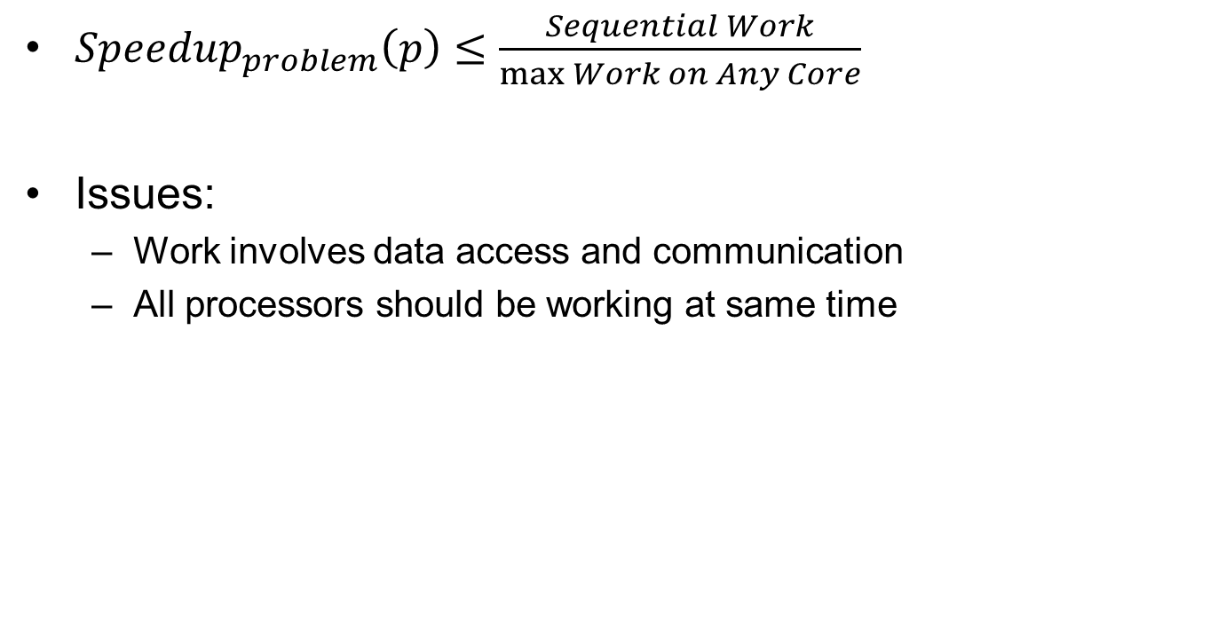
Load balancing and synchronization wait time
${Speedup}_{problem}\left(p\right)≤\frac{Sequential Work}{\max{Work on Any Core}}$
Issues:
  Work involves data access and communication
  All processors should be working at same time

Slide 8
Load balancing and synchronization wait time (2)
Identify enough concurrency and overcome Amdahl’s law
Decide how to mange concurrency (statically or dynamically)
Determine the granularity at which to exploit concurrency
Reduce serialization and synchronization cost

Slide 9
Identify enough concurrency
Data parallelism:
  Same computation on different parts
  Grows with data size
  Mostly used
Functional parallelism
  Different computations
    Task parallelism
    Pipelined computation
  Typically used in combination with data parallelism
  Often modest amount

Slide 10
Identify enough concurrency (2)
Static assignment
  Algorithmic mapping
  Depends on problem size, #cores, algorithm parameters,…
  Low runtime overhead
  Work per task must be predictable
  Can be perturbed by other applications (or system workload)
Dynamic assignment
  Pool (bag) of available tasks
  Mini-lecture by Ibrahim on Thursday
Semistatic
  Initially static assignment; then adjust dynamically

Slide 11
Linda
Seminal parallel programming approach
Library language
Uncoupled processes
  Spatially and temporally
Tuple space (TS)
  Tuple: arbitrary data
  Tuples addressed by logical name (not address)
  Tuples cannot be modified
Operations
  out: insert tuple to TS
  in: remove tuple from TS
  read: read value from TS
  (eval)
Read more: Ahuja, S.; Carriero, N.; Gelernter, D.,
Linda and Friends, Computer , vol.19, no.8, pp.26,34, Aug. 1986.

Slide 12
Linda bag of tasks
Tuples: (“Task”, <task descriptor>)
Loop {
/* withdraw a task from the bag */
in(“Task”, formal NextTask);
process “Next Task”;
for (each new Task generated in the process) {
/* drop task to bag */
out(“Task”, NewTask);
}
}

Slide 13
MongoDB
NoSQL database (key-value store)
Similar approach as in Linda
Widely in use
Learn more: http://www.mongodb.org/ and http://api.mongodb.org/python/current/tutorial.html

Slide 14
@home computing
Embarrassingly parallel computations
Popularized by SETI@home
  Search for Extraterrestrial Intelligence
BOINC project
  Oper-source software for @home projects

Slide 15
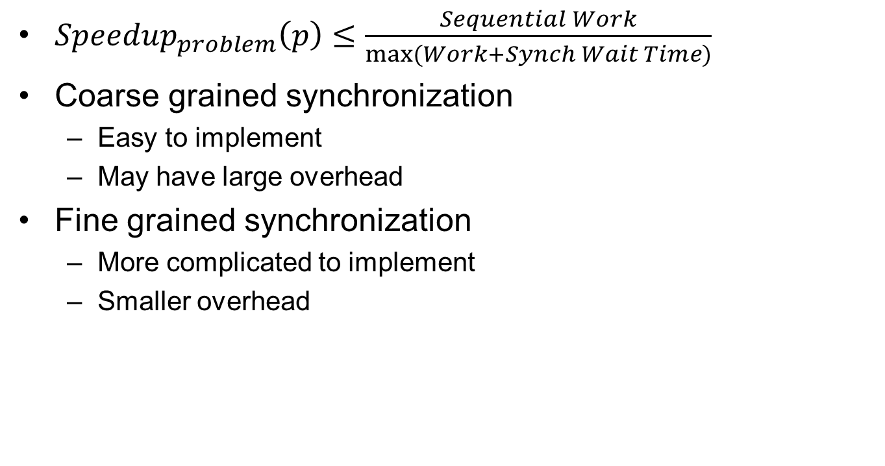
Reducing serialization
${Speedup}_{problem}\left(p\right)≤\frac{Sequential Work}{\max{(Work+Synch Wait Time)}}$
Coarse grained synchronization
  Easy to implement
  May have large overhead
Fine grained synchronization
  More complicated to implement
  Smaller overhead

Slide 16
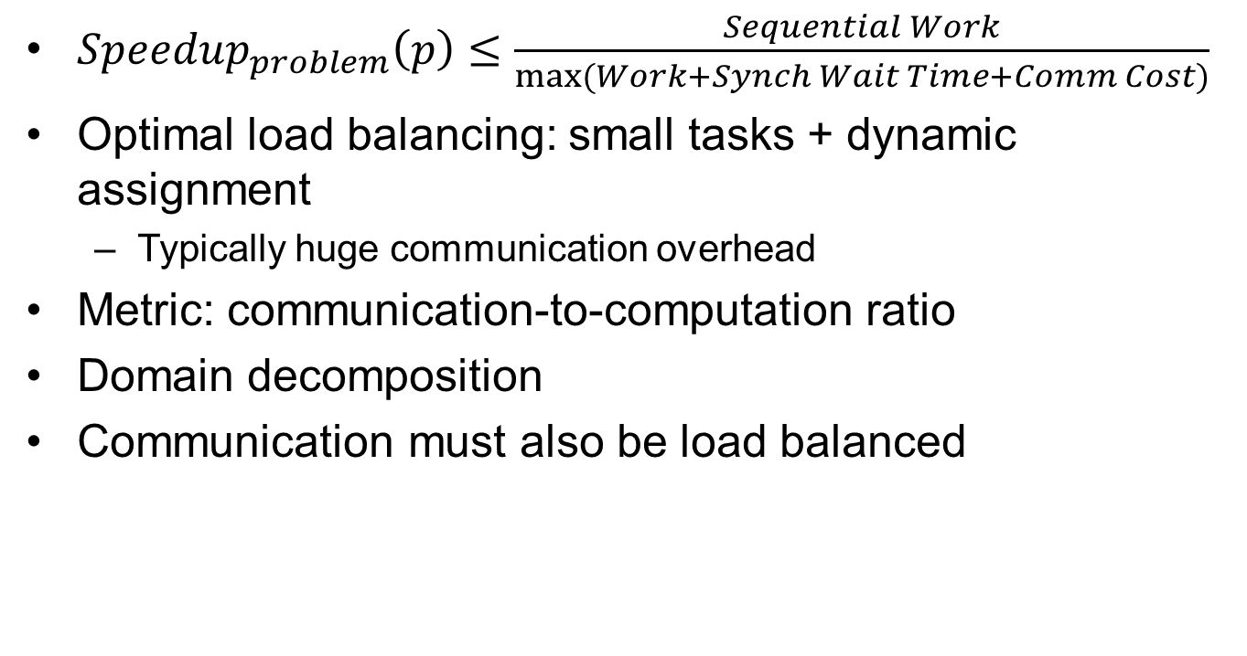
Reducing communication
${Speedup}_{problem}\left(p\right)≤\frac{Sequential Work}{\max{(Work+Synch Wait Time+Comm Cost)}}$
Optimal load balancing: small tasks + dynamic assignment
  Typically huge communication overhead
Metric: communication-to-computation ratio
Domain decomposition
Communication must also be load balanced

Slide 17
Rules of Thumb
Distributed computing economics (Jim Gray)
  1999
  2003
  2008
Designing distributed systems:
  Jeff Dean (LADIS keynote)

Slide 18
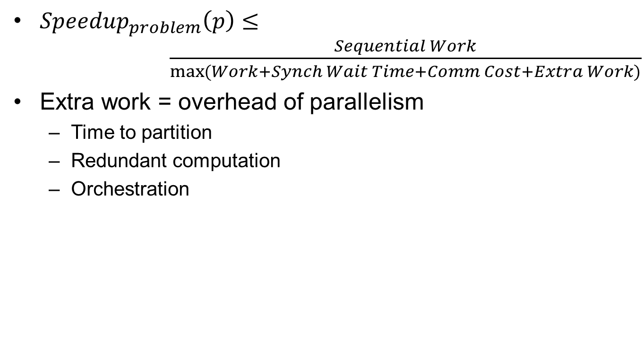
Reducing Extra Work
${Speedup}_{problem}\left(p\right)≤ \frac{Sequential Work}{\max{(Work+Synch Wait Time+Comm Cost+Extra Work)}}$
Extra work = overhead of parallelism
  Time to partition
  Redundant computation
  Orchestration

Slide 19
Outline
Partitioning for performance
Orchestration for performance

Slide 20
Reducing inherit communication
Exploit temporal locality (working set)
  Blocking
    E.g. matrix multiplication
Exploit spatial locality
Best strategy depends on problem size, algorithmic partitioning, implementation issues, parallel architecture…
Must be structured to fit underlying parallel architecture

Slide 21
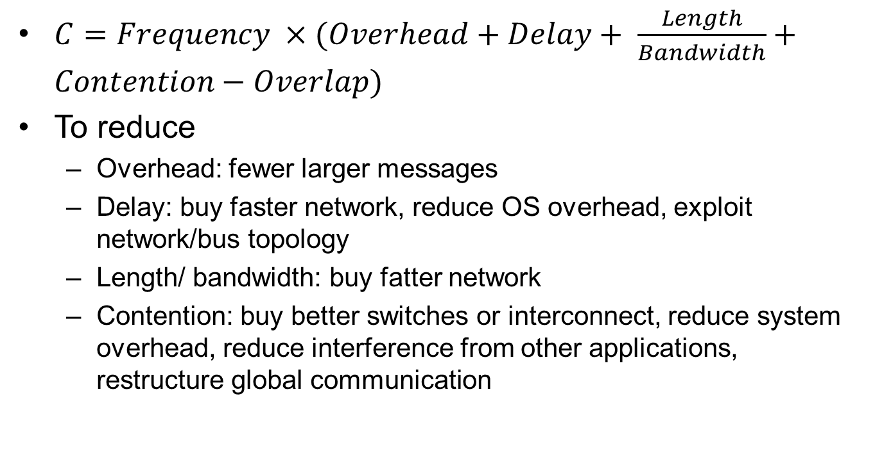
Communication cost
$C=Frequency ×(Overhead+Delay+ \frac{Length}{Bandwidth}+Contention−Overlap)$
To reduce
  Overhead: fewer larger messages
  Delay: buy faster network, reduce OS overhead, exploit network/bus topology
  Length/ bandwidth: buy fatter network
  Contention: buy better switches or interconnect, reduce system overhead, reduce interference from other applications, restructure global communication

Slide 22
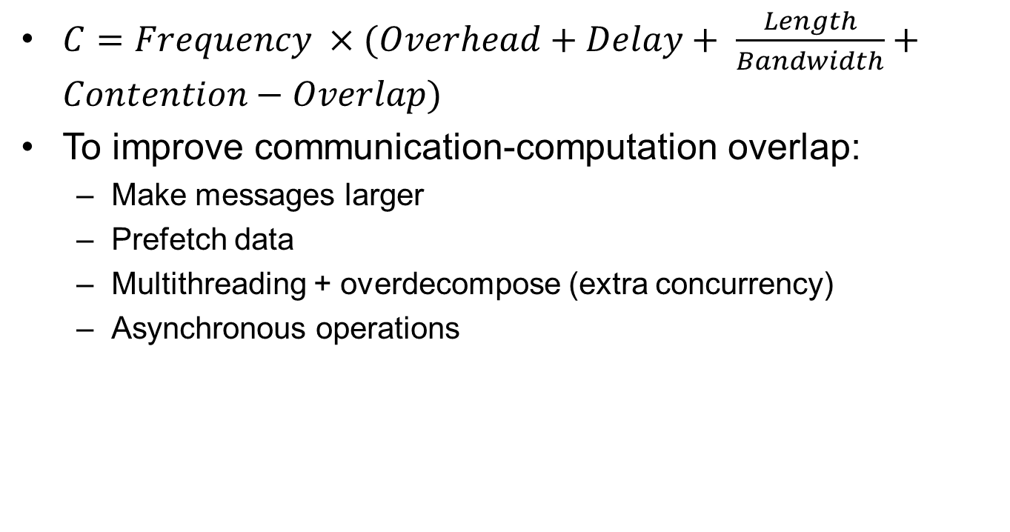
Communication cost (2)
$C=Frequency ×(Overhead+Delay+ \frac{Length}{Bandwidth}+Contention−Overlap)$
To improve communication-computation overlap:
  Make messages larger
  Prefetch data
  Multithreading + overdecompose (extra concurrency)
  Asynchronous operations

Slide 23
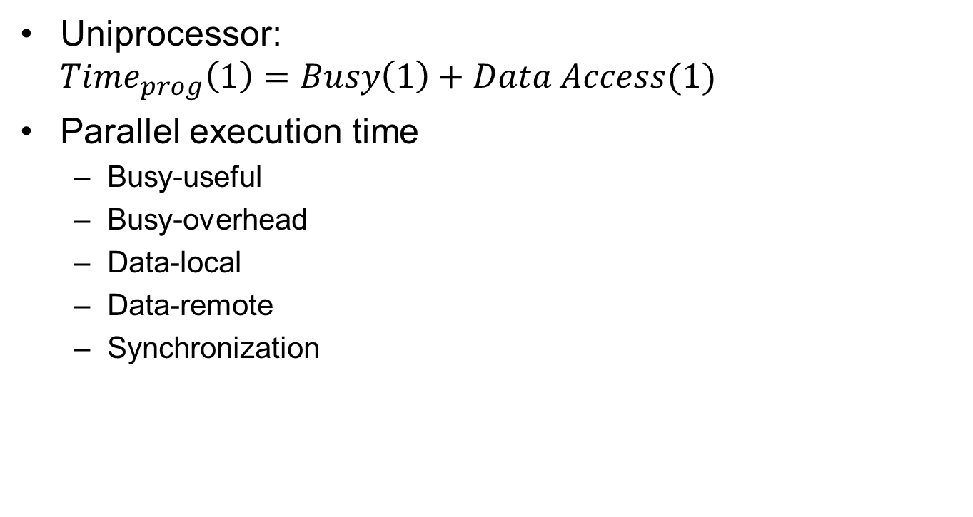
Processor view
Uniprocessor:
${Time}_{prog}\left(1\right)=Busy\left(1\right)+Data Access(1)$
Parallel execution time
  Busy-useful
  Busy-overhead
  Data-local
  Data-remote
  Synchronization
Notes:
Fig. 3.13

Slide 24

A performance model
$${Speedup}_{problem}\left(p\right)≤\frac{Busy\left(1\right)+{Data}_{local}\left(1\right)}{{Busy}_{useful}(p{)+{Data}_{local}\left(p\right)+Synch\left(p\right)+{Data}_{remote}(p)+{Busy}_{overhead}(p)}}$$

Slide 25
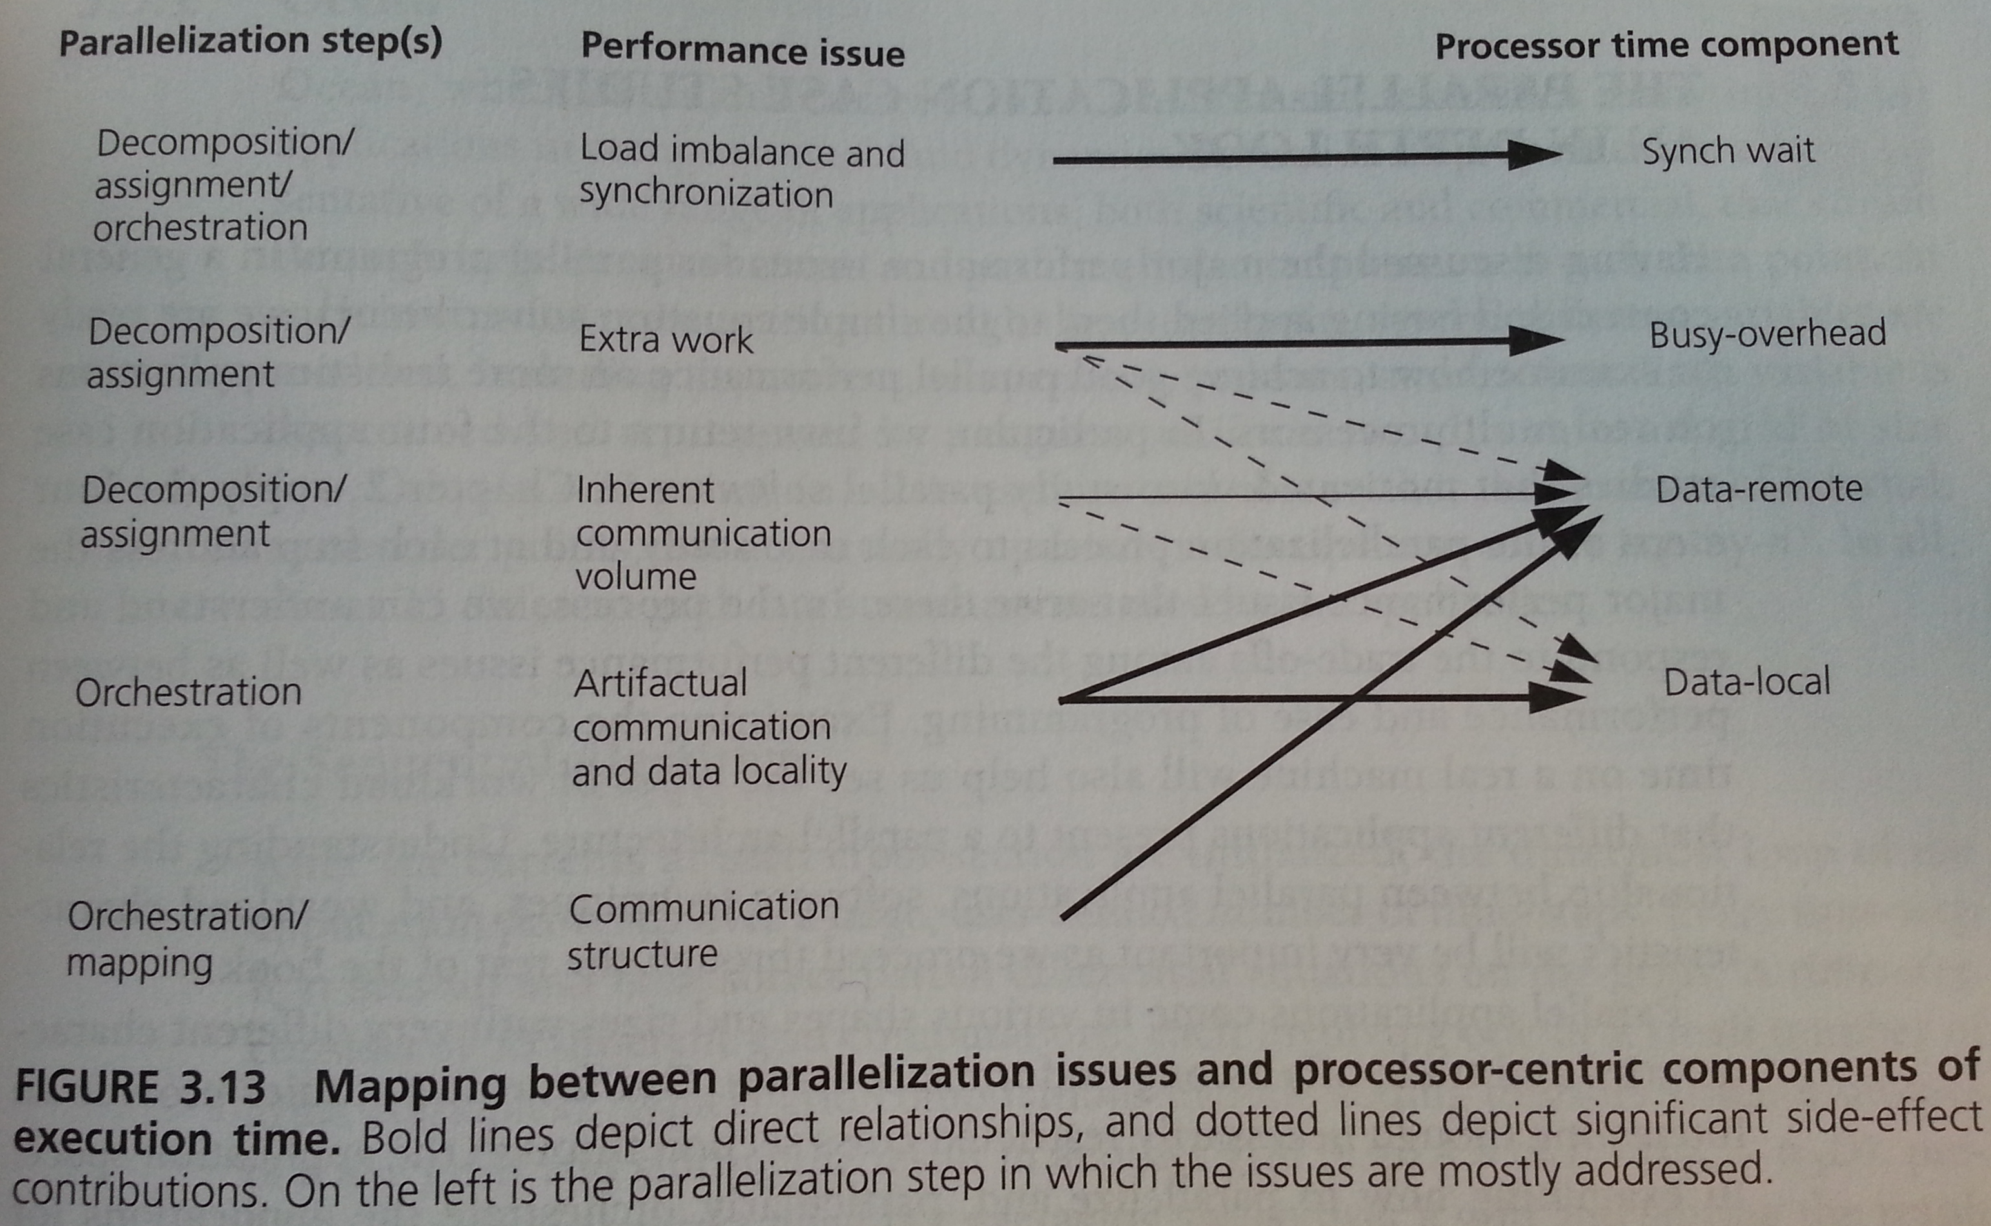

Slide 26
Case studies
Exercise: read chapter 3.5

Slide 27
Summary
Partitioning for performance
  Algorithmic
  Commonly used design patterns
Orchestration for performance
Linda and MongoDB programming models
Rules of thumb metrics

