Slide 1
Parallel programs
Inf-2202 Concurrent and System Level Programming
Fall 2013
Lars Ailo Bongo (larsab@cs.uit.no)

Slide 2
Course topics
Parallel programming
  The parallelization process
  Optimization of parallel programs
Performance analysis
Data-intensive computing

Slide 3
Parallel programs
Supercomputing
  Traditionally scientific applications
    Parallel programming was hard
    Parallel architectures were expensive
  Still important!
Data intensive computing
  Will return to this topic
Server applications
  Databases, Web servers, App servers, etc
Desktop applications
  Games, image processing, etc
Mobile phone applications
  Multimedia, sensor based, etc
GPU and hardware accelerator applications

Slide 4
Outline
Parallel architectures
Fundamental design issues
Case studies
Parallelization process
Examples

Slide 5
Parallel architectures
A parallel computer is “a collection of processing elements that communicate and cooperate to solve large problems fast” (Almasi and Gottlieb, 1989)
  Conventional computer architecture
  + communication among processes
  + coordination among processes
Notes:
Highly parallel computing (bbok), Almasi and Gottlieb, 1989.

Slide 6
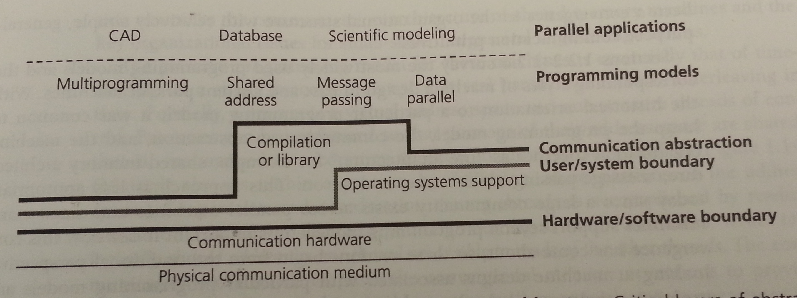
Communication architecture
Hardware/ software boundary?
User/ system boundary?
Defines:
  Basic communication operations
  Organizational structures to realize these operations
Notes:
Figure is from: Parallel Computer Architecture: A Hardware/Software Approach. David Culler, J.P. Singh, Anoop Gupta. Morgan Kaufmann. 1998.

Slide 7
Parallel architectures
Shared address space
Message passing
Data parallel processing
  Bulk synchronous processing (Valiant 1990)
  Google’s Pregel (Malewicz, et al., 2010)
  Bulk synchronous visualization (Bongo, 2013)
Dataflow architectures (wikipedia1, wikipedia2)
  VHDL, Verilog, Linda, Yahoo Pipes(?), Galaxy (?)
Notes:
BSP: http://dl.acm.org/citation.cfm?id=79181&CFID=355958399&CFTOKEN=92782375
Pregel: dl.acm.org/citation.cfm?id=1807184
BSV: http://dl.acm.org/citation.cfm?id=2442995
Wikipedia1: http://en.wikipedia.org/wiki/Dataflow_architecture
Wikipedia2: http://en.wikipedia.org/wiki/Dataflow_programming

Slide 8
Outline
Parallel architectures
Fundamental design issues
Case studies
Parallelization process
Examples

Slide 9
Fundamental design issues
Communication abstraction
Programming model requirements
Naming
Ordering
Communication and replication
Performance

Slide 10
Communication abstractions
Well defined operations
Suitable for optimization

Slide 11
Programming model
One or more threads of control operating on data
What data can be named by which threads
What operations can be performed on the named data
What ordering exists among those operations
Programming model for a uniprocessor?
Programming model with pthreads?
Why need for explicit synchronization primitives?

Slide 12
Naming
Critical at each level of the architecture
Example: naming in shared address space
Notes:
Figure from: Parallel Computer Architecture: A Hardware/Software Approach. David Culler, J.P. Singh, Anoop Gupta. Morgan Kaufmann. 1998

Slide 13
Operations
Operations that can be performed on the data
Example: shared address space

Slide 14
Ordering
Important at all layers in the architecture
Performance tricks
If implicit ordering is not enough, need synchronization:
  Mutual exclusion
  Events / condition variables
    Point-to-point
    Global

Slide 15
Communication and replication
Related to each other
Caching
IPC
Binding of data:
  Write
  Read
  Data transfer
  Data copy
  IPC

Slide 16
Performance
Data types, addressing modes, communication abstractions specifies naming, ordering and synchronization for shared objects
Performance characteristics specifies how they are actually used
Metrics
  Latency: the time for an operation
  Bandwidth: rate at which operations are performed
  Cost: impact on execution time

Slide 17
Outline
Parallel architectures
Fundamental design issues
Case studies
Parallelization process
Examples

Slide 18
Outline
Parallel architectures
Fundamental design issues
Case studies
Parallelization process
Examples

Slide 19
Parallelization process
Goals: performance, good resource utilization
Task: piece of work
Process/thread: entity that performs the work
Processor/core: physical processor cores
Decomposition of the computation into tasks
Assignment of tasks to processors
Orchestration of necessary data access, communication, and synchronization among processes
Mapping of threads to cores

Slide 20
Parallelization process
Goals:
  Performance
  Resource utilization
  Small effort
May be done at any layer

Slide 21
Parallelization process (2)
Task: piece of work
Process/thread: entity that performs the work
Processor/core: physical processor cores

Slide 22
Parallelization process (3)
Decomposition of the computation into tasks
Assignment of tasks to processors
Orchestration of necessary data access, communication, and synchronization among processes
Mapping of threads to cores

Slide 23
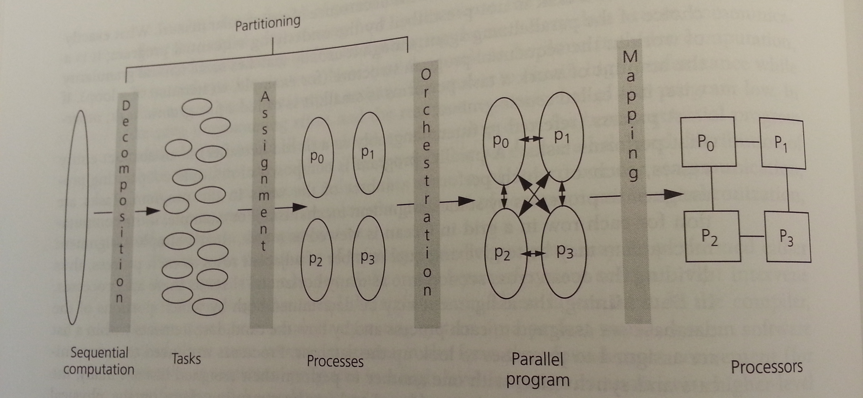
Steps in the parallelization process
Notes:
Figure from: Parallel Computer Architecture: A Hardware/Software Approach. David Culler, J.P. Singh, Anoop Gupta. Morgan Kaufmann. 1998

Slide 24
Decomposition
Split computation into a collection of tasks
Algorithmic
Task granularity limits parallelism
➔ Amdahl’s law

Slide 25
Assignment
Algorithmic
Goal: load balancing
  All processes should do equal amount of work
  Important for performance
Goal: reduce communication volume
  Send minimum amount of data
Two types:
  Static
  Dynamic

Slide 26
Orchestration
Specific to computer architecture, programming model, and programming language
Goals:
  Reduce communication cost
  Reduce synchronization cost
  Locality of data
  Efficient scheduling
  Reduce overhead

Slide 27
Mapping
Specific to system or programming environment
  Parallel system resource allocator
  Queuing systems
  OS scheduler

Slide 28
Goals of parallelization process
Step | Architecture dependent? | Major performance goals
Decomposition | Mostly no | Expose enough concurrency but not too much
Assignment | Mostly no | Balance workload Reduce communication volume
Orchestration | Yes | Reduce noninherent communication via data locality Reduce communication and synchronization cost as seen by the processor Reduce serialization to shared resources Schedule tasks to satisfy dependencies early
Mapping | Yes | Put related threads on the same core if necessary Exploit locality in chip and network topology
Notes:
Table from: Parallel Computer Architecture: A Hardware/Software Approach. David Culler, J.P. Singh, Anoop Gupta. Morgan Kaufmann. 1998

Slide 29
Example
Example from chapter 2.3 in Parallel Computer Architecture: A Hardware/Software Approach. David Culler, J.P. Singh, Anoop Gupta. Morgan Kaufmann. 1998.

Slide 30
Exercises
Implement example program using Python threads

