Slide 1
Threads and synchronization primitives
Inf-2202 Concurrent and System Level Programming
Fall 2013
Lars Ailo Bongo (larsab@cs.uit.no)

Slide 2
Practicalities
Web page:
  http://www.cs.uit.no/~larsab/inf2202/fall13/
Mailing list:
  Will be created soon
First mandatory assignment:
  Thursday 12:15

Slide 3
Outline
Operating system course recap
  Processes and threads
  Atomic lock operations
  Mutex, semaphore, condition variable, monitors, message passing
  Pthread and Python thread programming
Architecture course recap
  Hardware multi-threading
  ILP and vector processing
  GPUs
  Parallel I/O

Slide 4
Processes and non-preemptive scheduling
Tore Larsen University of Tromsø
Otto J. Anshus University of Tromsø, University of Oslo
Kai Li Princeton University

Slide 5
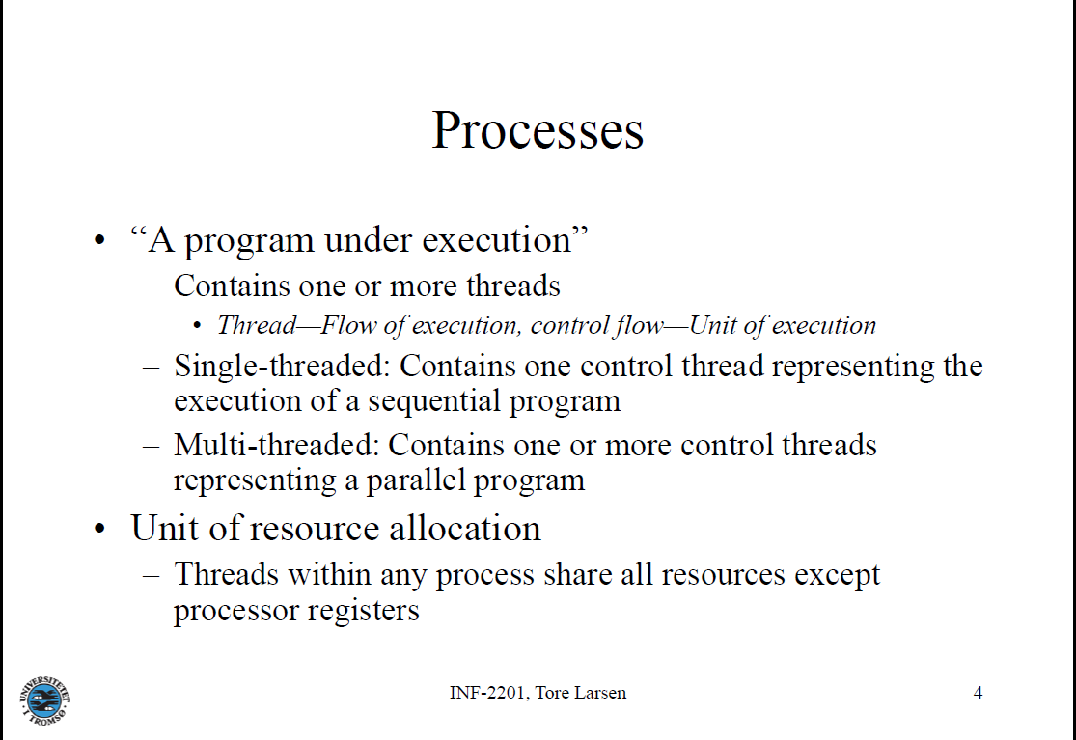

Slide 6
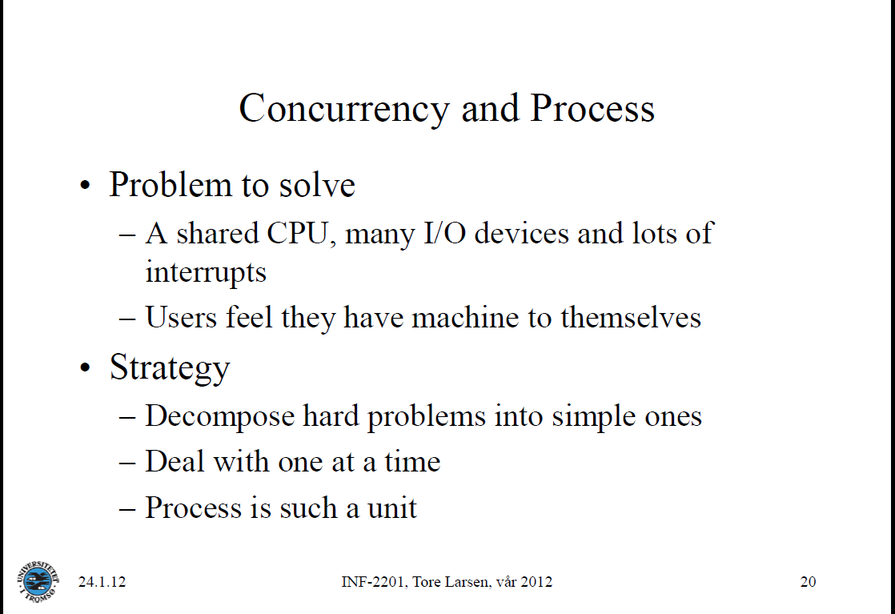

Slide 7
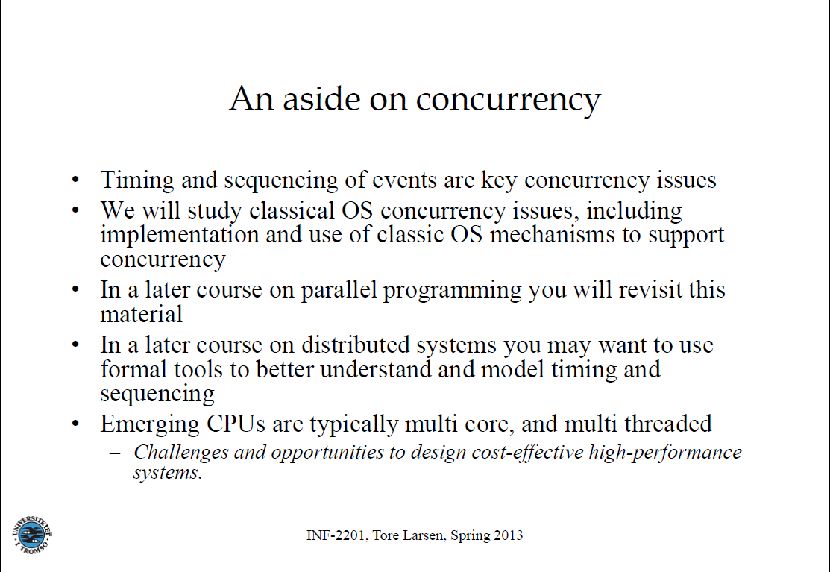

Slide 8
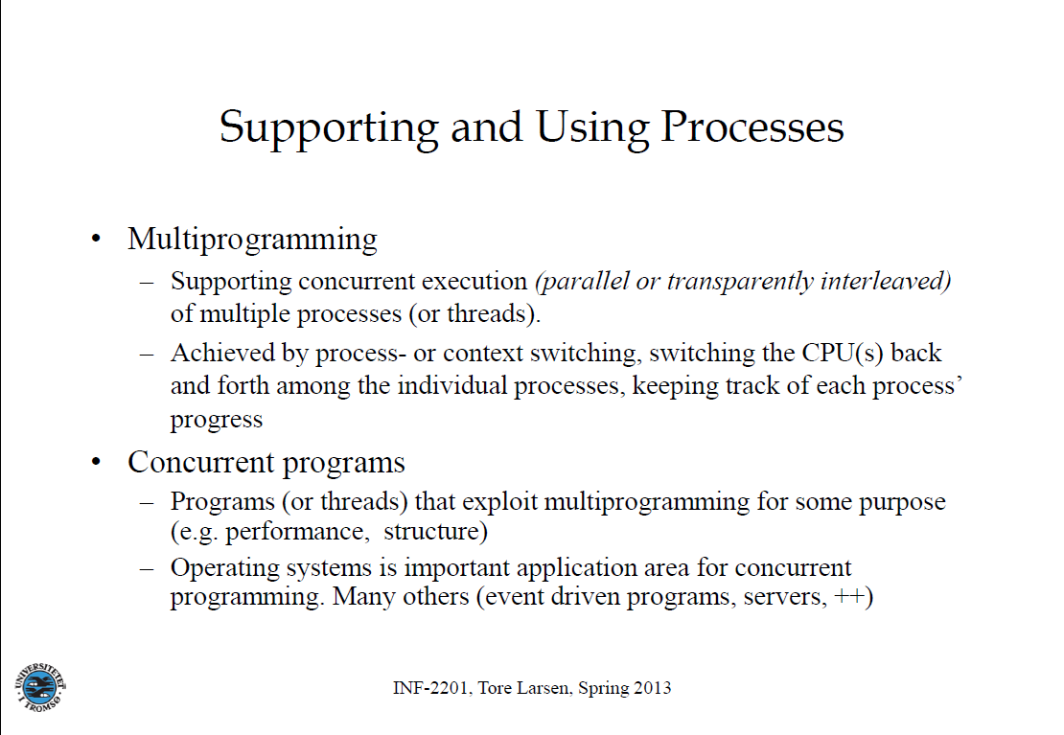

Slide 9
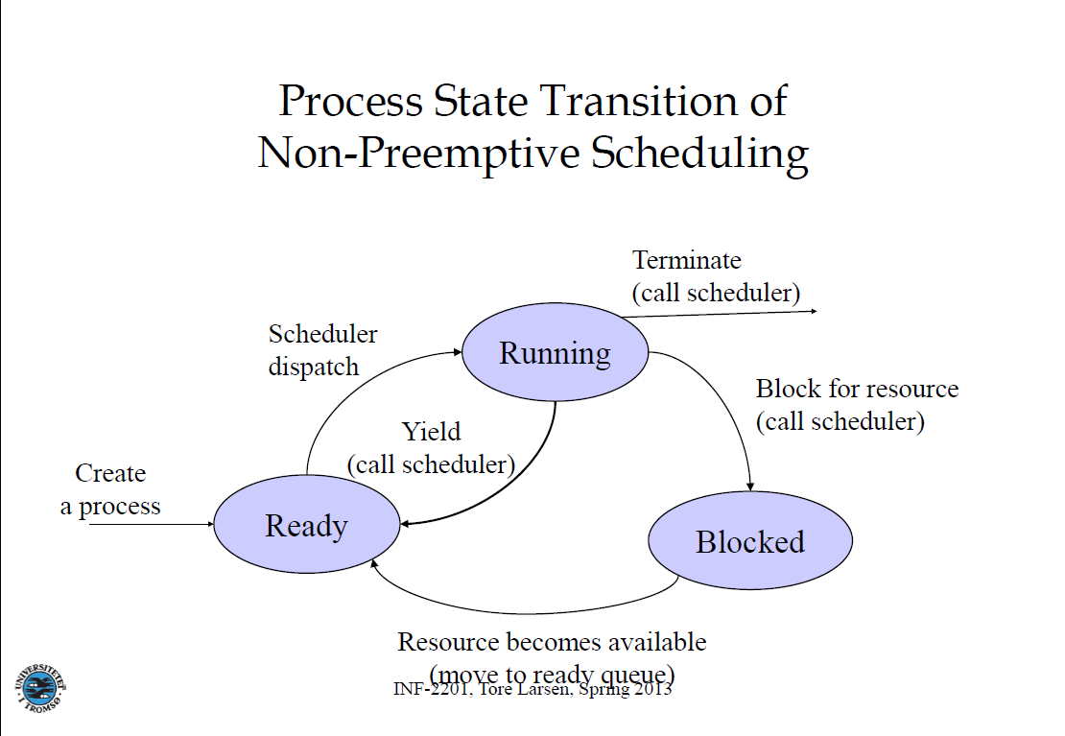

Slide 10
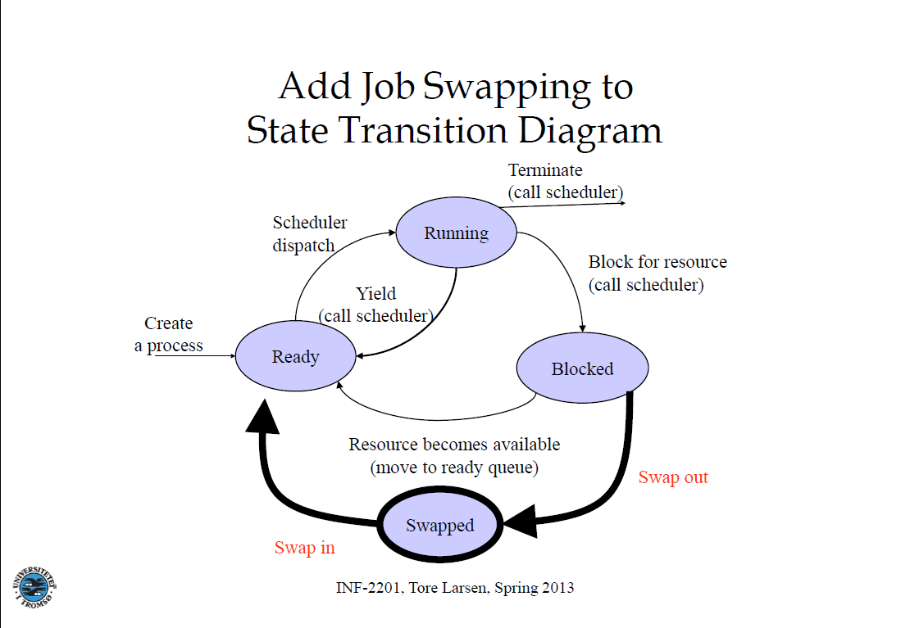

Slide 11
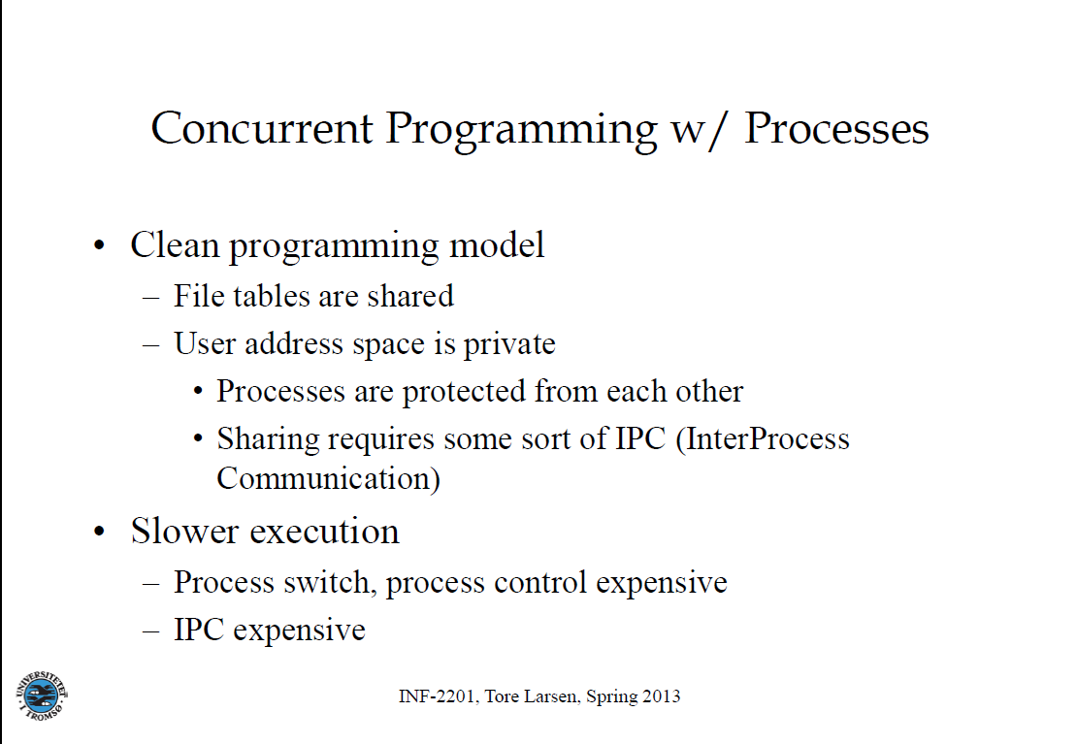

Slide 12
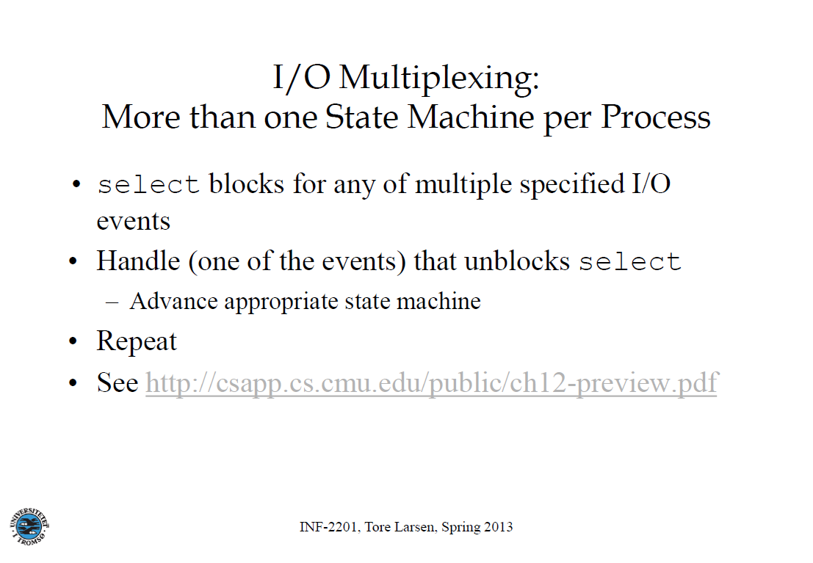

Slide 13
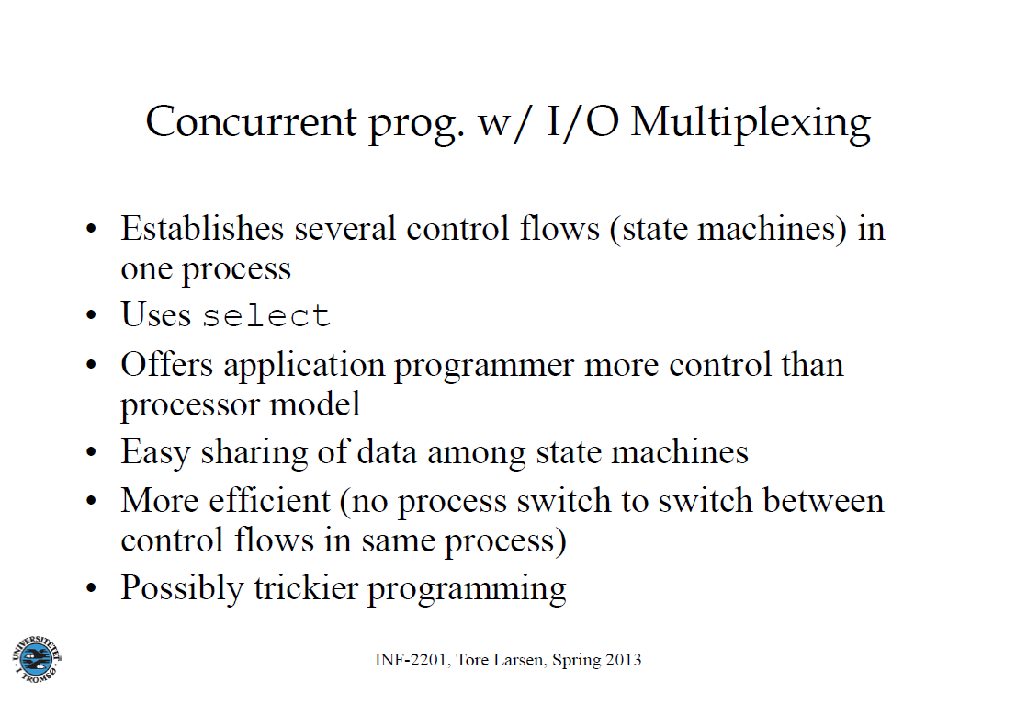

Slide 14
Threads and critical sections
Thomas Plagemann (University of Oslo)
Slides from Otto J. Anshus, Tore Larsen (University of Tromsø), Kai Li (Princeton University)

Slide 15
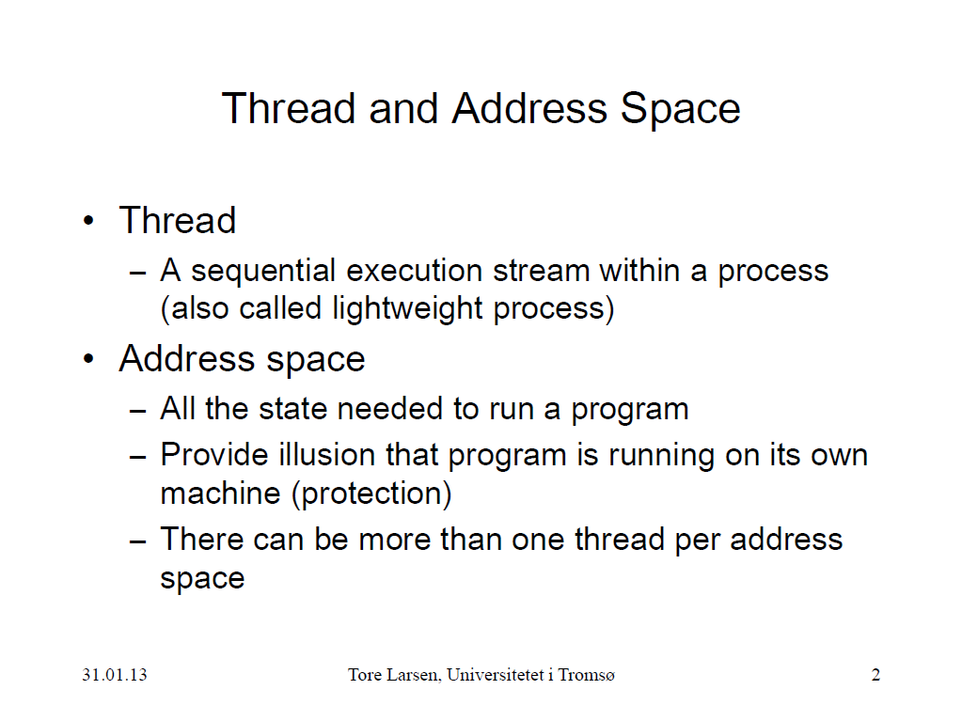

Slide 16
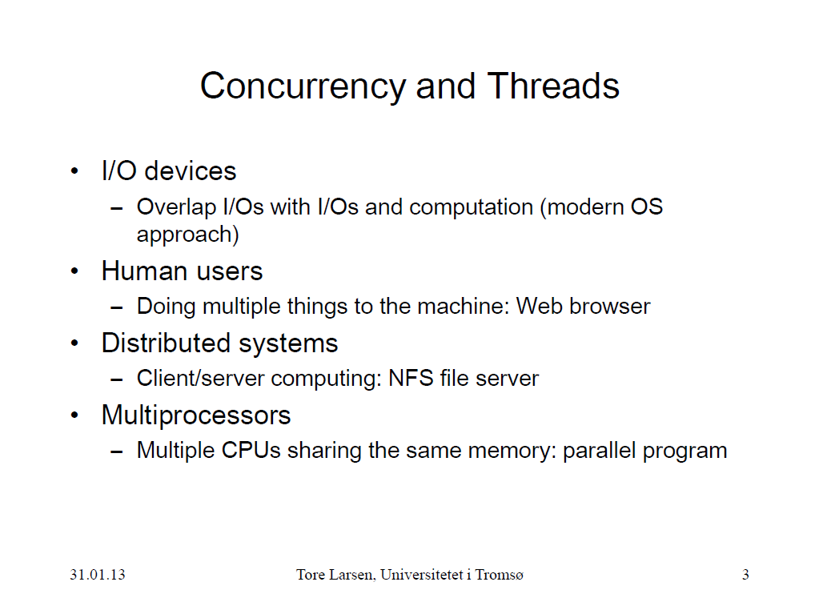

Slide 17
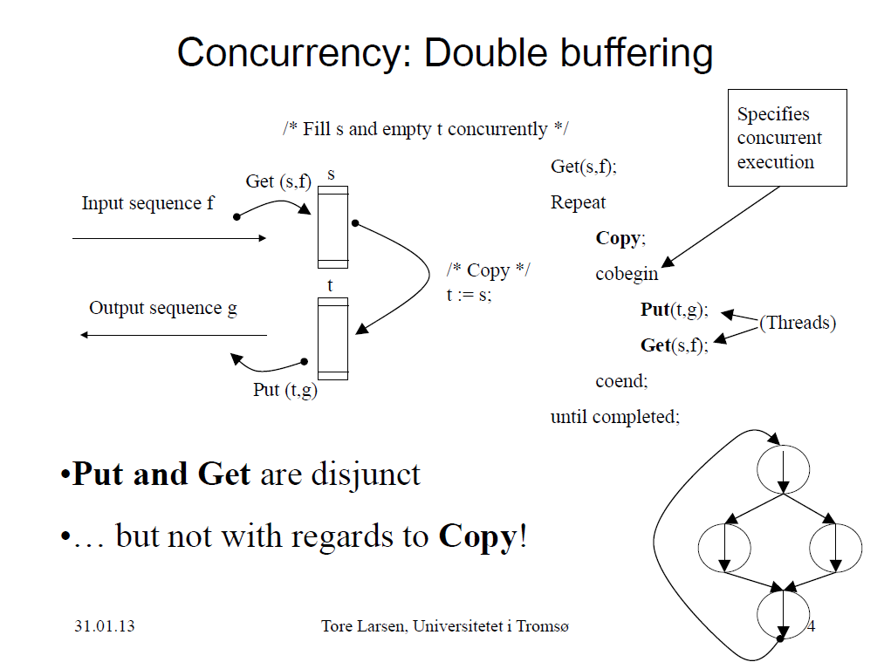

Slide 18
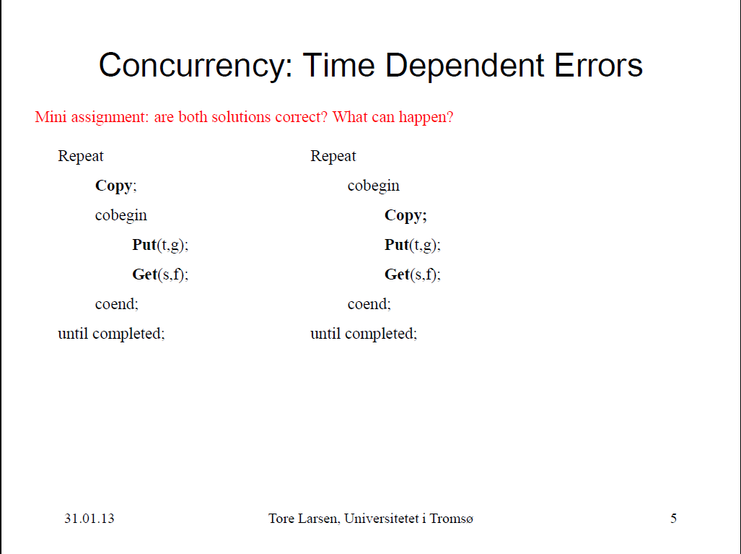

Slide 19
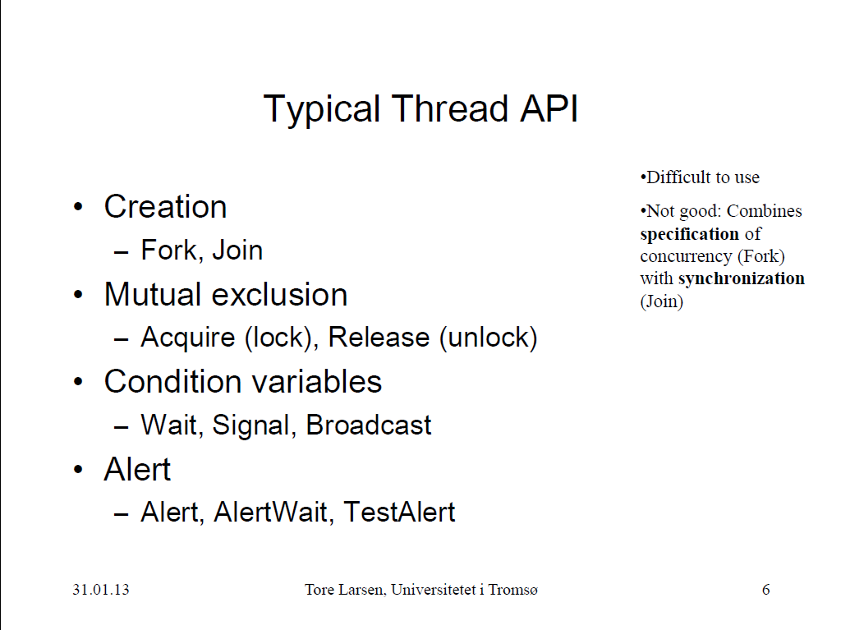

Slide 20
Mutual Exclusion
Phuong Ha
Based on slides from Otto J. Anshus, Tore Larsen, Kai Li, Thomas Plagemann, A. S. Tanenbaum, A. Silberschatz, M. Herlihy, N. Shavit

Slide 21
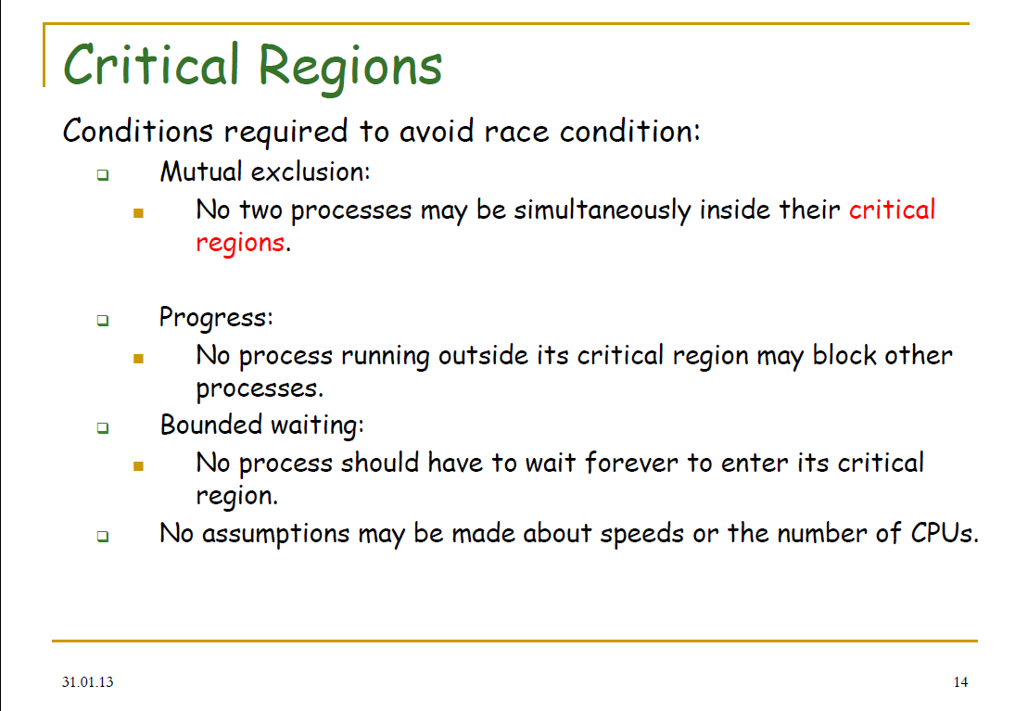

Slide 22
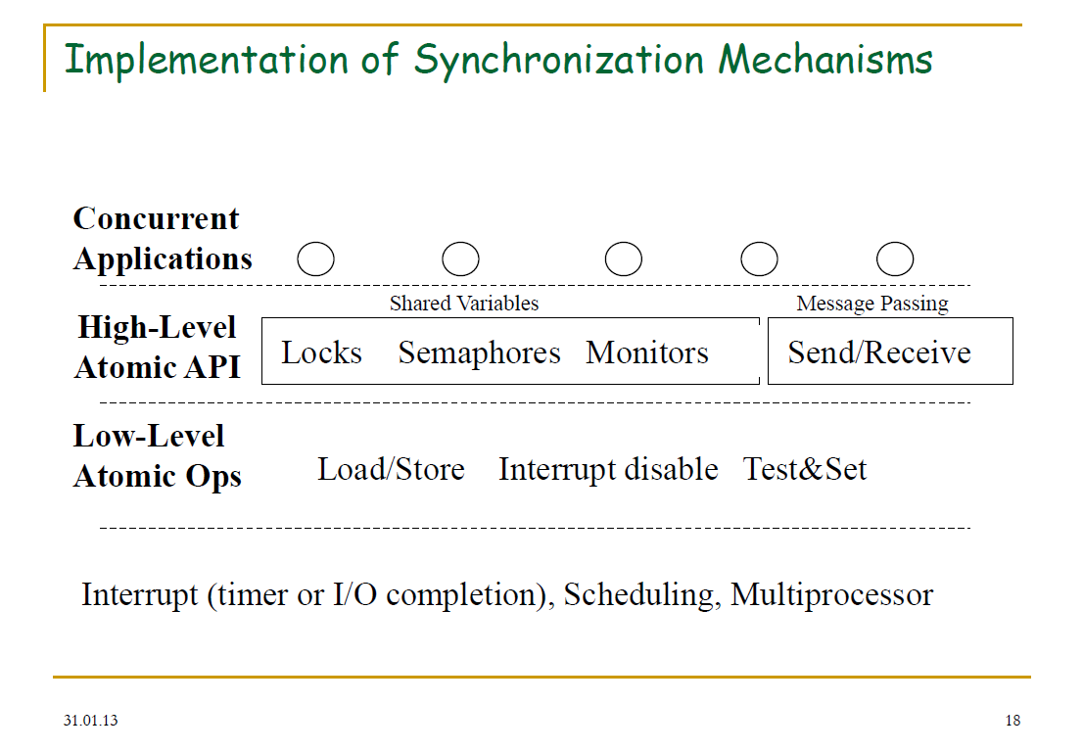

Slide 23
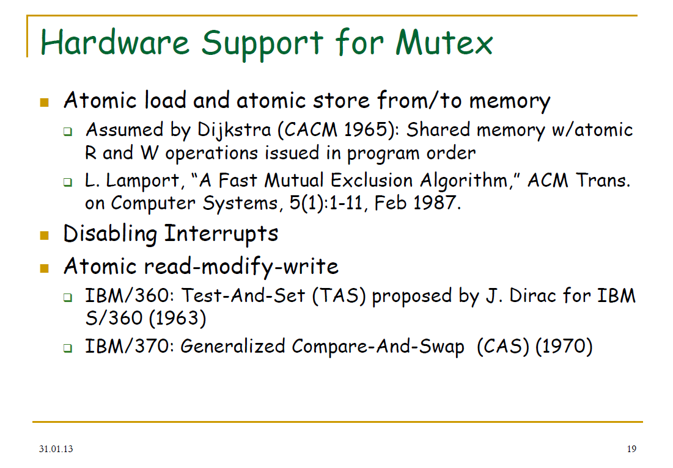

Slide 24
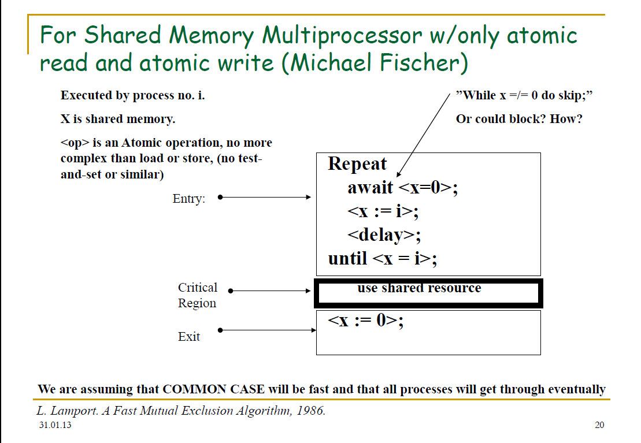

Slide 25
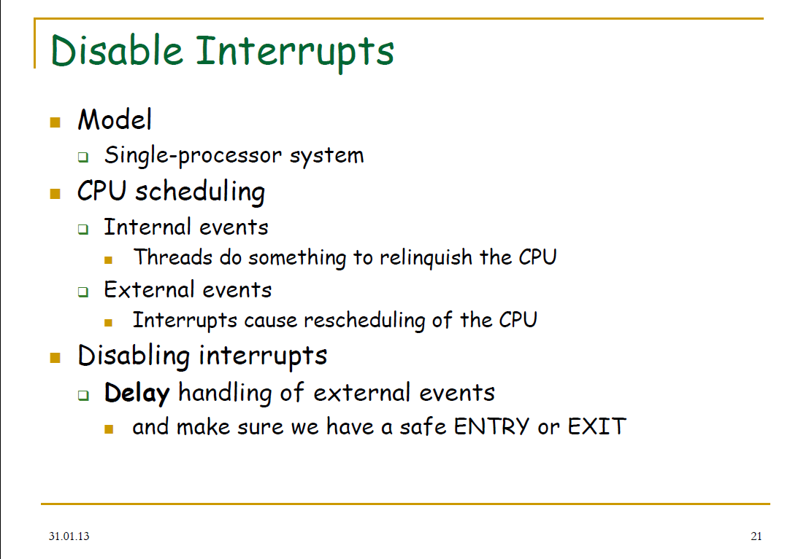

Slide 26
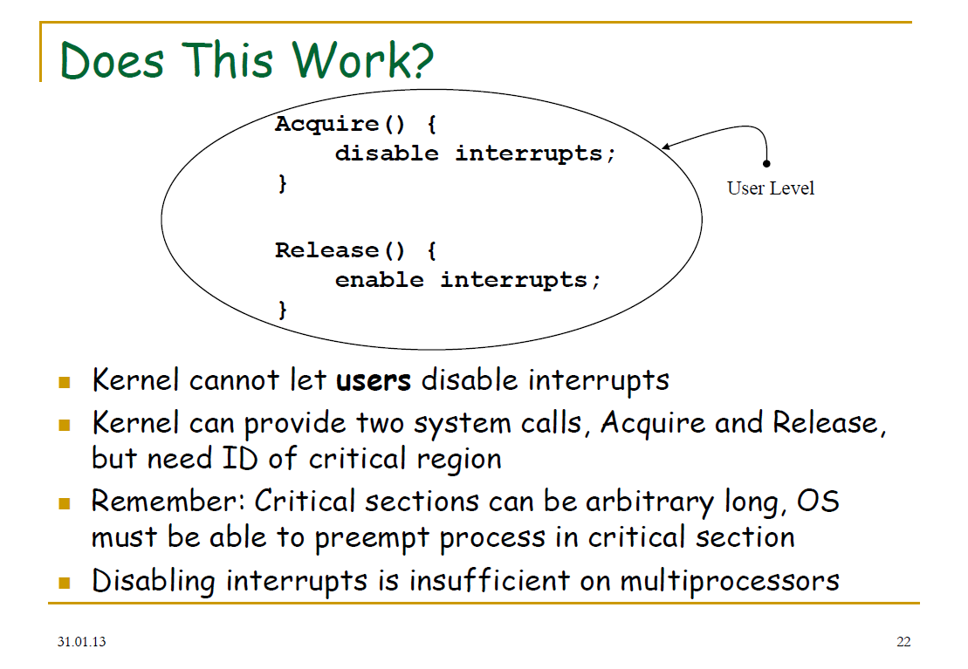

Slide 27
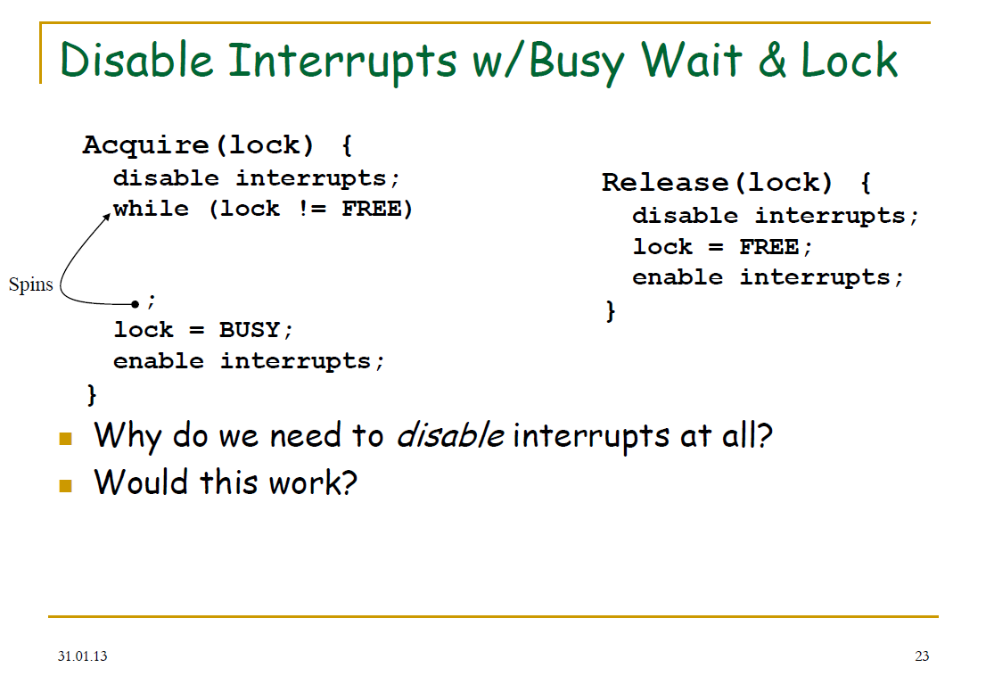

Slide 28
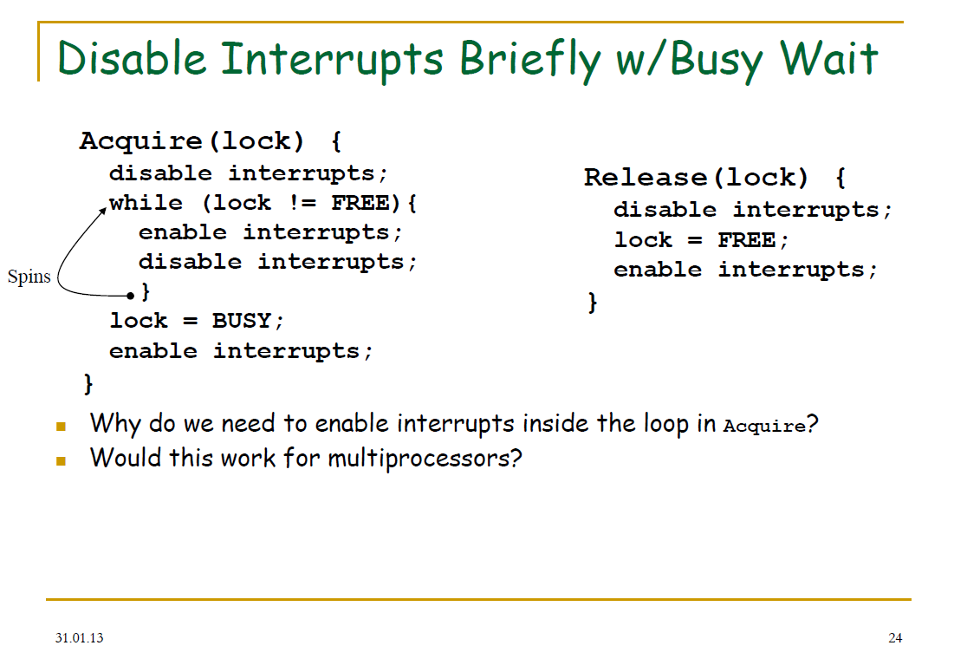

Slide 29
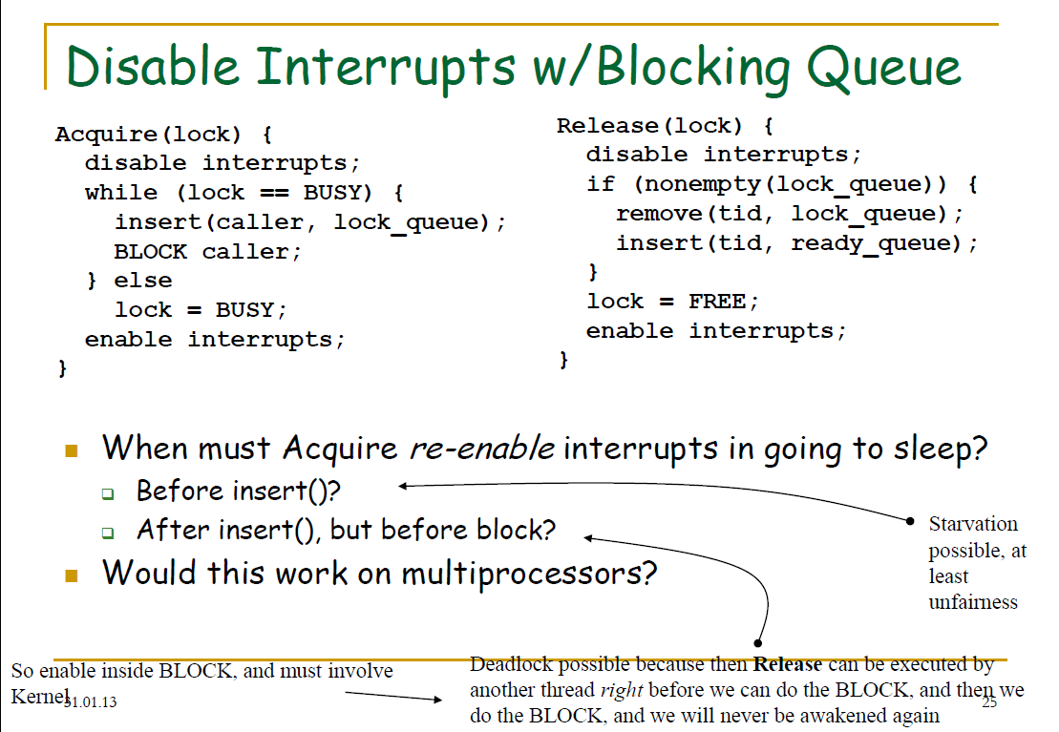

Slide 30
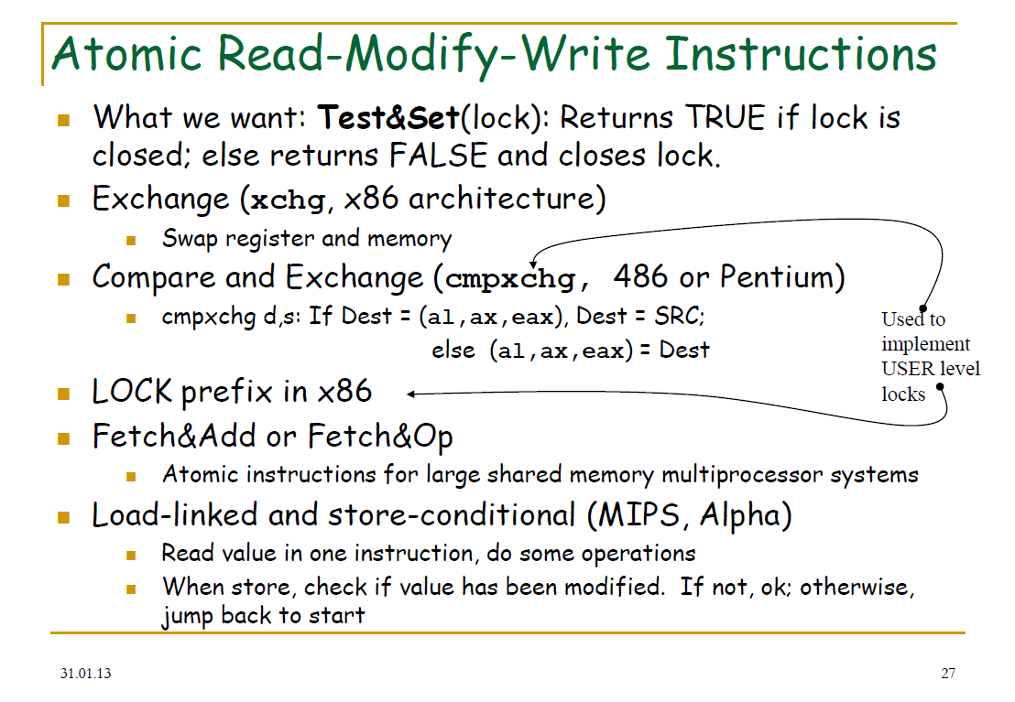

Slide 31
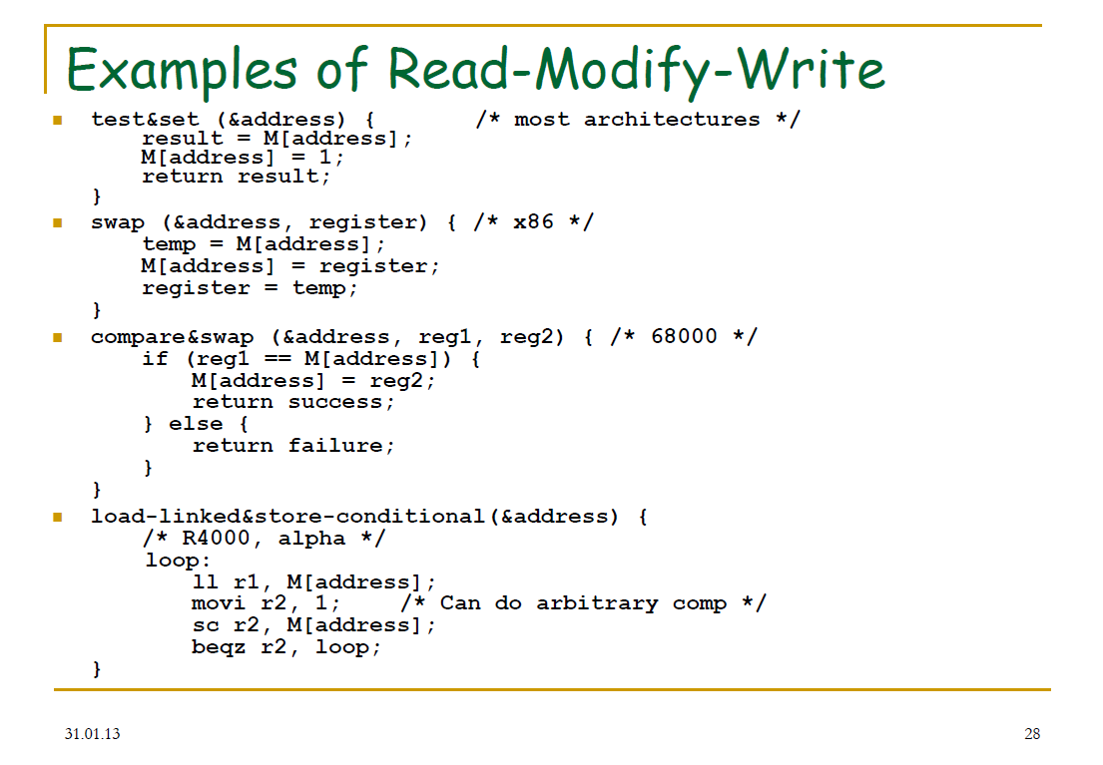

Slide 32
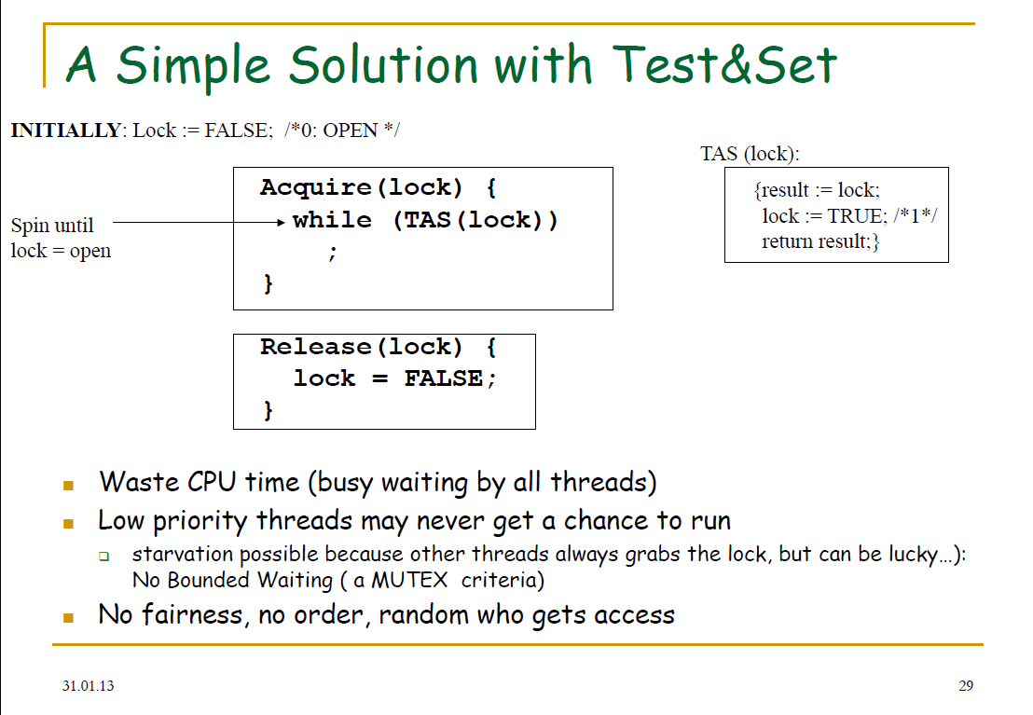

Slide 33
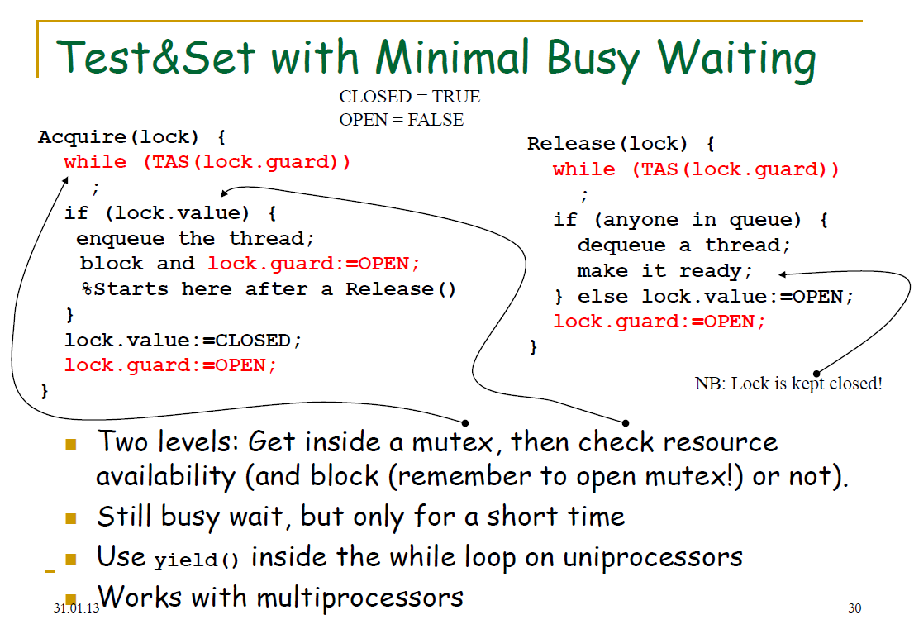

Slide 34
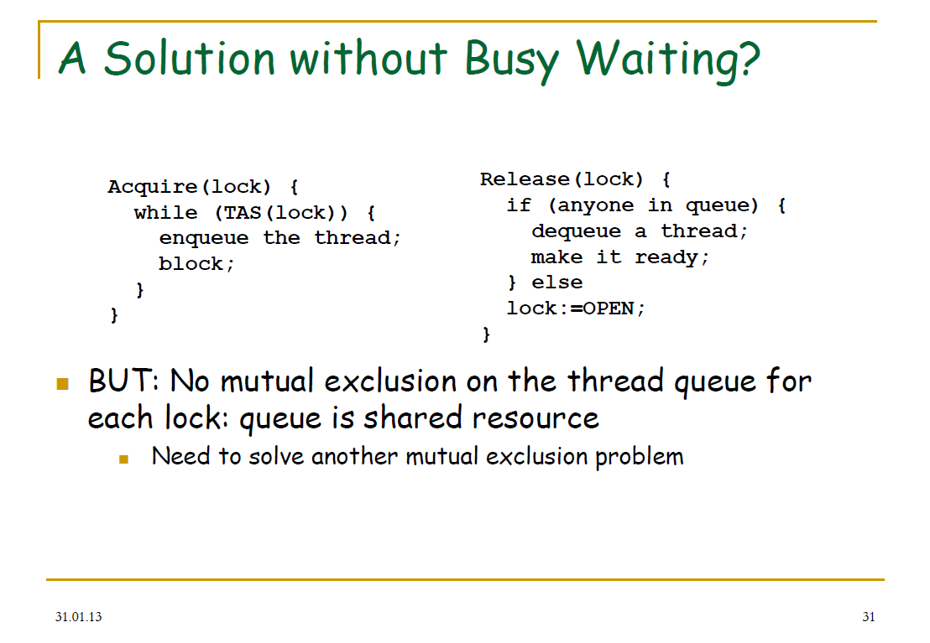

Slide 35
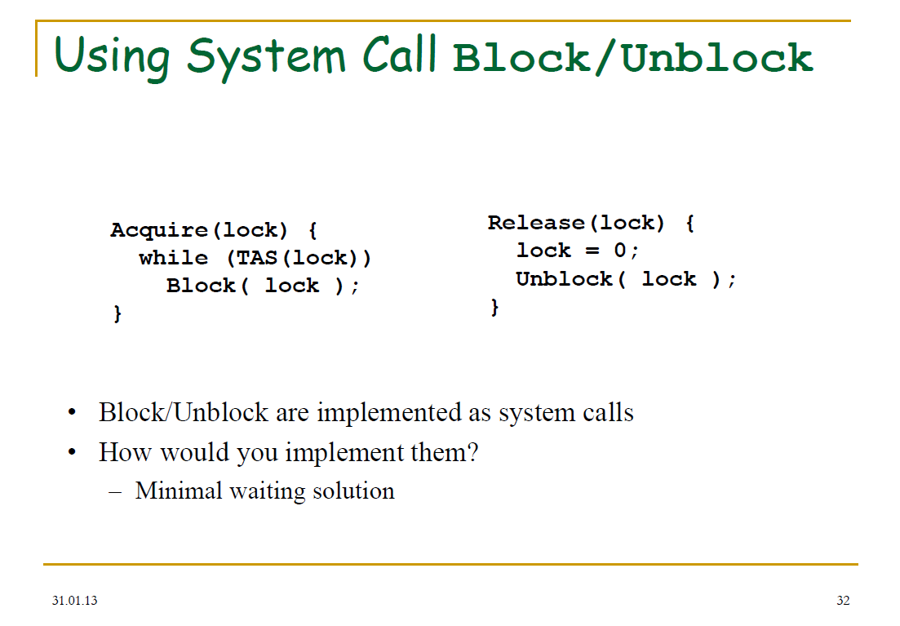

Slide 36
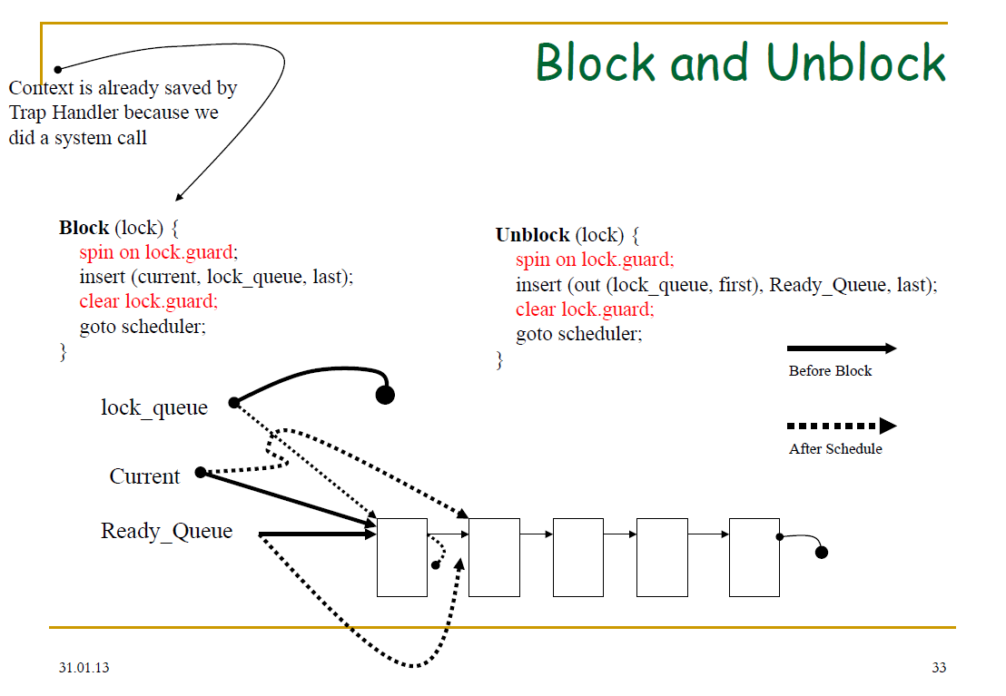

Slide 37
Semaphores
Tore Larsen, UiT
Otto J. Anshus, UiT, UiO

Slide 38
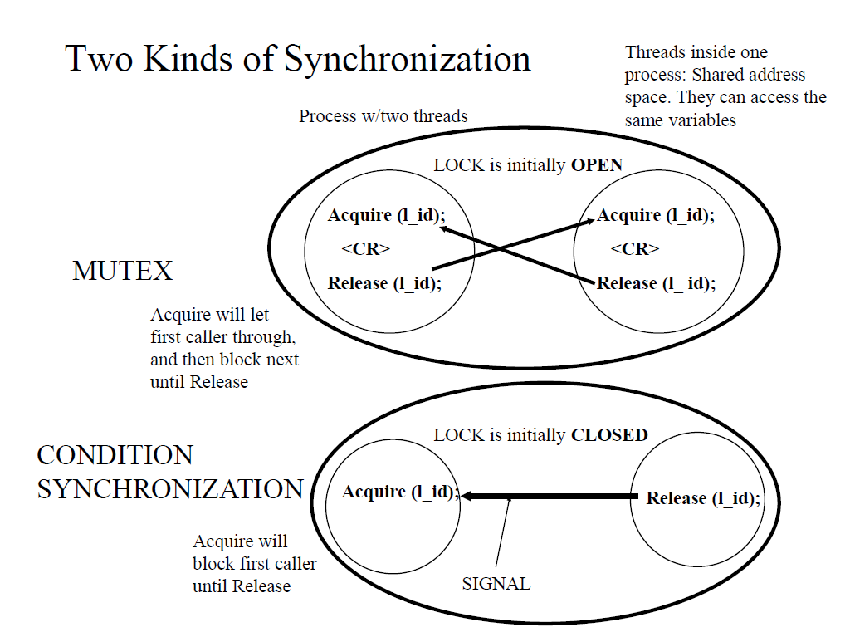

Slide 39
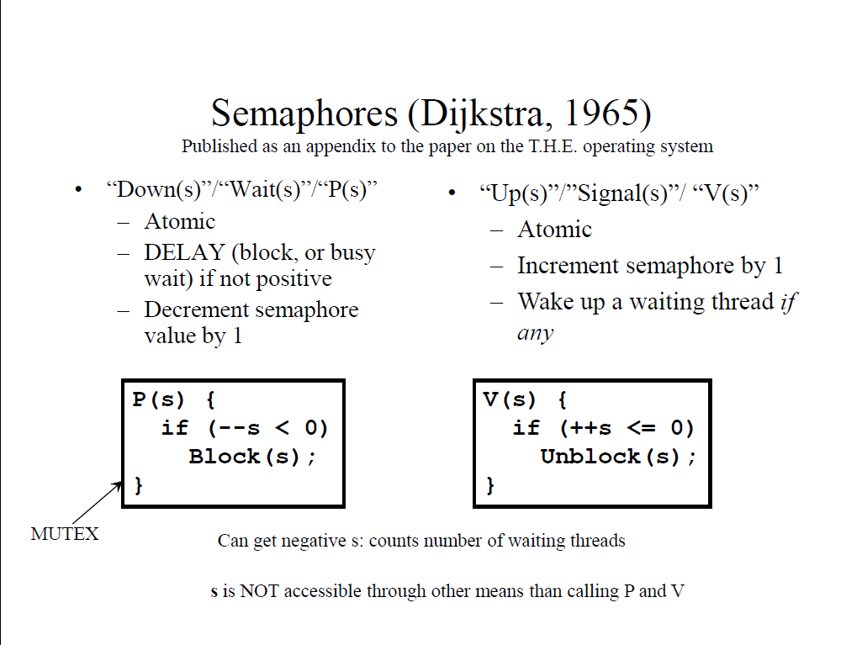

Slide 40
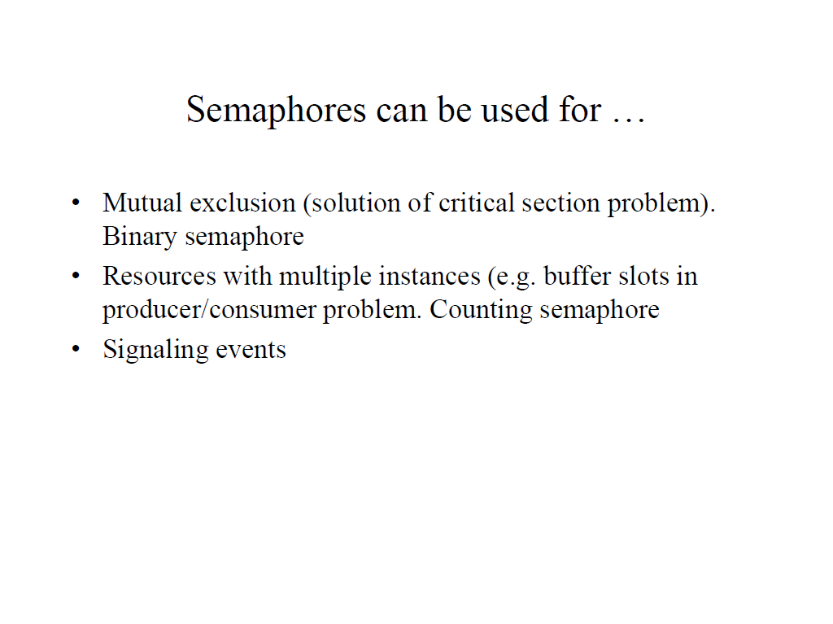

Slide 41
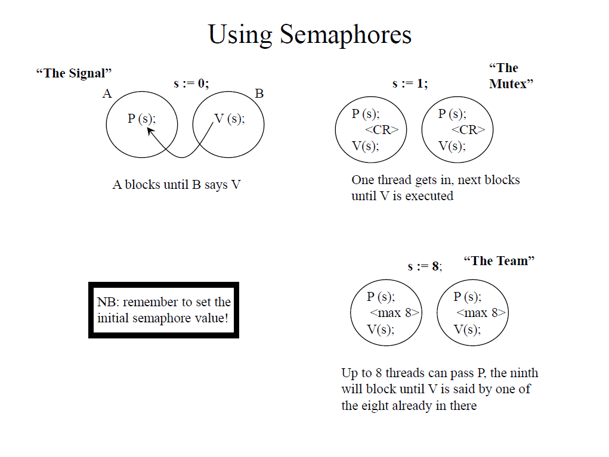

Slide 42
Thread packages
Lars Ailo Bongo, UiT

Slide 43











Pthreads

Slide 44
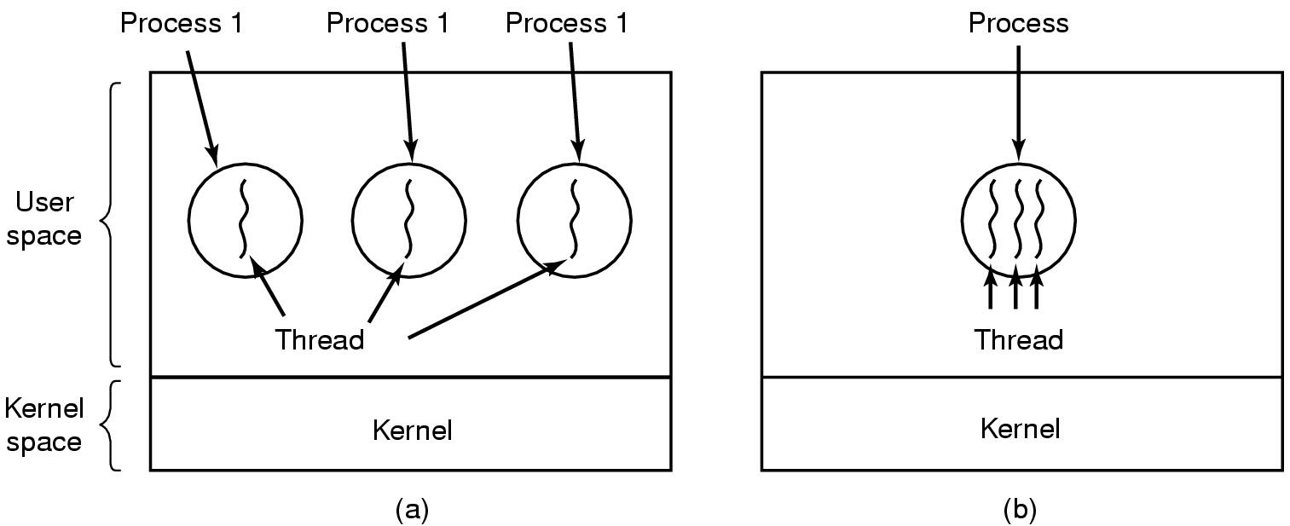
Threads
The Thread Model (1)
(a) Three processes with one thread each
(b) One process with three threads
Notes:
Processes were invented as single thread entities
Parallelism between processes
Offers protection
Which makes (single threaded) processes inefficient as a means for many threads working together on same task
Multiple threads within single processes offer the potential of efficient cooperation between threads working in parallel
We assume threads within same process all are “friendly” and want to work together.
Process still offers protection between threads in different processes.
“Lightweight processes” was a term that is descriptive of what one wanted. But possibly misleading as to what threads actually are.
So, how “light” should a thread be? What information should we keep per thread, and what per process?
Need: Switching between threads as we already do for processes.
Program pointer, obviously. Stack for procedure calls/returns, obviously. Registers, seems reasonable. Process state, i.e. blocked, ready, running, terminated; for thread scheduling purposes.

Slide 45
The Thread Model (2)
Per process items | Per thread items
Address space | Program counter
Global variables | Registers
Open files | Stack
Child processes | State
Privileges
Pending alarms
Signals and signal handlers
Accounting information
Items shared by all threads in a process | Items private to each thread
Notes:
Make a note that it is appropriate to have semaphores, mutexes and condition variables as global variables, or at least at a well-known place in the shared address space (dynamic memory -> later).
Important to have them – memory allocation example.

Slide 46
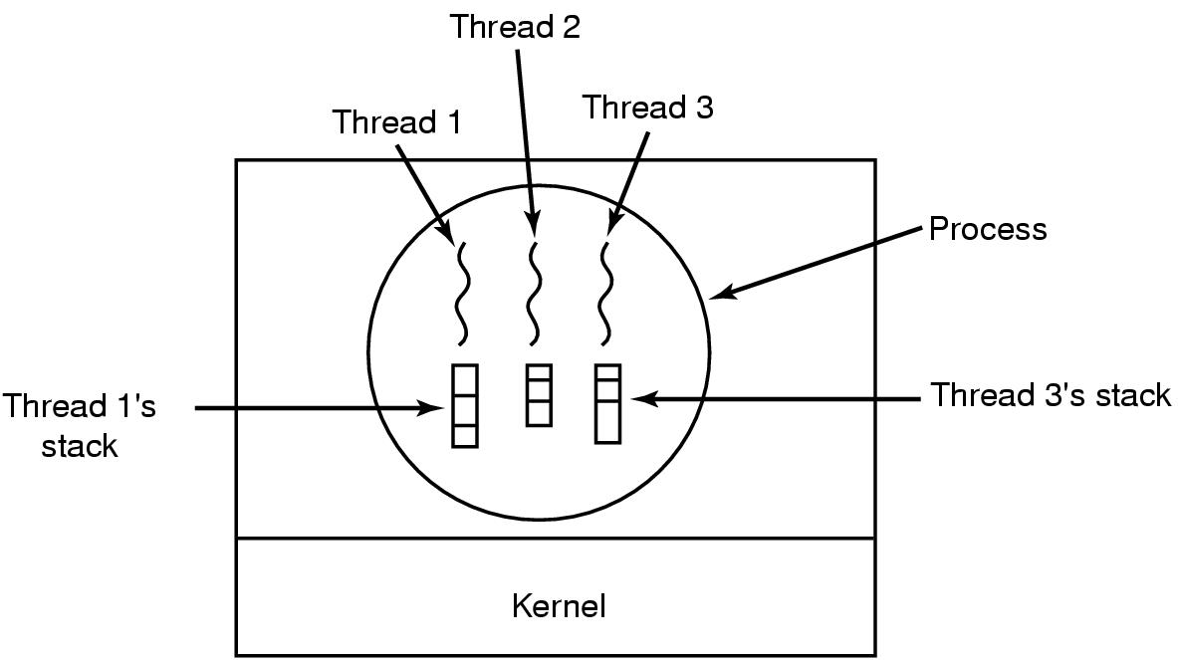
The Thread Model (3)
Each thread has its own stack
Notes:
Each thread has it’s own stack.
Also, we need to be able to store PC, register values, PC, and thread state, per thread.

Slide 47
Linux Process/ Threads
Linux takes a unique approach to implementing the process and thread abstractions. In Linux, all threads are simply processes that might share certain resources. Instead of being something different than a thread or a group of threads, a process in Linux is simply a group of threads that share something called a thread group ID (TGID) and whatever resources are necessary.
It is worth mentioning that this model, combined with certain tricks like a COW (Copy On Write) forking algorithm causes process and thread spawning to be very fast and efficient in Linux, whereas spawning a process is much more expensive than spawning threads on many other operating systems […]
It is only important to know that Linux considers processes to be merely groups of threads and does not differentiate between the two. Because of this, Linux schedules threads only, essentially ignoring what POSIX processes they belong to.
Source: Understanding the Linux 2.6.8.1 CPU Scheduler, Josh Aas, 2005.

Slide 48
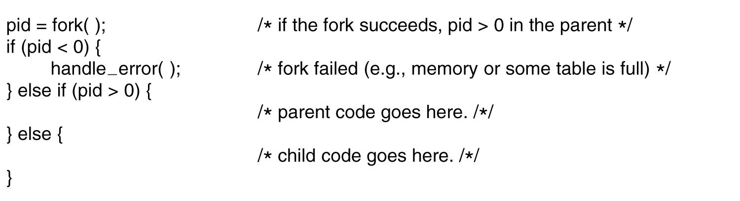
Processes in Linux
Figure 10-4. Process creation in Linux.
Tanenbaum, Modern Operating Systems 3 e, (c) 2008 Prentice-Hall, Inc. All rights reserved. 0-13-6006639

Slide 49
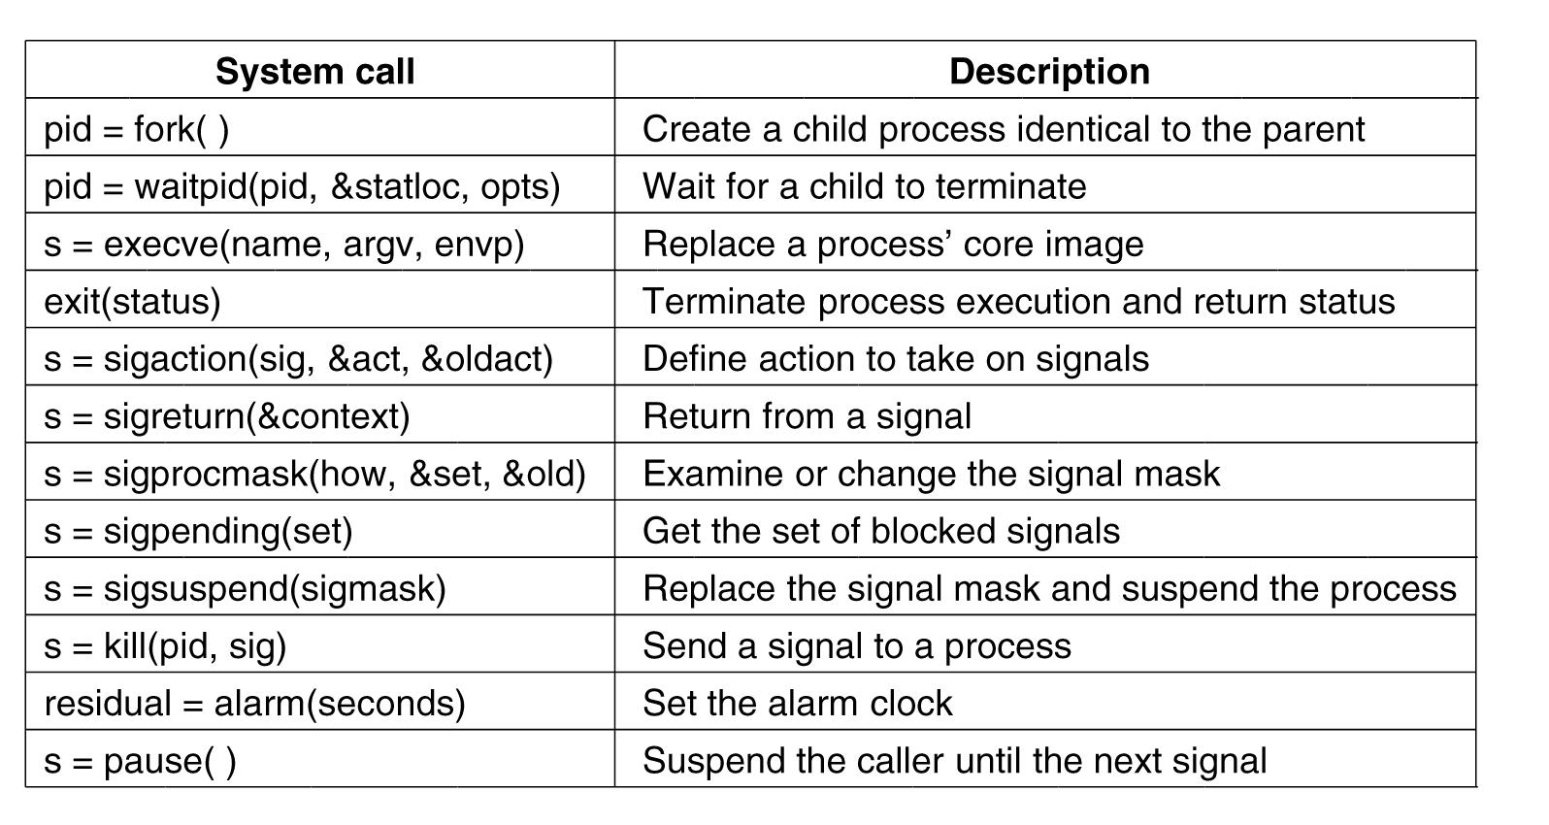
Process Management
System Calls in Linux
Figure 10-6. Some system calls relating to processes.
Tanenbaum, Modern Operating Systems 3 e, (c) 2008 Prentice-Hall, Inc. All rights reserved. 0-13-6006639

Slide 50
Implementation of Processes and Threads
Categories of information in the process descriptor:
Scheduling parameters
Memory image
Signals
Machine registers
System call state
File descriptor table
Accounting
Kernel stack
Miscellaneous
Tanenbaum, Modern Operating Systems 3 e, (c) 2008 Prentice-Hall, Inc. All rights reserved. 0-13-6006639

Slide 51
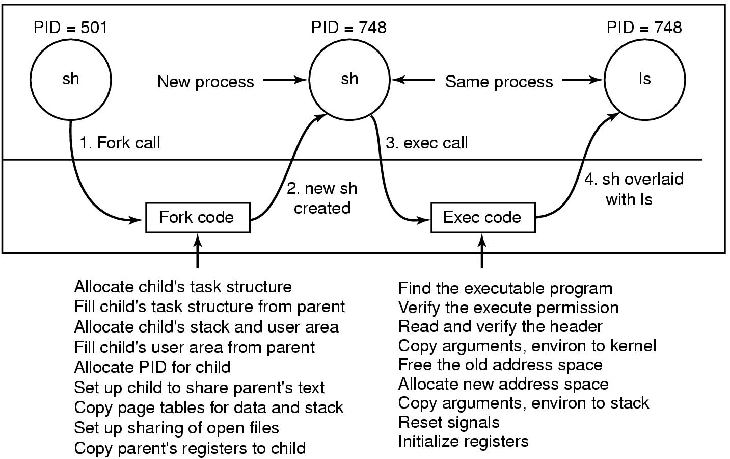
Implementation of Exec
Figure 10-8. The steps in executing the command
ls typed to the shell.
Tanenbaum, Modern Operating Systems 3 e, (c) 2008 Prentice-Hall, Inc. All rights reserved. 0-13-6006639

Slide 52
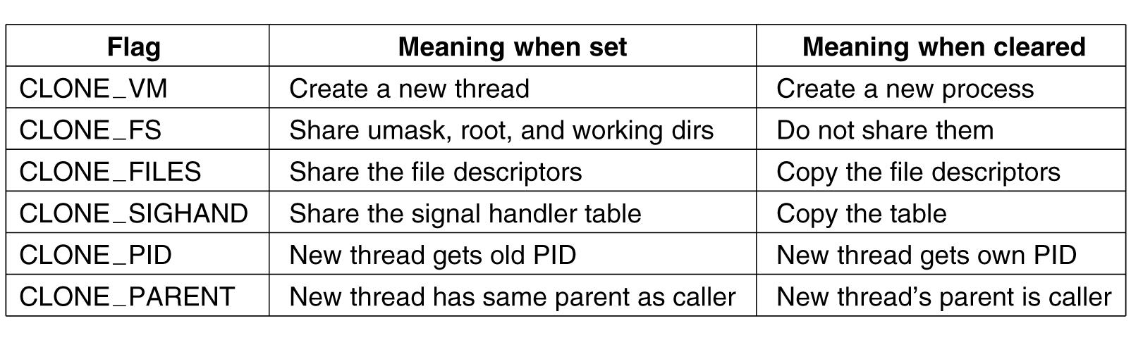
The Clone System Call
Figure 10-9. Bits in the sharing_flags bitmap.
Tanenbaum, Modern Operating Systems 3 e, (c) 2008 Prentice-Hall, Inc. All rights reserved. 0-13-6006639

Slide 53
The futex System Call
The futex() system call provides a method for a program to wait for a value at a given address to change, and a method to wake up anyone waiting on a particular address (while the addresses for the same memory in separate processes may not be equal, the kernel maps them internally so the same memory mapped in different locations will correspond for futex() calls). This system call is typically used to implement the contended case of a lock in shared memory, as described in futex(7).
When a futex(7) operation did not finish uncontended in userspace, a call needs to be made to the kernel to arbitrate. Arbitration can either mean putting the calling process to sleep or, conversely, waking a waiting process.
Source: futex(2) man page

Slide 54
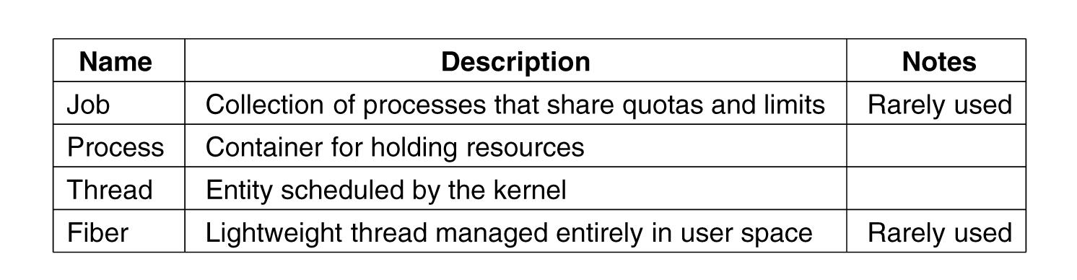
Processes and Threads in Windows Vista (2)
Figure 11-25. Basic concepts used for CPU
and resource management.
Tanenbaum, Modern Operating Systems 3 e, (c) 2008 Prentice-Hall, Inc. All rights reserved. 0-13-6006639

Slide 55
Job, Process, Thread, and Fiber Management API Calls (1)
Actual search path for finding program to execute buried in library code for Win32, but managed more explicitly in UNIX.
Current working directory is kernel-mode concept in UNIX but user-mode string in Windows.
UNIX parses command line and passes an array of parameters, Win32 leaves argument parsing up to individual program.
Whether file descriptors can be inherited in UNIX is property of handle. In Windows it is property of both handle and parameter to process creation.
Win32 is GUI-oriented, new processes directly passed information about their primary window
Tanenbaum, Modern Operating Systems 3 e, (c) 2008 Prentice-Hall, Inc. All rights reserved. 0-13-6006639

Slide 56
Job, Process, Thread, and Fiber Management API Calls (2)
Windows has no SETUID bit as property of executable, one process can create a process that runs as a different user, as long as it can obtain a token with that user’s credentials.
Process and thread handle returned from Windows can be used to modify the new process/thread in many substantive ways. UNIX just makes modifications to new process between fork and exec calls.
Tanenbaum, Modern Operating Systems 3 e, (c) 2008 Prentice-Hall, Inc. All rights reserved. 0-13-6006639

Slide 57
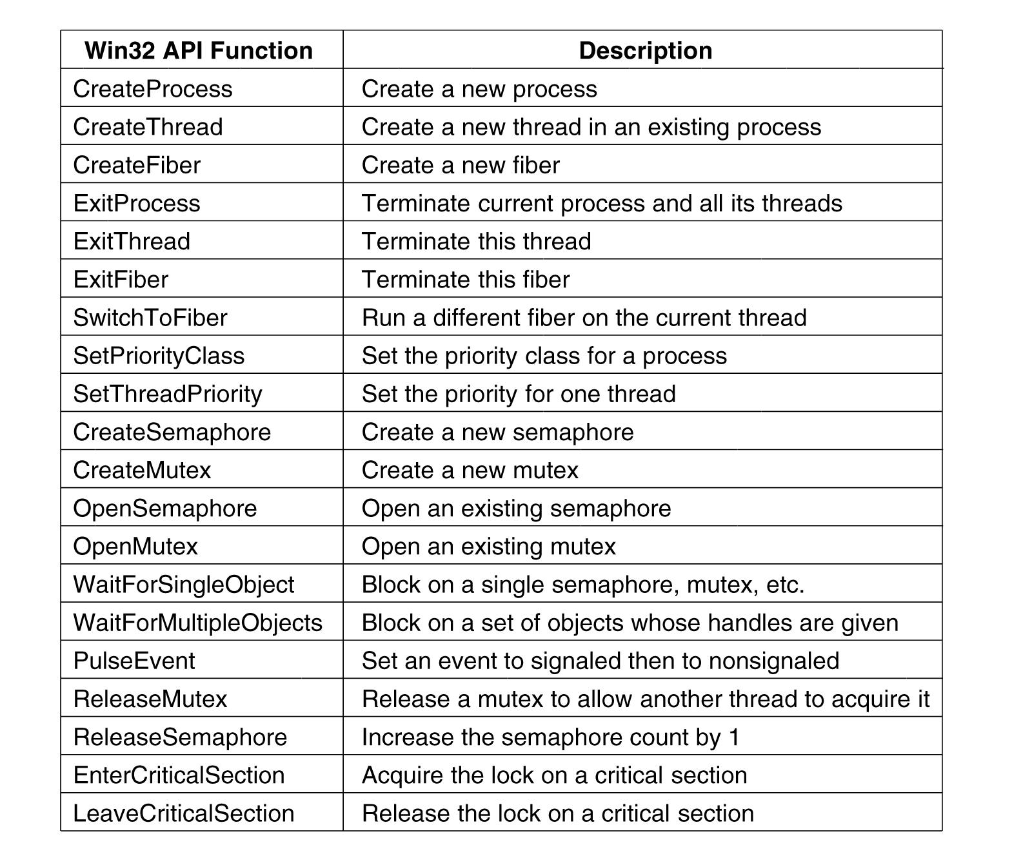
Synchronization
Figure 11-26. Some of the Win32 calls for
managing processes, threads, and fibers.
Tanenbaum, Modern Operating Systems 3 e, (c) 2008 Prentice-Hall, Inc. All rights reserved. 0-13-6006639

Slide 58
POSIX Threads (Pthreads)
Threading for C/C++ programmers
Standardized thread programming interface
  Low-level operations
De-facto standard on Linux
Implemented on top of OS system calls
Available as C library
  Usage: gcc –lpthread foo.c

Slide 59
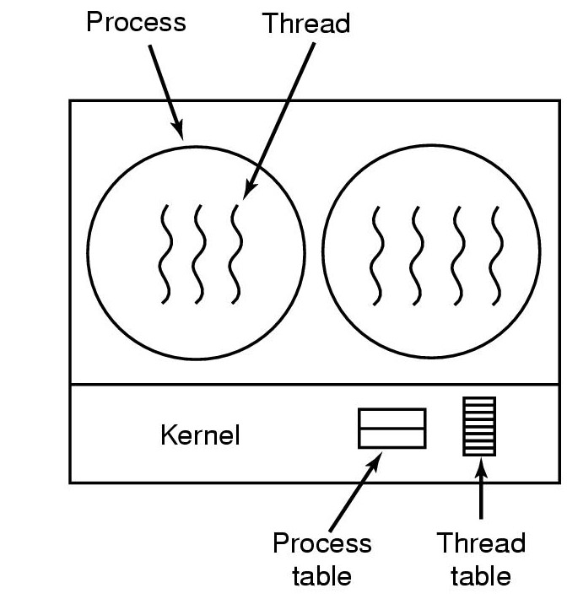
Thread Model
One process can have multiple threads
A thread has a private stack and can also have private global variables (explicitly declared)
All threads created within a process share address space, file handlers, etc…
Pthreads are implemented as Linux kernel-level threads

Slide 60
Pthread API
Can be divded into four major groups:
Thread management :
  pthread_create, pthread_detach, pthread_join, pthread_self, …
Mutexes:
  pthread_mutex_lock, pthread_mutex_unlock, pthread_mutex_init, pthread_mutex_trylock, …
Condition variables:
  pthread_cond_wait, pthread_cond_signal, pthread_cond_broadcast, pthread_cond_init, pthread_cond_destroy, …
Synchronization
  pthread_barrier, …
  pthread_rwlock, …

Slide 61
Python
Provided by threading and thread module
Thread module implemented using Pthreads in Linux
  This is a low-level module typically not used by application programmers
Threading module builds on thread module:
  But be aware of the Global Interpreter Lock!
  An alternative multiprocessing interface for “threading using processes”
  Another alternative: c extension modules
Inspired by Java Threading
  But synchronization is explicit!
Python thread operations map well to Pthread operations
  Thread management: Thread objects
  Mutex: Lock objects (and RLock objects)
  Condition variables: Condition objects
  Other synchronization: Semaphore objects, Event objects,

Slide 62
Deadlocks
Phuong Ha

Slide 63
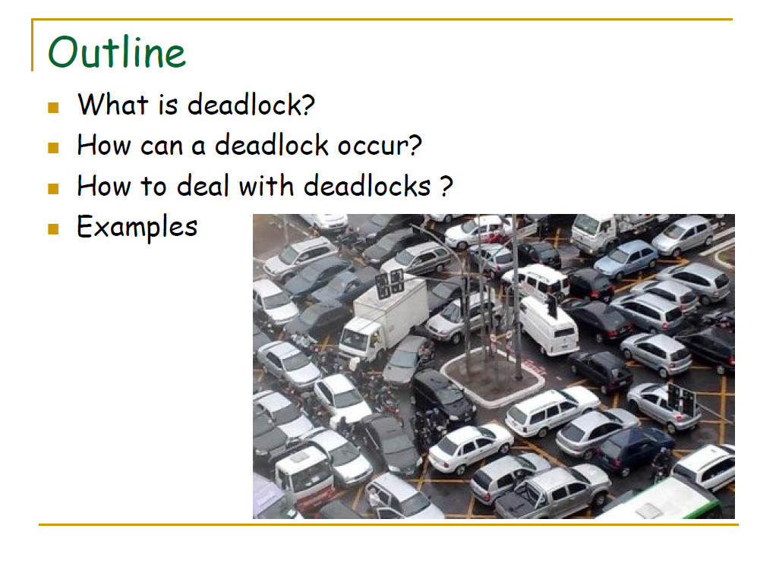

Slide 64
Message passing
Phuong Ha

Slide 65
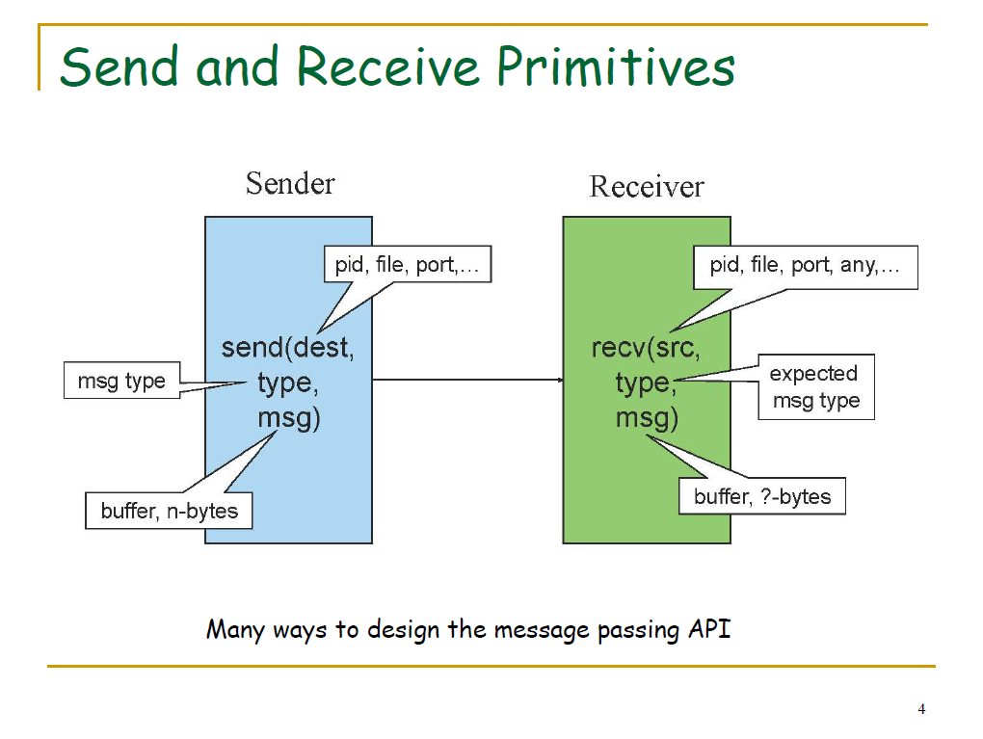

Slide 66
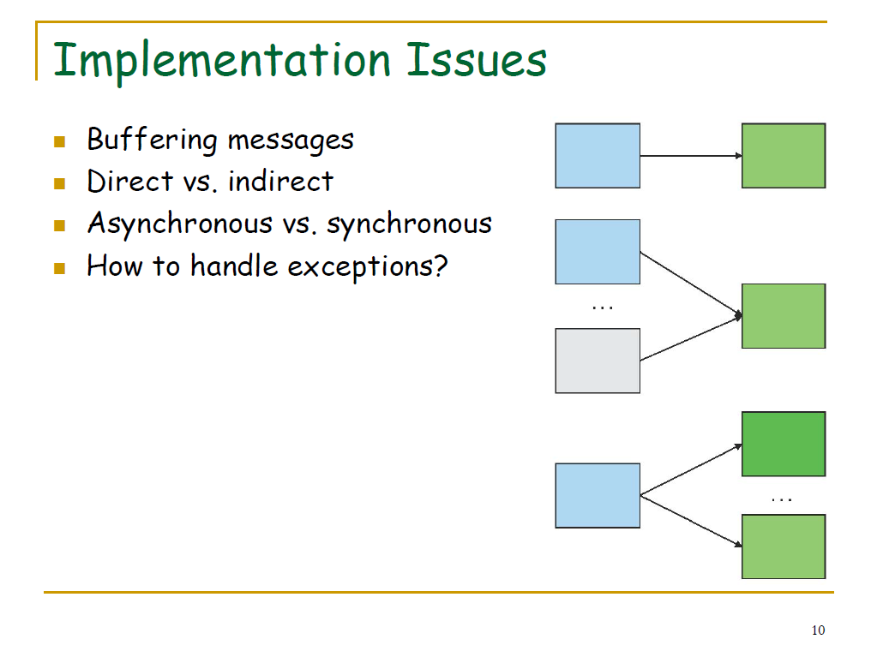

Slide 67
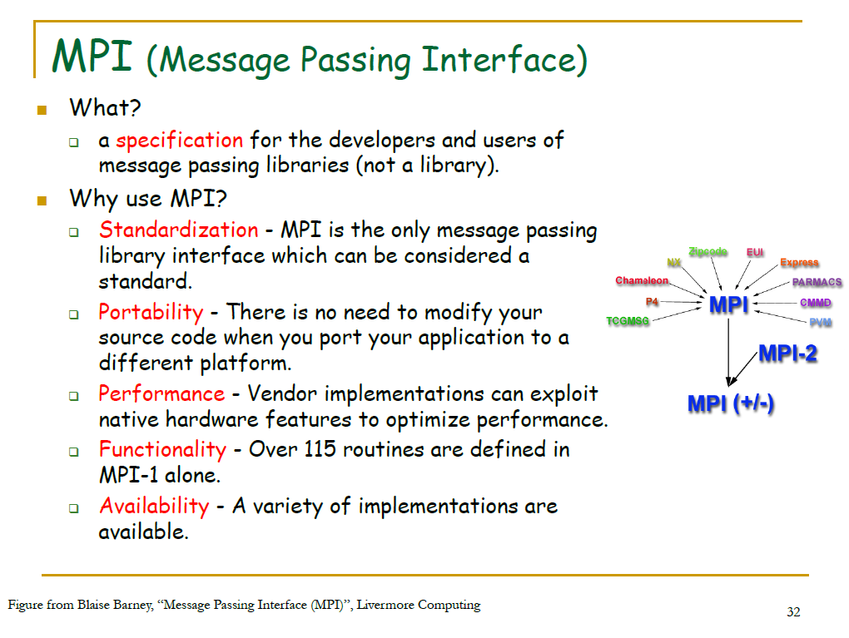

Slide 68
Storage
Lars Ailo Bongo

Slide 69
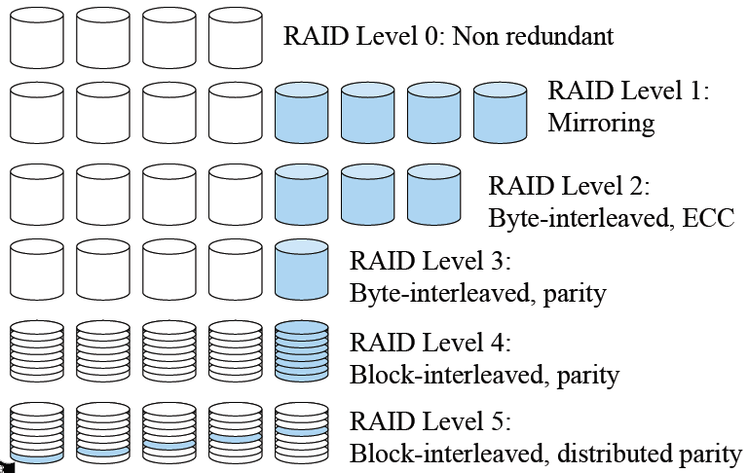
Synopsis of RAID Levels

Slide 70
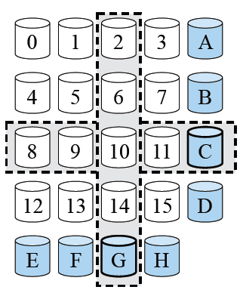

RAID Level 6 and Beyond
Goals
  Less computation and fewer updates per random writes
  Small amount of extra disk space
Extended Hamming code
Specialized Eraser Codes
  IBM Even-Odd, NetApp RAID-DP, …
Beyond RAID-6
  Reed-Solomon codes, using MOD 4 equations
  Can be generalized to deal with k (>2) disk failures

Slide 71
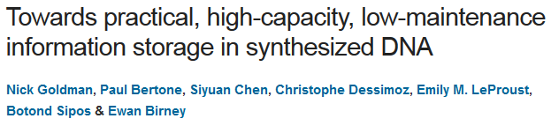
10.000 Years Storage System
How to build a storage system with a mean time to failure = 10.000 years?
Fun read
Uses lots of basic storage system principles
I/O performance not great

Slide 72
Also relevant
Graphics. Phuong Ha.
Many- and Multi-core operating systems. Lars Ailo Bongo.

