Slide 1
Introduction
Inf-2202 Concurrent and System Level Programming
Fall 2013
Lars Ailo Bongo (larsab@cs.uit.no)

Slide 2
Outline
Motivation
More motivation
Practicalities

Slide 3
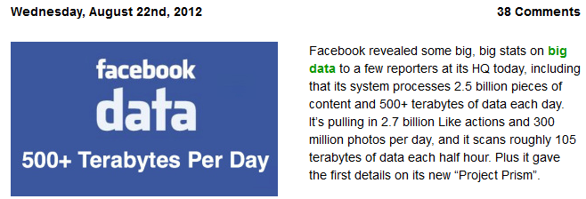
Motivation – Take 1
Many important applications require parallelism
Notes:
Sources:
http://engineering.stanford.edu/news/stanford-researchers-break-million-core-supercomputer-barrier
http://techcrunch.com/2012/08/22/how-big-is-facebooks-data-2-5-billion-pieces-of-content-and-500-terabytes-ingested-every-day/

Slide 4
Motivation – Take 1
Many cool application require parallelism
Notes:
Sources:
http://blogs.windows.com/windows/b/extremewindows/archive/2013/07/25/pushing-the-12k-pc-gaming-boundary-at-1-5-billion-pixels-per-second.aspx

Slide 5
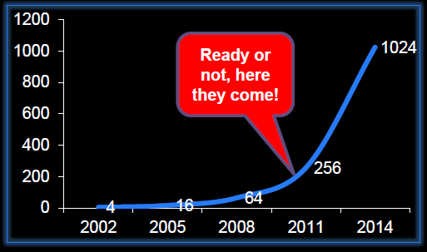
Motivation – Take 2
“The core is the logic gate of the 21st century” Anant Agarwal, MIT
The number of cores will double every 18th month
Figure from a lecture by Bruce Shriver, Feb 2012, UiT
Notes:
Figure from a lecture by Bruce Shriver, Feb 2012, UiT

Slide 6
Slide from a lecture by Bruce Shriver, Feb 2012, UiT
Notes:
Slide from a lecture by Bruce Shriver, Feb 2012, UiT

Slide 7
Slide from a lecture by Bruce Shriver, Feb 2012, UiT
Notes:
Slide from a lecture by Bruce Shriver, Feb 2012, UiT

Slide 8
Motivation
Application pull
Supercomputing
Data-intensive computing
Games
Robotics
…
Technology push
How to utilize 1000’s of cores?

Slide 9
Practicalities

Slide 10
Teaching staff
Associate prof. Lars Ailo Bongo
PhD student Ibrahim Umar

Slide 11
Information sources and contact info
Web page
Mailing list
We will only use Fronter for handins
Email
Office
Lars Ailo: A257, but due to construction noise I am mostly in Forskningsparken
Ibrahim: A135

Slide 12
Why a new course in concurrent programming?
Concurrency part of operating systems, architecture, databases, networking…
Some of content in current inf-3201 Parallel Programming too simple for 3000-level
Inf-2202 vs. Inf-3201
Programming vs. understanding systems
Shared memory vs. distributed systems

Slide 13
Course content
3 main topics:
Parallel programming (overlaps with current inf-3201 course)
Data-intensive computing
Performance evaluation
Considered but not included
GPU programming
Concurrency theory
No textbook

Slide 14
Lecture plan
Lecture | Date | Subject | Lecturer
L1 | Fri 16.08 | Introduction | Lars Ailo
L2 | Tue 20.08 | Threads & synchronization primitives | Lars Ailo
L3 | Tue 27.08 | Parallel architectures and system software | Lars Ailo
L4 | Tue 03.09 | Parallel programs | Lars Ailo
L5 | Tue 10.09 | Programming for performance | Lars Ailo
L6 | Tue 17.09 | Guest lecture: Go | Giacomo Tartari
L7 | Tue 24.09 | Performance evaluation | Lars Ailo
L8 | Tue 01.10 | Parallel program performance evaluation | Lars Ailo
L9 | Tue 08.10 | Guest lecture | TBA
L10 | Tue 15.10 | Data-intensive computing | Lars Ailo
L11 | Tue 22.10 | MapReduce & BigTable | Lars Ailo
L12 | Tue 29.10 | Data analytics | Lars Ailo
L13 | Tue 5.11 | Event-based programming | Lars Ailo
L14 | Tue 12.11 | Summary | Lars Ailo
 | Tue 19.11 | No lecture
 | Fri 22.11 | Exam

Slide 15
Mandatory assignments
Thread programming on Lego Mindstorms
?
Data intensive computing

Slide 16
Exercises
Note! This is a programming course. You need to spend a significant amount of time designing, implementing, testing, and evaluating programs.

