Slide 1
Minimum Spanning Trees
Inf-2101, Fall 2012
Lars Ailo Bongo (larsab@cs.uit.no)
Department of Computer Science, University of Tromsø
Based on and including slides by Robert Sedgewick and Kevin Wayne, Princeton University.

Slide 2
Outline
10:15-10:30: Introduction to Minimum Spanning Trees
10:30-11:15: Mini colloquia
11:15-12:00: Discussion: MST algorithm comparison

Slide 3
Minimum Spanning Tree

Slide 4
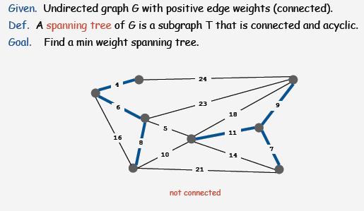
Minimum Spanning Tree

Slide 5
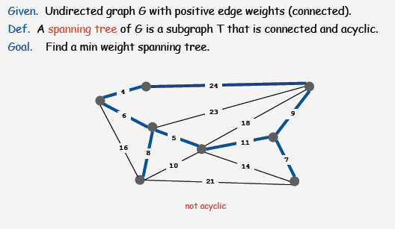
Minimum Spanning Tree

Slide 6
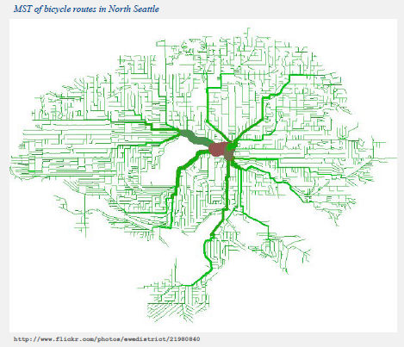
Application: Network Design

Slide 7
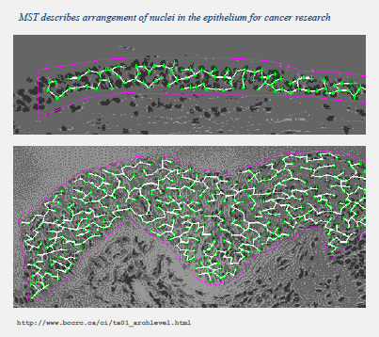
Application: Medical Image Processing

Slide 8
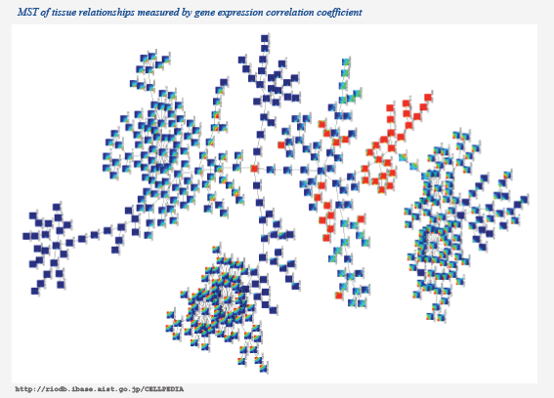
Application: Genetic Research

Slide 9
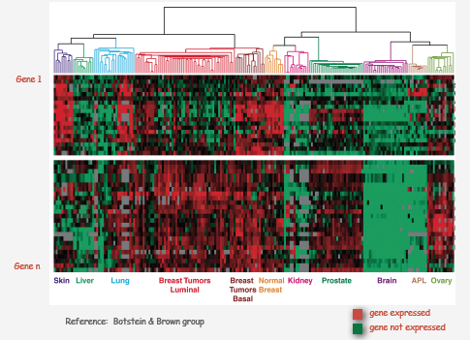
Application: Clustering in Bioinformatics

Slide 10
More Applications
Max bottleneck paths.
Real-time face verification.
LDPC codes for error correction.
Image registration with Renyi entropy.
Find road networks in satellite and aerial imagery.
Reducing data storage in sequencing amino acids in a protein.
Model locality of particle interactions in turbulent fluid flows.
Autoconfig protocol for Ethernet bridging to avoid cycles in a network.
Approximation algorithms for NP-hard problems (e.g., TSP, Steiner tree

Slide 11
Mini Colloquia
Group 1: Prim’s algorithm and priority-first search
Group 2: Kruskal’s algorithm
Group 3: Boruvka’s algorithm
Each group will prepare for a discussion about (45 min)
Implementation
Running time and space requirements
Scalability (graph size and density limitations)
Advantages (when will you use this algorithm)
Disadvantages (when should you not use this algorithm)
Discussion and algorithm comparison (45 min)

