Slide 1
Machine Learning
Inf-2101, fall 2012
Lars Ailo Bongo
larsab@cs.uit.no

Slide 2
Overview
Today:
Why machine learning?
Machine learning for classification
Rob Shapire
Princeton PICASso mini-course
Next week:
Data analysis using machine learning

Slide 3
Disclaimer
Machine learning is a big topic
Goal for these lectures is to give you an overview
I am not an expert in machine learning
To learn more:
FYS-3012 Pattern Recognition
Requires linear algebra and statistics

Slide 4
Why learn machine learning?

Slide 5
Turing Award 2012 (Nobel Prize of Computing)
Judea Perl (UCLA)
“For fundamental contributions to artificial intelligence through the development of a calculus for probabilistic and causal reasoning.”
http://amturing.acm.org/award_winners/pearl_2658896.cfm

Slide 6
Alan Turing
Born July 23, 1912
Computer science pioneer
Father of Artificial Intelligence
Turing test
War hero (cryptoanalysis)
Homosexual
http://www.nature.com/news/specials/turing/index.html
http://www.radiolab.org/blogs/radiolab-blog/2012/mar/19/turing-problem/

Slide 7
Greatest Jeopardy! player in the world

Slide 8
Who is Watson?
Artificial Intelligence demonstration system from IBM
http://www-03.ibm.com/innovation/us/watson/
http://www.nytimes.com/2010/06/20/magazine/20Computer-t.html?pagewanted=all

Slide 9
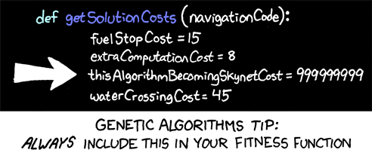
Science Fiction

Slide 10
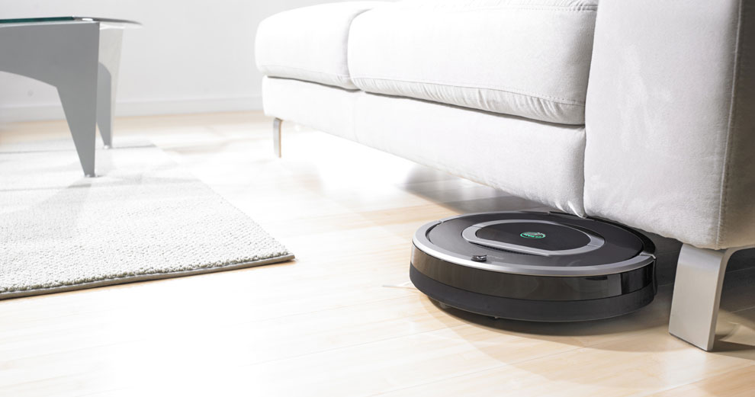
State of the art?

Slide 11
Machine learning
Branch of AI
Very much in use:
Bioinformatics
Google
Business Inteligence

Slide 12
Fifth Paradigm in Science
3rd: computational science
Last decade
4th: data-intensive science
Currently
5th: hypothesis generation
Some claim

Slide 13
PICASso Mini-Course
http://www.cs.princeton.edu/~schapire/talks/picasso-minicourse.pdf

Slide 14
SVM
Figure in next slide is from: http://www.broadinstitute.org/annotation/winter_course_2006/index_files/Noble%202006%20SVM%20tutorial%20Nat%20Biotech.pdf

Slide 15
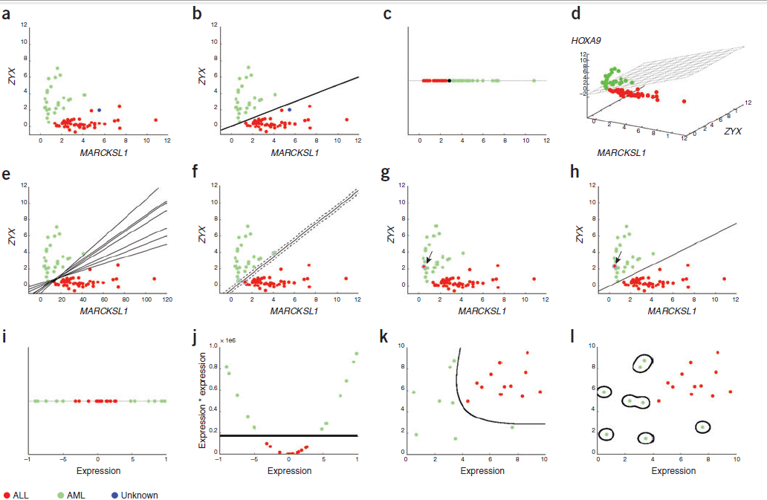

Slide 16
Machine Learning (part II)
Inf-2101, fall 2012
Lars Ailo Bongo
larsab@cs.uit.no

Slide 17
Overview
Previous week:
Why machine learning?
Machine learning for classification
This week:
Data analysis using machine learning

Slide 18
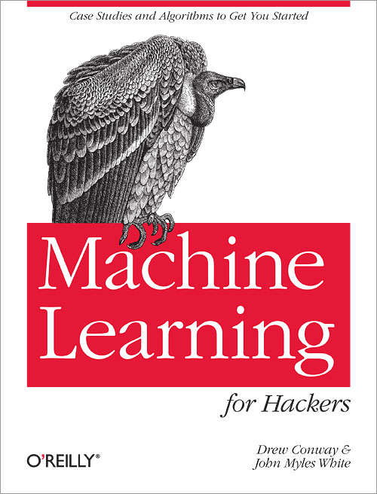
Source for Examples

Slide 19
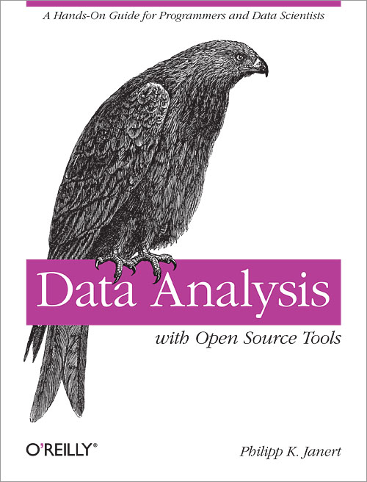
Alternative Book (does not focus on machine learning)

Slide 20
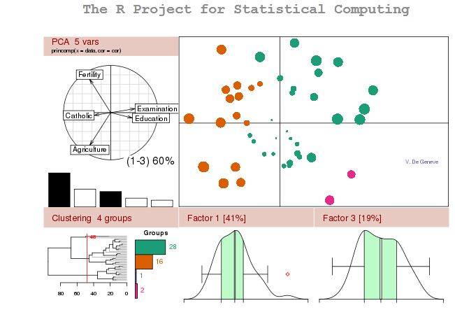
“The best thing about R is that it was developed by statisticians. The worst thing about R is that… it was developed by statisticians.” -Bo Cowgill, Google

Slide 21
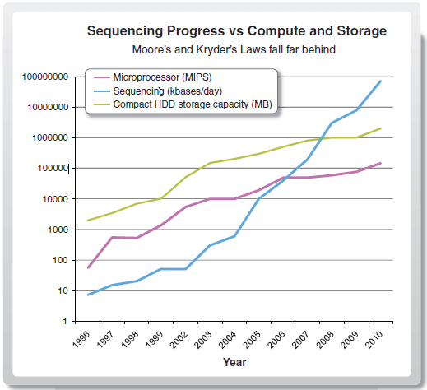
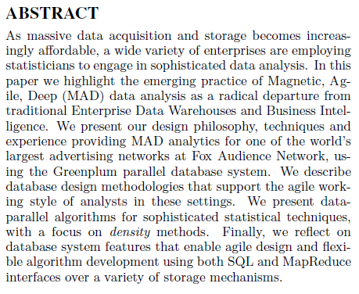

Slide 22
UFO Sightings
Is there a pattern in UFO sightings/ visitors?
Introduction to R
Data exploration
Data cleaning
Naïve Bayes

Slide 23
SPAM Filter
Classify mail as either SPAM or HAM
Binary classifier

Slide 24
Partisanism in the US Senate
Has US senate become more partisan?
Clustering based on voting similarity

Slide 25
Breaking Codes
How to break a secret code?
Optimization
Metropolitan

