Slide 1
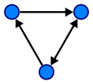
Directed Graphs
Inf-2101, Fall 2012
Lars Ailo Bongo (larsab@cs.uit.no)
Department of Computer Science, University of Tromsø
Based on and including slides by Robert Sedgewick and Kevin Wayne, Princeton University.

Slide 2
Outline
Applications
API
Search
Transitive closure
Topological sort (DAGs)
Strong connectivity
Implementation issues

Slide 3
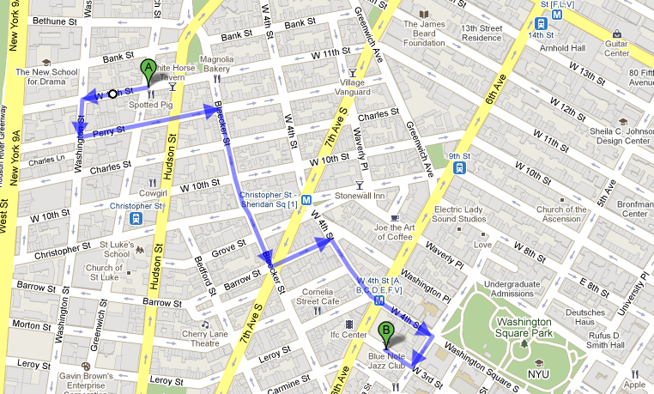
Digraph
Set of vertices connected by pairwise oriented edges

Slide 4
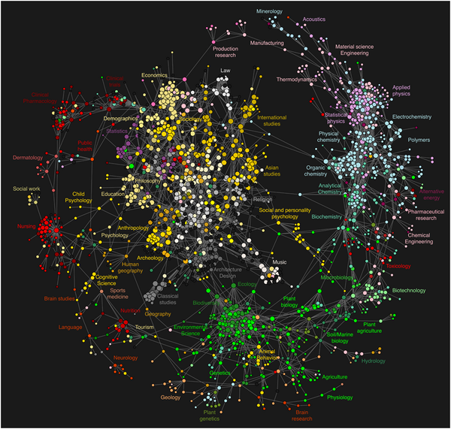
Link structure
Map of science:
Vertex: journal
Edges: reference clicks
http://www.plosone.org/article/info:doi/10.1371/journal.pone.0004803

Slide 5
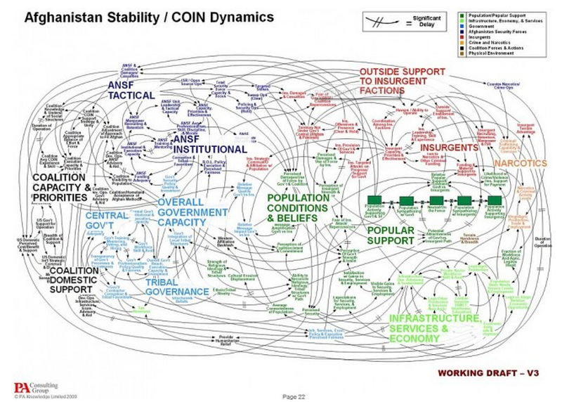
Eh..

Slide 6
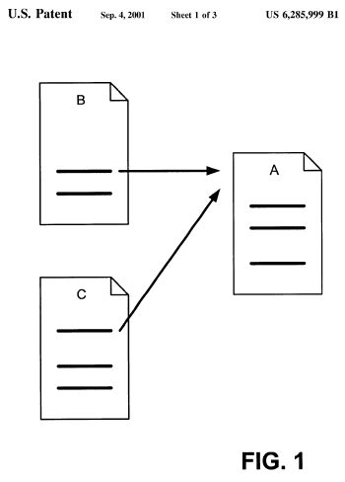
Web graph
US Patent 6,258,999:
Method for Node Ranking In a Linked Database
Vertex: web page
Edge: hyperlink
Aka. Google Pagerank

Slide 7
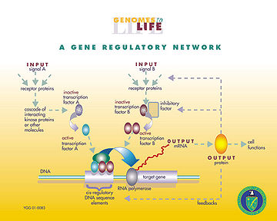
Gene regulation networks
Vertex: DNA segments
Edge: RNA/ protein expression product
Source: wikipedia

Slide 8
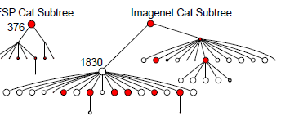
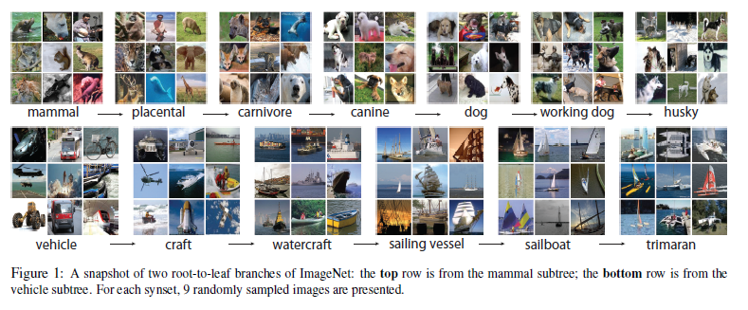
ImageNet graph
Vertex: image
Edge: relation ship (e.g. “is a”)
Source: ImageNet: A Large-Scale Hierarchical Image Database, Deng. et al. CVPR’09.

Slide 9
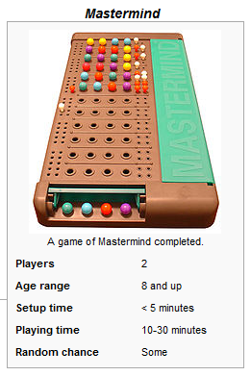
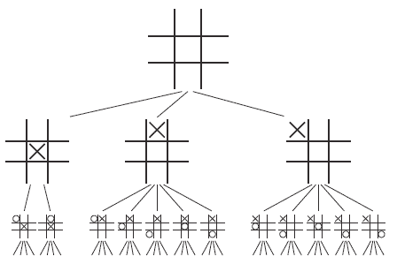
Game decision tree
Tic-tac-toe decision tree
Vertex: state
Edge: next move

Slide 10
Digraph applications
Graph | Vertex | Edge
Transportation | Street intersection | One-way street
Citation | Journal article | Citation
Web | Web page | Hyperlink
Gene regulatory network | Cell “component” | Interaction
ImageNet | Image | Relationship (is a…)
Mastermind | Board position | Legal move
CPU pipeline scheduling | Instruction | Precedence constraint
Financial | Stock, currency | Transaction
Cell phone | Person | Placed call
Infectious disease | Person | Infection
Object graph | Object | Pointer
Inheritance hierarchy | Class | Inherits from
Control flow | Code block | Jump

Slide 11
Some digraph problems
Path: is there a direct path from s to t?
Shortest path: what is the shortest path from s to t?
Strong connectivity: are all vertices mutually reachable?
Transitive closure: for which vertices v and w is there a path from v to w?
Topological sort: can you draw the digraph so that all edges point from left to right?
PageRank: what is the importance of web pages?
Mastermind: how to win the competition?!

Slide 12
Today’s Topics
Digraph applications
Digraph representations
Digraph search
Transitive closure
Topological sort
Strong components

Slide 13
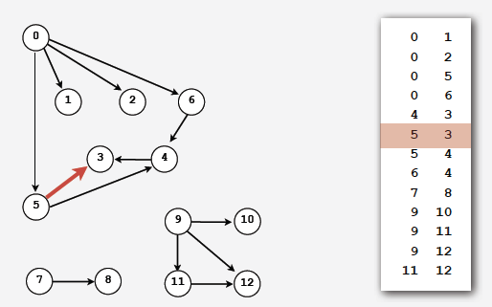
Set of edges representation
Store the list of edges (linked list or array)

Slide 14
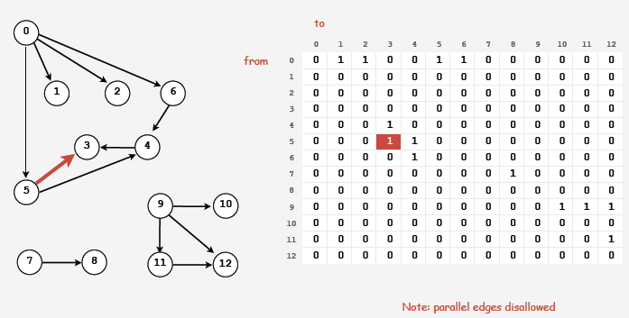
Adjacency-matrix representation
Maintain a two-dimensional v-by-v bitmap (boolean array)
For each edge: v→w in the digraph adj[v][w] = true

Slide 15
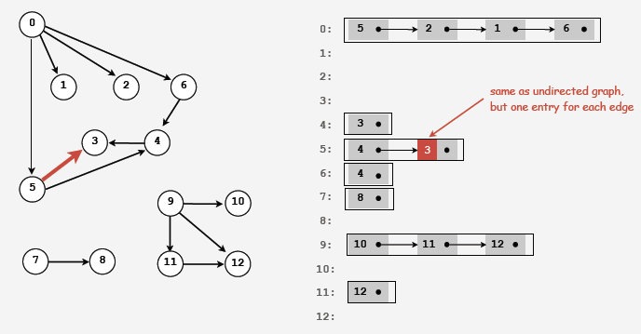
Adjacency-list representation
Maintain vertex-indexed array of lists (use Bag abstraction)

Slide 16
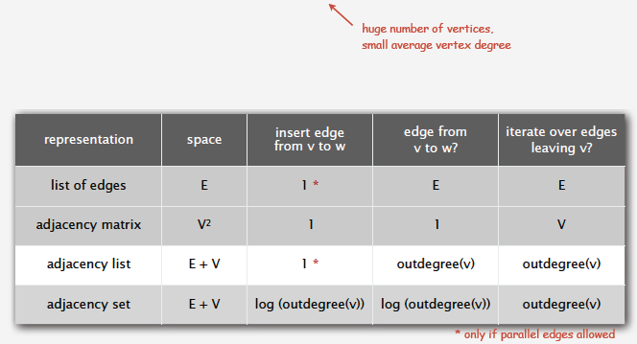
Digraph representation
In practice: use adjacency-list representation
Algorithms are all based on iterating over edges incident to v.
Real-world digraphs tend to be sparse.

Slide 17
Today’s Topics
Digraph applications
Digraph API
Digraph search
Transitive closure
Topological sort
Strong components

Slide 18
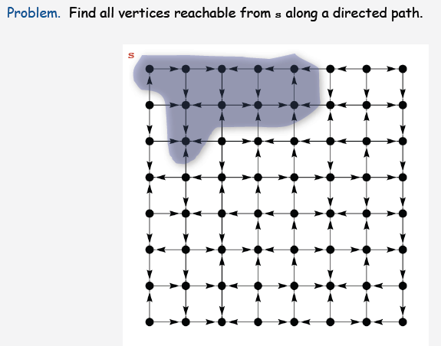
Reachability

Slide 19
Reachability application: program flow analysis

Slide 20
Reachability application: Mark-sweep garbage collector

Slide 21
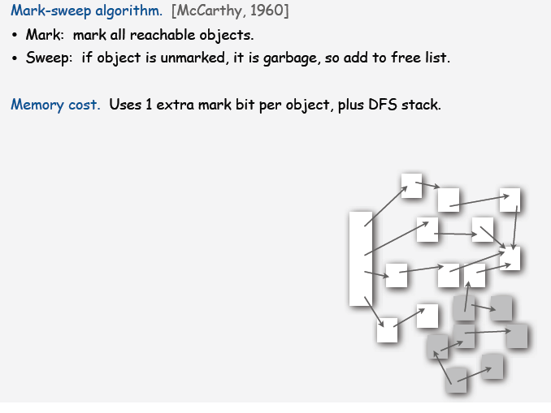
Reachability application: Mark-sweep garbage collector

Slide 22
Depth-first search in digraphs

Slide 23
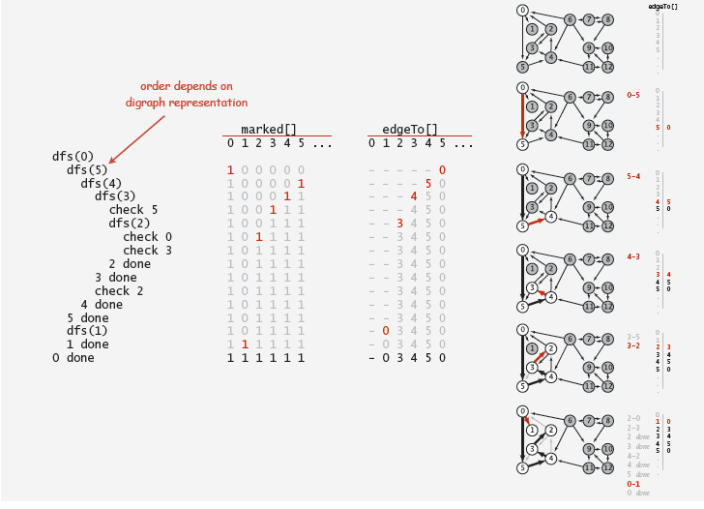
DFS pathfinding trace in digraph

Slide 24
Depth-first search

Slide 25
Breadth-first search in digraphs

Slide 26
Digraph BFS application: web crawler

Slide 27
Algorithm execution time
Single source reachability: time proportional to edges in subgraph induced by reachable vertices
Time for example graphs?
Pathfinder time?
BFS time?
Notes:
BFS: V^2 for adj matrix, V+E adj. list

Slide 28
Today’s Topics
Digraph applications
Digraph API
Digraph search
Transitive closure
Topological sort
Strong components

Slide 29
Graph-processing challenge (revisited)

Slide 30
Digraph processing challenge 1

Slide 31
Transitive closure

Slide 32
Digraph processing challenge 1 (revisited)

Slide 33
Digraph processing challenge 1 (revised again)

Slide 34
Today’s Topics
Digraph applications
Digraph API
Digraph search
Transitive closure
Topological sort
Strong components

Slide 35
Digraph application: scheduling

Slide 36
Digraph application: scheduling

Slide 37
Digraph processing challenge 2

Slide 38
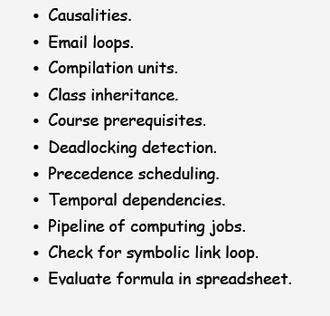
Cycle detection applications

Slide 39
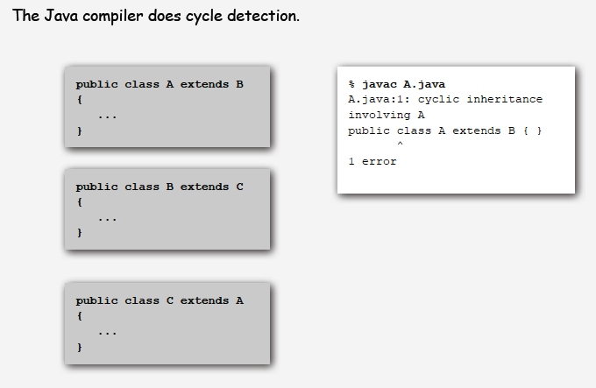
Cycle detection application: cyclic inheritance

Slide 40
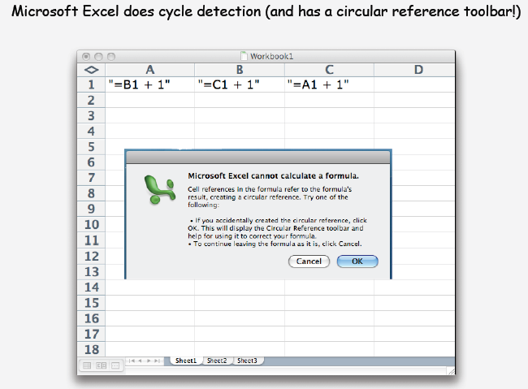
Cycle detection application: spreadsheet recalculation

Slide 41
Cycle detection application: Linux file system

Slide 42
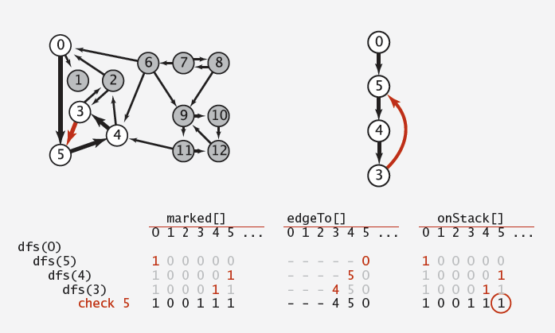
Finding a cycle in a digraph:

Slide 43
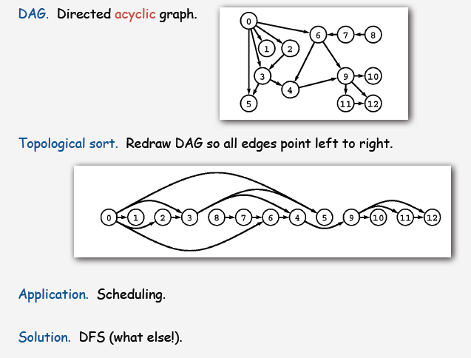
Topological sort

Slide 44
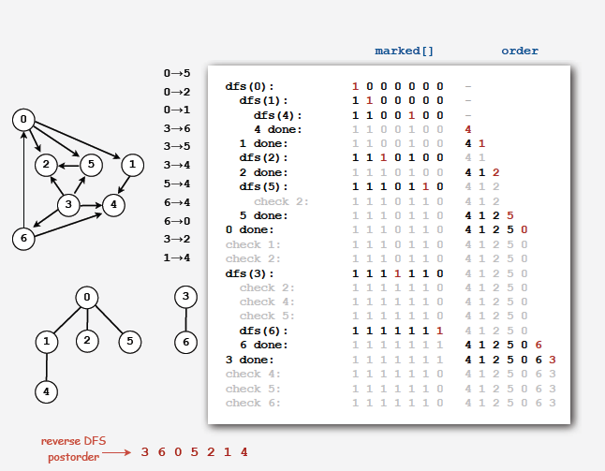
Reverse DFS postorder in a DAG

Slide 45
Reverse DFS postorder in a DAG: an amazing fact

Slide 46
Today’s Topics
Digraph applications
Digraph API
Digraph search
Transitive closure
Topological sort
Strong components

Slide 47
Strongly connected components

Slide 48
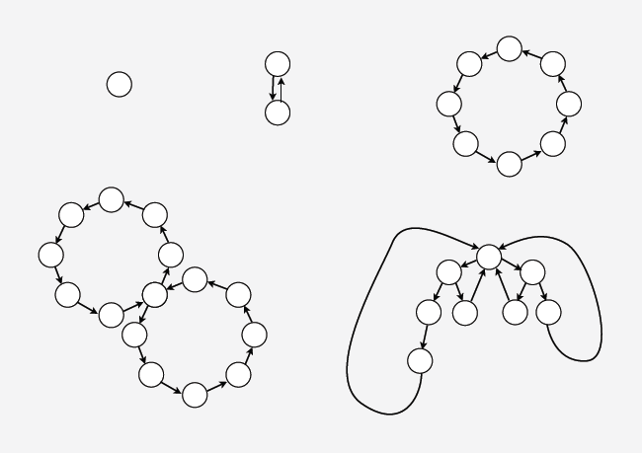
Examples of strongly connected components

Slide 49
Strong component application: Ecological food web graph

Slide 50
Strong component application: Software module dependency graph

Slide 51
Digraph processing challenge 3

Slide 52
Kosaraju’s algorithm

Slide 53
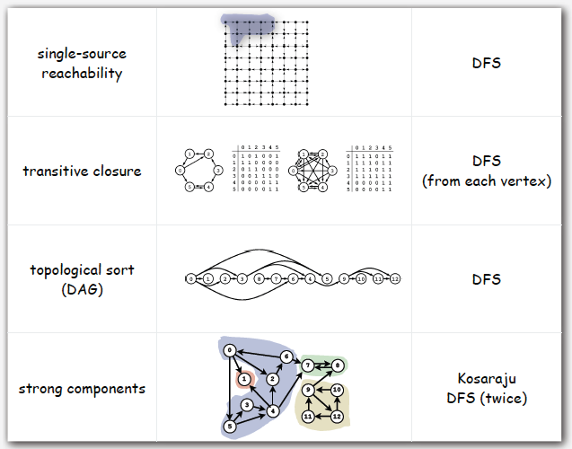
Summary: algorithms of the day

