Slide 1
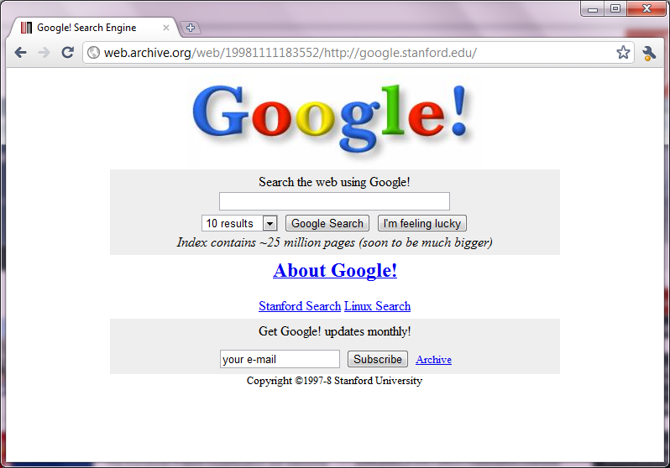

Slide 2
PageRank
Inf-2101, Fall 2011
Lars Ailo Bongo (larsab@cs.uit.no)
Department of Computer Science, University of Tromsø

Slide 3
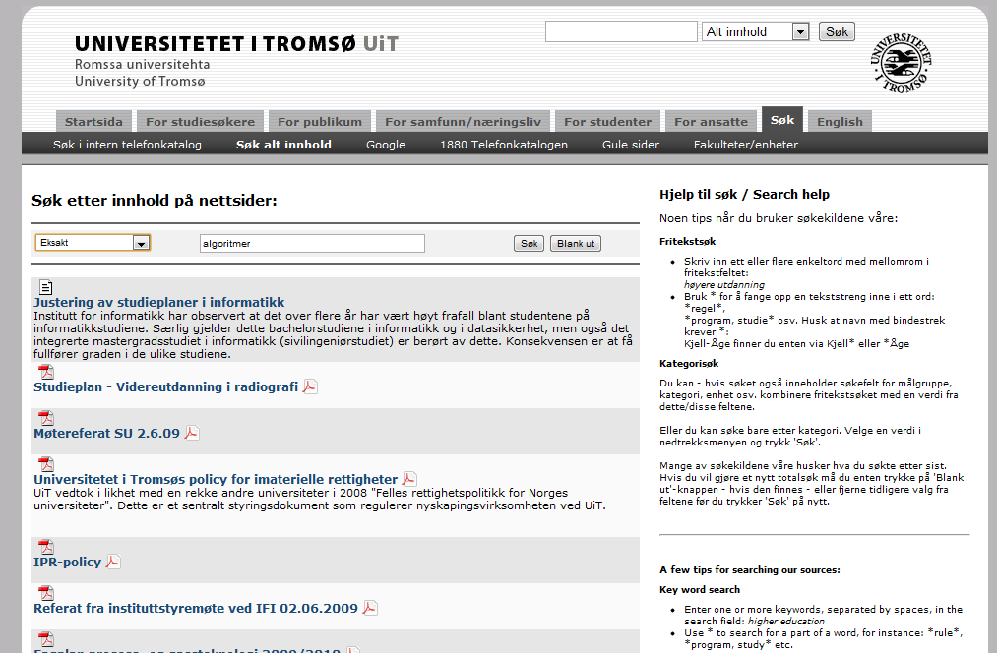
No PageRank

Slide 4
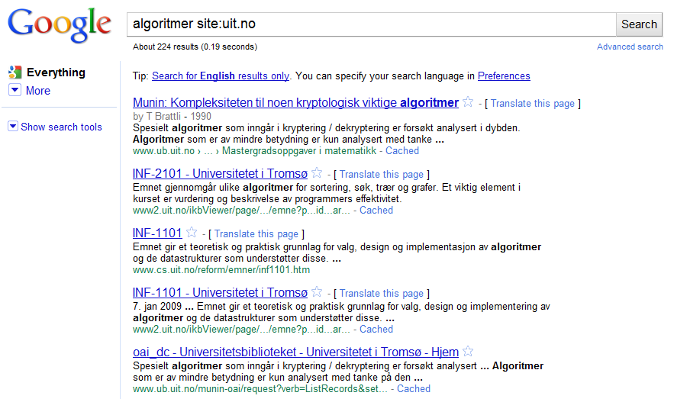
PageRank

Slide 5
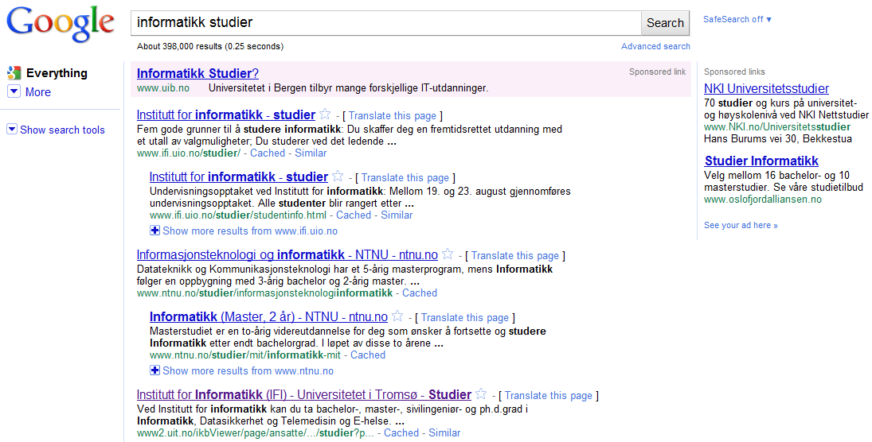
Success of Google = PageRank + Micro advertisement?

Slide 6
Properties
Billions of web pages
and PDF’s, Powerpoint slides, images, movies…
Search through all pages in ~0.1 seconds
Google probably has more than 500.000 servers
Many interesting systems motivated by search engine requirements:
Google File System: distributed storage on commodity computers
MapReduce: scalable fault-tolerant data-intensive processing
BigTable: alternative to RDBM for very large datasets
Pregel: graph processing on thousands of machines
Used by Facebook, Yahoo, ebay…
Available as open source: hadoop MapReduce, HBase, nutch…

Slide 7
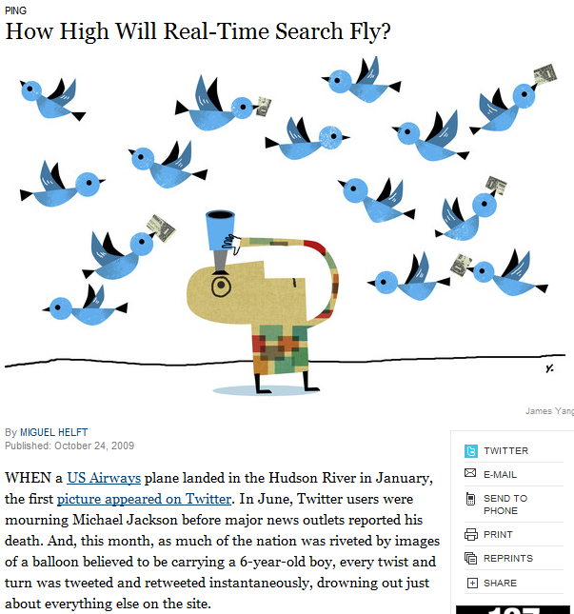
The Future of Search
Google dominates web search
Hot topic: real-time search (social networking)
Research stage: similarity search
Niche market: bioinformatics search
Link: http://www.nytimes.com/2009/10/25/business/25ping.html

Slide 8
Outline
How to read a research paper
PageRank paper
How to read a patent
PageRank patent
Algorithm
I introduce
You read
We discuss

Slide 9
Information Sources
Textbooks
Research papers
Patent applications
Design documents
Chromium OS (http://www.chromium.org/chromium-os)
White papers
NetApp (http://www.netapp.com/us/library/white-papers.html)
Magazines, blogs, and other news outlets
Slashdot, Google research blog, New York Times
Open source projects
Linux, Hadoop, nutch, Android
Grant proposals
Word-of-mouth

Slide 10
Research papers
Where to find good Computer Science articles?
Published by ACM (www.acm.org/dl)
Published by Usenix (http://www.usenix.org/publications/)
Published by IEEE (http://ieeexplore.ieee.org)
Other publications of interest:
Science, Nature
Four main types:
Journal article
ACM Transaction on X, ACM Computing Surveys…
Conference paper
SOSP, OSDI, NSDI, FAST, VLDB, ISCA, ASPLOS, SIGMETRICS…
Workshop paper
HotOS, NetDB, HotStorage, LADIS…
Technical report
Stanford, Berkley, MIT, Princeton, Tromsø…

Slide 11
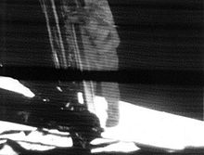
IMRaD
Huge volume of published papers
Need efficient way of reading papers
Solution: IMRaD
Introduction
Materials & Methods
Results
and
Discussion
All scientific papers are organized according to IMRAD
In addition: clear and concise

Slide 12
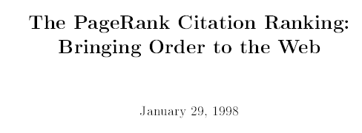
PageRank – unpublished draft
Available as Stanford Technical report
A better paper about the Google search engine (in Proc. of WWW’07):

Slide 13
Abstract
All papers starts with a summary of the article content
Motivation
What did they investigate?
Why?
Methods
What did they do?
Results
What did they find out?
Conclusions
What does their result mean?
So what?
Source: http://writing.wisc.edu/Handbook/ScienceReport.html
Notes:
Read abstract: 3 minutes

Slide 14
Abstract – critical reader
All papers starts with a summary of the article content - Should I spend my valuable time reading this article?
Motivation – Does anyone care about the problem?
What did they investigate?
Why?
Methods – Do they know what they are doing?
What did they do?
Results – Did they mess up their experiments?
What did they find out?
Conclusions – Did they find out anything interesting
What does their result mean?
So what?
Notes:
Read abstract: 3 minutes

Slide 15
Abstract
All papers starts with a summary of the article content
Motivation
What did they investigate?
Why?
Methods
What did they do?
Results
What did they find out?
Conclusions
What does their result mean?
So what?
Read abstract
Help me create a slide

Slide 16
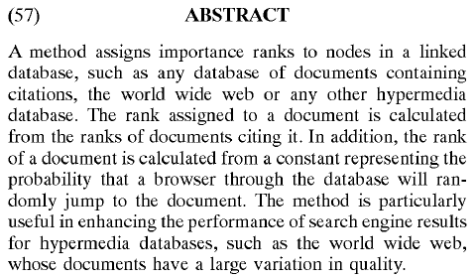

Slide 17
PageRank Abstract
Motivation
Find relevant documents
Methods
Count references to a document, probability of “random surfer”
Results
Applicability for search and “user navigation”
Conclusions

Slide 18
Introduction
What is the problem?
Problem description
Context, key terms, and concepts
Why is it important?
Review of relevant research
What unanswered questions does the experiment address?
What findings of others are they challenging or extending?
What solution is proposed?
Hypothesis and/or research questions
General experiment design
Justification of experiment design
Read introduction: ~5 minutes

Slide 19
PageRank Introduction
What is the problem?
Oversikt over hva som finnes på nettet
Kvaliteten til websider er forskjellig og kan manipuleres
Relevans I forhold til søke query
Why is it important?
Lett å generere sider med lav kvalitet ➔ mye “søppel”
Finne relevante sider
Kommersielle interesser/ mulgiheter
What solution is proposed?
PageRank: metode for å beregne rank basert på grafen til weben

Slide 20
Figures and Tables
The most important concepts and results are illustrated using figures and tables

Slide 21
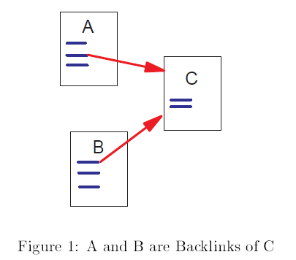

Slide 22
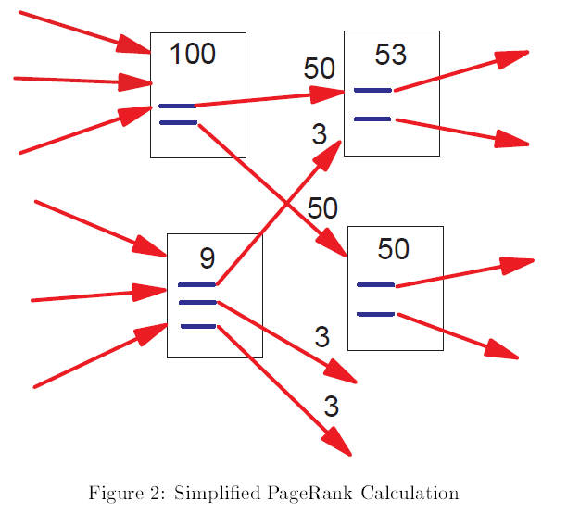

Slide 23
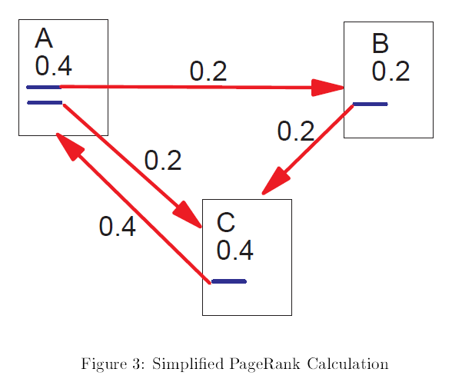

Slide 24
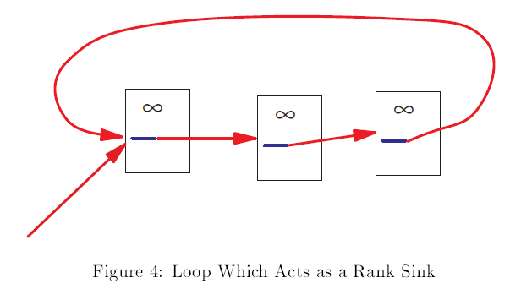

Slide 25
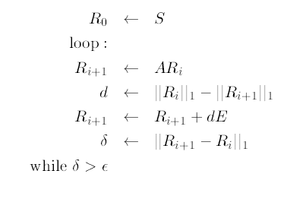

Slide 26
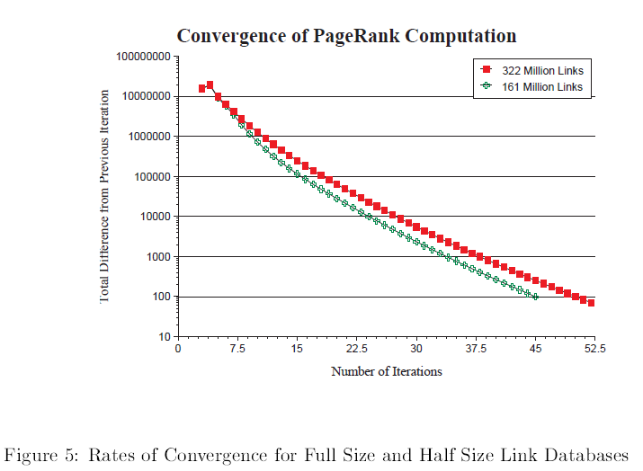

Slide 27
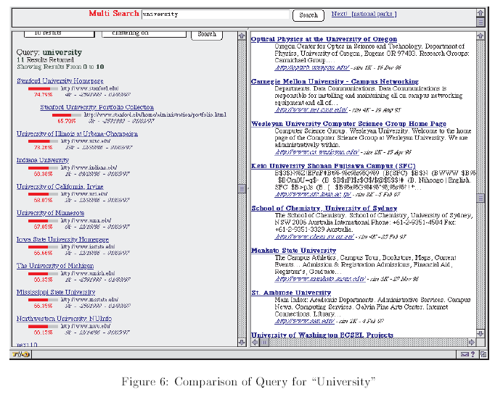

Slide 28
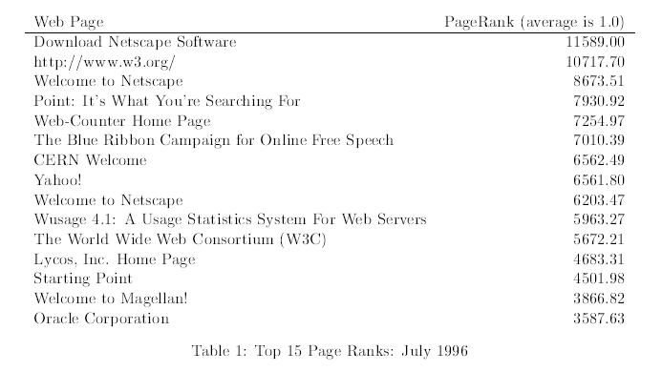

Slide 29
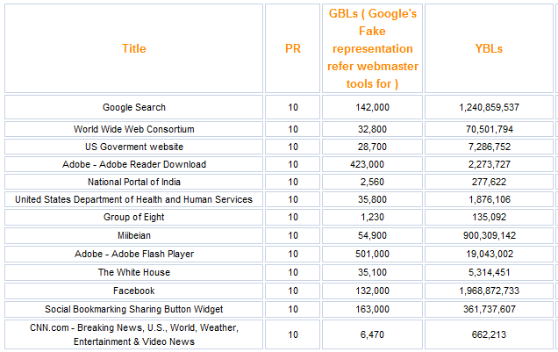
PageRank 10 sites: April 2010
http://www.searchenginegenie.com/pagerank-10-sites.htm

Slide 30
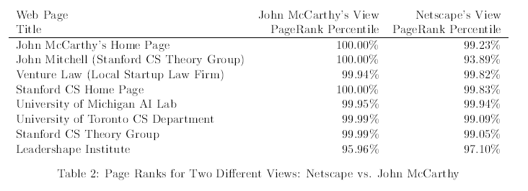

Slide 31
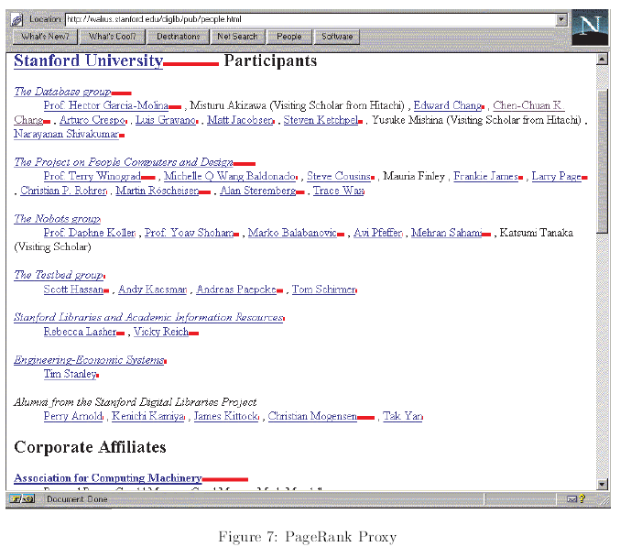

Slide 32
Discussion (Conclusion)
What do their observations mean?
What conclusions do they draw?
Patterns, principles, and relationships of their results
How do the results relate to expectations in the literature?
Agreements, contradictions or exceptions
What additional research can resolve contradictions or explain exceptions
How do the results fit in the broader context?
Theoretical implications
Practical applications
Findings extended to other cases
The big picture: do the findings help understand a broader topic

Slide 33
PageRank Conclusions
What do their observation mean?
Metode for sortering av søkeresultat
What conclusions do they draw?
PAgeRank virker effektivt (gode resultater)
Optimaliseringer mht tid vha mindre databaser
Søk I databaser og WWW
Traffic estimation basert på PageRank’en
Personlized PageRank
Viktighet av sider: kommersielle høyere ranket en “private”
How do the results fit in the broader context?
Flere bruksområder
Struktur I web nyttig for information retrieval

Slide 34
Methods
How did they study the problem?
Algorithm description, system architecture, or protocol description
What did they implement
Detailed description of system design and implementation
What did they measure
How did they set up their experiments
Read through sections: 2.2 - 2.5
~7-8 minutes

Slide 39
Iterative algorithm
We will return to it

Slide 40
Results
What did they observe?
For each experiment:
Which question do they want to answer?
How do they answer this question (brief description)
Main results (common case, best-case, and exceptions)
Read section 4 and explain Figure 5
Be critical
Discuss with a partner
~ 5 minutes

Slide 43
PageRank conclusions - revisited
Did the results justify the conclusion?
PageRank Conclusions

Slide 44
Outline
How to read a research paper
PageRank research paper
How to read a patent
PageRank patent

Slide 45
Patents
A set of exclusive rights granted to an inventor for a limited period of time in exchange for a public disclosure of an invention
Rights to exclude others from using invention
Enforced through civil lawsuits
Usually granted by a nations patent office:
European patent office: http://www.epo.org/
US Patent and Trademark office: http://www.uspto.gov/
Many patent applications are available online
http://www.google.com/patents

Slide 46
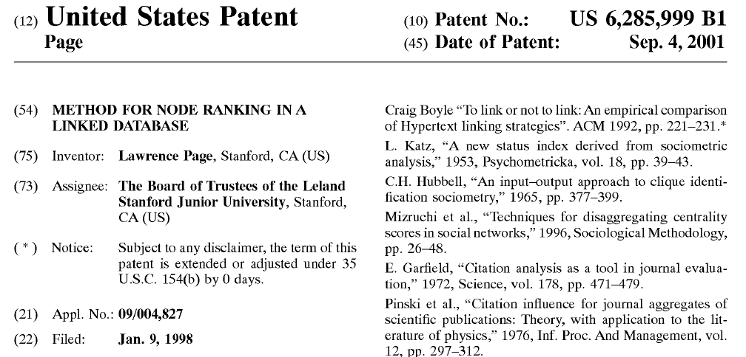
PageRank patent

Slide 47
Patent structure
Similar to research paper but no evaluation
Abstract
Field of invention
Background
Detailed description
Including claims

Slide 48
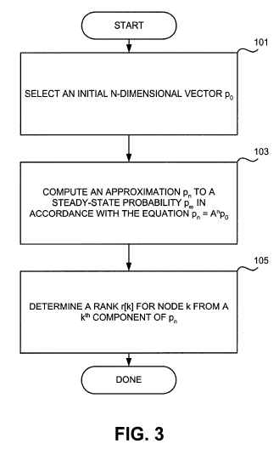
How is PageRank implemented?
Read Detailed description columns 3-6
~15-20 minutes
Explain figure 3
How to set initial ranks?
When to stop the rank calculation?
Why are pages without links a problem and how to deal with them?
What is the dampening factor?

Slide 49
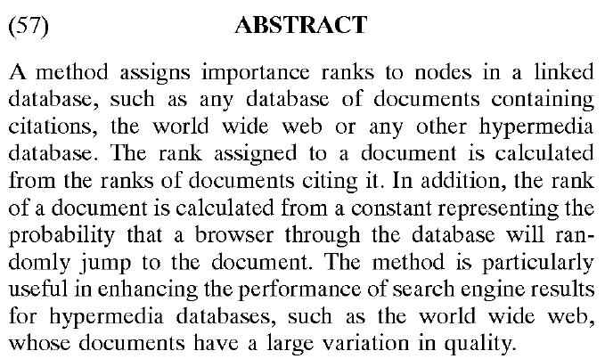
Summary

